Slide 1
华南理工大学
文学系学术答辩 PPT
South China University of Technology
author / OfficePLUS
Time / 20XX.06

Slide 2
01 /
Text h ere
Contents
Supporting text here Supporting text here
02 /
Text h ere
Supporting text here Supporting text here
03 /
Text h ere
Supporting text here Supporting text here
04 /
Text h ere
Supporting text here Supporting text here

Slide 3
01
Edit Master text styles
Theme color makes PPT more convenient to change.
Adjust the spacing to adapt to Chinese typesetting, use the reference line in PPT.
……

Slide 4
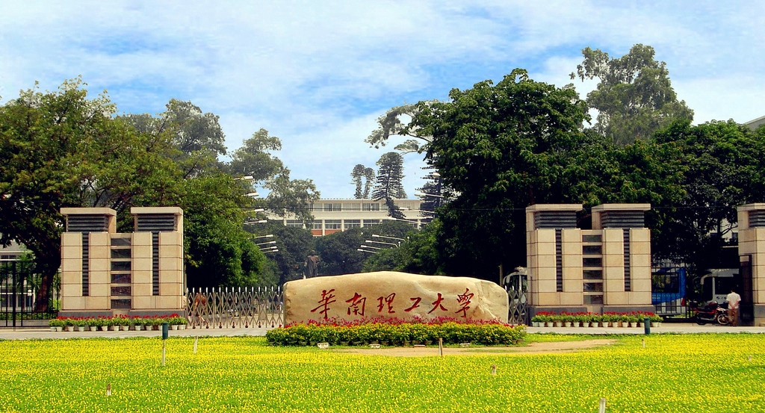
Text here
Unified fonts make reading more fluent.
Theme color makes PPT more convenient to change.
Adjust the spacing to adapt to Chinese typesetting, use the reference line in PPT.
……

Slide 5
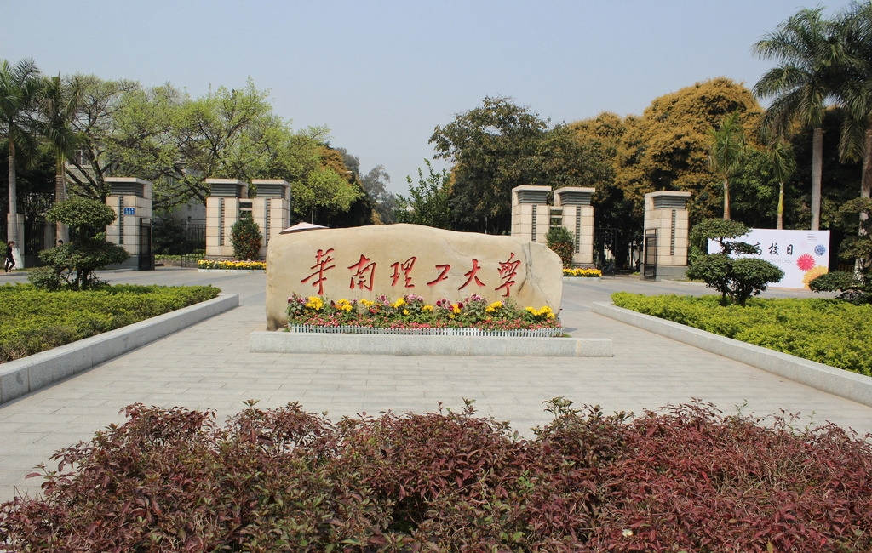
Unified fonts
m ake reading more fluent.
Theme color makes PPT more convenient to change.
Adj ust the spacing to adapt to Chinese typesetting, use the reference line in PPT

Slide 6
Text here
Unified fonts make reading more fluent.
Theme color makes PPT more convenient to change.
Adjust the spacing to adapt to Chinese typesetting, use the reference line in PPT.
……
Text here
Text here
Text here
Text here

Slide 7
South China University
of Technology
Sup porting text here.
Unifi ed Fonts Make Reading More Fluent.
Unified fonts make reading more flu ent.
Theme color makes PPT more convenient to change.Adjust the spacing to adapt to Chinese typesetting, use the reference line in PPT.
  Supporting text here.
  You can use the icon library in OfficePLUS (OfficePLUS) to filter and replace existing icon elements with one click.
  ……

Slide 8


71%
36%
Text here
Theme color makes PPT more convenient to change.
Adjust the spacing to adapt to Chinese typesetting, use the reference line in PPT.
……

Slide 9
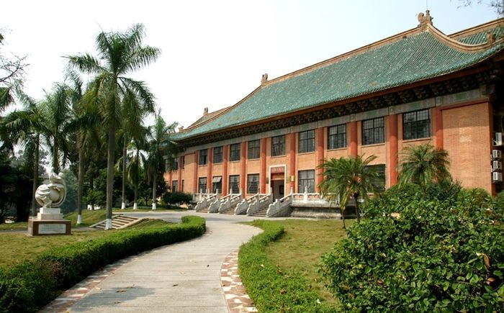
Adjust the spacing to adapt to Chinese typesetting,
use the reference line in PPT.
Adjust the spacing to adapt to Chinese typesetting,
use the reference line in PPT.
28%
28%
58%
58%

Slide 10
Unified fon ts make reading more fluent.
Theme color makes PPT more convenient to change. Adjust the spacing to adapt to Chinese typesetting, use the reference line in PPT.
52%
63%
83%
44%
69%
Text here
Text here
Text here
Text here
Text here

Slide 11

Unified fonts make reading more fluent.
Theme color makes PPT more convenient to change.Adjust the spacing to adapt to Chinese typesetting, use the reference line in PPT.
……
Supporting text here
……
Supporting text here
……
Supporting text here
……
Supporting text here
……
Supporting text here
……
Supporting text here
……

Slide 12
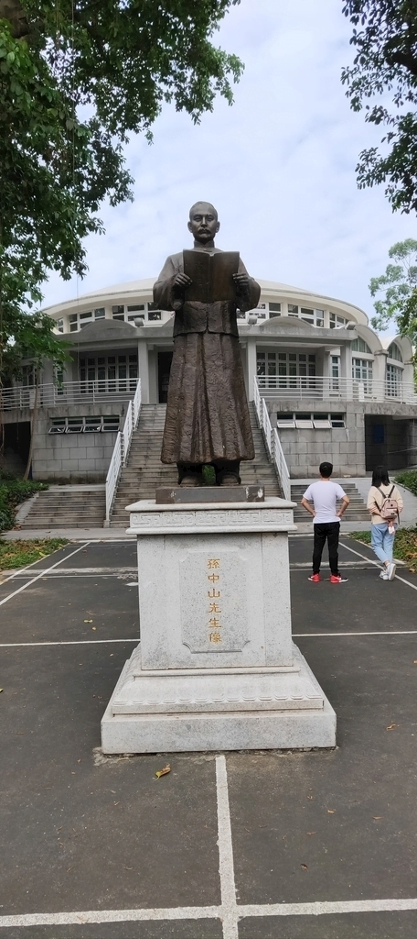
Text here
Theme color makes PPT more convenient to change.Adjust the spacing to adapt to Chinese typesetting, use the reference line in PPT.
……
0 1
02
03
04
05
Supportin g text here.
……
Supportin g text here.
……
Supportin g text here.
……
Supportin g text here.
……
Supportin g text here.
……

Slide 13






…te xt
…te xt
Text he re
Text he re
Copy paste fonts. Choose the only option to retain text.
……
Copy paste fonts. Choose the only option to retain text.
……
Text he re
Tex t here
Copy paste fonts. Choose the only option to retain text.
……
Copy paste fonts. Cho ose the only option to retain text.
……
Text he re
Text he re
Copy paste fonts. Choose the only option to retain text.
……
Copy paste fonts. Cho ose the only option to retain text.
……

Slide 14
First
The Preface
Unified fonts make reading more fluent.
Theme color makes PPT more convenient to change.
Adjust the spacing to adapt to Chinese typesetting, use the reference line in PPT.
……
68%
Text here
Unified fonts make reading more fluent.
Theme color makes PPT more convenient to change.
Adjust the spacing to adapt to Chinese typesetting, use the reference line in PPT.
……
22%
Text here

Slide 15
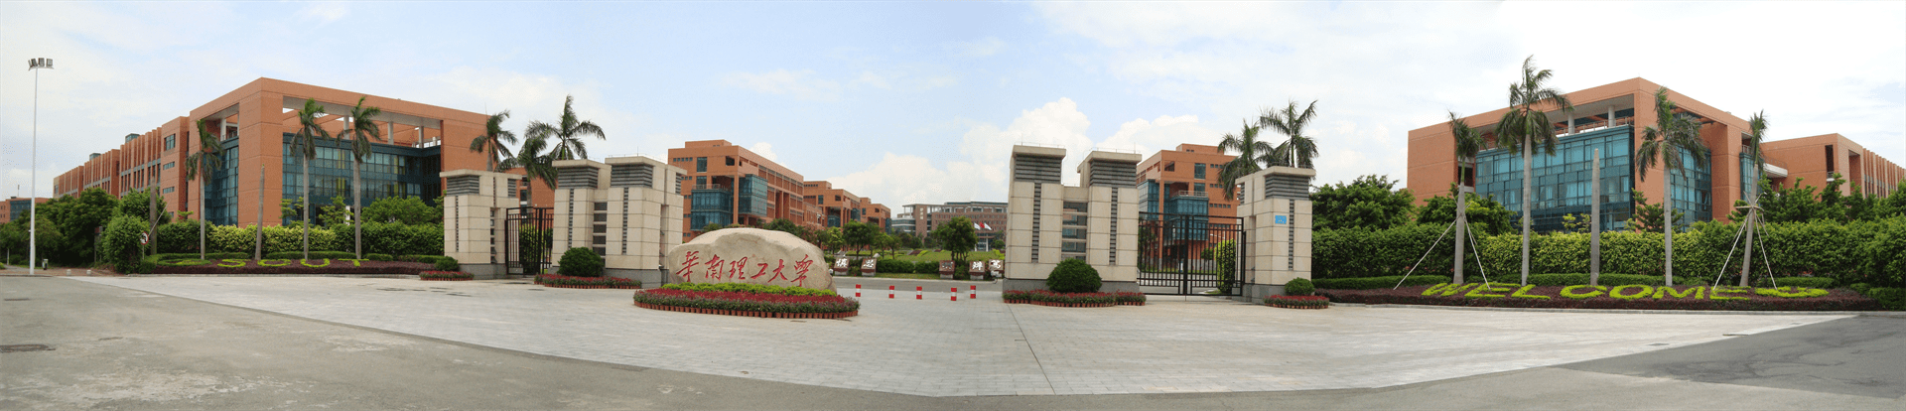
Unified fonts make
reading more fluent.
Theme color makes PPT more convenient to change. Adjust the spacing to adapt to Chinese typesetting, use the reference line in PPT.
Theme color makes PPT more convenient to change. Adjust the spacing to adapt to Chinese typesetting, use the reference line in PPT.
Text here
Text here
Text here
Text here

Slide 16
Unified fonts
make reading more
fl uent.
Theme color make s PPT more convenient to change.
Adjust the spacing to adapt to Chinese typesetting, use the reference line in PPT.
Theme color make s PPT more convenient to change.
Adjust the spacing to adapt to Chinese typesetting, use the reference line in PPT.

Slide 17
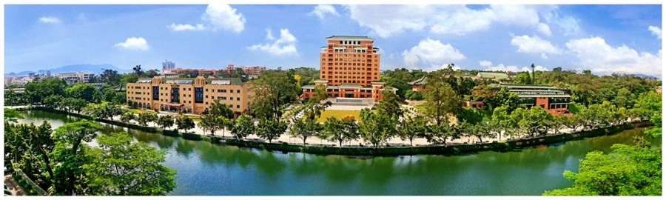
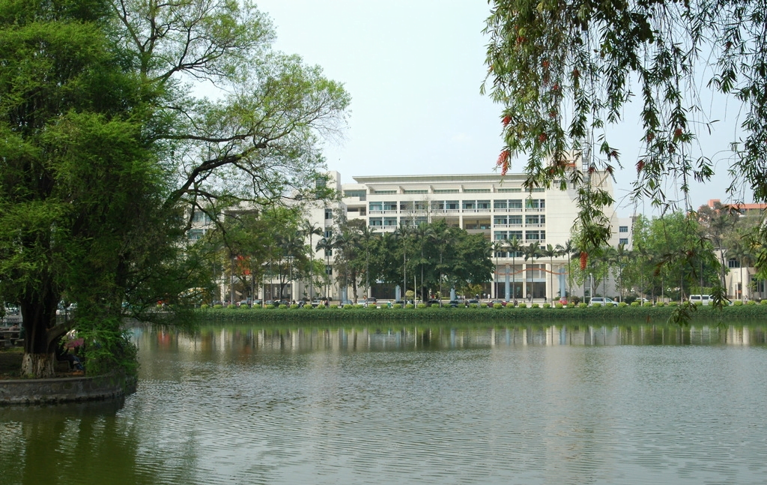
Unified fonts make reading more fluent.
Theme color makes PPT more c onvenient to change.
Adjust the spacing to adapt to Chinese typesetting, use the reference line in PPT.
… …
Te xt here
Text here
Suppo rting text here.
… …
Supporting text here.
… …

Slide 18

Supporting text here.
Unified fonts make reading more fluent.
Text here
Copy paste fonts. Choose the only option to retain text.
… …
Theme color makes PPT more convenient to change.
Adjust the spacing to adapt to Chinesetypesetting, use the reference line in PPT.
Copy paste fonts. Choose the only option to retain text……
Copy paste fonts. Choose the only option to retain text……
Copy paste fonts. Choose the only option to retain text……
Supporting text here.
… …
Supporting text here.
… …
Supporting text here.
… …
Copy paste fonts. Choose the only option to retain text……

Slide 19
Supporting text here.
Unified fonts make reading more fluent.
Copy paste fonts. Choose the only option to retain text.
… …
Copy paste fonts. Choose the only option to retain text.
… …
Text here …
Supporting text here.
… …
Copy paste fonts. Choose the only option to retain text.
… …
Supporting text here.
… …
Copy paste fonts. Choose the only option to retain text.
… …

Slide 20
Unified fonts
make reading more fl uent.
Theme color makes PPT more convenient to change.
Adjust the spacing to adapt to Chinese typesetting, use the reference line in PPT……

Slide 21
Supporting text here.
Unified fonts make reading more fluent.
2,600
4,600
Text here
Text here
Copy paste fonts. Choose the only option to retain text.……

Slide 22
Text here
Copy paste fonts. Choose the only option to retain text.……
Text here
Copy paste fonts. Choose the only option to retain text.……
Text here
Copy paste fonts. Choose the only option to retain text.……
Text here
Copy paste fonts. Choose the only option to retain text.……

Slide 23
Unified fonts make reading more fluent.
Text here
Text here
Text here
Text here
Text here
Supporting text here.
……
Supporting text here.
……
Supporting text here.
……
Supporting text here.
……
Supporting text here.
……
Supporting text here.
……
Supporting text here.
……
Supporting text here.
……

Slide 24
Unified fonts make reading
more flu ent.
Theme color makes PPT more convenient to change.
Adjust the spacing to adapt to Chinese typesetting, use the reference line in PPT…… Adjust the spacing to adapt to Chinese typesetting, use the refer ence line in PPT……

Slide 25
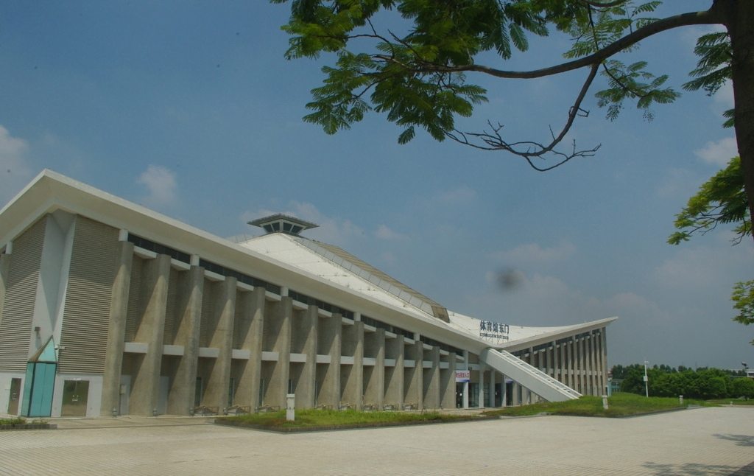
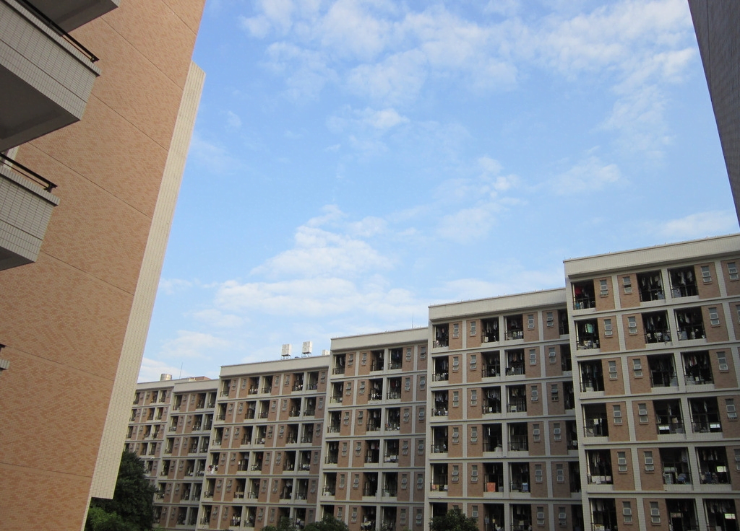
Text here
Unified
Fo nts Make
Reading More Fluent.
Text here
Theme color make s PPT more convenient to change.
Adjust the spacing to adapt to Chinese typesetting, use the reference line in PPT.
Text here

Slide 26
Supporting text here.
Unified Fonts Make Reading More Fluent.

Slide 27
Tex t Here
Suppor ting text here.
Copy paste fonts. Choose the only option to retain text.
……
Unified font s make reading more fluent.
Tex t Here
Theme color makes PPT more convenient to change.
Adjust t he spacing to adapt to Chinese typesetting, use the reference line in PPT.
Theme color makes PPT more convenient to change.
… …
Copy paste fonts. Choose the only option to retain text.
……
Tex t Here
Copy paste fonts. Choose the only option to retain text.
……
Tex t Here
Copy paste fonts. Choose the only option to retain text.
……

Slide 28
Text here
Text here
Text here
Copy paste fonts. Choose the only option to retain text.
Copy paste fonts. Choose the only option to retain text.
Copy paste fonts. Choose the only option to retain text.

Slide 29
THANKS
Supporting text here.
Unified fonts make reading more fluent.

