Slide 1
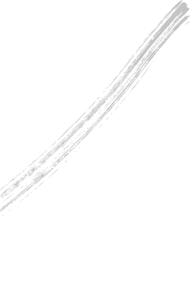
将
进
INVITATION TO WINE
酒

Slide 2
情
感
悲
喜
愤
狂
壹
贰
叁
肆
SORROW
JOYFUL
INDIGNANT
UNRESTRAINED
层
次

Slide 3
悲
君不见黄河之水天上来，奔流到海
不复回。 君不见高堂明镜悲白发，朝如青丝暮成雪。
SORROW
壹

Slide 4
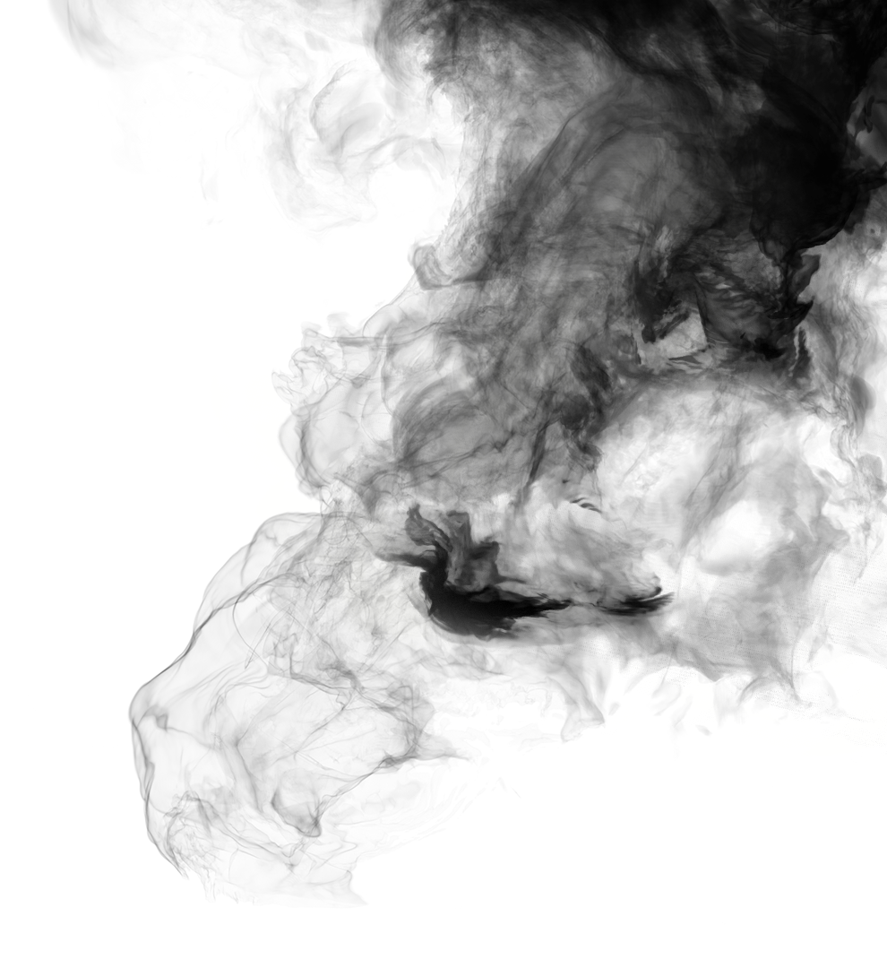
不复回
奔流到海
天上来
黄河之水
君不见
[你难道没有看见吗？那黄河之水犹如从天上倾泻而来，波涛翻滚直奔大海从来不会再往回流。]
悲
DO YOU NOT SEE THE YELLOW RIVER COME FROM THE SKY. RUSHING INTO THE SEA AND NE'ER COME BACK?
SORROW

Slide 5
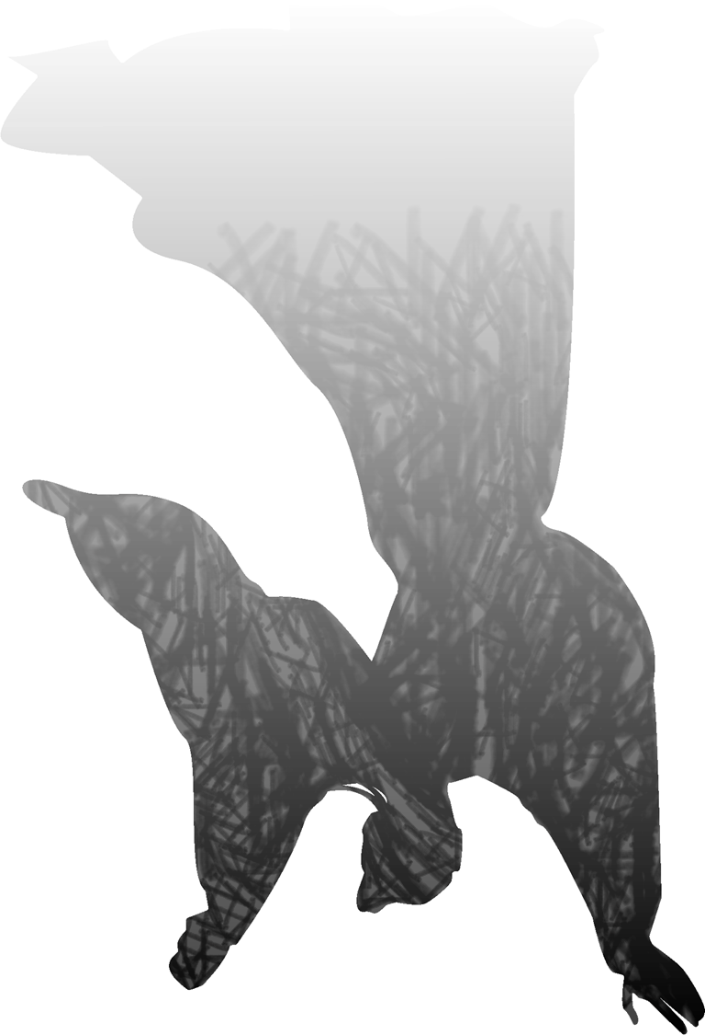
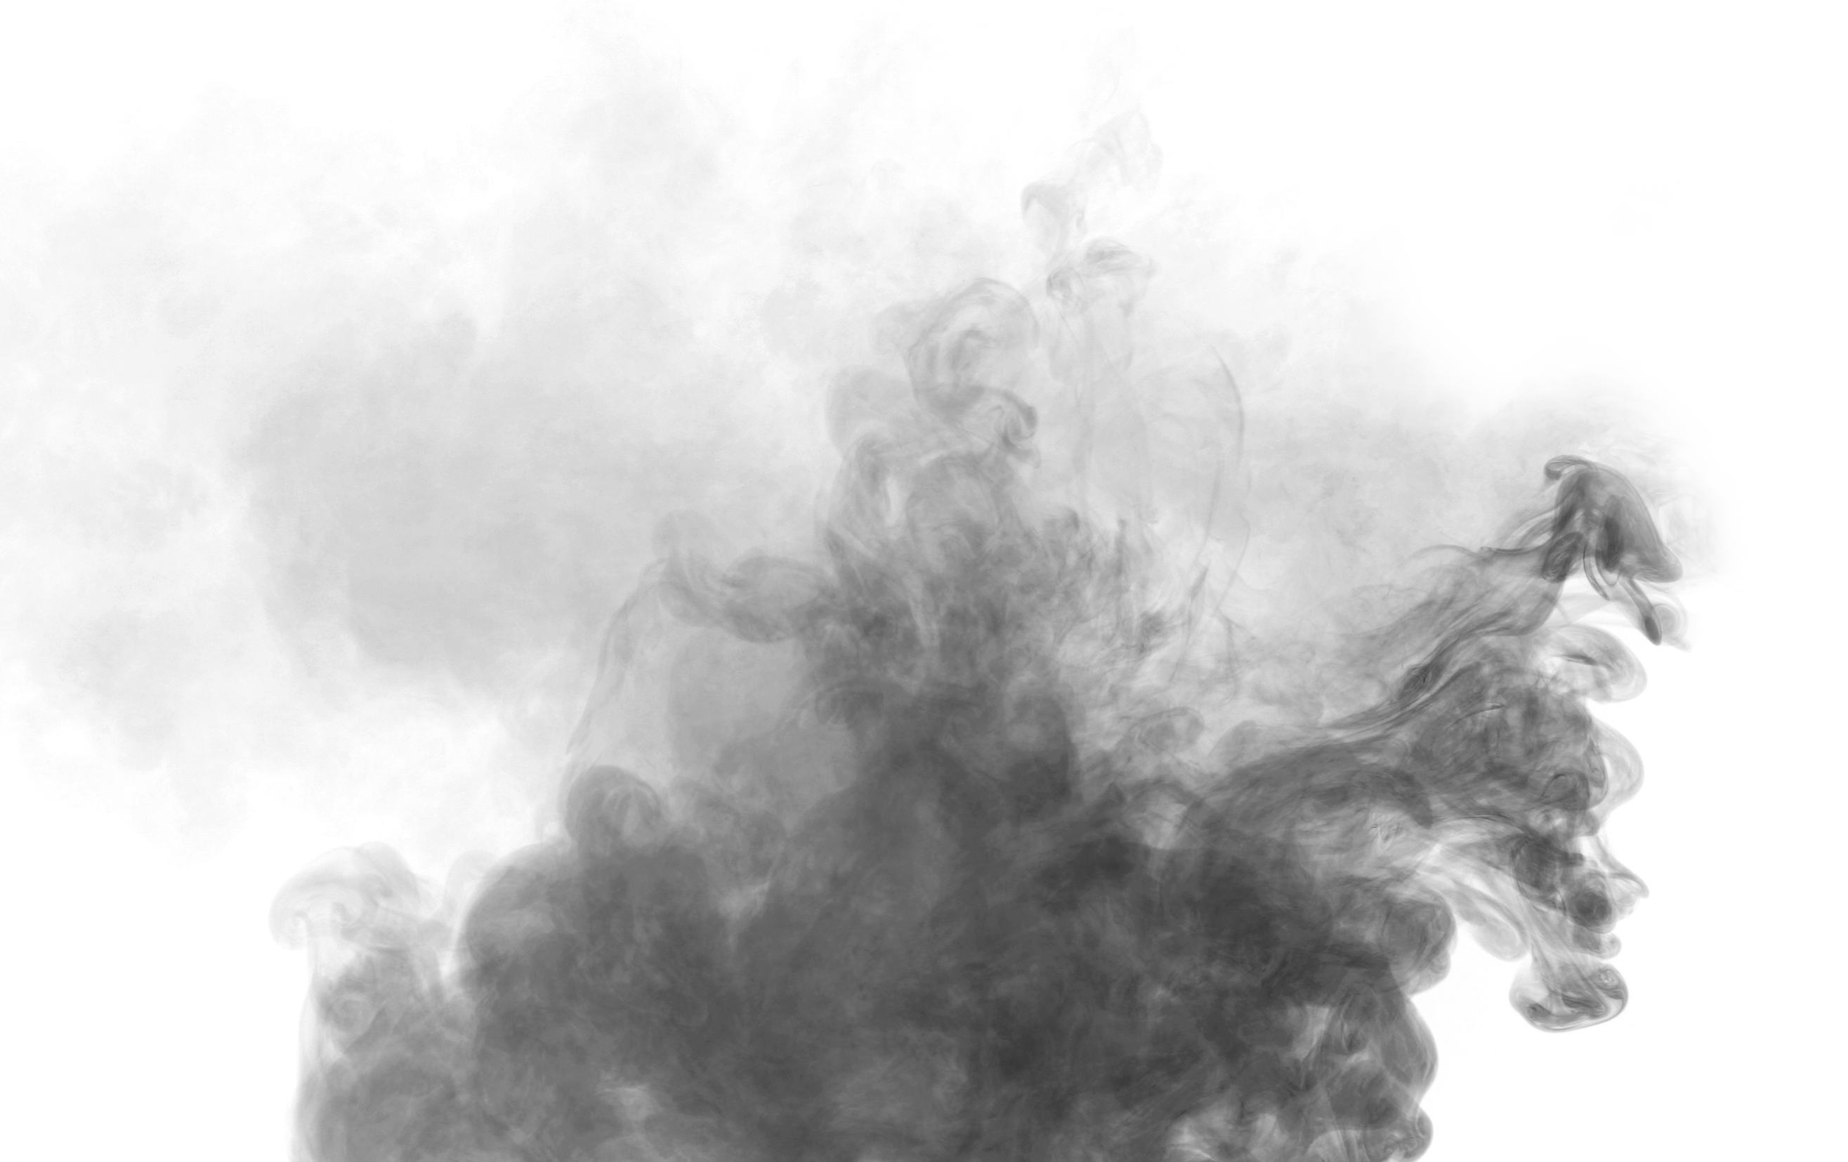
[你难道没有看见，在高堂上面对明镜，深沉悲叹那一头白发？早晨还是黑发到了傍晚却变得如雪一般。]
暮成雪
朝如青丝
悲白发
高堂明镜
君不见
悲
DO YOU NOT SEE THE MIRROR BRIGHT IN CHAMBER HIGH. GRIEVE O'ER YOUR SNOW-WHITE HAIR THAT ONCE WAS SILKEN BACK?
SORROW

Slide 6
喜
人生得意须尽欢，莫使金樽空对月。 天生我材必有用，千金散尽还复来。 烹羊宰牛且为乐，会须一饮三百杯。 岑夫子，丹丘生，将进酒，杯莫停。 与君歌一曲，请君为我倾耳听。
JOYFUL
贰

Slide 7
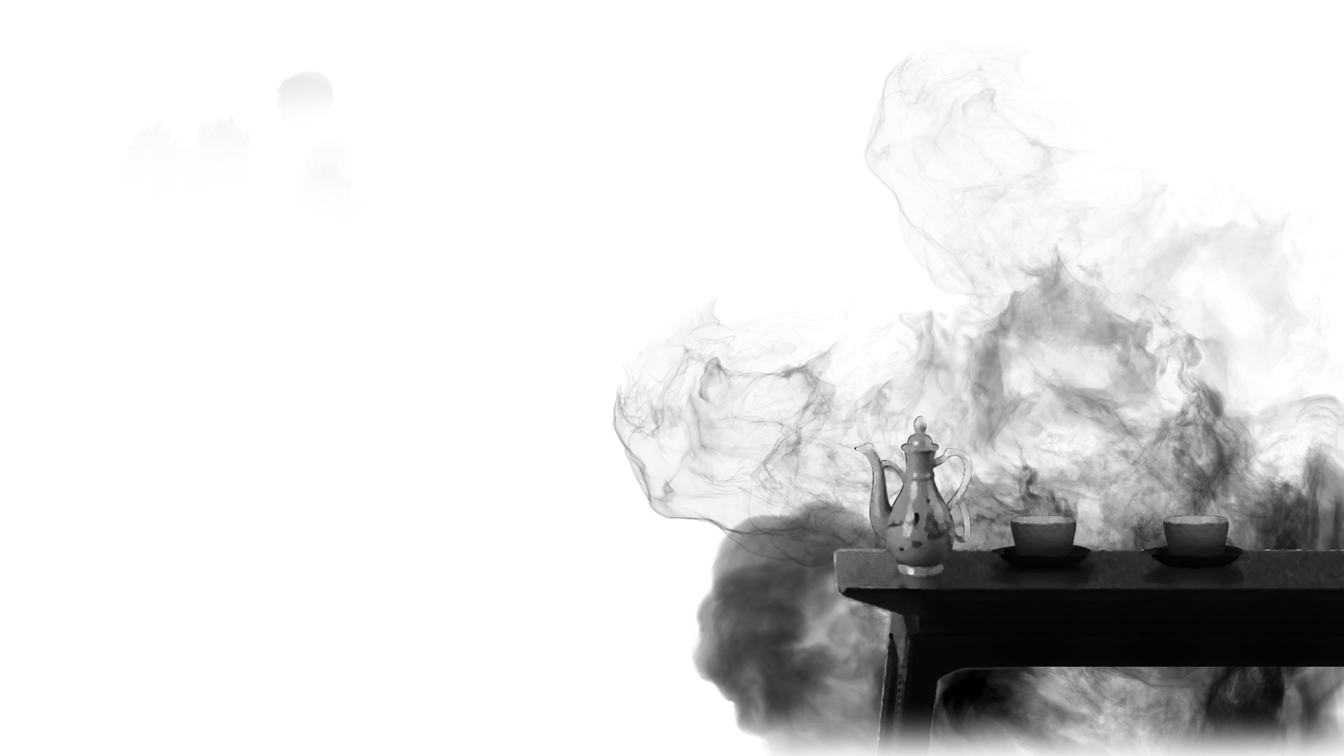
JOYFUL
人生得意须尽欢
莫使金樽空对月
喜
[人生得意之时就要尽情的享受欢乐，不要让金杯无酒空对皎洁的明月。]
WHEN HOPES ARE WON, OH, DRINK YOUR FILL IN HIGH DELIGHT. AND NEVER LEAVE YOUR WINE CUP EMPTY IN MOONLIGHT!

Slide 8
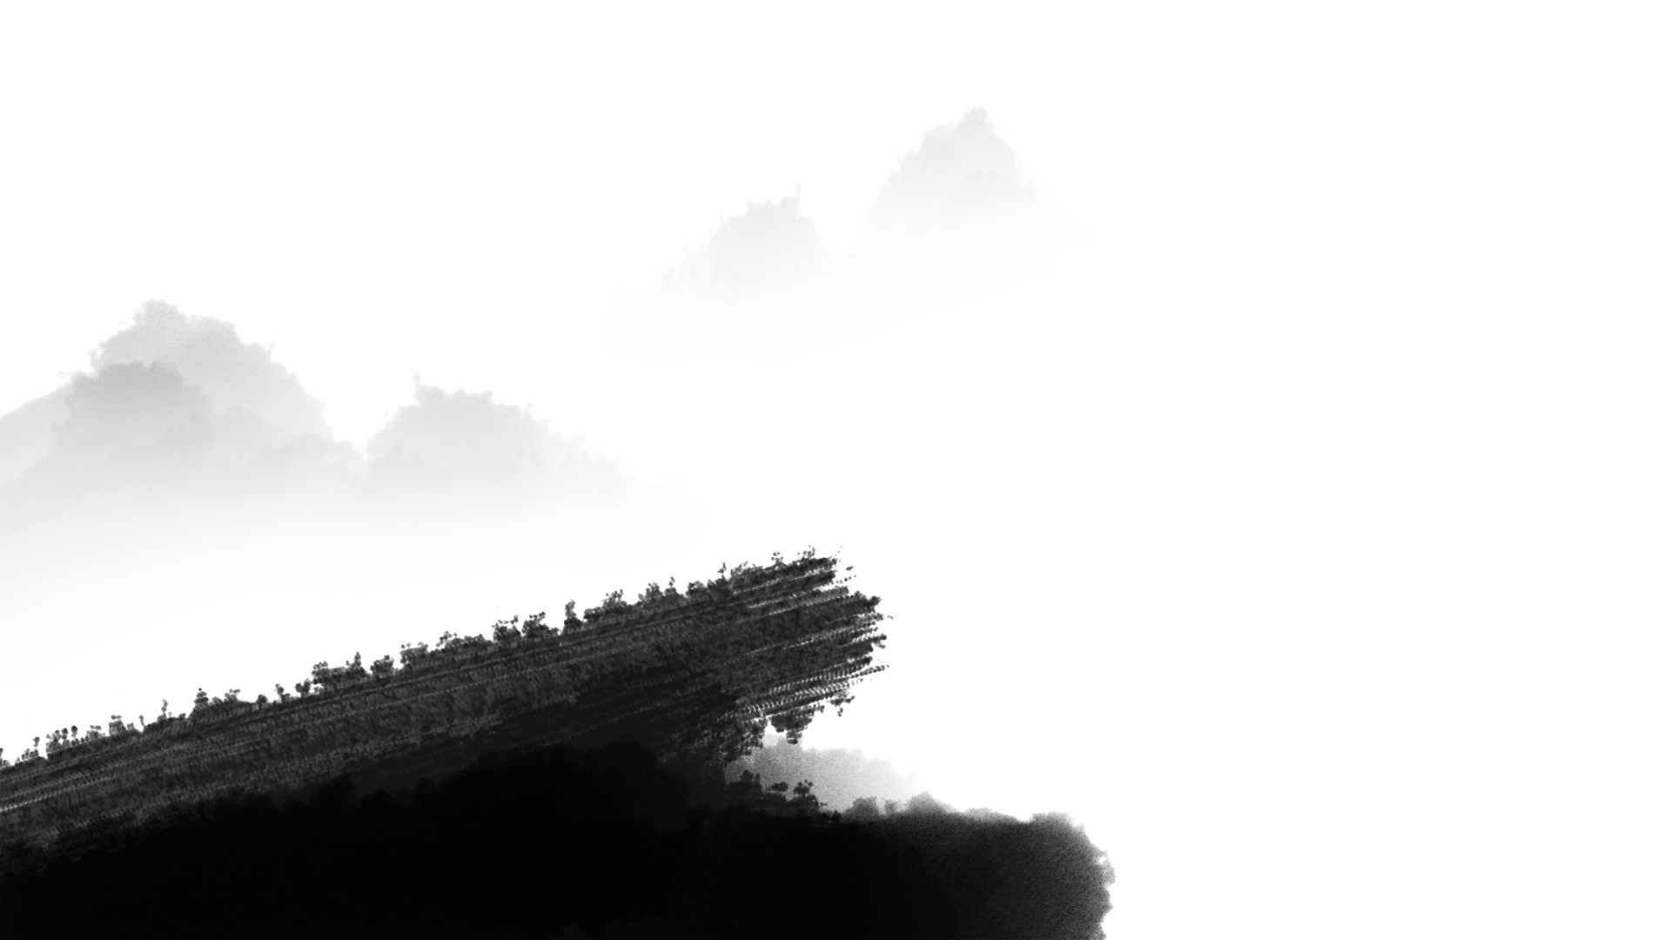
天生我材必有用
千金散尽还复来
[上天造就了我的才干就必然是有用处的，千两黄金花完了也能够再次获得。]
HEAVEN HAS MADE US TALENTS; WE'RE NOT MADE IN VAIN. A THOUSAND GOLD COINS SPENT, MORE WILL TURN UP AGAIN.
喜
JOYFUL

Slide 9
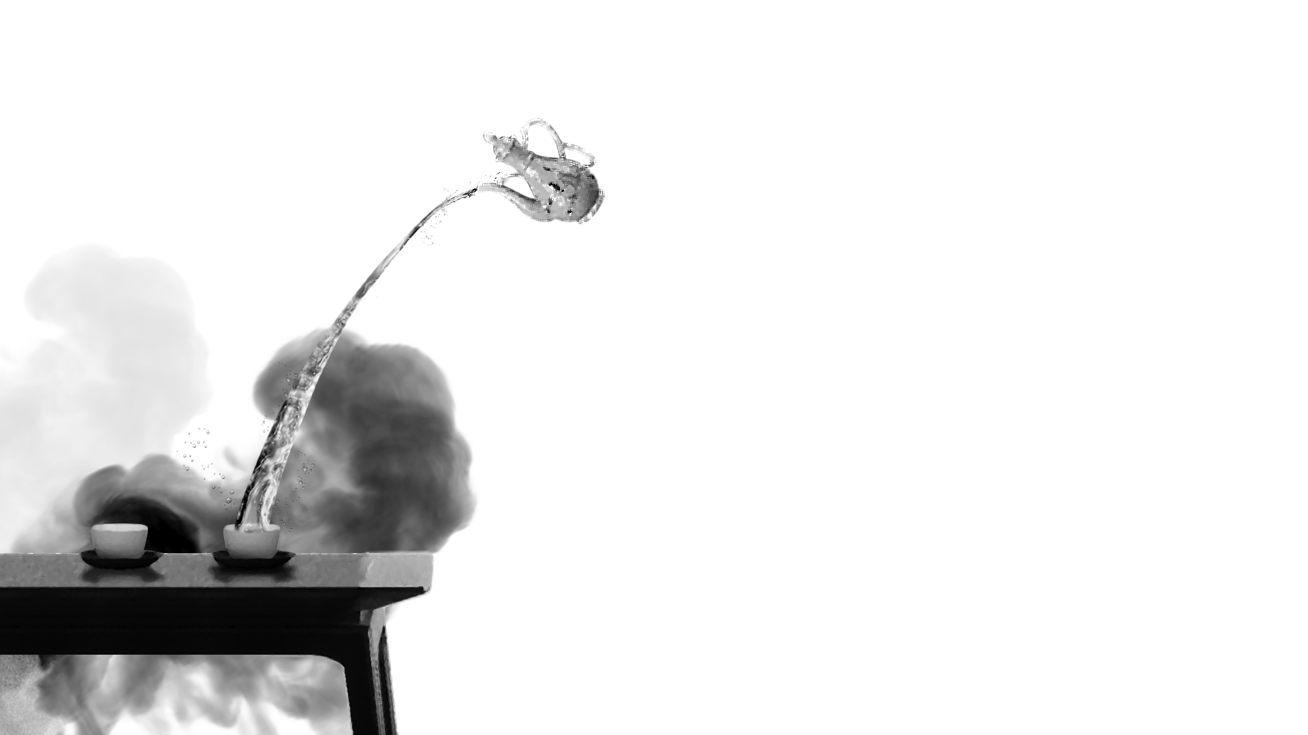
喜
[我们烹羊宰牛姑且作乐，痛快地饮三百杯也不为多。]
JOYFUL
烹羊宰牛且为乐
会须一饮三百杯
KILL A COW, COOK A SHEEP AND LET US MERRY BE, AND DRINK THREE HUNDRED CUPFULS OF WINE IN HIGH GLEE!

Slide 10
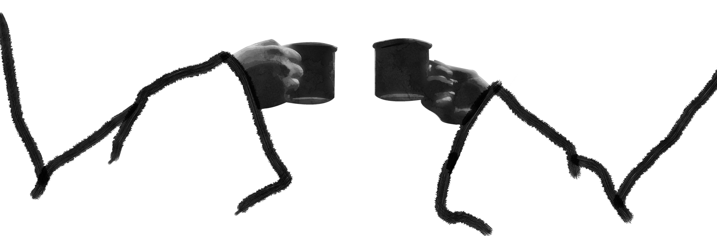
君莫停
将进酒
丹丘生
岑夫子
喜
岑勋，元丹丘，快点喝酒，不要停下来。
JOYFUL
DEAR FRIENDS OF MINE, CHEER UP, CHEER UP! DO NOT PUT DOWN YOUR CUP!

Slide 11
与君歌一曲
请君为我倾耳听
喜
[我给你们吟唱一首，请你们倾耳细听。]
JOYFUL
I WILL SING YOU A SONG, PLEASE HEAR, O HEAR! LEND ME A WILLING EAR!

Slide 12
愤
钟鼓馔玉不足贵，但愿长醉不愿醒。
古来圣贤皆寂寞，惟有饮者留其名。陈王昔时宴平乐，斗酒十千恣欢谑。
INDIGNANT
叁

Slide 13
愤
但愿长醉不愿醒
不足贵
钟鼓馔玉
[山珍海味的豪华生活算不上什么珍贵，只希望能醉生梦死而不愿清醒。]
WHAT DIFFERENCE WILL RARE AND COSTLY DISHES MAKE.I WANT ONLY TO GET DRUNK AND NE'ER TO WAKE.
INDIGNANT

Slide 14
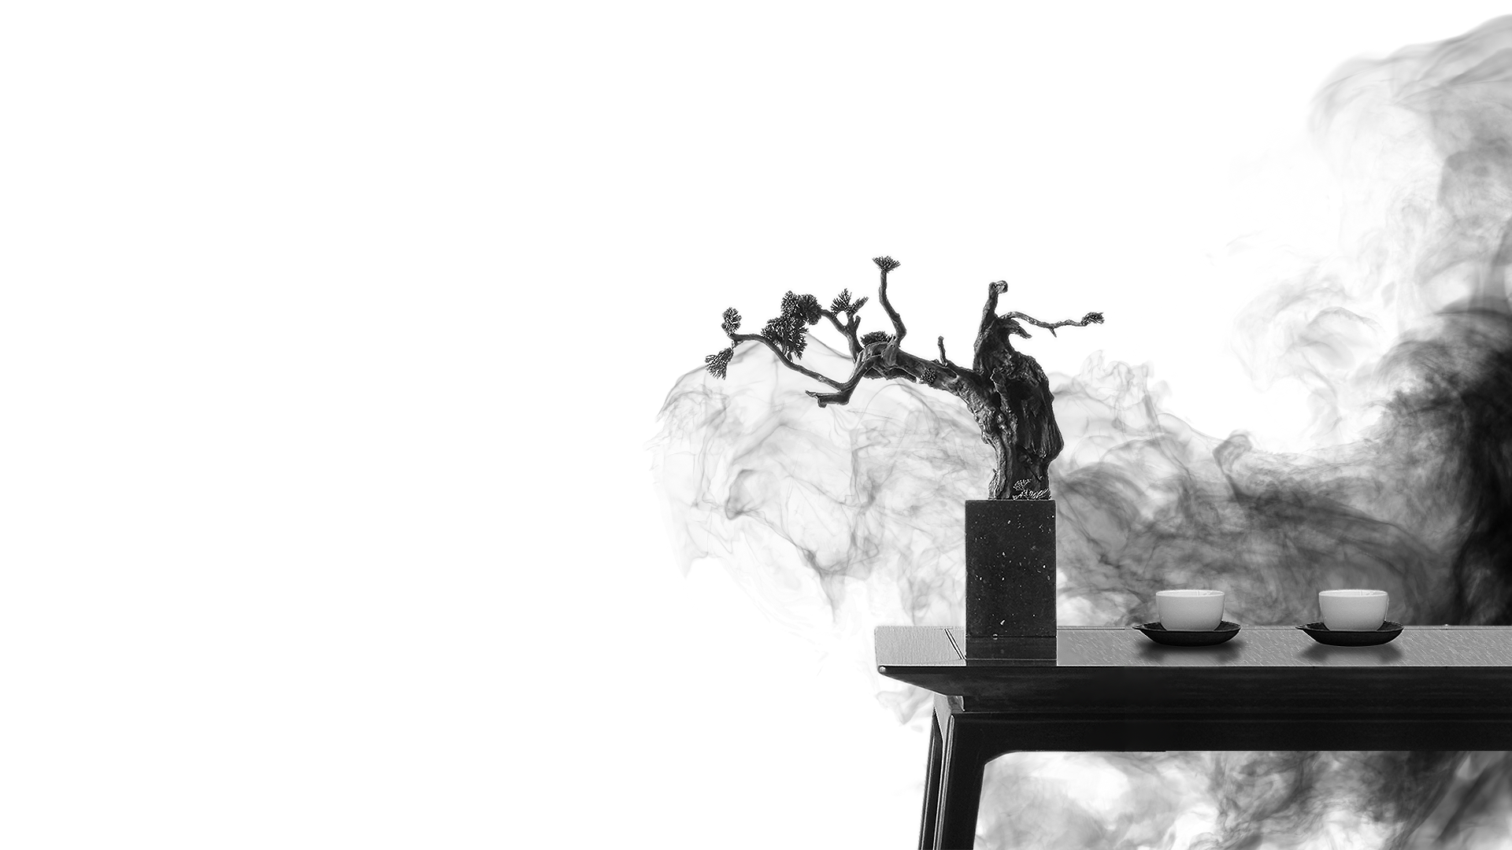
惟有饮者留其名
古来圣贤皆寂寞
[自古以来圣贤都是被世人冷落的，只有爱喝酒的人才留传下了美名。]
HOW MANY GREAT MEN WERE FORGOTTEN THROUGH THE AGES? GREAT DRINKERS ARE BETTER KNOWN THAN SOBER SAGES.
愤
INDIGNANT

Slide 15
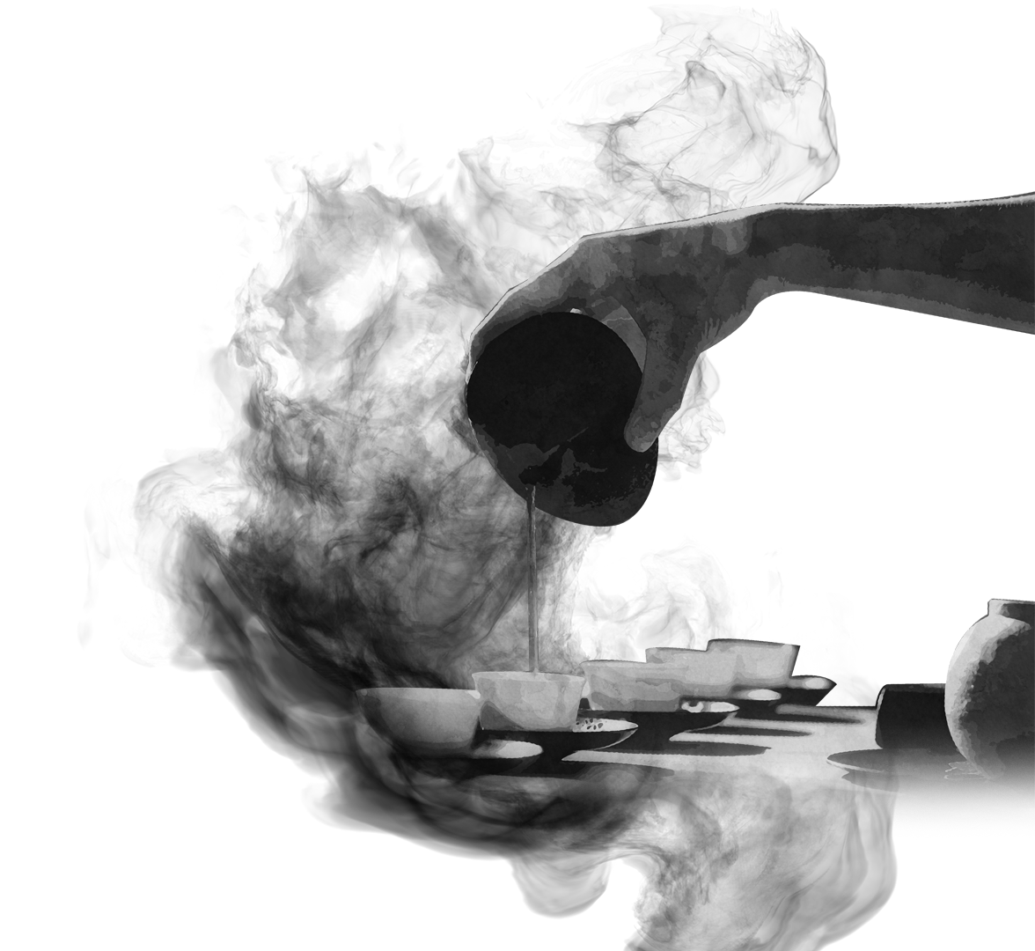
愤
陈王昔时宴平乐
THE PRINCE OF POETS FEASTED IN HIS PALACE AT WILL, DRANK WINE AT TEN THOUSAND COINS A CASK AND LAUGHED HIS FILL.
INDIGNANT
斗酒十千恣欢谑
[陈王曹植当年设宴平乐观，喝着名贵的酒纵情地欢乐。]

Slide 16
狂
主人何为言少钱，径须沽取对君酌。
五花马、千金裘，呼儿将出换美酒，与尔同销万古愁。
UNRESTRAINED
肆

Slide 17
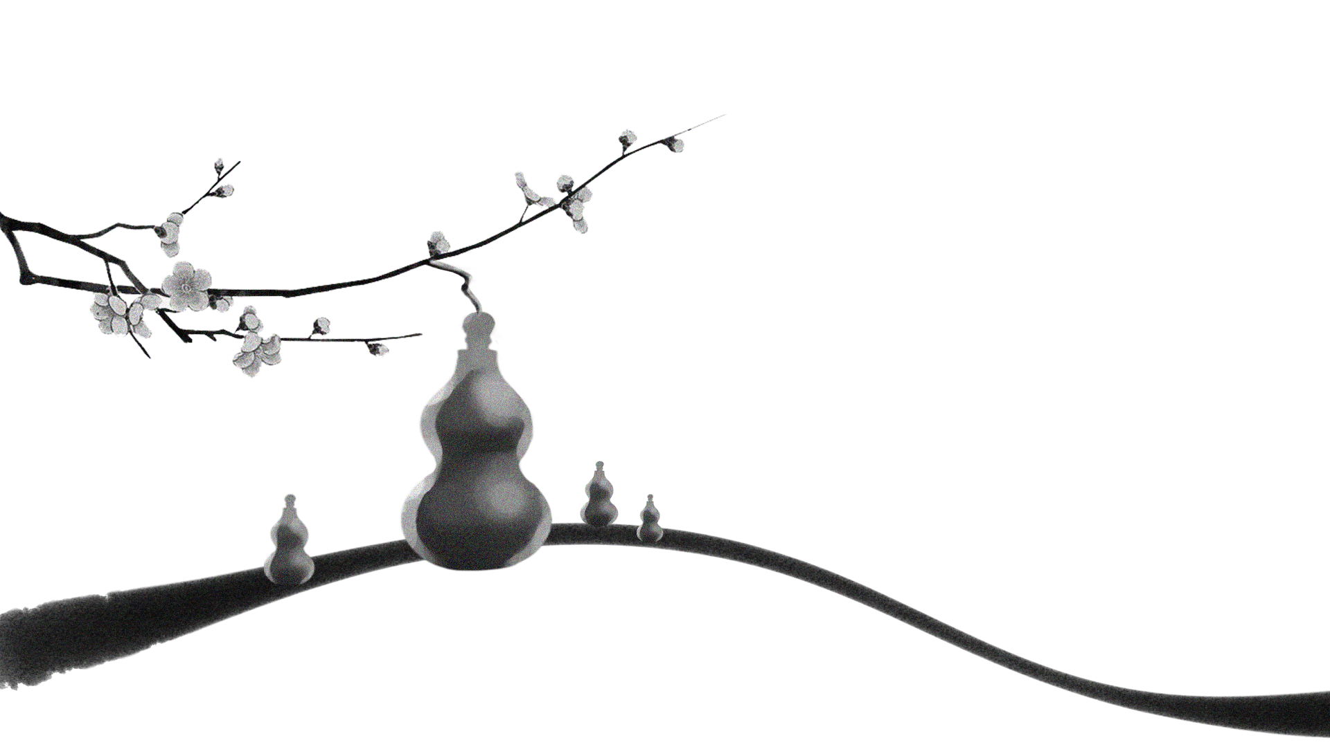
主人何为言少钱
[你为何说我的钱不多？只管把这些钱用来买酒一起喝。]
狂
A HOST SHOULD NOT COMPLAIN OF MONEY HE IS SHORT;
TO DRINK TOGETHER WE'D SELL THINGS OF ANY SORT.
UNRESTRAINED
径须沽取对君酌

Slide 18
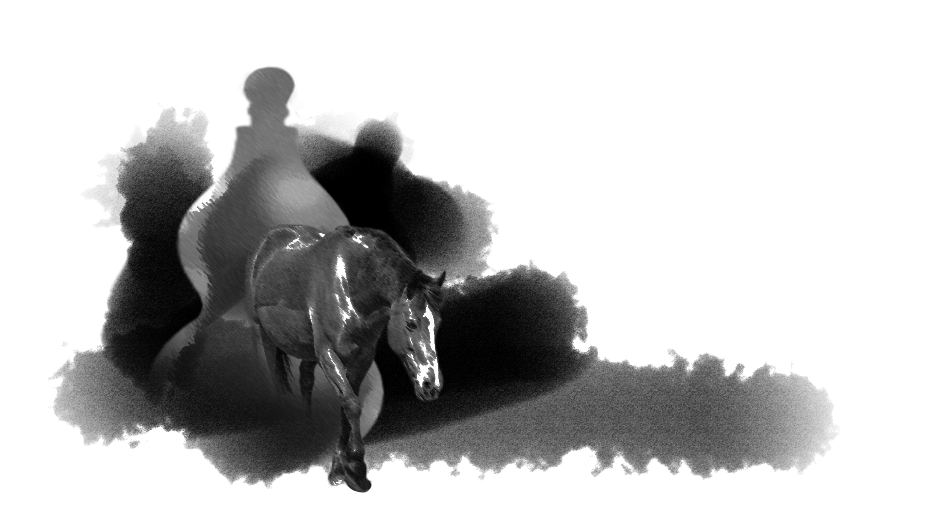
万古愁
与尔同消
换美酒
呼儿将出
千金裘
五花马
THE FUR COAT WORTH A THOUSAND COINS OF GOLD. AND FLOWER-DAPPLED HORSE MAY BOTH BE SOLD. TO BUY GOOD WINE THAT WE MAY DROWN THE WOES AGE-OLD.
[名贵的五花良马，昂贵的千金皮衣，叫侍儿拿去统统换美酒，让我们一起来消除这无尽的长愁!]
狂
UNRESTRAINED

Slide 19
将进酒

