Slide 1
20XX-XX三年级二班
年度教学总结
Subtitle here
OfficePLUS学校
汇报人：OfficePLUS

Slide 2
Contents
01
年度工作概述
02
工作完成情况
03
成功项目展示
04
明年工作计划

Slide 3
年度工作概述
/01
节标题内容：Arial/微软雅黑11号灰色，行距1.2-1.5倍
… …

Slide 4
年度工作概述1
Unified fonts make
reading more fluent.
科目抓取
Supporting text here.
……
Theme color makes PPT more convenient to change.
Adjust the spacing to adapt to Chinese typesetting, use the reference line in PPT.
单独辅导
Supporting text here.
……
完成测试
Supporting text here.
……
整体提升
Supporting text here.
……

Slide 5
年度工作概述2
Unified fonts make reading more fluent.
科目抓取
整体提升
Supporting text here.
… …
Supporting text here.
… …
单独辅导
完成测试
Supporting text here.
… …
Supporting text here.
… …

Slide 6
工作完成情况
/02
节标题内容：Arial/微软雅黑11号灰色，行距1.2-1.5倍
… …

Slide 7
工作完成情况1
全面辅导
获得A班资格
Supporting text here.
……
Supporting text here.
……
… text
单科抓取
身体素质提升
Supporting text here.
……
Supporting text here.
……

Slide 8
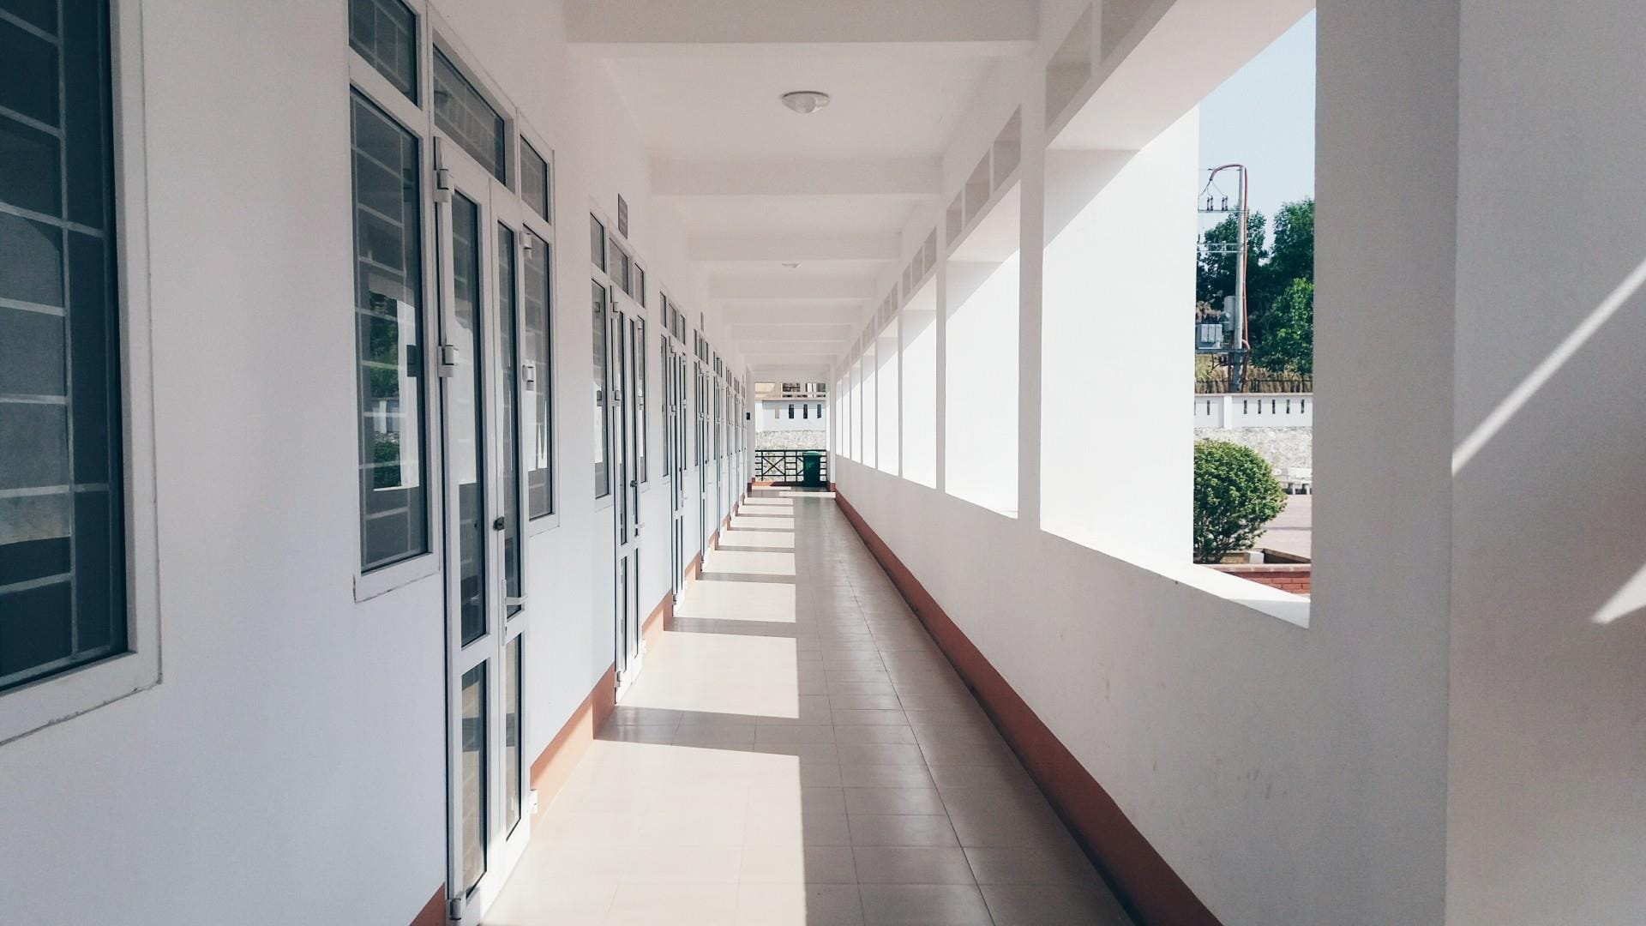
工作完成情况2
Text here
Copy paste fonts. Choose the only option to retain text……
全面辅导
获得A班资格
Copy paste fonts. Choose the only option to retain text.
……
Copy paste fonts. Choose the only option to retain text.
……
单科抓取
身体素质提升
Copy paste fonts. Choose the only option to retain text.
……
Copy paste fonts. Choose the only option to retain text.
……

Slide 9
成功项目展示
/03
节标题内容：Arial/微软雅黑11号灰色，行距1.2-1.5倍
… …

Slide 10
成功项目展示1
Unified fonts make
reading more fluent.
Theme color makes PPT more convenient to change.
Adjust the spacing to adapt to Chinese typesetting, use the reference line in PPT.
A班优秀奖
Copy paste fonts. Choose the only option to retain text……
体操二等奖
Copy paste fonts. Choose the only option to retain text……
三好班级
Copy paste fonts. Choose the only option to retain text……

Slide 11
成功项目展示2
A班优秀奖
Copy paste fonts. Choose the only option to retain text.
……
三好班级
Text
优秀干部
Copy paste fonts. Choose the only option to retain text.
……
Copy paste fonts. Choose the only option to retain text.
……

Slide 12
明年工作计划
/04
节标题内容：Arial/微软雅黑11号灰色，行距1.2-1.5倍
… …

Slide 13
明年工作计划1
Supporting text here.
Unified fonts make
reading more fluent.
Theme color makes PPT more convenient to change.
Adjust the spacing to adapt to Chinese typesetting, use the reference line in PPT.
…计划
…计划
Copy paste fonts. Choose the only option to retain text.
……
Copy paste fonts. Choose the only option to retain text.
……
1559
1176

Slide 14
明年工作计划2
…计划
…计划
Copy paste fonts. Choose the only option to retain text.
… …
Copy paste fonts. Choose the only option to retain text.
… …
…计划
…计划
Copy paste fonts. Choose the only option to retain text.
… …
Copy paste fonts. Choose the only option to retain text.
… …

Slide 15
Thanks
And Your Slogan Here
汇报人：OfficePLUS
20XX/XX/XX

