Slide 1
华中农业大学
文学系学术答辩 PPT
HUAZHONG AGRICULTURAL UNIVERSITY
author / OfficePLUS

Slide 2
Contents
01
T ext here
Copy paste fonts. Choose the only option to ret ain text.
02
T ext here
Copy paste fonts. Choose the only option to ret ain text.
03
T ext here
Copy paste fonts. Choose the only option to ret ain text.

Slide 3
01
Edit Master text styles
Theme color make s PPT more convenient to change.
Adjust the spacing to adapt to Chinese typesetting, use the reference line in PPT.

Slide 4
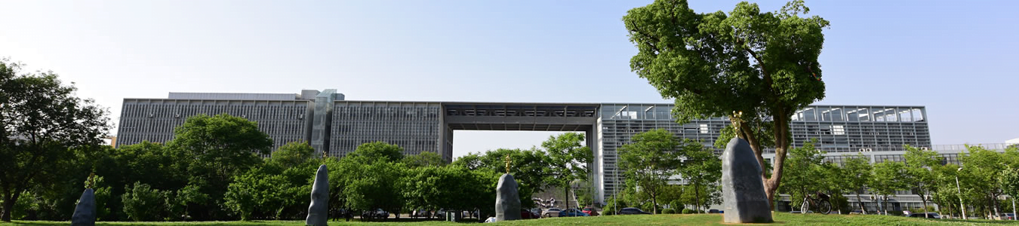
U nified fonts
make reading more fluent.
Unified fonts make reading more fluent. The me color makes PPT more convenient to change.
Adjust the spacing to adapt to Chinese typesetting, use the reference line in PPT.
……

Slide 5

Supportin g text here.
Unified Fonts Ma ke
Reading More Fluent.
Unified fonts make reading more fluent.
Theme color makes PPT more conv enient to change.
Adjust the spacing to adapt to Chinese typesetting, use the reference line in PPT.
……
01
02
03
04
40%
23%
72%
57%
text here
text here
text here
text here

Slide 6
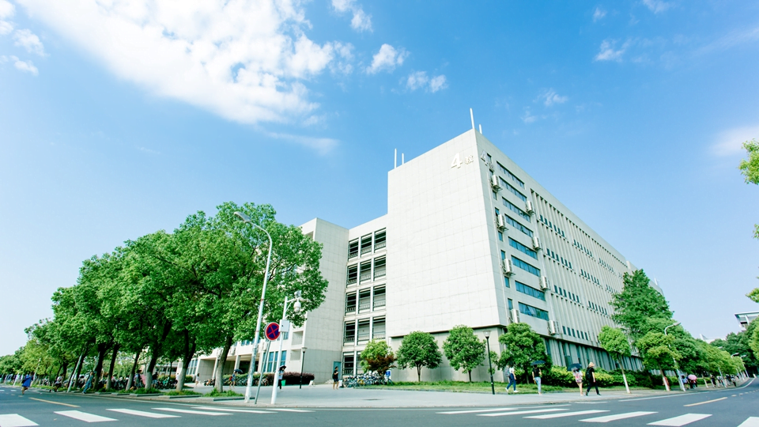
Text here
Unified fonts make reading more fluent. Theme color makes PPT more convenient to change. Adjust the spacing to adapt to Chinese typesetting, use the reference line in PPT ……
Text here
Text here
Text here
Copy paste fonts. Choosethe only option to retain text.
Copy paste fonts. Choose the only option toretain text.
Copy paste fonts. Choosethe only option to retain text.

Slide 7



U nified fonts
make reading more fluent.
Them e color makes PPT more convenient to change.
Adjust the spacing to adapt to Chinese typesetting, use the reference line in PPT.
Te xt here
Te xt here
T ext here
Copy paste fonts. Choose the only option to retain text.
……
Copy paste fonts. Choose the only option to retain text.
……
Co py paste fonts. Choose the only option to retain text.
……
T ext here ›

Slide 8
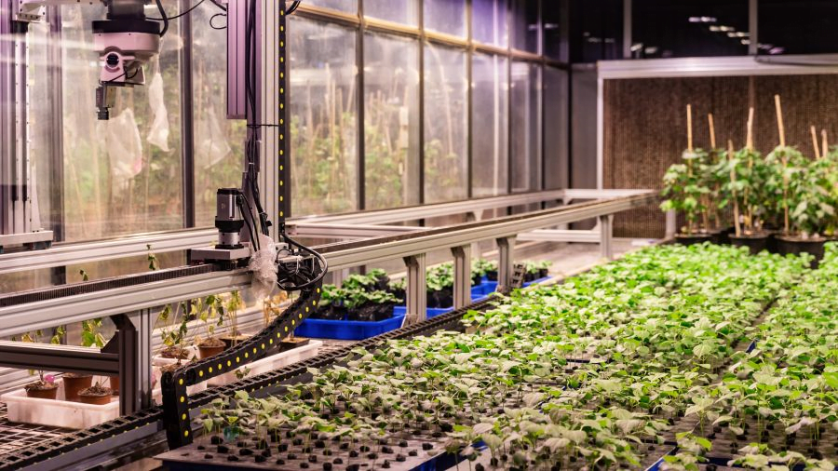
Text here
Copy paste fonts.Choose the only option to retain text
0 1
0 2
Support ing text here.
……
Supporting text here.
……

Slide 9
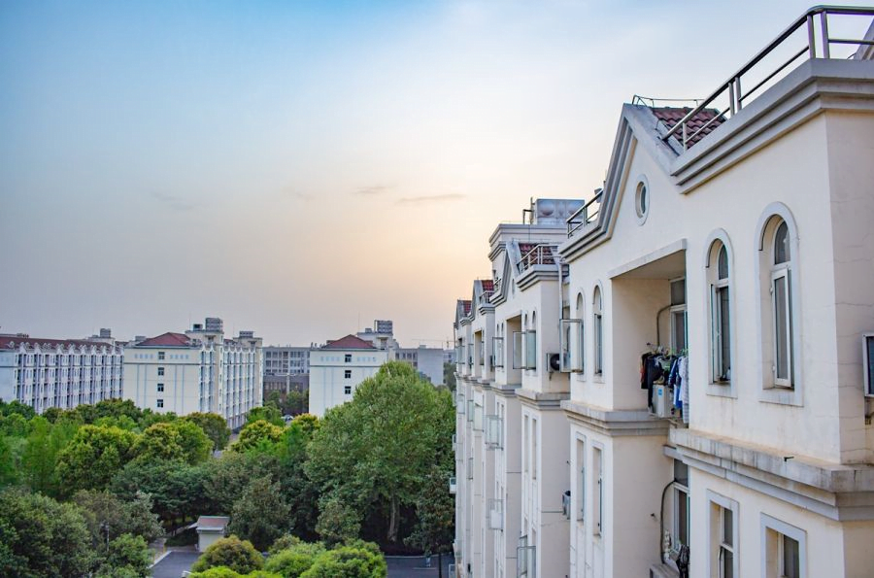
Supporting text here.
Unified Fonts Make Reading More Fluent.
Text here
Copy paste fonts. Choose the only option to retain text……
Text here
Copy paste fonts. Choose the only option to retain text……
Text here
Copy paste fonts. Choose the only option to retain text……

Slide 10

Text here
Copy paste fonts.Choose the only option to retain text.
……
Text here
Text here
Copy paste fonts.Choose the only option to retain text.
……
Copy paste fonts. Choose the only option to retain text.
……
Text here
Copy paste fonts. Choose the only option to retain text.
……

Slide 11
Text h ere
Text h ere
Text h ere
Text here
Text here
Supporting text her e.
……
Supporting text her e.
……
Supporting text her e.
……
Supporting text here.
……
Supporting text here.
……

Slide 12
Text here
Text here
Copy paste fonts. Choose the only option to retain text.
Copy paste fonts. Choose the only option to retain text.
Text
Text here
Text here
Copy paste fonts. Choose the only option to retain text.
Copy paste fonts. Choose the only option to retain text.
Text
Text here
Text here
Copy paste fonts. Choose the only option to retain text.
Copy paste fonts. Choose the only option to retain text.

Slide 13
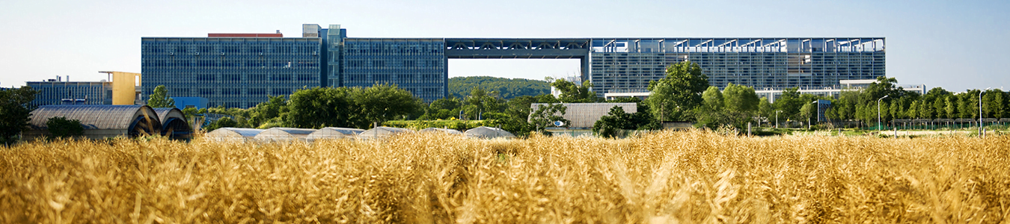
Text
here
Text here
Text here
Supporting text here.
……
Supporting text here.
Supporting text here.
……
Supporting text here.
Supporting text here.
……
Text here
Supporting text here.
……

Slide 14


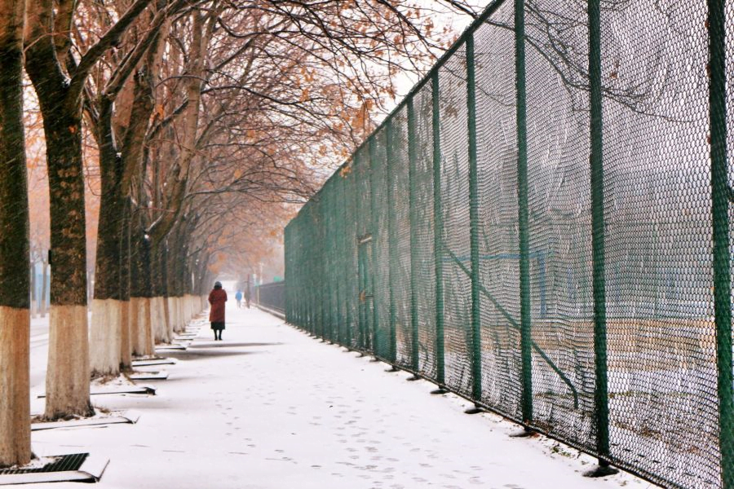
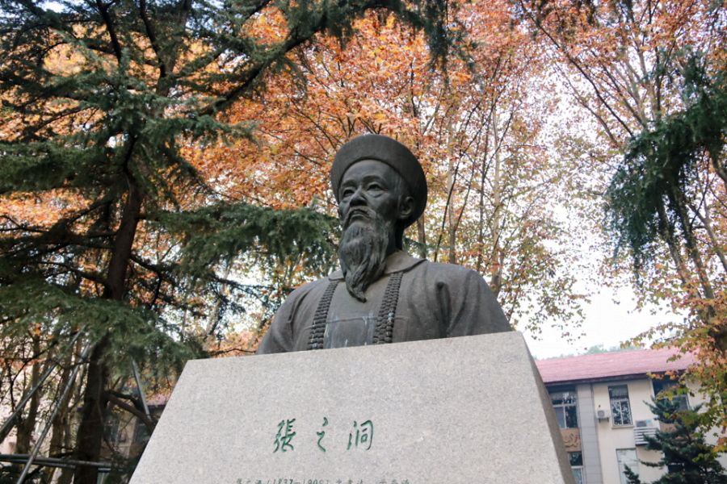

Texthere
Text here
Text here
Text here
Supporting text here.
……
Supporting text here.
……
Texthere
Supporting text here.
……
Supporting text here.
……
Supporting text here.
……

Slide 15
Text here
Supporti ng text here.
……
23%
Text here
Tex t here
Supporti ng text here.
……
23%
Text here
Tex t here
Supporti ng text here.
……

Slide 16

Text here
Copy paste fonts. Choose the only option to retain text.
… …
Unified fonts make
reading more fluent.
Text here
Theme color makes PPT more convenient to change.
Adjust the spacing to adapt to Chinese typesetting, use the reference line in PPT.
Copy paste fonts. Choose the only option to retain text.
… …
Text here
Copy paste fonts. Choose the only option to retain text.
… …

Slide 17
Texthere
Texthere
Copy paste fonts. Choose the only option to retain text.
… …
Copy paste fonts. Choose the only option to retain text.
… …
Text here
Text here
Copy paste fonts. Choose the only option to retain text.
… …
Copy paste fonts. Choose the only option to retain text.
… …

Slide 18
Unified Fonts Make Reading More Fluent. Theme color makes PPT more convenient to change. Adjust the spacing to adapt to Chinese typesetting, use the reference line in PPT..……
..t ext
Unified Fonts Make Reading More Fluent. Theme color makes PPT more convenient to change. Adjust the spacing to adapt to Chinese typesetting, use the reference line in PPT..……
Unified Fonts Make Reading More Fluent. Theme color makes PPT more convenient to change. Adjust the spacing to adapt to Chinese typesetting, use the reference line in PPT..……

Slide 19
Text here
Text here
Copy paste fonts. Choose the only opt ion to retain text.
……
Copy paste fonts. Choose the only opt ion to retain text.
……
Text here
Text here
Copy paste fonts. Choose the only opt ion to retain text.
……
Copy paste fonts. Choose the only opt ion to retain text.
……

Slide 20
Supportin g text here.
Unified Fonts Ma ke
Reading More Fluent.
Unified fonts make reading more fluent.
Theme color makes PPT more conv enient to change.
Adjust the spacing to adapt to Chinese typesetting, use the reference line in PPT.
……
Text here
52%
Supporting text here
31%
27%
77%

Slide 21
Text here
Supporting text here.
……
…text
Text here
Text here
Supporting text here.
Supporting text here.
Supporting text here.
……
Supporting text here.
……
Text here
Supporting text here.
……

Slide 22
Unified fonts make
reading more fluent.
Theme color makes PPT more convenient to change.
Adjust the spacing to adapt to Chinese typesetting, use the reference line in PPT.
Texthere ›

Slide 23
Unified fonts make
reading more fl uent.
Theme color makes PPT more convenient to change. Adjust the spacing to adapt to Chinese typesetting, use the referen ce line in PPT.
Theme color makes PPT more convenient to change.
Adjust the spacing to adapt to Chinese typesetting, use the referenc e line in PPT……
6 5%
3 5%
1 5%
T ext here
T ext here
Text he re

Slide 24
Unified Fonts Make Reading More Fluent.
Text here
Text here
Text here
Supporting text here.
… …
Supporting text here.
… …
Supporting text here.
… …

Slide 25
Unified fonts make reading more fluent.
Text here
Copy paste fonts. Choose th e only option to retain text.
Text h ere
Copy paste fonts. Choose th e only option to retain text.
Text h ere
Copy paste fonts. Choose the only option to ret ain text.

Slide 26
“
Supporting text he re
Supporting text here
Supporting text he re
…
Text Here
2 0%
Supporting text here
Sup porting text here
50%
Text He re
30%
Supporting text here
Supporting text h ere
Text He re
Supporting text here
Supporting text h ere

Slide 27




Unified fonts make
r eading more fluent.
Theme color makes PPT more convenient to change.
Adjust the spacing to adapt to Chinese typesetting, use the reference line in PPT.
Text here ›

Slide 28
THANKS
Theme color makes PPT more convenient to change.
Adjust the spacing to adapt to Chinese typesetting, use the reference line in PPT……

