Slide 1
小提琴 - 兴趣班培训 招生课件
LOGO HERE
Day.01
Day.02
Violin concert
Adjust the spacing to adapt to Chinese typesetting use the reference line in PPT.
OfficePLUS
Speaker name and title

Slide 2
提琴介绍
01
Theme color makes PPT
基础训练
02
Theme color makes PPT
进阶训练
03
Theme color makes PPT
结课
04
Theme color makes PPT

Slide 3
提琴介绍
LOGO HERE
Day.01
Day.02
01.
When you copy & paste, choose "keep text only" option.
Violin concert

Slide 4
Use "Title Only" Layout
Supporting text here.
Theme color makes PPT more convenient to change. Adjust the spacing to adapt to Chinese typesetting, use the reference line in PPT…… Theme color makes PPT more convenient to change. Adjust the spacing to adapt to Chinese typesetting, use the reference line in PPT……
01
02
Supporting text here.
Supporting text here.
Theme color makes PPT more convenient to change. Adjust the spacing to adapt to Chinese typesetting, use the reference line in PPT……
Theme color makes PPT more convenient to change. Adjust the spacing to adapt to Chinese typesetting, use the reference line in PPT……

Slide 5
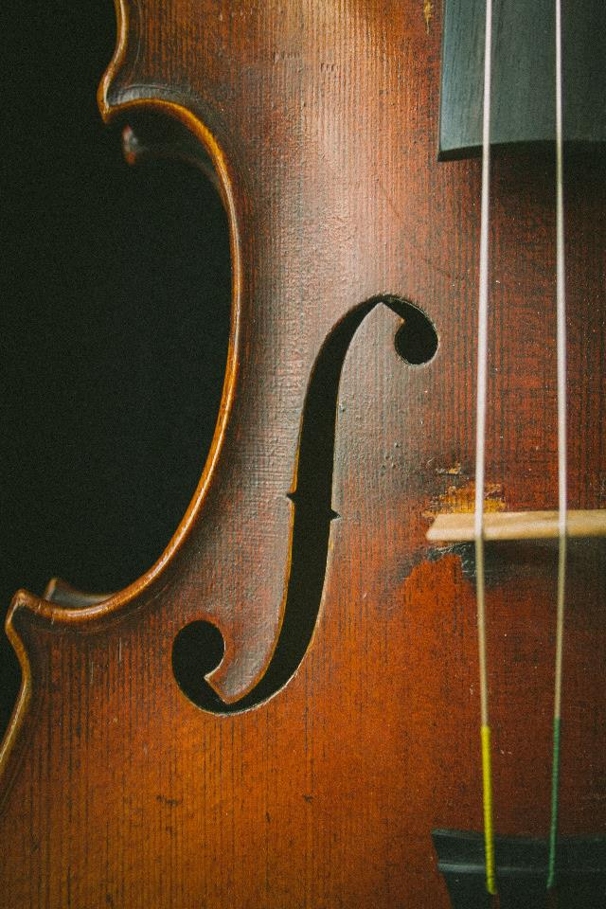
Use "Title Only" Layout
Text here
Copy paste fonts. Choose the only optio to retain text
Unified
fonts make reading more fluent.
Unified fonts make reading more fluent.Copy paste fonts. Choose the only optio to retain text.
Copy paste fonts. Choose the only optio to retain text.
Unified fonts make reading more fluent. Choose the only optio to retain text.
Notes:
02c9c245-a3a1-404e-93ed-7163cd13c96a.source.default.zh-Hans

Slide 6
Use "Title Only" Layout
Unified fonts make reading more fluent
Text here | Text here
… | …

Slide 7
Use "Title Only" Layout
Unified fonts make reading more fluent.
”
Unified fonts make reading more fluent.Copy paste fonts. Choose the only optio to retain text……
Unified fonts make reading more fluent.Copy paste fonts. Choose the only optio to retain text……
Notes:
8b7eda6b-dc9b-4a70-b3a2-8dd256dd4843.source.default.zh-Hans

Slide 8
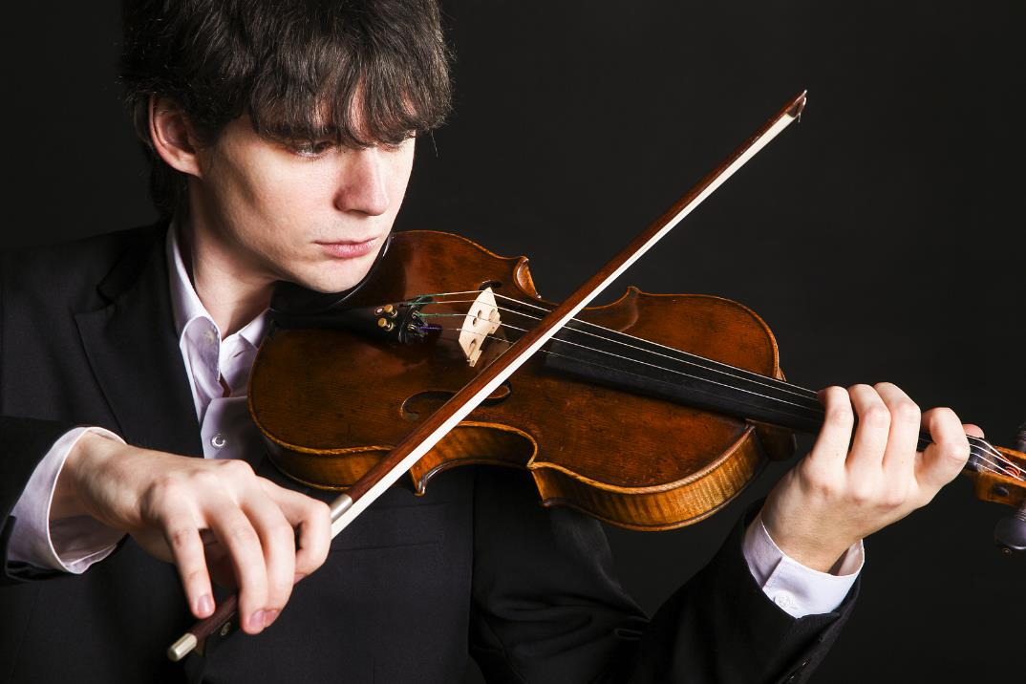
Use "Title Only" Layout
Unified
fonts make.
Theme color makes PPT more convenient to change . Adjust the spacing to adapt to Chinese typesetting, use the reference line in PPT . Unified fonts make reading more fluent . Copy paste fonts. Choose the only o to retain text.Copy paste fonts. Choose the only option to retain text. Theme color makes PPT more convenient to change . the spacing to adapt to Chinese typesetting, use the reference line in PPT
01.

Slide 9
Use "Title Only" Layout
Supporting text here.
Theme color makes PPT more convenient to change.
Supporting text here.
Theme color makes PPT more convenient to change.

Slide 10
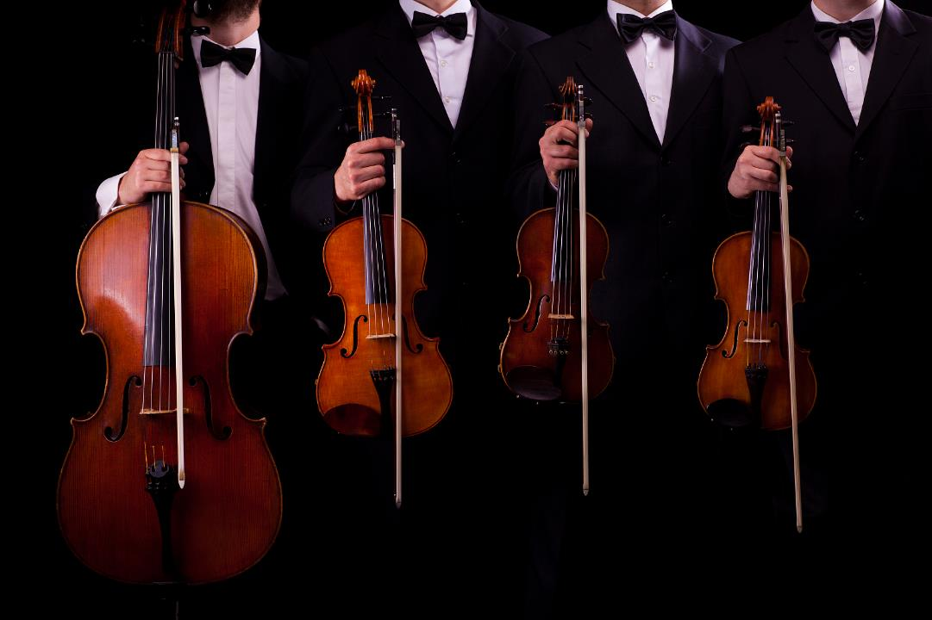
Use "Title Only" Layout
Supporting text here.
Theme color makes PPT more convenient to change.
Unified fonts make reading more fluent.
Copy paste fonts Choose the only option to retain text Adjust the spacing to adapt to Chinese typesetting
Supporting text here.
Theme color makes PPT more convenient to change.

Slide 11
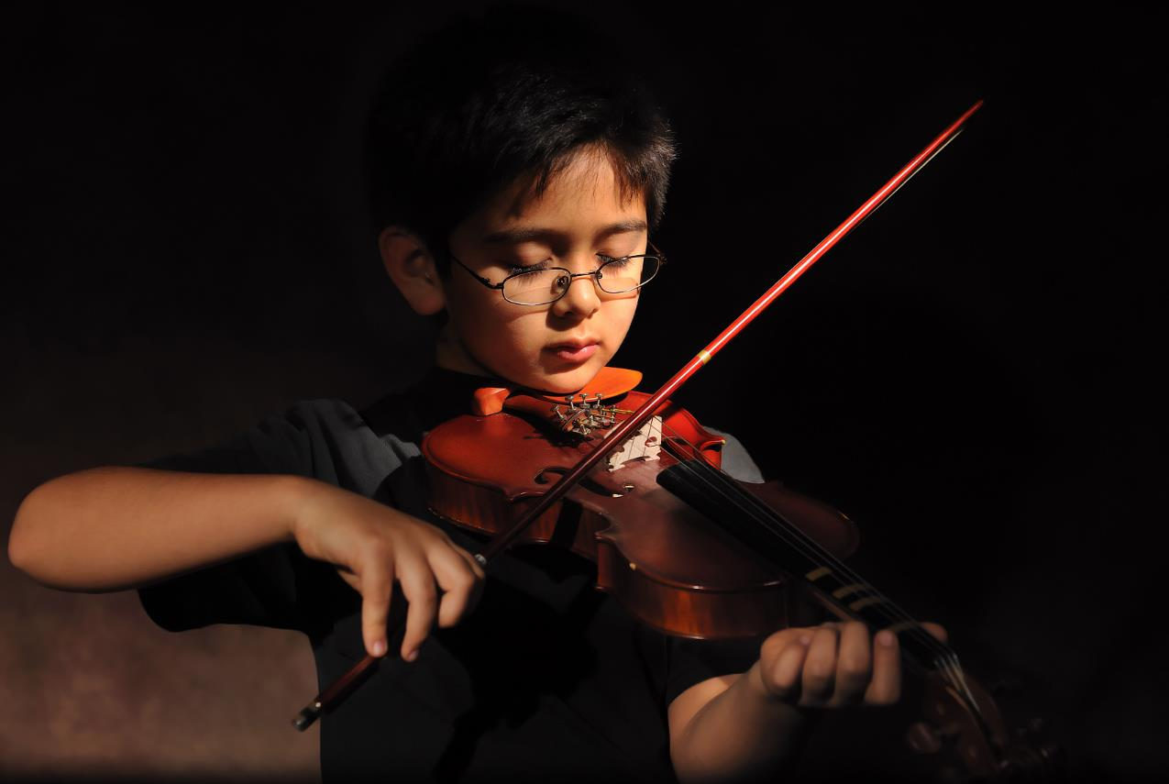
Unified fonts make reading more fluent.
Theme color makes PPT more convenient to change. Adjust the spacing to adapt to Chinese typesetting, use the reference line in PPT.
……

Slide 12
Use "Title Only" Layout
Unified fon ts make
reading more fluent.
Theme color makes PPT more convenient to change.
Adjust the spacing to adapt to Chinese typesetting, use the reference line in PPT.
Unified fonts make reading more fluent.Copy paste fonts. Choose the only optio to retain text.
Copy paste fonts. Choose the only option to retain text.

Slide 13
Use "Title Only" Layout
Supporting text here.
Theme color makes PPT more convenient to change.Adjust the spacing to adapt to Chinese typesetting, use the reference line in PPT.
Unified fonts make reading more fluent.Copy paste fonts. Choose the only optio to retain text.
NO.1

Slide 14
Use "Title Only" Layout
Unified fonts make reading more fluent
01-
Text he re
Choose the only option to retain text Adjust the spacing to adapt to Chinese typesetting Adjust the spacing to adapt to Chinese typesetting, use the reference line in PPT.

Slide 15
LOGO HERE
Day.01
Day.02
Thank you for
watching.
Violin concert
OfficePLUS
Speaker name and title

