Slide 1
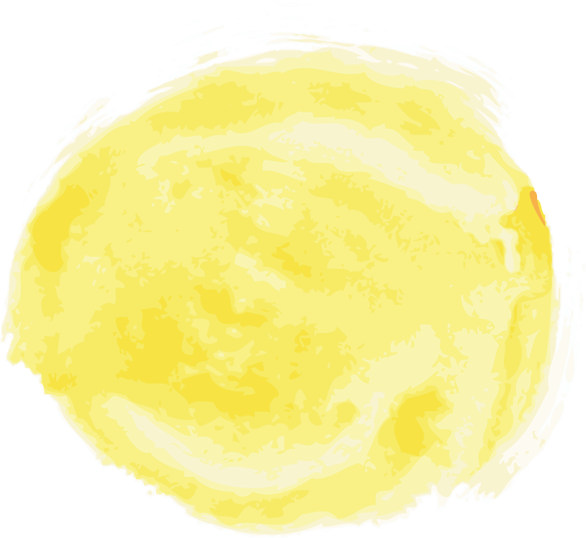


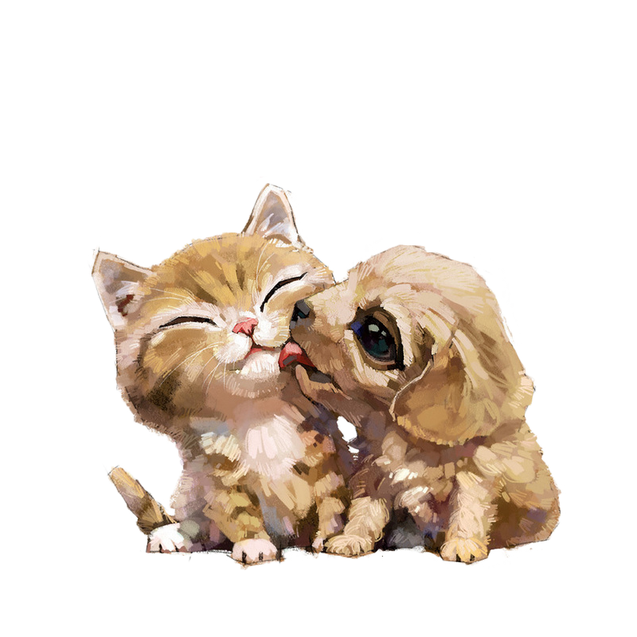


PETS
A large collection of cats and dogs
Name
December 5th

Slide 2

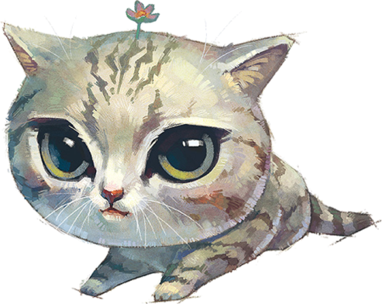

前言
PREFACE
TEXT

Slide 3
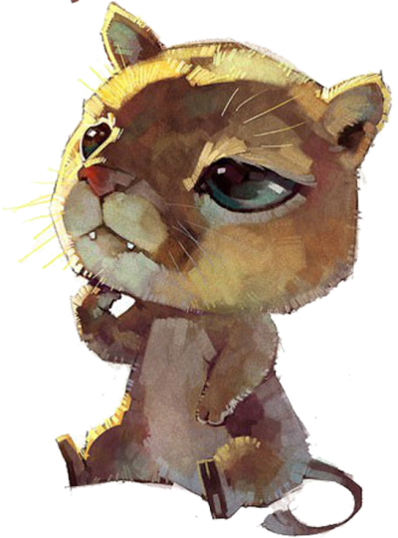


目录
CONTENTS
ONE
TWO
TITLE
TITLE
THR
FOU
TITLE
TITLE

Slide 4


1
PETS
A large collection of cats and dogs
TEXT

Slide 5

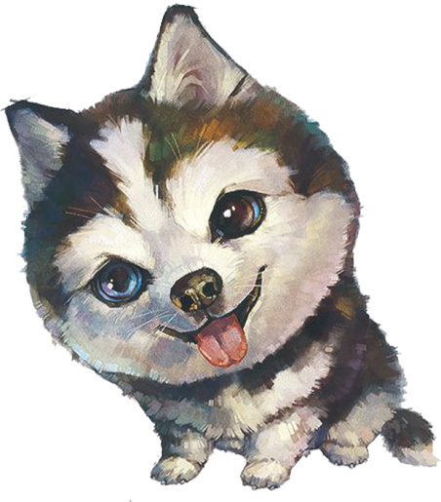
汪汪
hohohohohohohohooho
TEXT

Slide 6
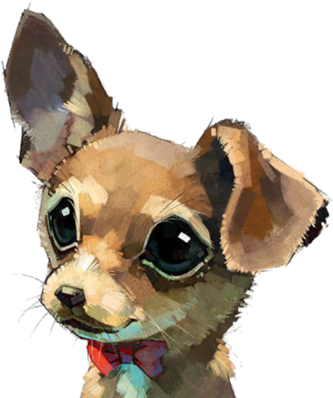

TEXT
TEXT
TEXT
TEXT
TEXT
TEXT
Dog
Little

Slide 7
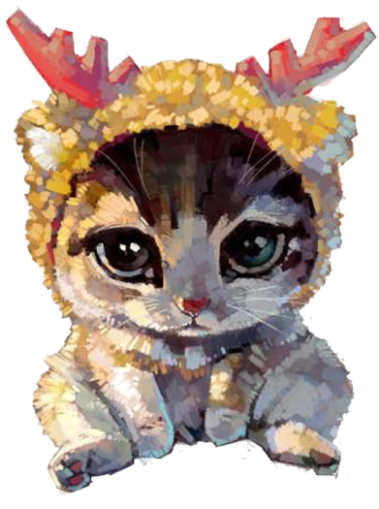

Cat
TEXT
bababababba
TEXT
TEXT
TEXT

Slide 8
2
PETS
A large collection of cats and dogs
TEXT

Slide 9
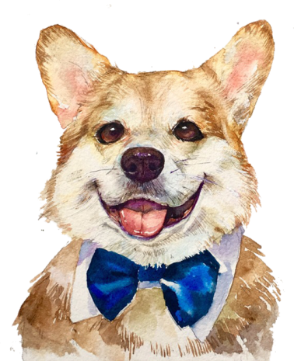
TEXT
TEXT
TEXT
wa
TEXT

Slide 10

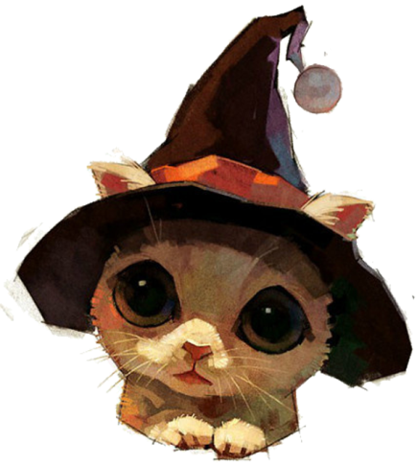
Magic
TEXT

Slide 11

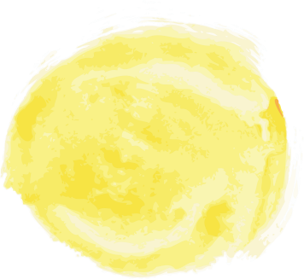
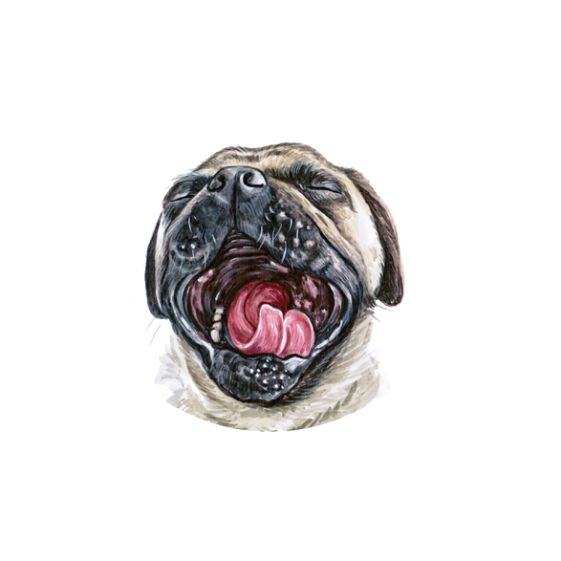

Sweet
TEXT
TEXT
TEXT
TEXT
TEXT

Slide 12

3
PETS
A large collection of cats and dogs
TEXT

Slide 13

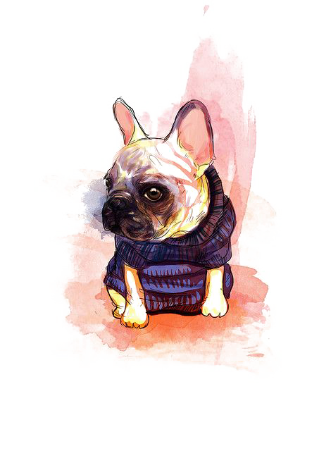

Tcc
TEXT
TEXT
TEXT
TEXT
TEXT
TEXT
TEXT

Slide 14


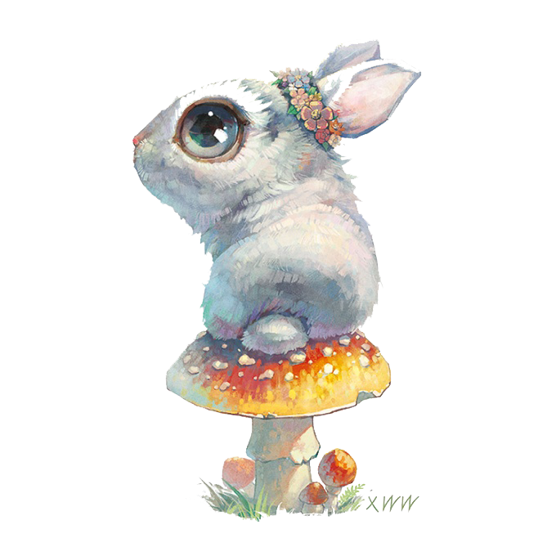
Rabbit
TEXT

Slide 15

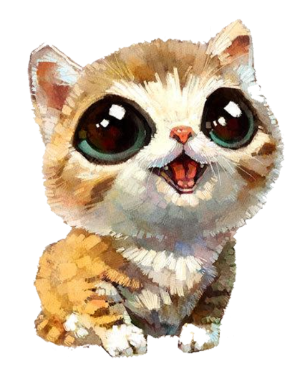

MAO
TEXT
TEXT

Slide 16

4
PETS
A large collection of cats and dogs
TEXT

Slide 17


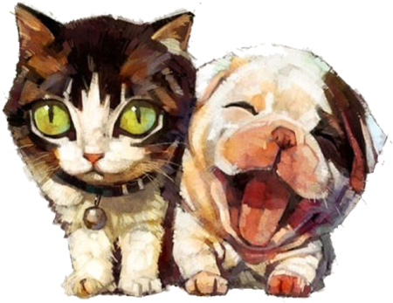
Friend
TEXT
TEXT
TEXT

Slide 18
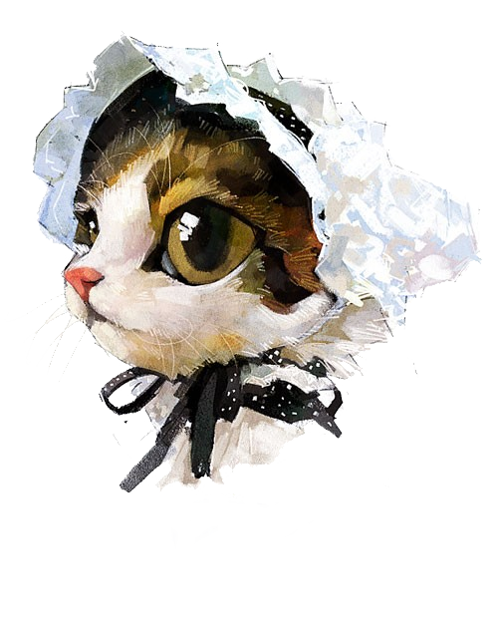
Eye
TEXT
TEXT
TEXT

Slide 19
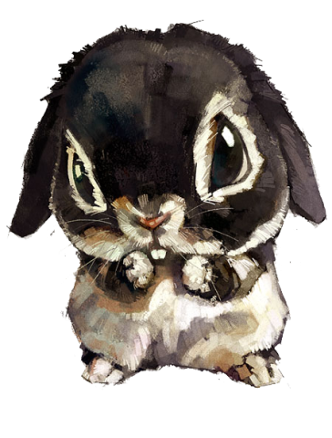
TEXT
TEXT
TEXT
Lovely

Slide 20

THANKS
A large collection of cats and dogs
December 5th

Slide 21
UI

Slide 22
UI

Slide 23
UI

Slide 24
UI

