Slide 1
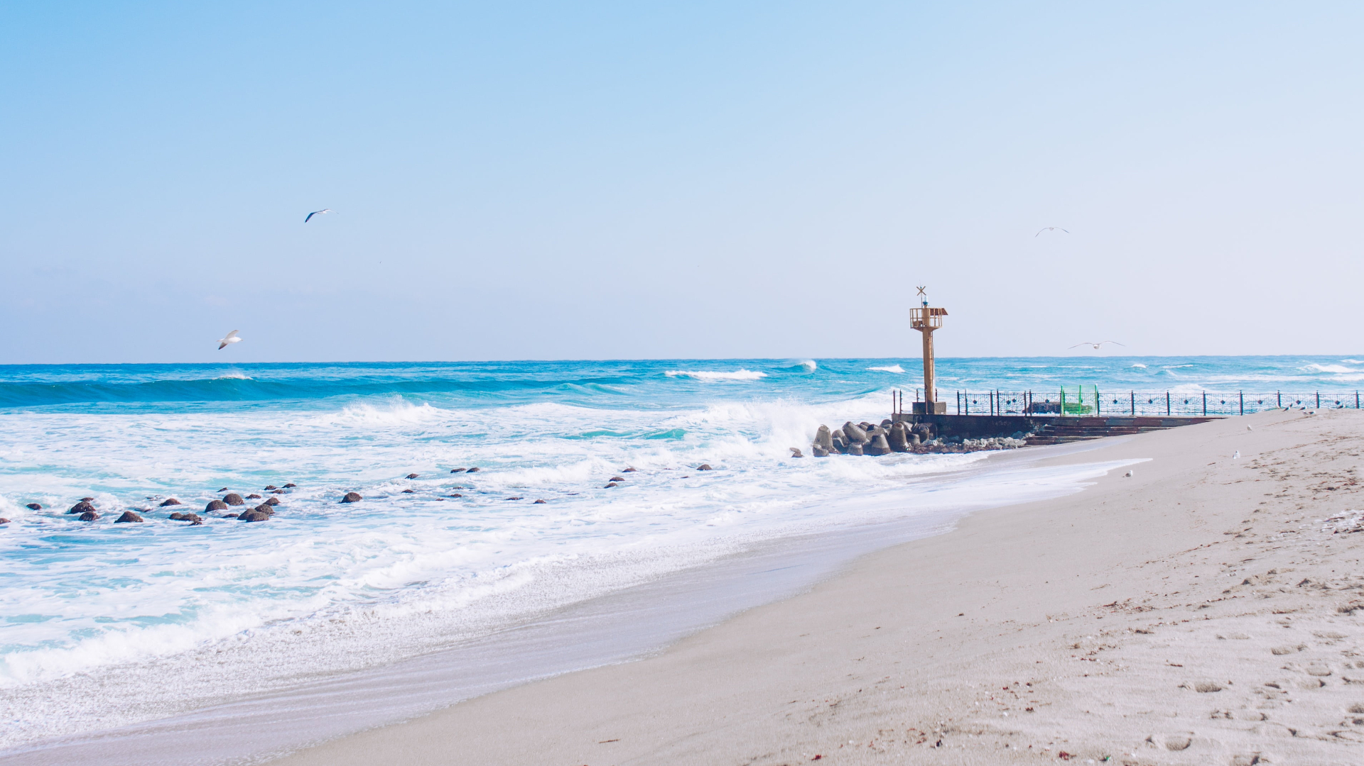
TRAVEL
旅游相册
I love you more than I've ever loved any woman. And I've waited longer for you than I've waited for any woman

Slide 2
01
part
标题

Slide 3

Create
After listening closely to a client's needs, we use our knowledge and experience to carefully craft a strategy that'll help them deliver an amazing product. One that their customers will enjoy using, time and time again.

Slide 4
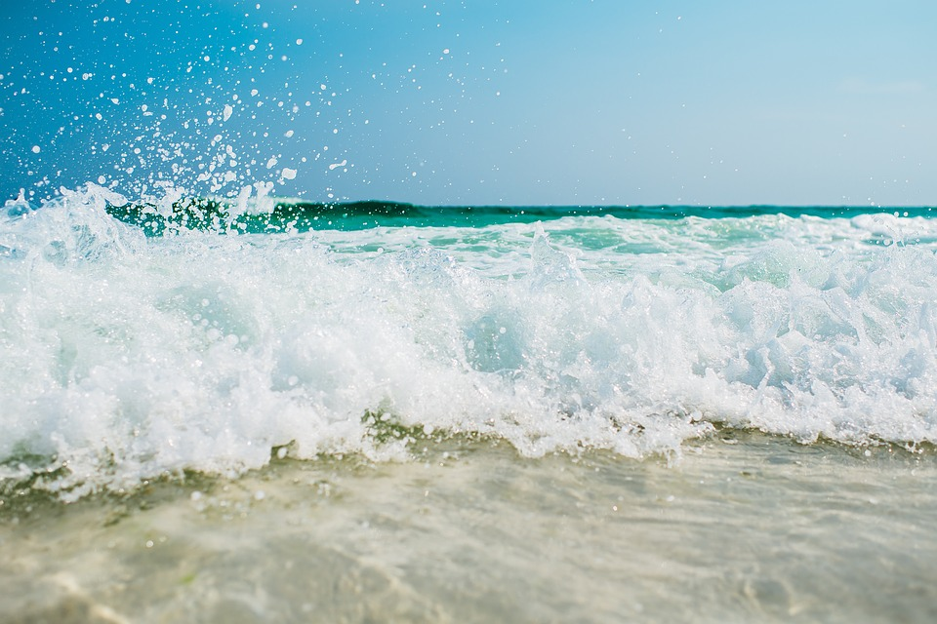
Travel
Click here to add your title
I love you more than I've ever loved any woman. And I've waited longer for you than I've waited for any woman.
I love you more than I've ever loved any woman. And I've waited longer for you than I've waited for any woman.I love you more than I've ever loved any woman. And I've waited longer for you than I've waited for any woman.

Slide 5
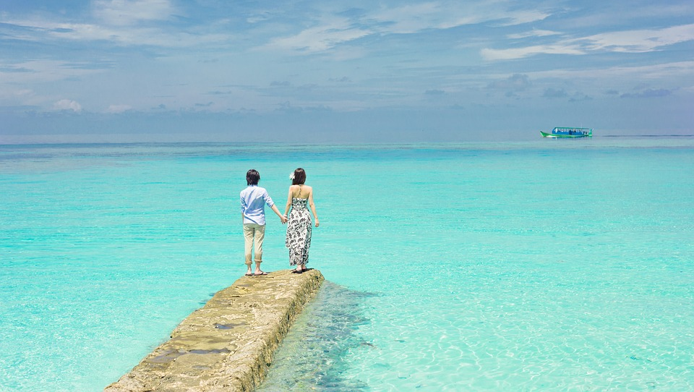
TRAVEL
Project Name
After listening closely to a client's needs, we use our knowledge and experience to carefully craft a strategy that'll help them deliver an amazing product. One that their customers will enjoy using, time and time again.

Slide 6
02
part
标题

Slide 7

Click here to add your title
I love you more than I've ever loved any woman. And I've waited longer for you than I've waited for any woman.
I love you more than I've ever loved any woman. And I've waited longer for you than I've waited for any woman.I love you more than I've ever loved any woman. And I've waited longer for you than I've waited for any woman.

Slide 8
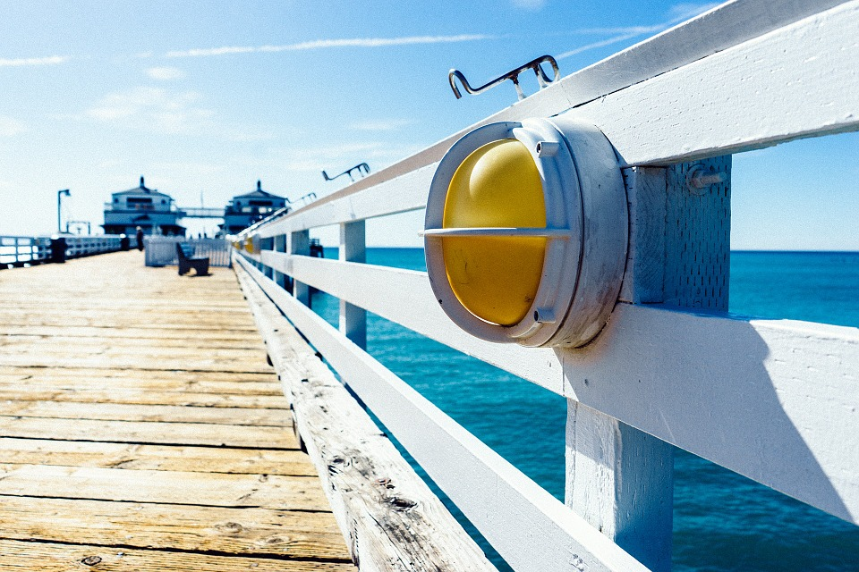
I love you more than I've ever loved any woman. And I've waited longer for you than I've waited for any woman.
I love you more than I've ever loved any woman. And I've waited longer for you than I've waited for any woman.I love you more than I've ever loved any woman. And I've waited longer for you than I've waited for any woman.
I love you more than I've ever loved any woman. And I've waited longer for you than I've waited for any woman.

Slide 9
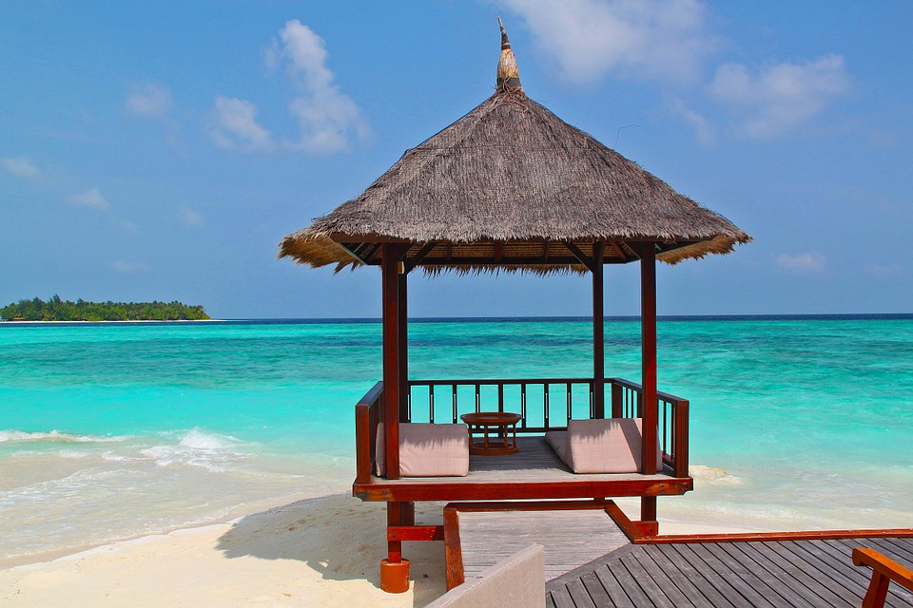
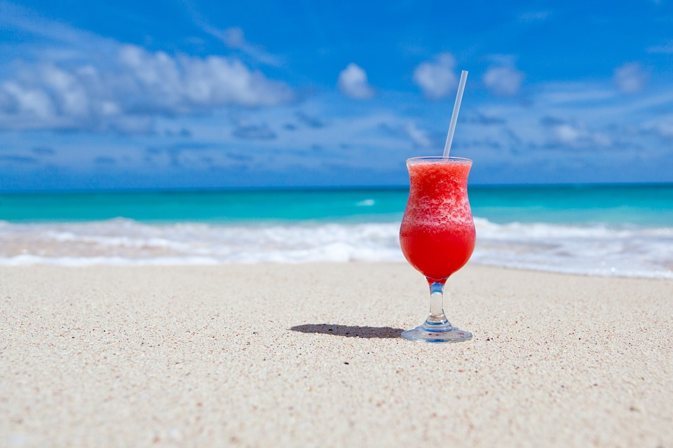
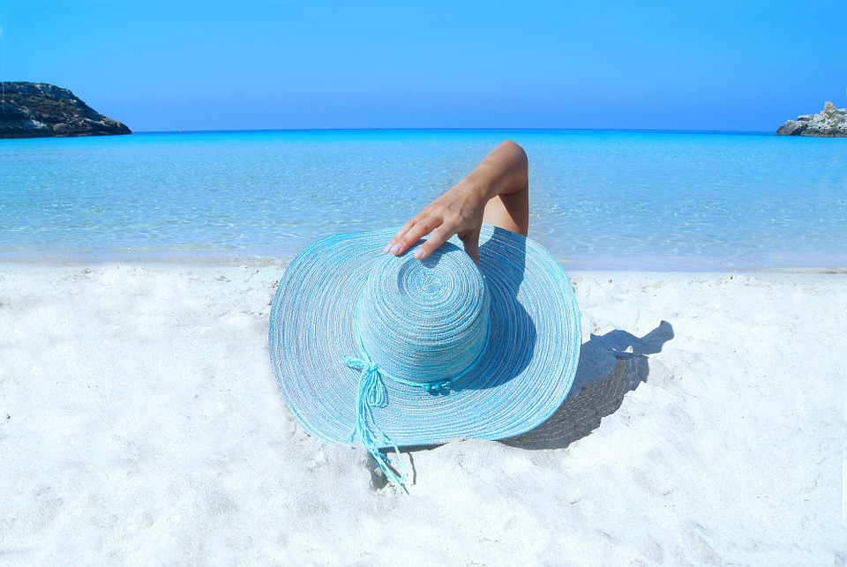
标题
您的内容打在这里，或者通过复制您的文本后，
或者通过复制您的文本后，在此框中选择粘贴，并选择只保留。

Slide 10
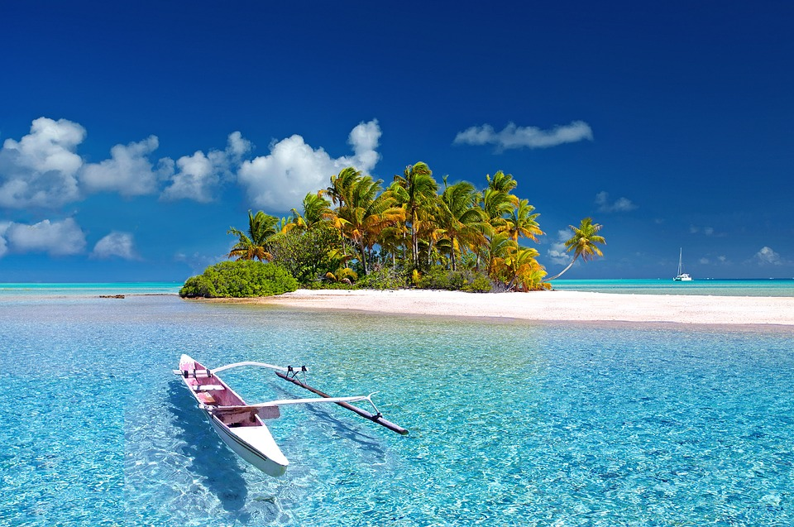
TRAVEl
I love you more than I've ever loved any woman. And I've waited longer for you than I've waited for any woman.
I love you more than I've ever loved any woman. And I've waited longer for you than I've waited for any woman.I love you more than I've ever loved any woman. And I've waited longer for you than I've waited for any woman.

Slide 11

Click here to add your title
Click here to add your title
I love you more than I've ever loved any woman. And I've waited longer for you than I've waited for any woman.
I love you more than I've ever loved any woman. And I've waited longer for you than I've waited for any woman.

Slide 12
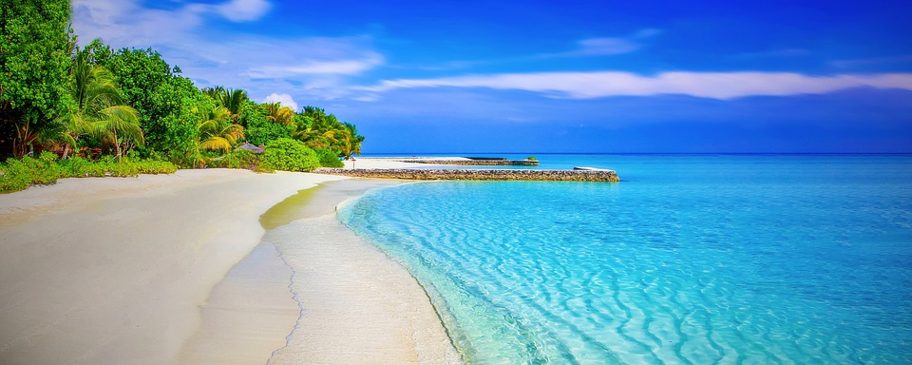
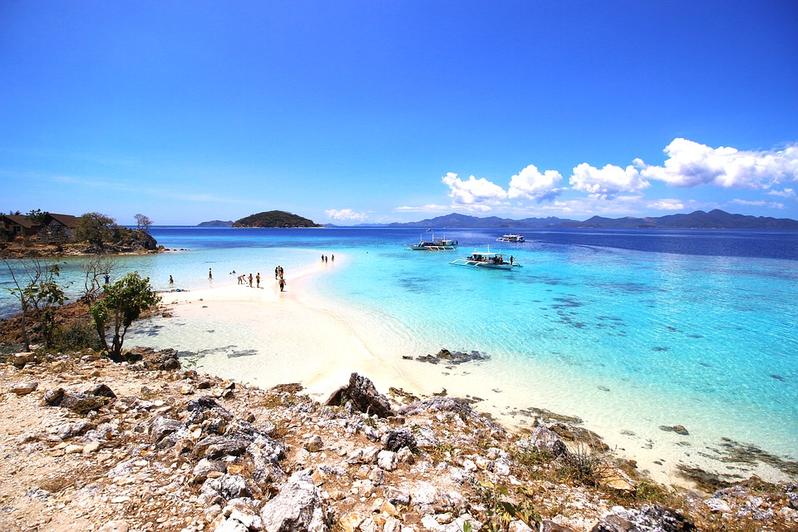
I love you more than I've ever loved any woman. And I've waited longer for you than I've waited for any woman.
I love you more than I've ever loved any woman. And I've waited longer for you than I've waited for any woman.I love you more than I've ever loved any woman. And I've waited longer for you than I've waited for any woman.

Slide 13
03
part
标题

Slide 14
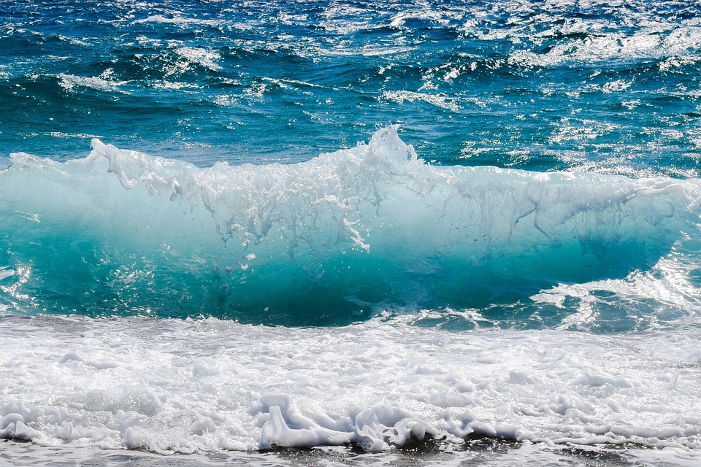
TRAVEL
Click here to add your title
I love you more than I've ever loved any woman. And I've waited longer for you than I've waited for any woman.
I love you more than I've ever loved any woman. And I've waited longer for you than I've waited for any woman.I love you more than I've ever loved any woman. And I've waited longer for you than I've waited for any woman.

Slide 15
I love you more than I've ever loved any woman. And I've waited longer for you than I've waited for any woman.
I love you more than I've ever loved any woman. And I've waited longer for you than I've waited for any woman.
I love you more than I've ever loved any woman. And I've waited longer for you than I've waited for any woman.
I love you more than I've ever loved any woman. And I've waited longer for you than I've waited for any woman.

Slide 16
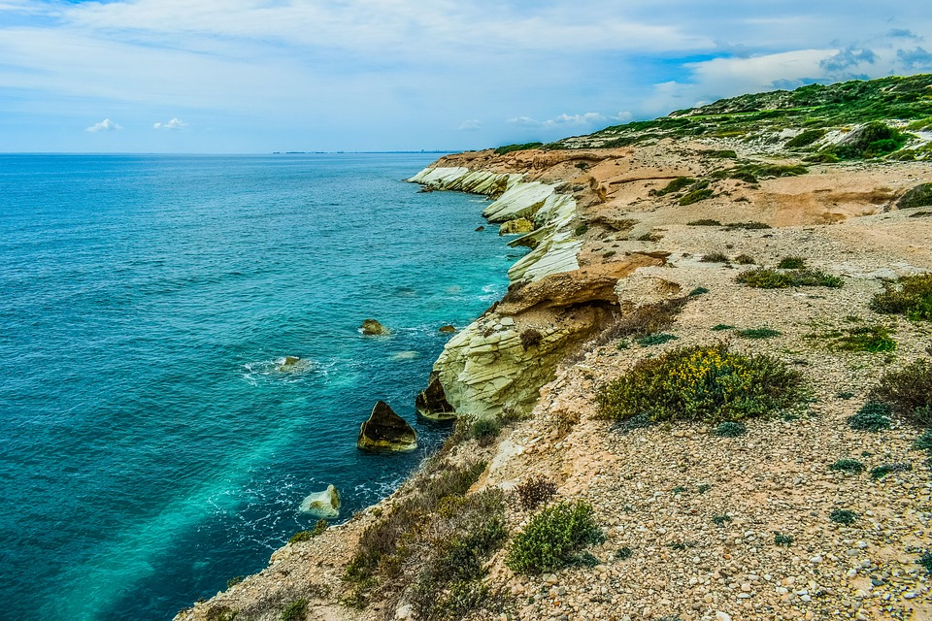
Travel
I love you more than I've ever loved any woman. And I've waited longer for you than I've waited for any woman.
I love you more than I've ever loved any woman. And I've waited longer for you than I've waited for any woman.I love you more than I've ever loved any woman. And I've waited longer for you than I've waited for any woman.

Slide 17


ALL OR NOTHING
NOW OR NEVER
Click here to add your title
I love you more than I've ever loved any woman. And I've waited longer for you than I've waited for any woman.
I love you more than I've ever loved any woman. And I've waited longer for you than I've waited for any woman.I love you more than I've ever loved any woman. And I've waited longer for you than I've waited for any woman.

Slide 18
04
part
标题

Slide 19
TRAVEL
I love you more than I've ever loved any woman. And I've waited longer for you than I've waited for any woman.
I love you more than I've ever loved any woman. And I've waited longer for you than I've waited for any woman.I love you more than I've ever loved any woman. And I've waited longer for you than I've waited for any woman.

Slide 20

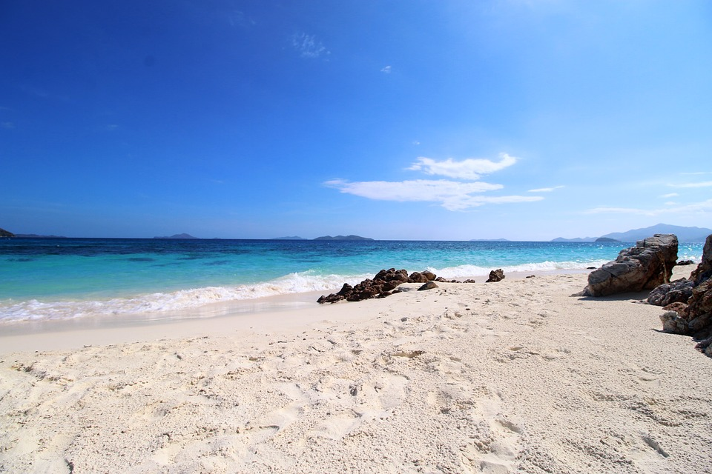
I love you more than I've ever loved any woman. And I've waited longer for you than I've waited for any woman.I love you more than I've ever loved any woman. And I've waited longer for you than I've waited for any woman.
I love you more than I've ever loved any woman. And I've waited longer for you than I've waited for any woman.

Slide 21
THANKS
感谢观看
I love you more than I've ever loved any woman. And I've waited longer for you than I've waited for any woman

