Slide 1
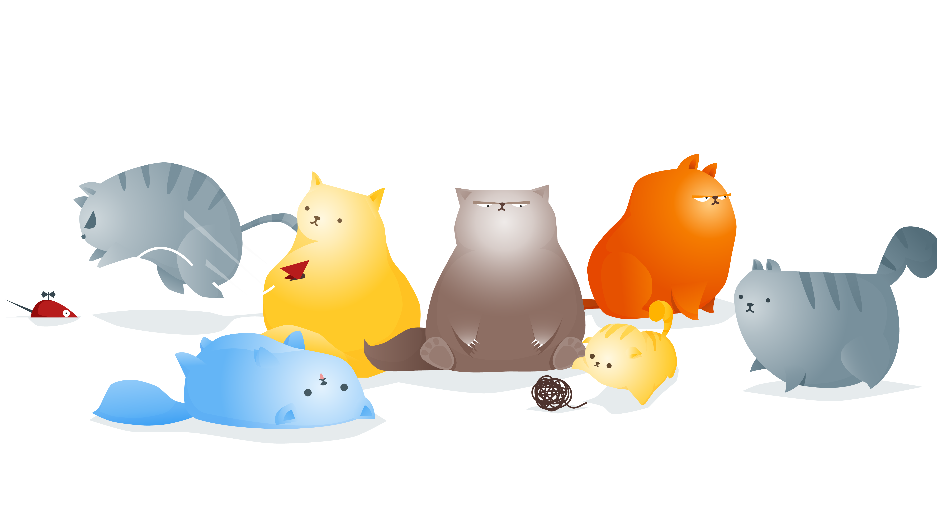
猫咪的幸福生活
THIS IS A ART TEMPLATE ,THE TEMPLATE.THANK YOU WATCHING THIS ONE.

Slide 2
日 常
Just for today I will try to live through this day only and not tackle my whole life problem at once Just for today I will try to live through this day only and not tackle my whole life
Just for today I will try to live through this day only and not tackle my whole life problem at once Just for today I will try to live through this day only and not tackle my whole life

Slide 3
YOUR TITTLE
1
Just for today I will try to live through this day only
YOUR TITTLE
2
Just for today I will try to live through this day only
C O N T E N T S
YOUR TITTLE
3
Just for today I will try to live through this day only
YOUR TITTLE
4
Just for today I will try to live through this day only

Slide 4
01
ADD YOUR TITTLE HERE
THIS IS A ART TEMPLATE ,THE TEMPLATE THANK YOU WATCHING THIS ONE. THIS IS A ART TEMPLATE

Slide 5
章 节 提 要
Just for today I will try to live through this day only and not tackle my whole life problem at once
STEP 01
Just for today I will try to live through this day only and not tackle my whole life problem at once
STEP 02
Just for today I will try to live through this day only and not tackle my whole life problem at once

Slide 6
Just for today I will try to live through this day only and not tackle my whole life problem at once. I can do for twelve hours that hours that Just for today I will try to live through this day only and not tackle my
I will do somebody a good turnJust for today I will try to live through this day only and not tackle my whole three ways. I will do somebody a good turnJust for today I will try to live through this day only and not tackle my whole

Slide 7
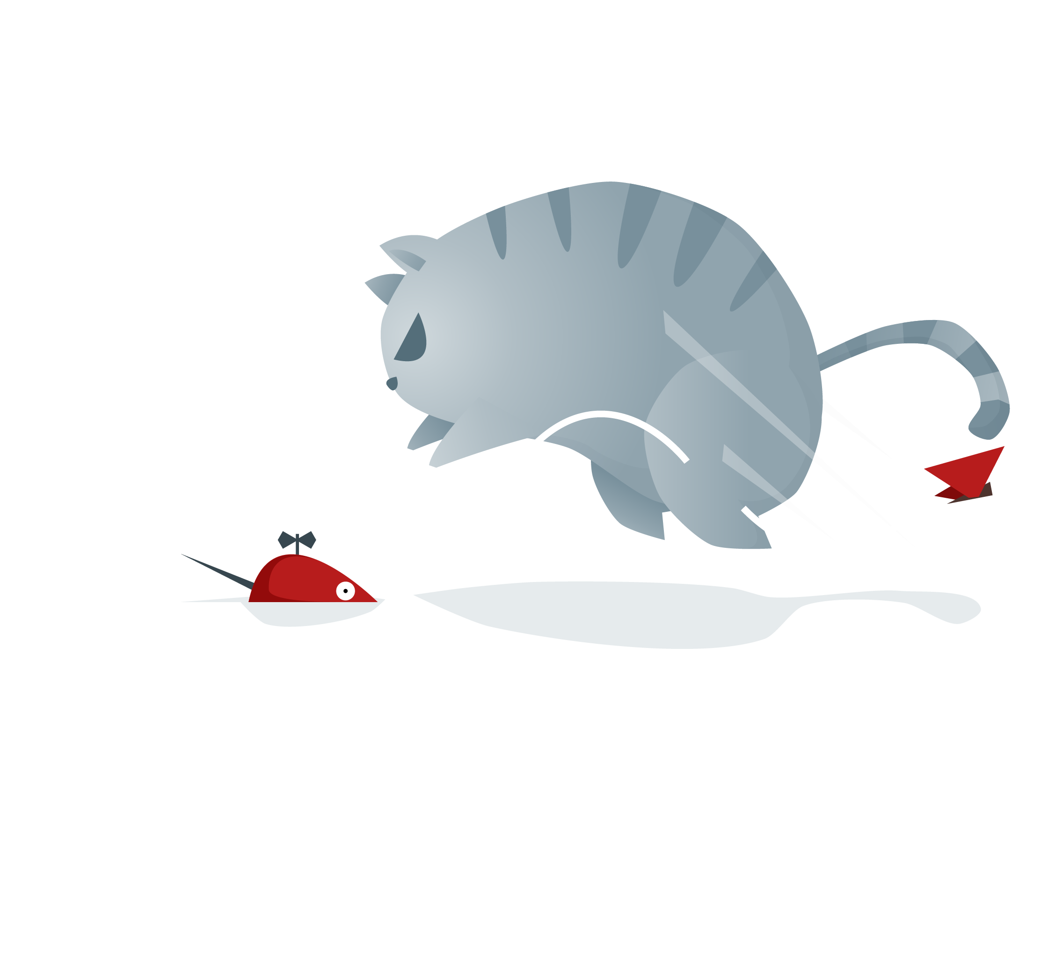
I will do somebody a good turnJust for today I will try to live through this day only and not tackle my whole three ways. I will do somebody a good turnJust for today
I will do somebody a good turnJust for today I will try to live through this day only and not tackle my whole three ways. I will do somebody a good turnJust for today

Slide 8
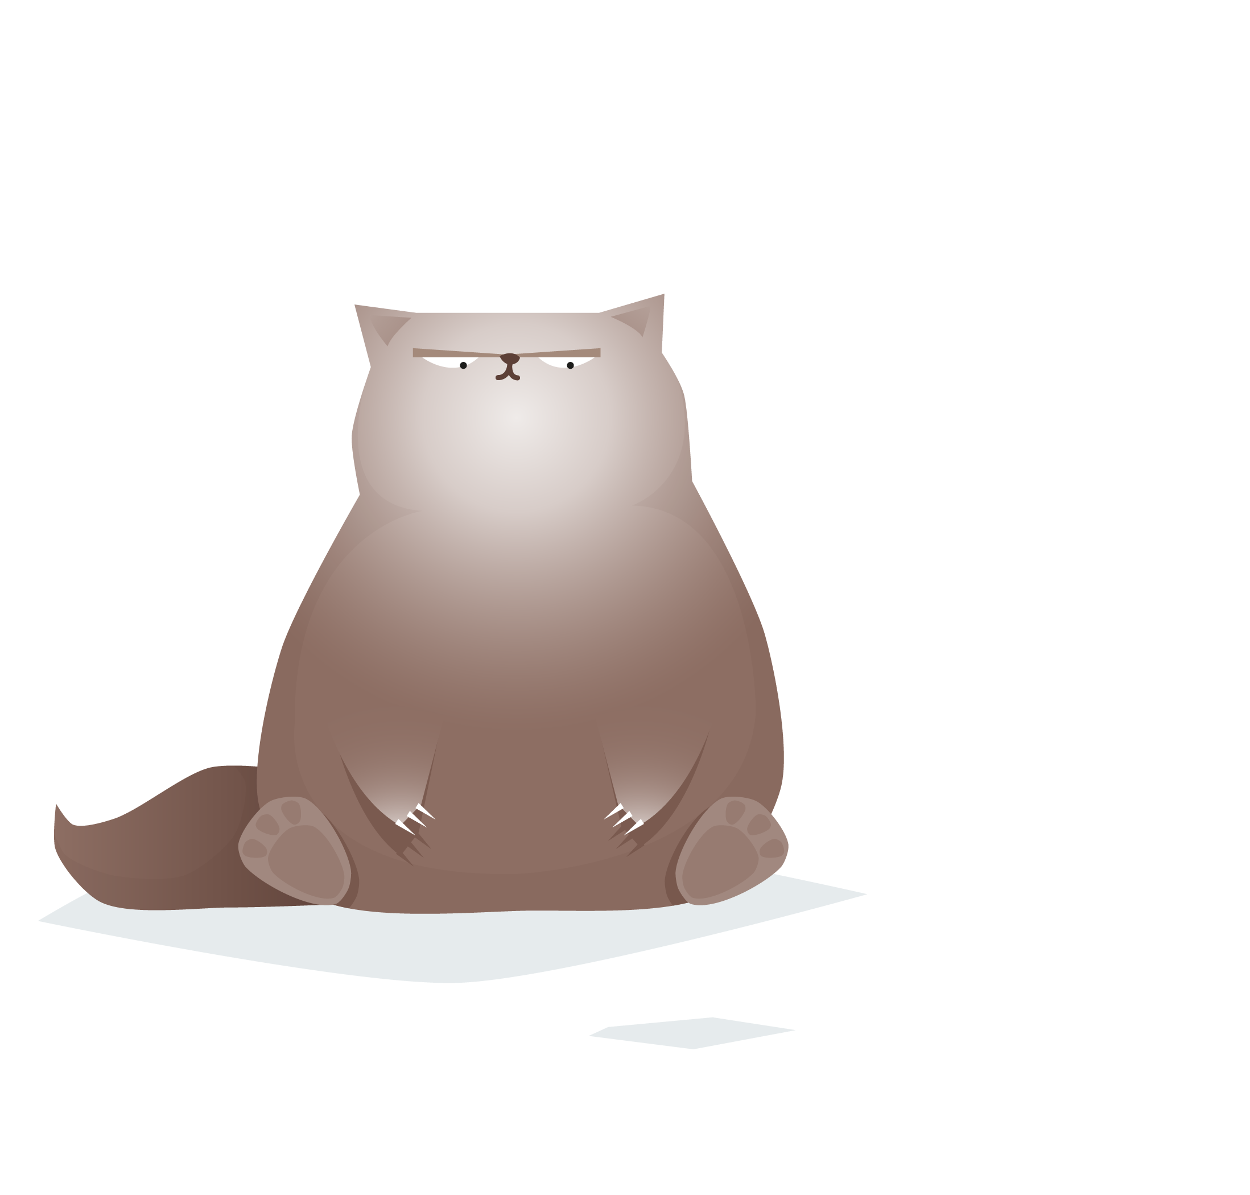
Just for today I will try to live through this day only and not tackle my whole life problem at once Just for today I will try to live through this day only and not tackle my whole life
Just for today I will try to live through this day only and not tackle my whole life problem at once Just for today I will try to live through this day only and not tackle my whole life

Slide 9
02
ADD YOUR TITTLE HERE
THIS IS A ART TEMPLATE ,THE TEMPLATE THANK YOU WATCHING THIS ONE. THIS IS A ART TEMPLATE

Slide 10
章 节 提 要
Just for today I will try to live through this day only and not tackle my whole life problem at once
STEP 01
Just for today I will try to live through this day only and not tackle my whole life problem at once
STEP 02
Just for today I will try to live through this day only and not tackle my whole life problem at once

Slide 11
YOU CAN ADD
YOUR TITTLE HERE
Just for today I will try to live through this day only and not tackle my whole life problem at once. I can do for twelve hours that
Just for today I will try to live through this day only and not tackle my whole life problem at once. I can do for twelve hours that hours that Just for today I will try to live through this day only and not tackle my

Slide 12
TITTLE HERE
TITTLE HERE
The waves beside them danced; but they Out-did the sparkling waves in glee: A poet could not but be gay The waves beside them danced; but they Out-did the
TITTLE HERE
The waves beside them danced; but they Out-did the sparkling waves in glee: A poet could not but be gay The waves beside them danced; but they Out-did the sparkling waves in glee: A poet could not but be gay The waves beside them danced; but they Out-did the sparkling waves in glee: A poet could not but be gay

Slide 13
Just for today I will try to live through this day only and not tackle my whole life problem at once.
Just for today I will try to live through this day only and not tackle my whole life problem at once.
Just for today I will try to live through this day only and not tackle my whole life problem at once.
Just for today I will try to live through this day only and not tackle my whole life problem at once.

Slide 14
03
ADD YOUR TITTLE HERE
THIS IS A ART TEMPLATE ,THE TEMPLATE THANK YOU WATCHING THIS ONE. THIS IS A ART TEMPLATE

Slide 15
章 节 提 要
Just for today I will try to live through this day only and not tackle my whole life problem at once
STEP 01
Just for today I will try to live through this day only and not tackle my whole life problem at once
STEP 02
Just for today I will try to live through this day only and not tackle my whole life problem at once

Slide 16
I will do somebody a good turnJust for today I will try to live through this day only and not tackle my whole three ways. I will do somebody a good turnJust for today
I will do somebody a good turnJust for today I will try to live through this day only and not tackle my whole three ways. I will do somebody a good turnJust for today

Slide 17
ADD YOUR TITTLE HERE
THIS IS A ART TEMPLATE ,THE TEMPLATE. THANK YOU WATCHING THIS ONE.
STEP 01
STEP 02
STEP 03
STEP 04
Just for today I will try to live through this day only and not tackle my whole life problem at once
Just for today I will try to live through this day only and not tackle my whole life problem at once
Just for today I will try to live through this day only and not tackle my whole life problem at once
Just for today I will try to live through this day only and not tackle my whole life problem at once

Slide 18
YOU CAN ADD
YOUR TITTLE HERE
Just for today I will try to live through this day only and not tackle my whole life problem at once. I can do for twelve hours that
Just for today I will try to live through this day only and not tackle my whole life problem at once. I can do for twelve hours that hours that Just for today I will try to live through this day only and not tackle my

Slide 19
04
ADD YOUR TITTLE HERE
THIS IS A ART TEMPLATE ,THE TEMPLATE THANK YOU WATCHING THIS ONE. THIS IS A ART TEMPLATE

Slide 20
章 节 提 要
Just for today I will try to live through this day only and not tackle my whole life problem at once
STEP 01
Just for today I will try to live through this day only and not tackle my whole life problem at once
STEP 02
Just for today I will try to live through this day only and not tackle my whole life problem at once

Slide 21
YOU CAN ADD
YOUR TITTLE HERE
Just for today I will try to live through this day only and not tackle my whole life problem at once. I can do for twelve hours that
Just for today I will try to live through this day only and not tackle my whole life problem at once. I can do for twelve hours that hours that Just for today I will try to live through this day only and not tackle my

Slide 22
请输入你的题目
请输入你的题目
请输入你的题目
请输入你的题目
Just for today I will try to live through this day only and not tackle my whole life problem at once. Just for today I will try to live through this day only and not tackle my whole
Just for today I will try to live through this day only and not tackle my whole life problem at once. Just for today I will try to live through
Just for today I will try to live through this day only and not tackle my whole life problem at once. Just for today I will try
Just for today I will try to live through this day only and not tackle my whole life problem at once. Just for today I will try to live

Slide 23
01
Just for today I will try to live through this day only and not tackle my whole life problem at once
02
Just for today I will try to live through this day only and not tackle my whole life problem at once
03
Just for today I will try to live through this day only and not tackle my whole life problem at once
04
Just for today I will try to live through this day only and not tackle my whole life problem at once
05
Just for today I will try to live through this day only and not tackle my whole life problem at once
06
Just for today I will try to live through this day only and not tackle my whole life problem at once

Slide 24
感谢猫奴们
THIS IS A ART TEMPLATE ,THE TEMPLATE.THANK YOU WATCHING THIS ONE.

