Slide 1
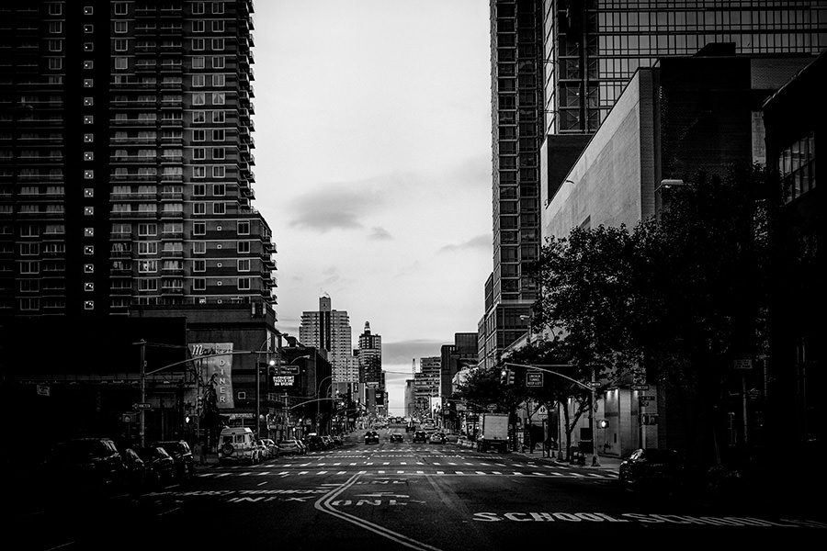
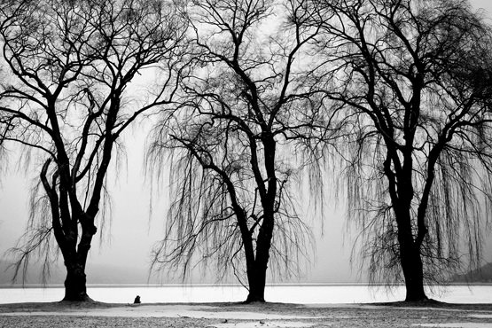

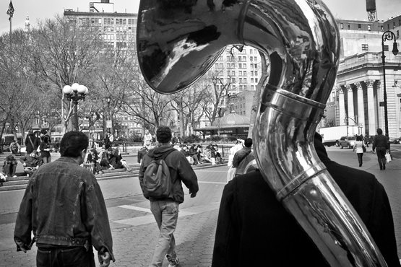
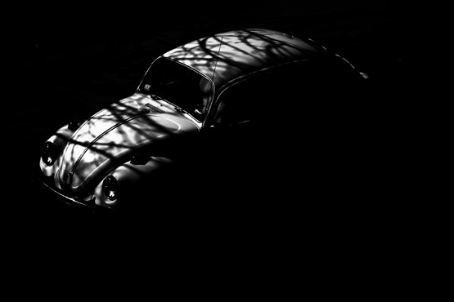
作品展示
相册类PPT模板
好客模板
www.haoke.com
Far far away, behind the word mountains, far from the countries Vokalia and Consonantia, there live the blind texts. Separated they live in Bookmarksgrove right at the coast of the Semantics, a large language ocean.

Slide 2

Far far away, behind the word mountains, far from the countries Vokalia and Consonantia, there live the blind texts. Separated they live in Bookmarksgrove right at the coast of the Semantics, a large language ocean.
A small river named Duden flows by their place and supplies it with the necessary regelialia. It is a paradisematic country.
左侧
图片展示

Slide 3
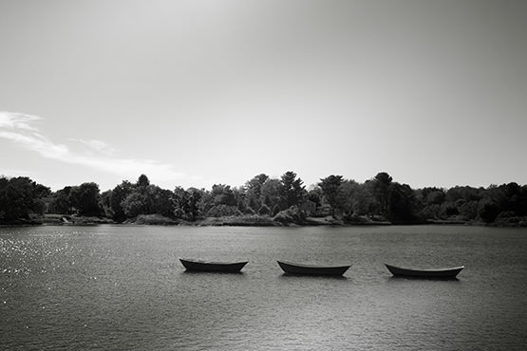
图片
标题在这里
Far far away, behind the word mountains, far from the countries Vokalia and Consonantia, there live the blind texts. Separated they live in Bookmarksgrove right at the coast of the Semantics, a large language ocean.
A small river named Duden flows by their place and supplies it with the necessary regelialia. It is a paradisematic country.

Slide 4
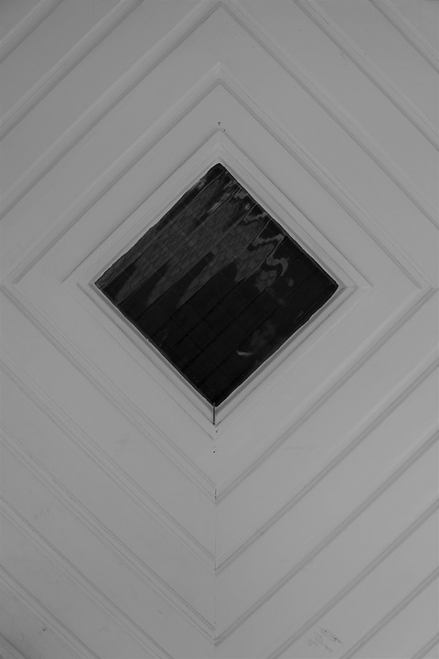
放置于
中间地区的
图片展示
作品名称
值得
描述的标题内容
Far far away, behind the word mountains, far from the countries Vokalia and Consonantia, there live the blind texts. Separated they live in Bookmarksgrove right at the coast of the Semantics, a large language ocean.
Far far away, behind the word mountains, far from the countries Vokalia and Consonantia, there live the blind texts. Separated they live in Bookmarksgrove right at the coast of the Semantics, a large language ocean.

Slide 5

作品展示
标题
相册
演示
产品展示
Far far away, behind the word mountains, far from the countries Vokalia and Consonantia, there live the blind texts. Separated they live in Bookmarksgrove right at the coast of the Semantics, a large language ocean.
A small river named Duden flows by their place and supplies it with the necessary regelialia. It is a paradisematic country.
- The Quotes
Far far away, behind the word mountains, far from the countries Vokalia and Consonantia, there live the blind texts. Separated they live in Bookmarksgrove right at the coast of the Semantics, a large language ocean.

Slide 6
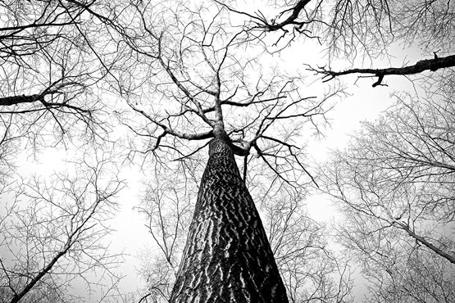
左侧
大图演示
填充
YOUR
TITLE HERE
Far far away, behind the word mountains, far from the countries Vokalia and Consonantia, there live the blind texts. Separated they live in Bookmarksgrove right at the coast of the Semantics, a large language ocean.
A small river named Duden flows by their place and supplies it with the necessary regelialia. It is a paradisematic country.
- The Quotes

Slide 7
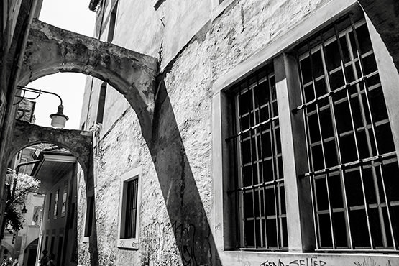
大背景
加上
顶层的文字
Far far away, behind the word mountains, far from the countries Vokalia and Consonantia, there live the blind texts. Separated they live in Bookmarksgrove right at the coast of the Semantics, a large language ocean.
A small river named Duden flows by their place and supplies it with the necessary regelialia. It is a paradisematic country.

Slide 8

+
右侧
图片展示
Far far away, behind the word mountains, far from the countries Vokalia and Consonantia, there live the blind texts. Separated they live in Bookmarksgrove right at the coast of the Semantics, a large language ocean.
A small river named Duden flows by their place and supplies it with the necessary regelialia. It is a paradisematic country.

Slide 9
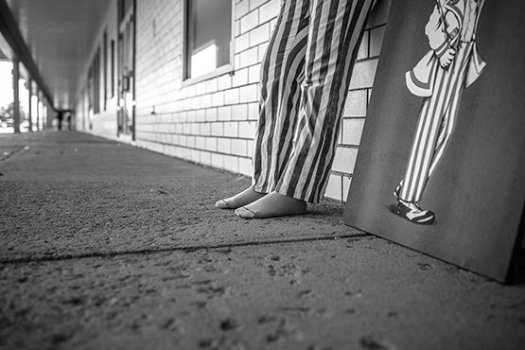
上方和下方
的图片和作品展示
Far far away, behind the word mountains, far from the countries Vokalia and Consonantia, there live the blind texts. Separated they live in Bookmarksgrove right at the coast of the Semantics, a large language ocean.
A small river named Duden flows by their place and supplies it with the necessary regelialia. It is a paradisematic country.
公司项目
展示和报告
85%
85%
Far far away, behind the word mountains, far from the countries Vokalia and Consonantia, there live the blind texts.
Far far away, behind the word mountains, far from the countries Vokalia and Consonantia, there live the blind texts.

Slide 10

大照片
焦点作品展示页面
Far far away, behind the word mountains, far from the countries Vokalia and Consonantia, there live the blind texts.
Sign
Beautiful slide

Slide 11
标题
文字描述内容
85%
Far far away, behind the word mountains, far from the countries Vokalia and Consonantia, there live the blind texts. Separated they live in Bookmarksgrove right at the coast of the Semantics, a large language ocean.

Slide 12
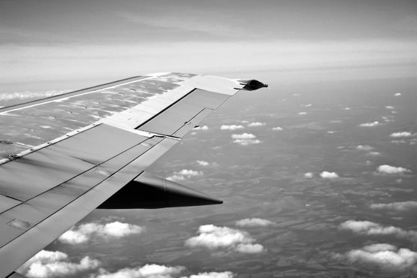
三图
作品展示
相册
Far far away, behind the word mountains, far from the countries Vokalia and Consonantia, there live the blind texts. Separated they live in Bookmarksgrove right at the coast of the Semantics, a large language ocean.
85%
Far far away, behind the word mountains, far from the countries Vokalia and Consonantia, there live the blind texts. Separated they live in Bookmarksgrove right at the coast of the Semantics, a large language ocean.
Sign

Slide 13


两张
对比展示
左右侧
Sign
Far far away, behind the word mountains, far from the countries Vokalia and Consonantia, there live the blind texts. Separated they live in Bookmarksgrove right at the coast of the Semantics, a large language ocean.
85%

Slide 14
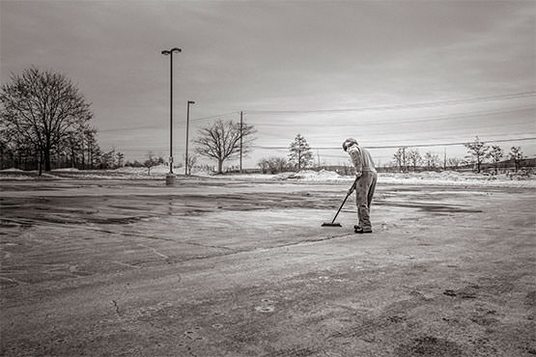
HORIZONTAL PICTURE
图片标题
Far far away, behind the word mountains, far from the countries Vokalia and Consonantia, there live the blind texts. Separated they live in Bookmarksgrove right at the coast of the Semantics, a large language ocean.
A small river named Duden flows by their place and supplies it with the necessary regelialia. It is a paradisematic country.
Sign

Slide 15
整张图片
遮罩展示风格
Break slide
Break slide

Slide 16
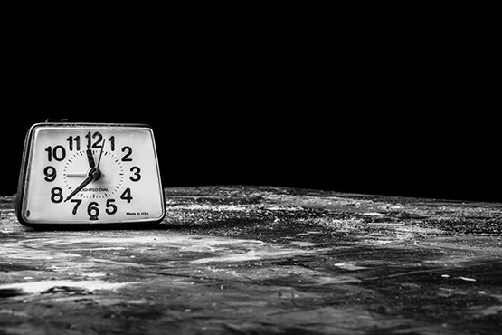
两张
右上左下
展示页面
YOUR TITLE
Far far away, behind the word mountains, far from the countries Vokalia and Consonantia, there live the blind texts. Separated they live in Bookmarksgrove right at the coast of the Semantics, a large language ocean.
A small river named Duden flows by their place and supplies it with the necessary regelialia. It is a paradisematic country.

Slide 17
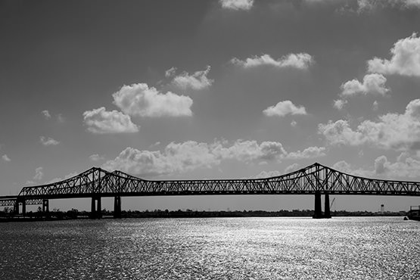
三张并排
YOUR TITLE
YOUR TITLE
YOUR TITLE
Far far away, behind the word mountains, far from the countries Vokalia and Consonantia.
Far far away, behind the word mountains, far from the countries Vokalia and Consonantia.
Far far away, behind the word mountains, far from the countries Vokalia and Consonantia.

Slide 18
四张图片展示页面
Far far away, behind the word mountains, far from the countries Vokalia and Consonantia, there live the blind texts. Separated they live in Bookmarksgrove right at the coast of the Semantics, a large language ocean.
A small river named Duden flows by their place and supplies it with the necessary regelialia. It is a paradisematic country.
Sign

Slide 19

创意
单张图片
左侧展示页面
ABOUT
ME
Far far away, behind the word mountains, far from the countries Vokalia and Consonantia, there live the blind texts. Separated they live in Bookmarksgrove right at the coast of the Semantics, a large language ocean.
- The Quotes
Photoshop
85%
Illustrator
70%

Slide 20
不规则图片
作品
Far far away, behind the word mountains, far from the countries Vokalia and Consonantia, there live the blind texts. Separated they live in Bookmarksgrove right at the coast of the Semantics, a large language ocean.

YOUR TITLE
Far far away, behind the word mountains, far from the countries Vokalia and Consonantia.

Slide 21

Far far away, behind the word mountains, far from the countries Vokalia and Consonantia, there live the blind texts. Separated they live in Bookmarksgrove right at the coast of the Semantics, a large language ocean.
A small river named Duden flows by their place and supplies it with the necessary regelialia. It is a paradisematic country.
右侧
作品展示

Slide 22
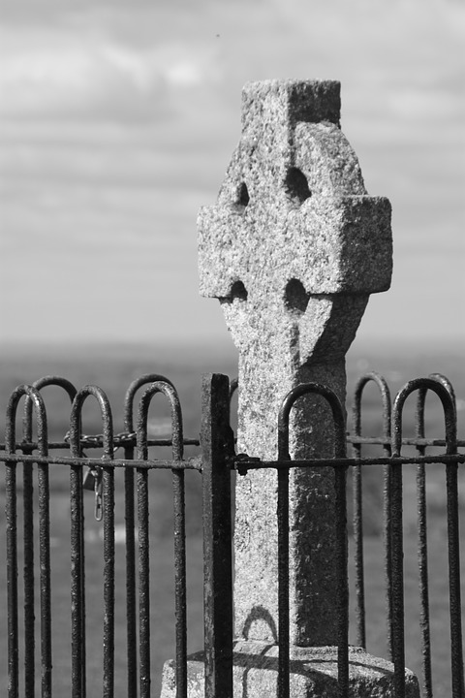
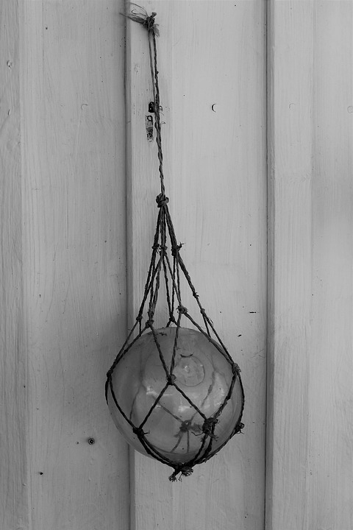
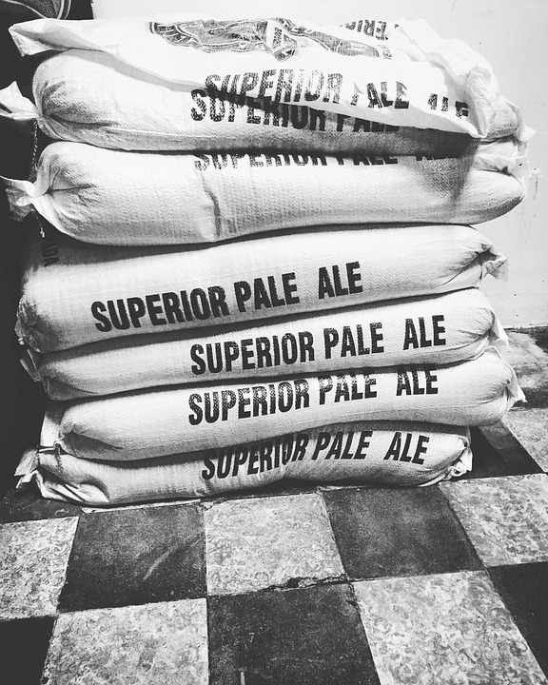
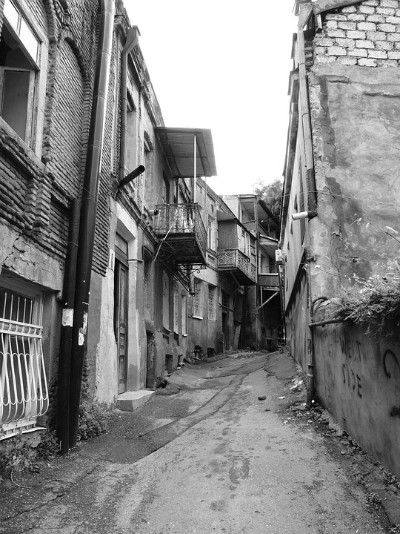
图片标题
图片标题
Far far away, behind the word mountains, far from the countries Vokalia and Consonantia, there live the blind texts.
Far far away, behind the word mountains, far from the countries Vokalia and Consonantia, there live the blind texts.
图片标题
图片标题
Far far away, behind the word mountains, far from the countries Vokalia and Consonantia, there live the blind texts.
Far far away, behind the word mountains, far from the countries Vokalia and Consonantia, there live the blind texts.

Slide 23
不规则图形
和遮罩
Far far away, behind the word mountains, far from the countries Vokalia and Consonantia, there live the blind texts. Separated they live in Bookmarksgrove right at the coast of the Semantics, a large language ocean.
- The Quotes
Photoshop
85%
Illustrator
70%

Slide 24
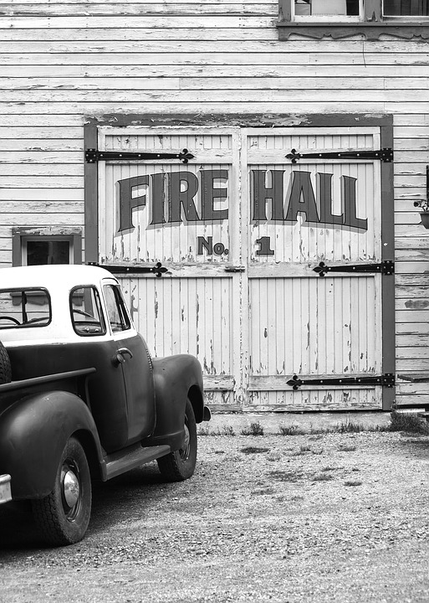
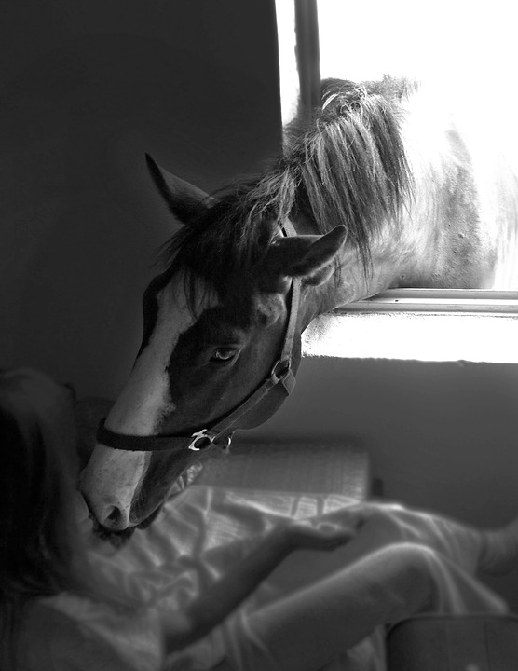
三张多边形
YOUR TITLE
YOUR TITLE
Photoshop
YOUR TITLE
Photoshop
Illustrator
Illustrator
Photoshop
Illustrator

Slide 25
大图一张
Far far away, behind the word mountains, far from the countries Vokalia and Consonantia, there live the blind texts. Separated they live in Bookmarksgrove right at the coast of the Semantics, a large language ocean.
- The Quotes
Far far away, behind the word mountains, far from the countries Vokalia and Consonantia, there live the blind texts. Separated they live in Bookmarksgrove right at the coast of the Semantics, a large language ocean.
- The Quotes
你的标题
写在这里

Slide 26
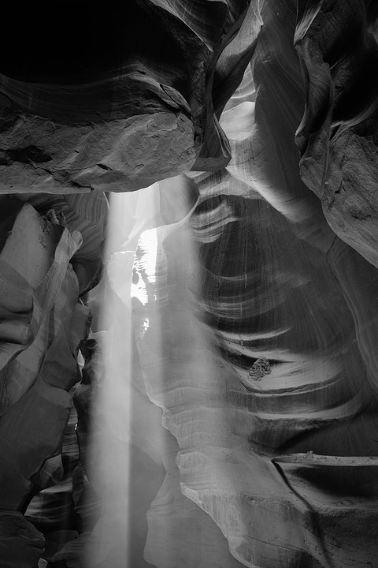
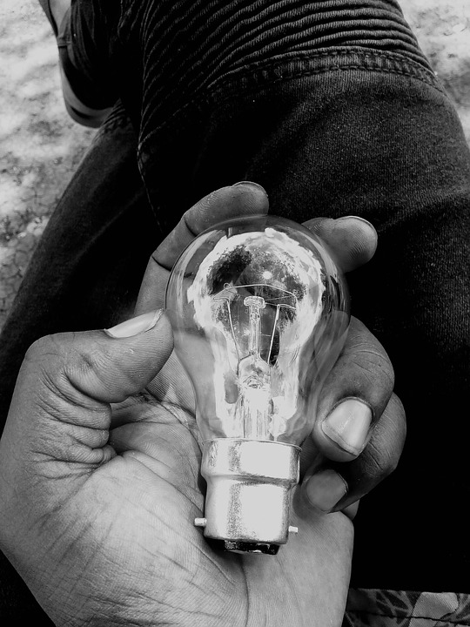
移动设备图片展示
Far far away, behind the word mountains, far from the countries Vokalia and Consonantia, there live the blind texts. Separated they live in Bookmarksgrove right at the coast of the Semantics, a large language ocean. A small river named Duden flows by their place and supplies it with the necessary regelialia. It is a paradisematic country.

Slide 27
图片标题
Far far away, behind the word mountains, far from the countries Vokalia and Consonantia, there live the blind texts. Separated they live in Bookmarksgrove right at the coast of the Semantics, a large language ocean.
A small river named Duden flows by their place and supplies it with the necessary regelialia. It is a paradisematic country.
Sign

Slide 28
不规则
图形
Far far away, behind the word mountains, far from the countries Vokalia and Consonantia, there live the blind texts. Separated they live in Bookmarksgrove right at the coast of the Semantics, a large language ocean. A small river named Duden flows by their place and supplies it with the necessary regelialia. It is a paradisematic country.
85%
Far far away, behind the word mountains, far from the countries Vokalia and Consonantia, there live the blind texts.
85%
Far far away, behind the word mountains, far from the countries Vokalia and Consonantia, there live the blind texts.

Slide 29
大背景
图片一张
Break slide
Break slide

Slide 30
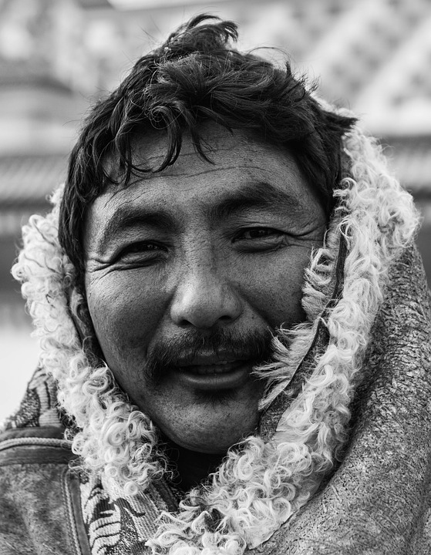
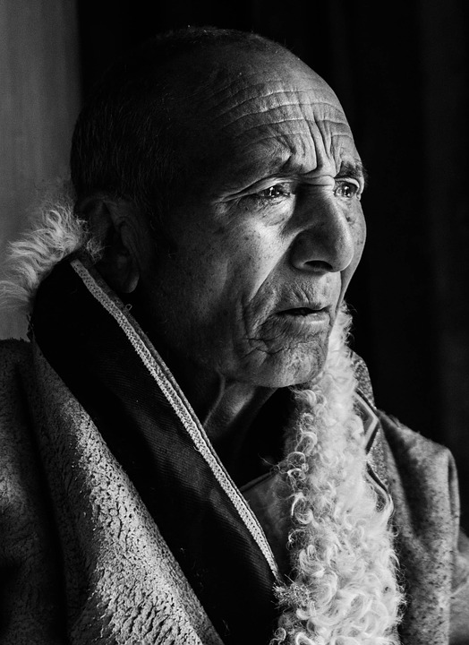
中
间
Far far away, behind the word mountains, far from the countries Vokalia and Consonantia, there live the blind texts. Separated they live in Bookmarksgrove.
Far far away, behind the word mountains, far from the countries Vokalia and Consonantia, there live the blind texts. Separated they live in Bookmarksgrove.
Sign

Slide 31

三张
图片展示
或者作品报告
Photoshop
85%
Illustrator
70%
Photoshop
85%
Illustrator
70%

Slide 32

图片
标题或说明
Far far away, behind the word mountains, far from the countries Vokalia and Consonantia, there live the blind texts. Separated they live in Bookmarksgrove right at the coast of the Semantics, a large language ocean.
A small river named Duden flows by their place and supplies it with the necessary regelialia. It is a paradisematic country.

Slide 33

创意标题
作品说明
右侧
图片展示
85%
Far far away, behind the word mountains, far from the countries Vokalia and Consonantia, there live the blind texts. Separated they live in Bookmarksgrove right at the coast of the Semantics, a large language ocean.
Sign

Slide 34
www.docer.com
SUBTITLE HERE
四张横向并排图片
Far far away, behind the word mountains, far from the countries Vokalia and Consonantia, there live the blind texts. Separated they live in Bookmarksgrove right at the coast of the Semantics, a large language ocean. A small river named Duden flows by their place and supplies it with the necessary regelialia. It is a paradisematic country.

Slide 35
大图一张
Far far away, behind the word mountains, far from the countries Vokalia and Consonantia, there live the blind texts.
Sign

Slide 36
不规则
图片一张展示
YOUR TITLE
Far far away, behind the word mountains, far from the countries Vokalia and Consonantia.
YOUR TITLE
Far far away, behind the word mountains, far from the countries Vokalia and Consonantia.
YOUR TITLE
Far far away, behind the word mountains, far from the countries Vokalia and Consonantia.

Slide 37
SUBTITLE HERE
大背景图片一张
Break slide
Break slide

Slide 38
左侧图片
展示
Far far away, behind the word mountains, far from the countries Vokalia and Consonantia, there live the blind texts. Separated they live in Bookmarksgrove right at the coast of the Semantics, a large language ocean.
Far far away, behind the word mountains, far from the countries Vokalia and Consonantia, there live the blind texts. Separated they live in Bookmarksgrove right at the coast of the Semantics, a large language ocean.
- The Quotes
Sign

Slide 39
笔记本电脑
展示
Far far away, behind the word mountains, far from the countries Vokalia and Consonantia, there live the blind texts. Separated they live in Bookmarksgrove.
Sign

Slide 40
平板电脑
模型展示
Far far away, behind the word mountains, far from the countries Vokalia and Consonantia, there live the blind texts. Separated they live in Bookmarksgrove right at the coast of the Semantics, a large language ocean.
- The Quotes

Slide 41
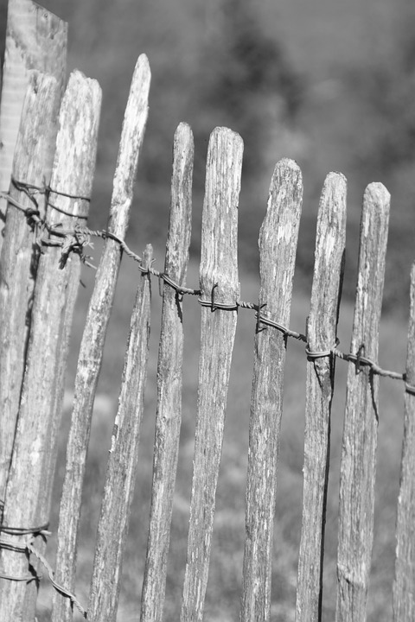
手机
模型图片展示
Far far away, behind the word mountains, far from the countries Vokalia and Consonantia, there live the blind texts. Separated they live in Bookmarksgrove right at the coast of the Semantics, a large language ocean.
- The Quotes

Slide 42
图表展示
Far far away, behind the word mountains, far from the countries Vokalia.
Far far away, behind the word mountains, far from the countries Vokalia.
Far far away, behind the word mountains, far from the countries Vokalia.
Far far away, behind the word mountains, far from the countries Vokalia.

Slide 43
圆形
图表展示
Far far away, behind the word mountains, far from the countries Vokalia and Consonantia, there live the blind texts. Separated they live in Bookmarksgrove right at the coast of the Semantics, a large language ocean.
- The Quotes
Sign

Slide 44
标题
在这里

Slide 45
进度条风格
图表展示
Far far away, behind the word mountains, far from the countries Vokalia and Consonantia, there live the blind texts. Separated they live in Bookmarksgrove right at the coast of the Semantics, a large language ocean.
- The Quotes

Slide 46
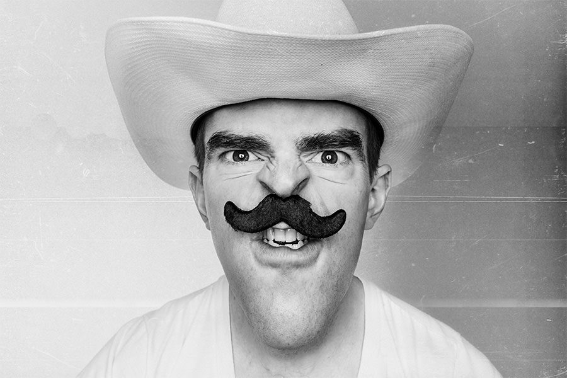
标题内容在这里
SUBTITLE HERE
THANK YOU
Sign
谢谢您的浏览

