Slide 1
BUSINESS TEMPLATE
可爱儿童课件框架模板
Just for today I will try to live through this day only
and not tackle my whole life problem at once. Just for today I will try to live through this day only and not tackle my whole life problem at once.

Slide 2
ADD YOUR TITTLE HERE
0 1
您的内容打在这里，或者通过复制您的文本后，在此框中选择粘贴，并选择只保留文字。
ADD YOUR TITTLE HERE
目 录
0 2
您的内容打在这里，或者通过复制您的文本后，在此框中选择粘贴，并选择只保留文字。
ADD YOUR TITTLE HERE
0 3
您的内容打在这里，或者通过复制您的文本后，在此框中选择粘贴，并选择只保留文字。
ADD YOUR TITTLE HERE
0 4
您的内容打在这里，或者通过复制您的文本后，在此框中选择粘贴，并选择只保留文字。

Slide 3
ADD YOUR TITTLE HERE
0 1
您的内容打在这里，或者通过复制您的文本后，在此框中选择粘贴，并选择只保留文字。

Slide 4
Just for today I will try to live through this day only and not tackle my whole life problem at once. I can do for twelve hours that Just for today I will try to live through this day. Just for today I will try to live through this day only and not tackle my whole life problem at once.
ART TEMPLATE

Slide 5
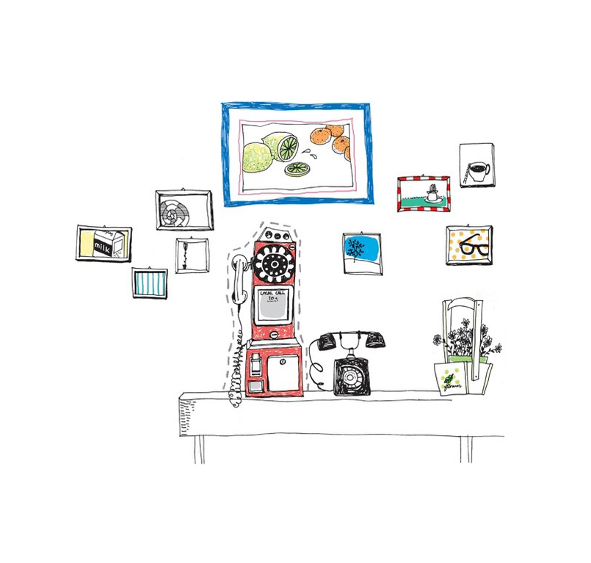
ADD YOUR TITTLE HERE
STEP 01
Just for today I will try to live through this day only and not tackle my whole life problem at once
STEP 02
Just for today I will try to live through this day only and not tackle my whole life problem at once
STEP 03
Just for today I will try to live through this day only and not tackle my whole life problem at once
STEP 04
Just for today I will try to live through this day only and not tackle my whole life problem at once

Slide 6
SUBTITLE
CLICK HERE TO ADD YOUR CONTENTS
SUBTITLE
CLICK HERE TO ADD YOUR CONTENTS
Just for today I will try to live through this day only and not tackle my whole life problem at once. I can do for twelve hours that Just for today I will try to live through this day

Slide 7
SUBTITLE
CLICK HERE TO ADD YOUR CONTENTS
SUBTITLE
CLICK HERE TO ADD YOUR CONTENTS
Just for today I will try to live through this day only and not tackle my whole life problem at once. I can do for twelve hours that Just for today I will try to live through this day

Slide 8
ADD YOUR TITTLE HERE
0 2
您的内容打在这里，或者通过复制您的文本后，在此框中选择粘贴，并选择只保留文字。

Slide 9
THIS IS A REMO TEMPLATE ,THANK YOU WATCHING THIS ONE.THIS IS A REMO TEMPLATE ,THANK YOU WATCHING THIS ONE.
Just for today I will try to live through this day only and not tackle my whole life problem at once. I can do for twelve hours that Just for today I will try to live through this day. Just for today I will try to live through this day only and not tackle my whole life problem at once.
ART TEMPLATE

Slide 10
0 1
Just for today I will try to live through this day only and not tackle my whole life problem at once.
0 2
Just for today I will try to live through this day only and not tackle my whole life problem at once.
0 3
Just for today I will try to live through this day only and not tackle my whole life problem at once.
0 4
Just for today I will try to live through this day only and not tackle my whole life problem at once.

Slide 11
ADD YOUR TITTLE HERE
STEP 01
STEP 02
Just for today I will try to live through this day only and not tackle my whole
Just for today I will try to live through this day only and not tackle my whole
STEP 03
STEP 04
Just for today I will try to live through this day only and not tackle my whole
Just for today I will try to live through this day only and not tackle my whole

Slide 12
ADD YOUR TITTLE HERE
0 3
您的内容打在这里，或者通过复制您的文本后，在此框中选择粘贴，并选择只保留文字。

Slide 13
ADD TITLE HERE
ADD TITLE HERE
hours that Just for today I will try to live through this day only and not tackle my whole life problem at once. I can do for twelve hours that
hours that Just for today I will try to live through this day only and not tackle my whole life problem at once. I can do for twelve hours that
Just for today I will try to live through this day only and not tackle my whole life problem at once. I can do for twelve hours that Just for today I will try to live through this day

Slide 14
ADD YOUR TITTLE HERE
0 4
您的内容打在这里，或者通过复制您的文本后，在此框中选择粘贴，并选择只保留文字。

Slide 15
ADD YOUR TITLE
ADD YOUR TITLE
ADD YOUR TITLE
ADD YOUR TITLE
Click here to enter your text messages click here to enter your text messages
Click here to enter your text messages click here to enter your text messages
Click here to enter your text messages click here to enter your text messages
Click here to enter your text messages click here to enter your text messages

Slide 16
BUSINESS TEMPLATE
感 谢 您 的 观 看
Just for today I will try to live through this day only
and not tackle my whole life problem at once. Just for today I will try to live through this day only and not tackle my whole life problem at once.

