Slide 1
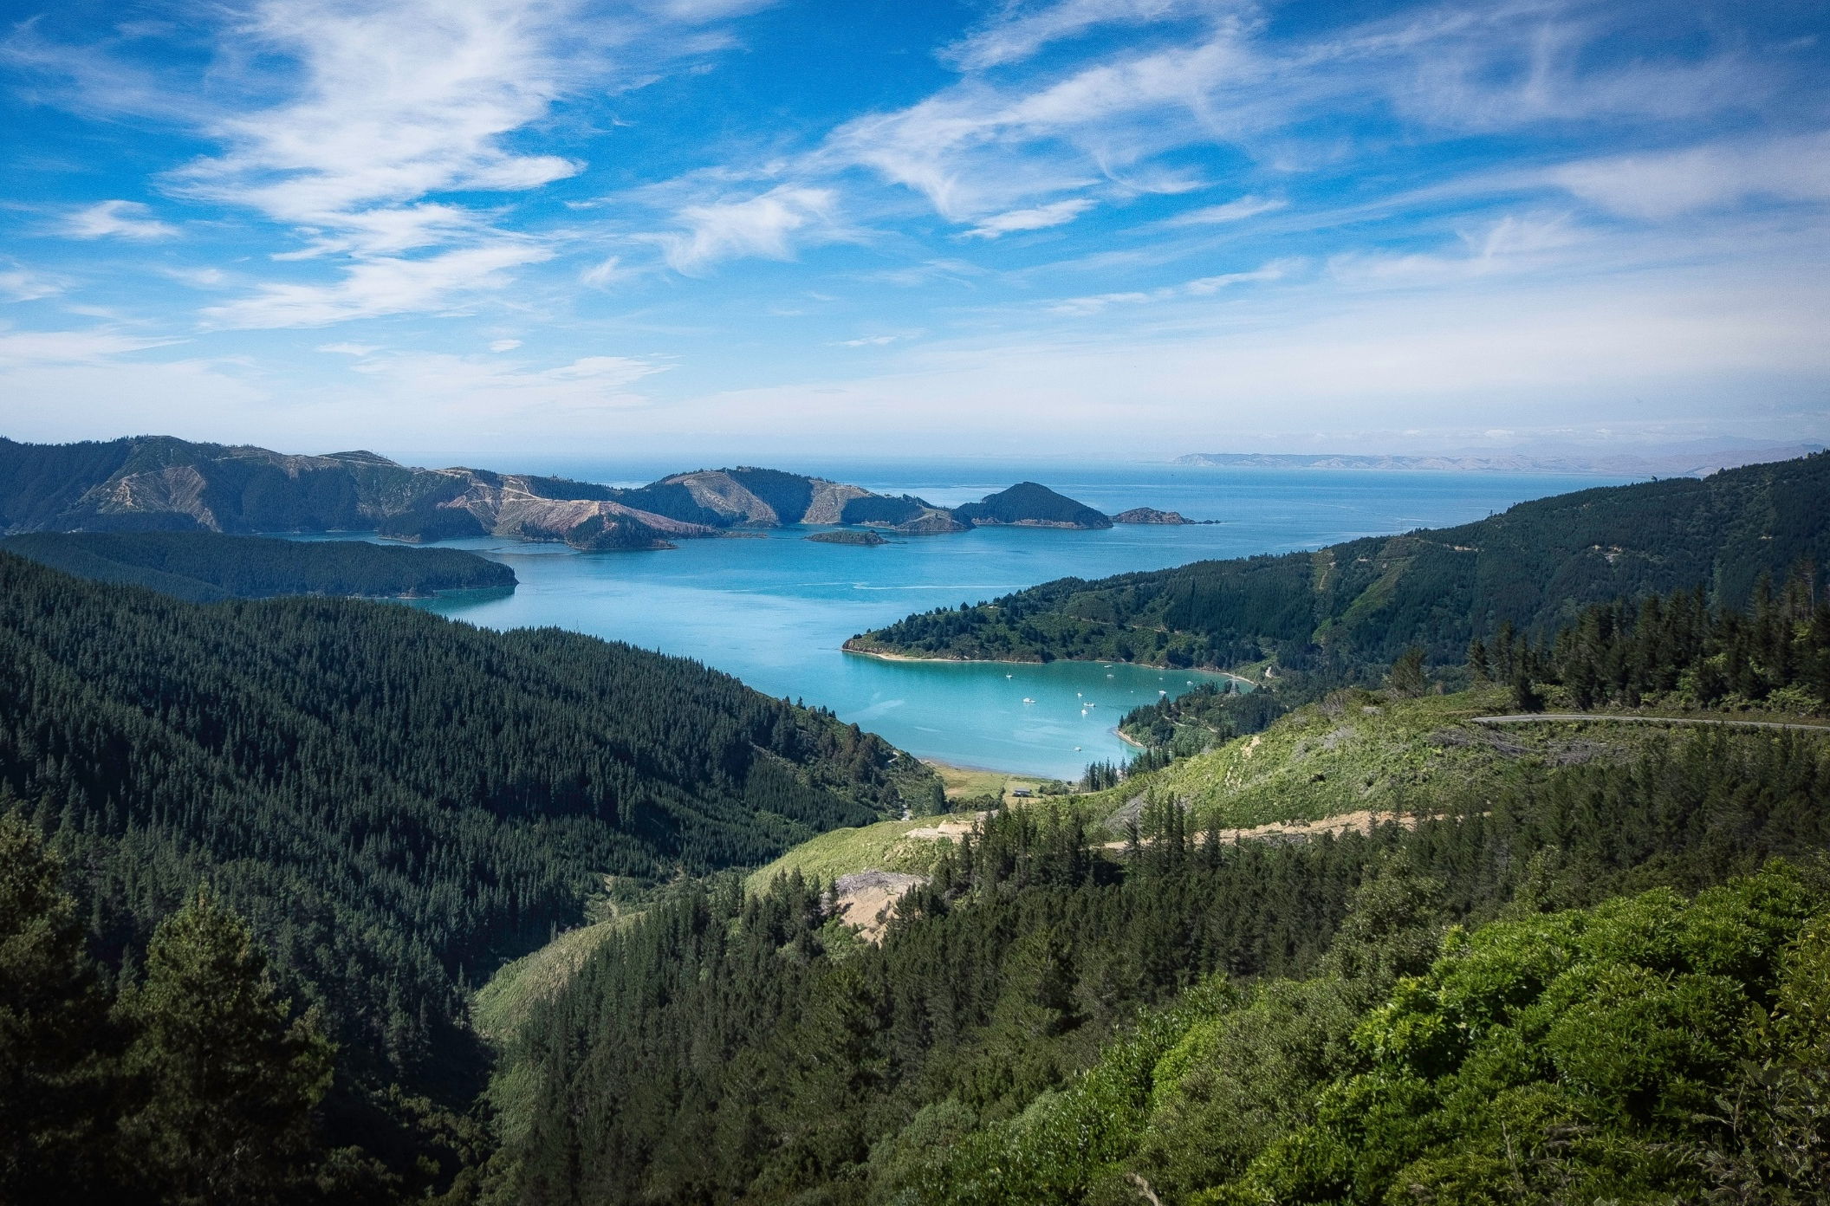
山川
河流
杂志画册风PPT通用模板
Click here to input the
replacement text and suggest replacing
it with this speech

Slide 2
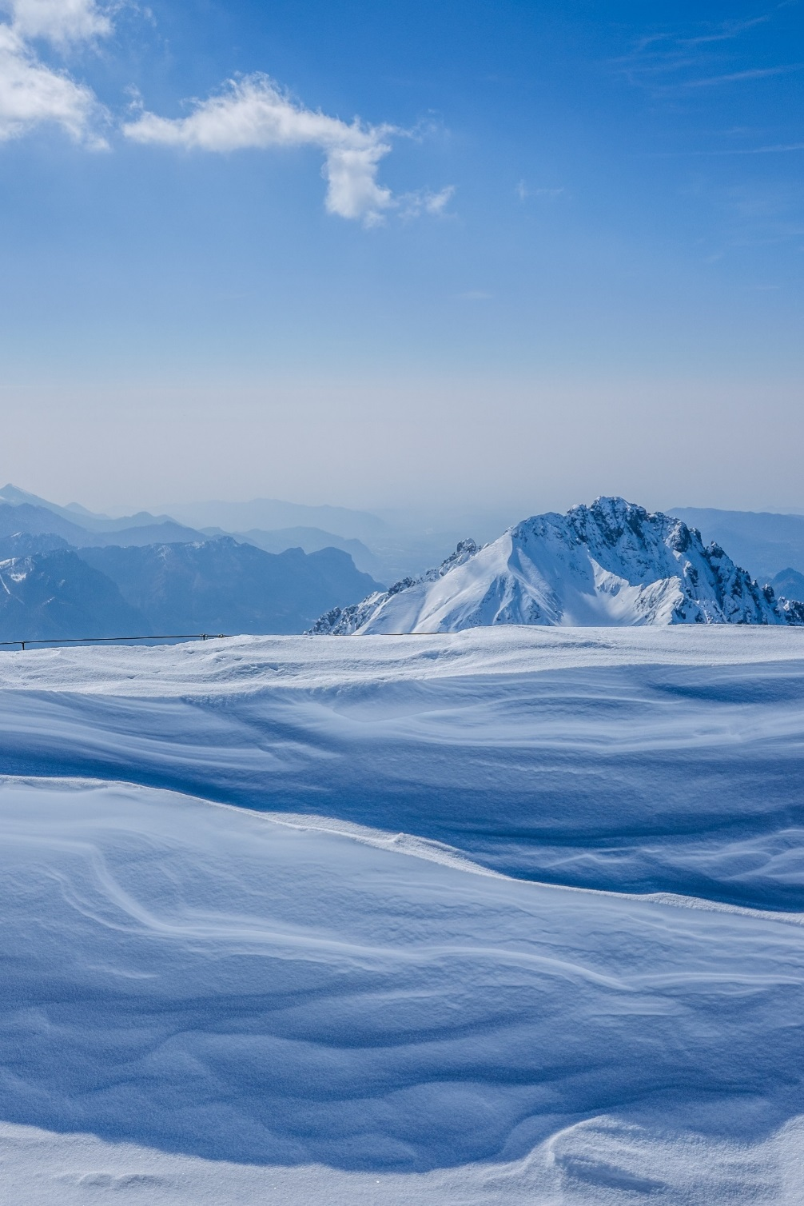
关于我们
About us
My working week and my Sunday rest, My noon,my midnight, my talk, my song;
I thought that love would last forever; I was wrong.
The stars are not wanted now:
put out every one; Pack up the moon and dismantle the sun;
Pour away the ocean and sweep up the wood;
For nothing now can ever come to any good.

Slide 3
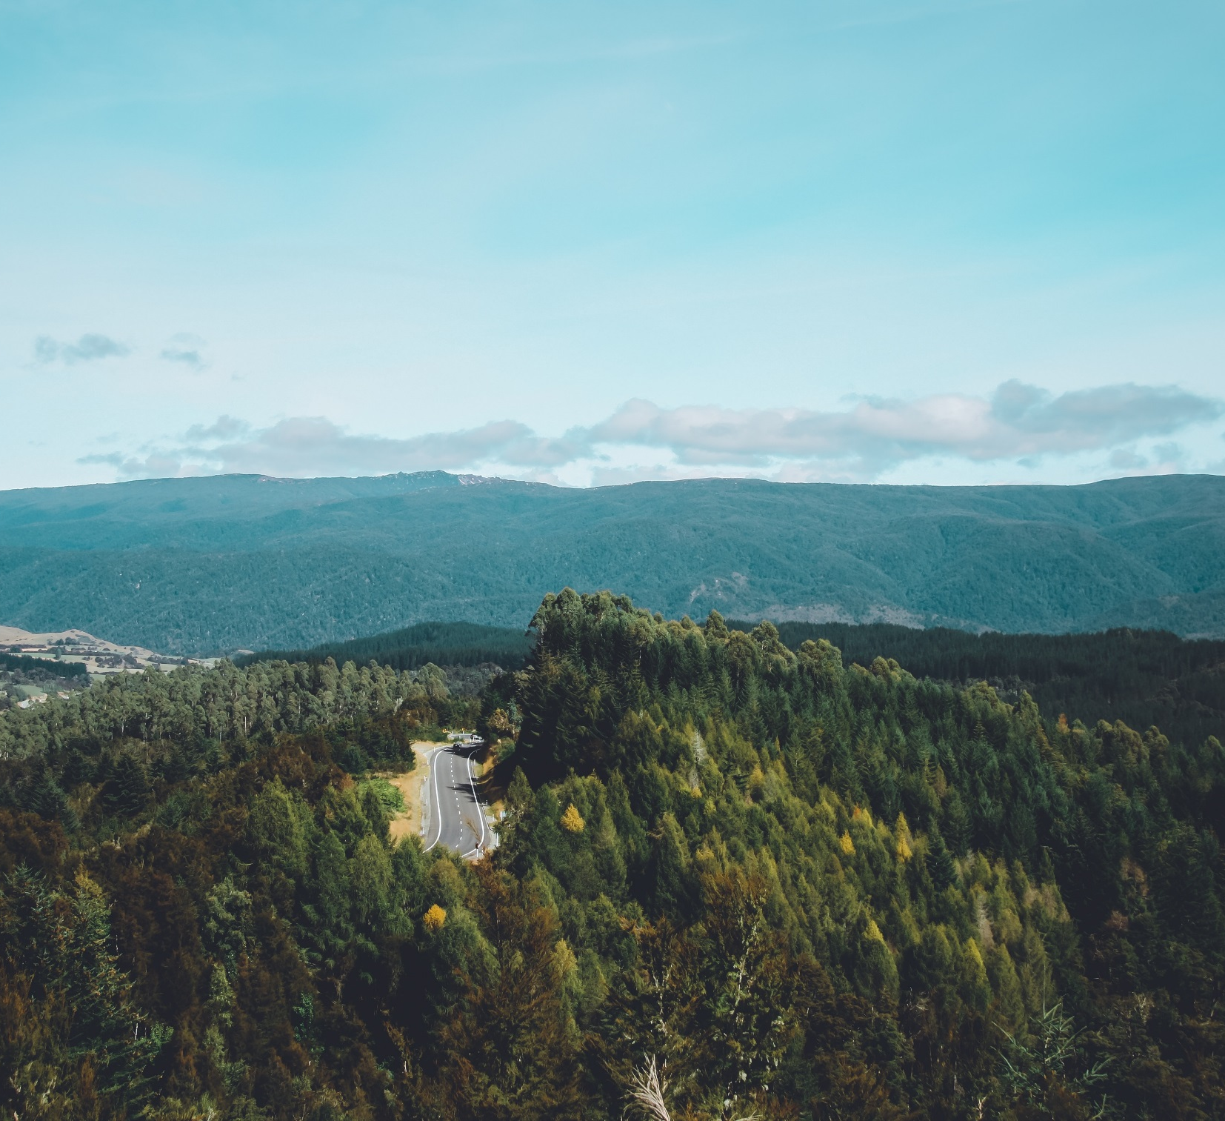
目录
输 入 标 题 文 本 一
输 入 标 题 文 本 一
输 入 标 题 文 本 一
输 入 标 题 文 本 一

Slide 4
Click here to input the
replacement text and
suggest replacing it with this speech.
ONE

Slide 5
Title
Title
Title
The stars are not wanted now: put out every one;Pack up the moon.
The stars are not wanted now: put out every one;Pack up the moon.
The stars are not wanted now: put out every one;Pack up the moon.

Slide 6
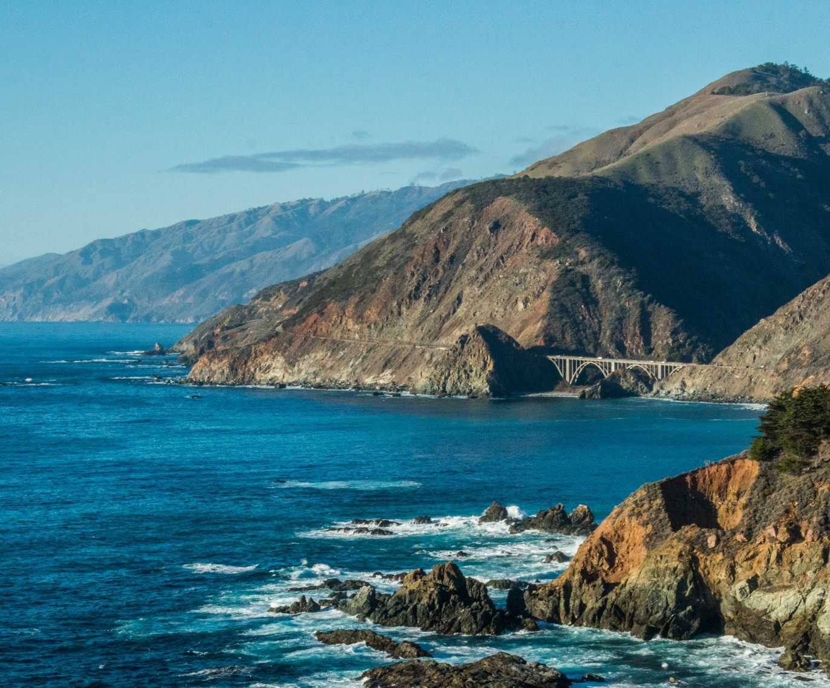
Title
My working week
and my Sunday rest, My noon,my
midnight, my talk
my song; I thought that love would
last forever; I was wrong

Slide 7
Subtitle
Subtitle
Subtitle

Slide 8
Subtitle
My working week and my Sunday
rest, My noon,my midnight, my talk,my song;
I thought that love would last forever; I was wrong.

Slide 9
Click here to input the
replacement text and
suggest replacing it with this speech.
Two

Slide 10
河流
I thought that
love would last
forever I was
wrong

Slide 11
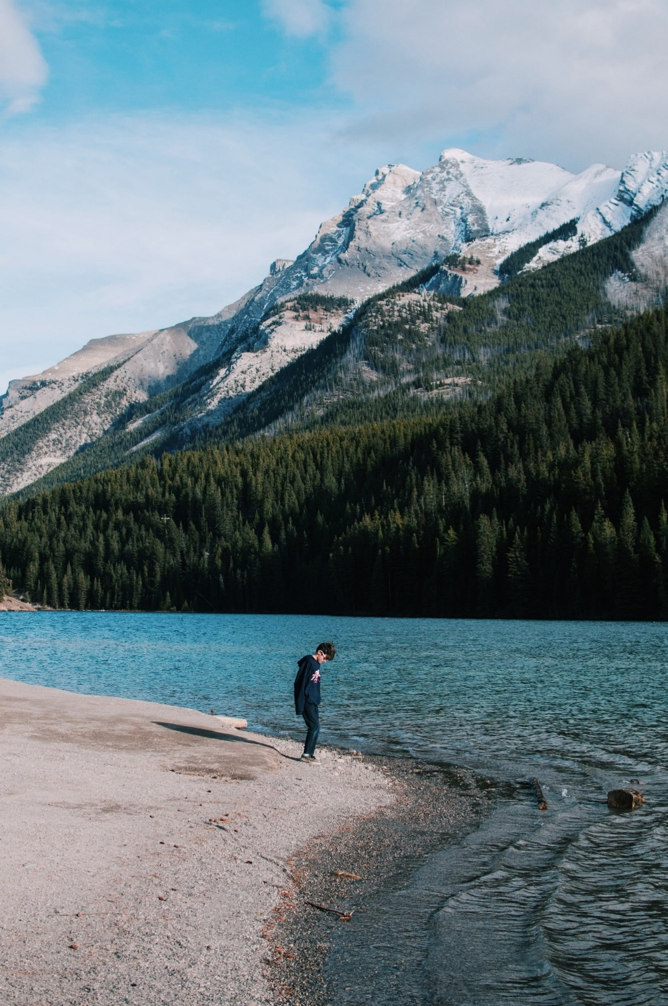
Subtitle
My working week and my Sunday rest, My noon,my midnight, my talk, my song;
I thought that love would last forever; I was wrong.
The stars are not wanted now:
put out every one; Pack up the moon and dismantle the sun;
Pour away the ocean and sweep up the wood;
For nothing now can ever come to any good.
Click here to enter the text of this section

Slide 12
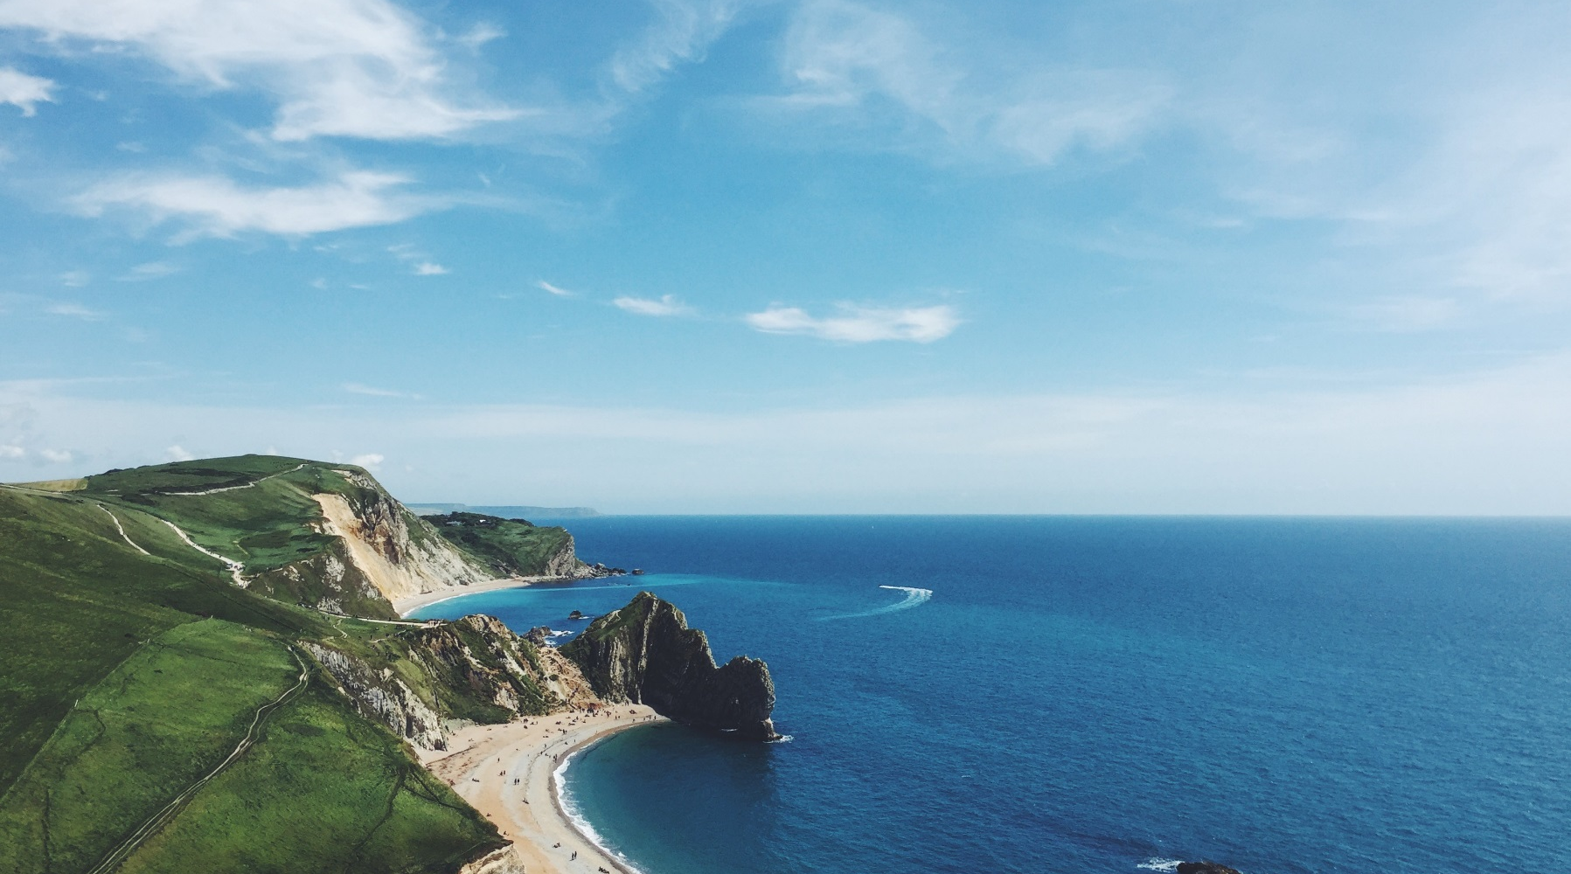
近山
My working week and my Sunday rest, My noon,
my midnight, my talk,my song;
I thought that love would last forever; I was wrong.

Slide 13
Headlines
C l I c k h e r e t o e n t e r t h e t e x t o f t h I s s e c t I o n
S u b t I t l e

Slide 14
Click here to input the
replacement text and
suggest replacing it with this speech.
Three

Slide 15
Subtitle
Subtitle
Subtitle

Slide 16
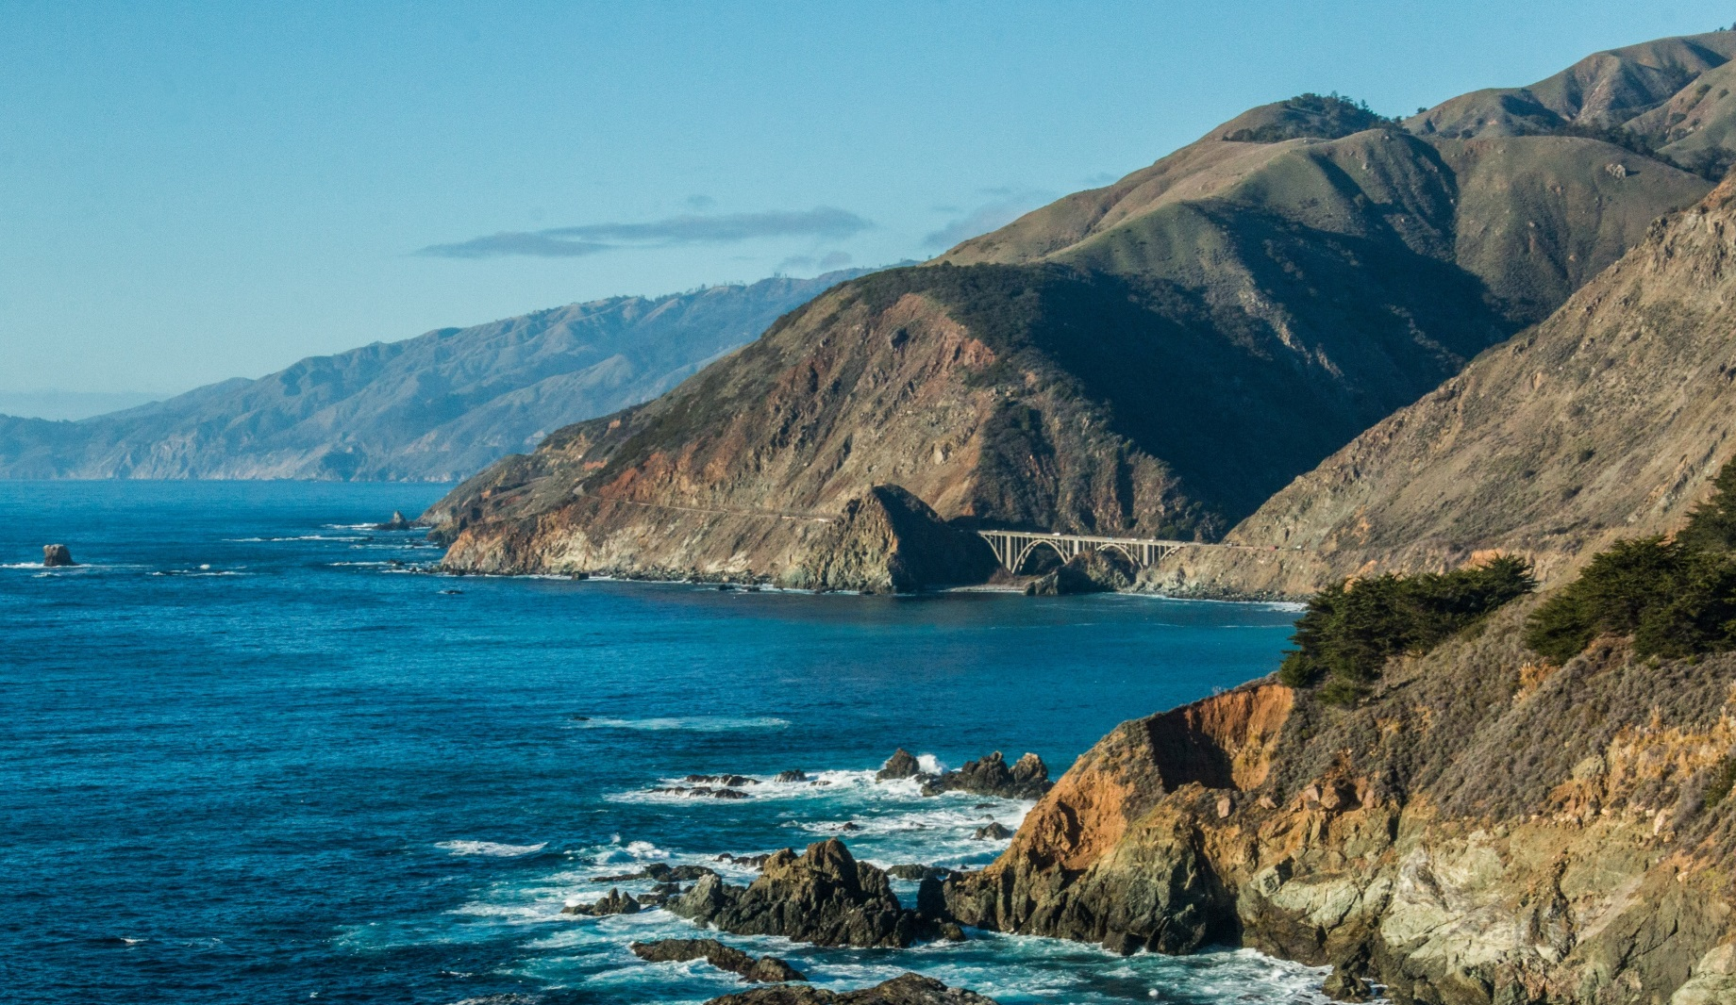
My working week and my Sunday rest, My noon, my midnight, my talk, my song;
I thought that love would last forever; I was wrong.

Slide 17
THE
S U B T I T L E

Slide 18
Title

Slide 19
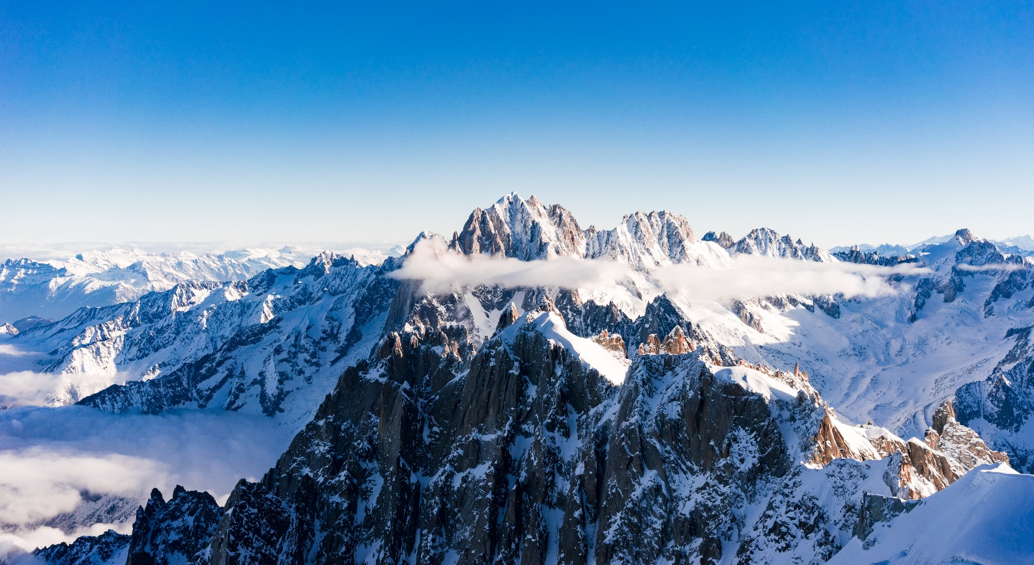
雪色
My working week and my Sunday rest, My noon,my midnight, my talk,my song;
I thought that love would last forever; I was wrong.

Slide 20
Summary

Slide 21
Summary
The stars are not wanted now: put out every one; Pack up the moon and dismantle the sun;
Pour away the ocean and sweep up the wood;
For nothing now can ever come to any good.

Slide 22
感谢观看

