Slide 1
清新文艺杂志风旅游画册PPT模板
And I've waited longer for you than I've waited for any woman.
汇报人：XXX
时间：20XX.XX

Slide 2
沿途风景
And I've waited longer for you than I've waited for any woman.
01
美食文化
And I've waited longer for you than I've waited for any woman.
02
CONTENTS
地方美食
And I've waited longer for you than I've waited for any woman.
03
旅游总结
And I've waited longer for you than I've waited for any woman.
04

Slide 3
PART ONE
沿途风景
I love you more than I've ever loved any woman. And I've waited longer for you than I've waited for any woman.
I love you more than I've ever loved any woman. And I've waited longer for you than I've waited for any woman.

Slide 4
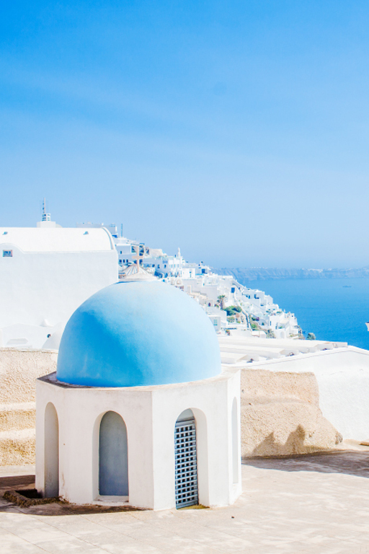
点击添加标题
Click here to add your title
I love you more than I've ever loved any woman. And I've waited longer for you than I've waited for any woman.
Click here to add your title
Click here to add your title
I love you more than I've ever loved any woman. And I've waited longer for you than I've waited for any woman.
I love you more than I've ever loved any woman. And I've waited longer for you than I've waited for any woman.
I love you more than I've ever loved any woman. And I've waited longer for you than I've waited for any woman.I love you more than I've ever loved any woman. And I've waited longer for you than I've waited for any woman.
Click here to add your title
I love you more than I've ever loved any woman. And I've waited longer for you than I've waited for any woman.

Slide 5
点击添加标题
DESTINY FREEDOM
I love you more than I've ever loved any woman. And I've waited longer for you than I've waited for any woman.
Add your title
Add your title
I love you more than I've ever loved any woman. And I've waited longer for you than I've waited for any woman.
I love you more than I've ever loved any woman. And I've waited longer for you than I've waited for any woman.

Slide 6
点击添加标题
+
Click here to add your title
Click here to add your title
I love you more than I've ever loved any woman. And I've waited longer for you than I've waited for any woman.
I love you more than I've ever loved any woman. And I've waited longer for you than I've waited for any woman.
I love you more than I've ever loved any woman. And I've waited longer for you than I've waited for any woman.
I love you more than I've ever loved any woman. And I've waited longer for you than I've waited for any woman.

Slide 7
点击添加标题
点击添加标题
I love you more than I've ever loved any woman. And I've waited longer for you than I've waited for any woman.
点击添加标题
I love you more than I've ever loved any woman. And I've waited longer for you than I've waited for any woman.

Slide 8
PART TWO
美食文化
I love you more than I've ever loved any woman. And I've waited longer for you than I've waited for any woman.
I love you more than I've ever loved any woman. And I've waited longer for you than I've waited for any woman.

Slide 9
点击添加标题
点击添加标题
I love you more than I've ever loved any woman. And I've waited longer for you than I've waited for any woman.
DESTINY FREEDOM
I love you more than I've ever loved any woman. And I've waited longer for you than I've waited for any woman.
I love you more than I've ever loved any woman. And I've waited longer for you than I've waited for any woman.

Slide 10
点击添加标题
点击添加标题
点击添加标题
N O W
O R
N E V E R
I love you more than I've ever loved any woman. And I've waited longer for you than I've waited for any woman.
I love you more than I've ever loved any woman. And I've waited longer for you than I've waited for any woman.I love you more than I've ever loved any woman. And I've waited longer for you than I've waited for any woman.
I love you more than I've ever loved any woman. And I've waited longer for you than I've waited for any woman.

Slide 11
点击添加标题
点击添加标题
I love you more than I've ever loved any woman. And I've waited longer for you than I've waited for any woman.
I love you more than I've ever loved any woman. And I've waited longer for you than I've waited for any woman.I love you more than I've ever loved any woman. And I've waited longer for you than I've waited for any woman.
I love you more than I've ever loved any woman. And I've waited longer for you than I've waited for any woman.
点击添加标题

Slide 12
点击添加标题
点击添加标题
DESTIN
FREEDOM
I love you more than I've ever loved any woman. And I've waited longer for you than I've waited for any woman.
I love you more than I've ever loved any woman. And I've waited longer for you than I've waited for any woman.I love you more than I've ever loved any woman. And I've waited longer for you than I've waited for any woman.
I love you more than I've ever loved any woman. And I've waited longer for you than I've waited for any woman.I love you more than I've ever loved any woman. And I've waited longer for you than I've waited for any woman.

Slide 13
PART THREE
地方美食
I love you more than I've ever loved any woman. And I've waited longer for you than I've waited for any woman.
I love you more than I've ever loved any woman. And I've waited longer for you than I've waited for any woman.

Slide 14
点击添加标题
点击添加标题
I love you more than I've ever loved any woman. And I've waited longer for you than I've waited for any woman.
I love you more than I've ever loved any woman. And I've waited longer for you than I've waited for any woman.
点击添加标题
I love you more than I've ever loved any woman. And I've waited longer for you than I've waited for any woman.

Slide 15
点击添加标题
ALL OR NOTHING
NOW OR NEVER
DESTINY FREEDOM
I love you more than I've ever loved any woman. And I've waited longer for you than I've waited for any woman.
I love you more than I've ever loved any woman. And I've waited longer for you than I've waited for any woman.I love you more than I've ever loved any woman. And I've waited longer for you than I've waited for any woman.
I love you more than I've ever loved any woman. And I've waited longer for you than I've waited for any woman.

Slide 16
点击添加标题
点击添加标题
点击添加标题
I love you more than I've ever loved any woman. And I've waited longer for you than I've waited for any woman.
I love you more than I've ever loved any woman. And I've waited longer for you than I've waited for any woman.
I love you more than I've ever loved any woman. And I've waited longer for you than I've waited for any woman.
I love you more than I've ever loved any woman. And I've waited longer for you than I've waited for any woman.I love you more than I've ever loved any woman. And I've waited longer for you than I've waited for any woman.
点击添加标题
I love you more than I've ever loved any woman. And I've waited longer for you than I've waited for any woman.
I love you more than I've ever loved any woman. And I've waited longer for you than I've waited for any woman.

Slide 17
点击添加标题
Click here to add your title
I love you more than I've ever loved any woman. And I've waited longer for you than I've waited for any woman.
I love you more than I've ever loved any woman. And I've waited longer for you than I've waited for any woman.I love you more than I've ever loved any woman. And I've waited longer for you than I've waited for any woman.

Slide 18
点击添加标题
点击添加标题
01
02
点击添加标题
点击添加标题
I love you more than I've ever loved any woman. And I've waited longer for you than I've waited for any woman.
I love you more than I've ever loved any woman. And I've waited longer for you than I've waited for any woman.

Slide 19
PART FOUR
旅游总结
I love you more than I've ever loved any woman. And I've waited longer for you than I've waited for any woman.
I love you more than I've ever loved any woman. And I've waited longer for you than I've waited for any woman.

Slide 20
点击添加标题
点击添加标题
I love you more than I've ever loved any woman. And I've waited longer for you than I've waited for any woman.I love you more than I've ever loved any woman. And I've waited longer for you than I've waited for any woman.
I love you more than I've ever loved any woman. And I've waited longer for you than I've waited for any woman.
点击添加标题
点击添加标题
I love you more than I've ever loved any woman. And I've waited longer for you than I've waited for any woman.
I love you more than I've ever loved any woman. And I've waited longer for you than I've waited for any woman.I love you more than I've ever loved any woman. And I've waited longer for you than I've waited for any woman.
I love you more than I've ever loved any woman. And I've waited longer for you than I've waited for any woman.

Slide 21
点击添加标题
Click here to add your title
I love you more than I've ever loved any woman. And I've waited longer for you than I've waited for any woman.
Click here to add your title
I love you more than I've ever loved any woman. And I've waited longer for you than I've waited for any woman.
Click here to add your title
I love you more than I've ever loved any woman. And I've waited longer for you than I've waited for any woman.

Slide 22
点击添加标题
点击添加标题
I love you more than I've ever loved any woman. And I've waited longer for you than I've waited for any woman.
I love you more than I've ever loved any woman. And I've waited longer for you than I've waited for any woman.I love you more than I've ever loved any woman. And I've waited longer for you than I've waited for any woman.
If you are ever in trouble, don't try to be brave, just run, just run away. If you are ever in trouble, don't try to be brave, just run, just run away.
If you are ever in trouble, don't try to be brave, just run, just run away. If you are ever in trouble, don't try to be brave, just run, just run away.

Slide 23
点击添加标题
点击添加标题
I love you more than I've ever loved any woman. And I've waited longer for you than I've waited for any woman.
点击添加标题
I love you more than I've ever loved any woman. And I've waited longer for you than I've waited for any woman.
点击添加标题
I love you more than I've ever loved any woman. And I've waited longer for you than I've waited for any woman.
点击添加标题
I love you more than I've ever loved any woman. And I've waited longer for you than I've waited for any woman.

Slide 24
感谢观看 THANKS
And I've waited longer for you than I've waited for any woman.
汇报人：XXX
时间：20XX.XX

