Slide 1
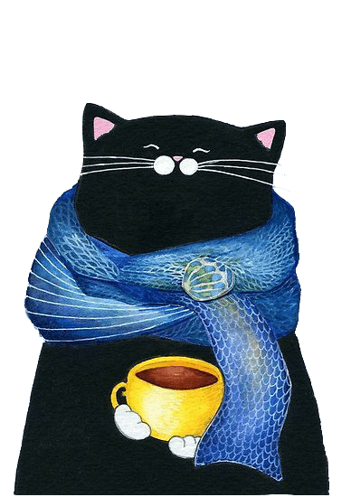
卡通动物可爱模板
THIS IS A ART TEMPLATE ,THE TEMPLATE DESIGN. THANK YOU WATCHING THIS ONE.

Slide 2
CONTENTS
0 1
0 2
0 3
0 4
THIS IS A ART TEMPLATE ,THANK YOU WATCHING THIS ONE.
THIS IS A ART TEMPLATE ,THANK YOU WATCHING THIS ONE.
THIS IS A ART TEMPLATE ,THANK YOU WATCHING THIS ONE.
THIS IS A ART TEMPLATE ,THANK YOU WATCHING THIS ONE.

Slide 3
01
ADD YOUR TITTLE HERE
Just for today I will try to live through this day only and not tackle my whole life problem at once. I can do for twelve hours that Just for today I will try to live through this day. Just for today I will try to live through this day only and not tackle my whole life problem at once.

Slide 4
章 节 提 要：
Just for today I will try to live through this day only and not tackle my whole life problem at once. I can do for twelve hours that Just for today I will try to live through this day. Just for today I will try to live through this day only and not tackle my whole life problem at once.

Slide 5
ADD YOUR TITTLE HERE
Just for today I will try to live through this day only and not tackle my whole life problem at once. I can do for twelve hours that Just for today I will try to live through this day. Just for today I will try to live through this day only and not tackle my whole life problem at once.

Slide 6
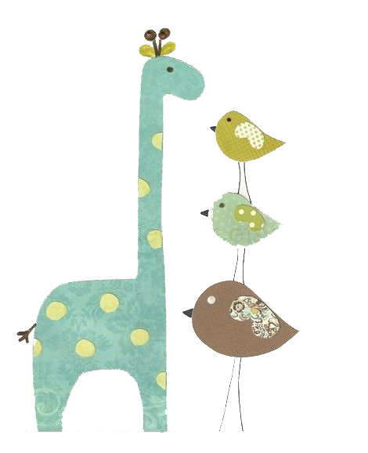
0 1
Just for today I will try to live through this day only and not tackle my whole life problem at once
0 2
Just for today I will try to live through this day only and not tackle my whole life problem at once
0 3
Just for today I will try to live through this day only and not tackle my whole life problem at once
0 4
Just for today I will try to live through this day only and not tackle my whole life problem at once

Slide 7
ADD YOUR TITTLE HERE
Just for today I will try to live through this day only and not tackle my whole life problem at once. I can do for twelve hours that Just for today I will try to live
ADD YOUR TITTLE HERE
Just for today I will try to live through this day only and not tackle my whole life problem at once. I can do for twelve hours that Just for today I will try to live

Slide 8
STEP 01
STEP 02
STEP 03
Just for today I will try to live through this day only and not tackle my whole life problem at once
Just for today I will try to live through this day only and not tackle my whole life problem at once
Just for today I will try to live through this day only and not tackle my whole life problem at once

Slide 9
02
ADD YOUR TITTLE HERE
Just for today I will try to live through this day only and not tackle my whole life problem at once. I can do for twelve hours that Just for today I will try to live through this day. Just for today I will try to live through this day only and not tackle my whole life problem at once.

Slide 10
章 节 提 要：
Just for today I will try to live through this day only and not tackle my whole life problem at once. I can do for twelve hours that Just for today I will try to live through this day. Just for today I will try to live through this day only and not tackle my whole life problem at once.

Slide 11
“
Just for today I will try to live through this day only and not tackle my whole life problem at once. I can do for twelve hours that Just for today I will try to live through this day
ADD YOUR TITTLE HERE
THIS IS A ART TEMPLATE ,THE TEMPLATE DESIGN BY THANK YOU WATCHING THIS ONE.

Slide 12
ADD YOUR TITTLE HERE
Just for today I will try to live through this day only and not tackle my whole life problem at once. I can do for twelve hours that Just for today I will try to live
ADD YOUR TITTLE HERE
Just for today I will try to live through this day only and not tackle my whole life problem at once. I can do for twelve hours that Just for today I will try to live

Slide 13
ADD YOUR TITTLE HERE
Just for today I will try to live through this day only and not tackle my whole life problem at once. I can do for twelve hours that Just for today I will try to live
ADD YOUR TITTLE HERE
Just for today I will try to live through this day only and not tackle my whole life problem at once. I can do for twelve hours that Just for today I will try to live

Slide 14
03
ADD YOUR TITTLE HERE
Just for today I will try to live through this day only and not tackle my whole life problem at once. I can do for twelve hours that Just for today I will try to live through this day. Just for today I will try to live through this day only and not tackle my whole life problem at once.

Slide 15
章 节 提 要：
Just for today I will try to live through this day only and not tackle my whole life problem at once. I can do for twelve hours that Just for today I will try to live through this day. Just for today I will try to live through this day only and not tackle my whole life problem at once.

Slide 16
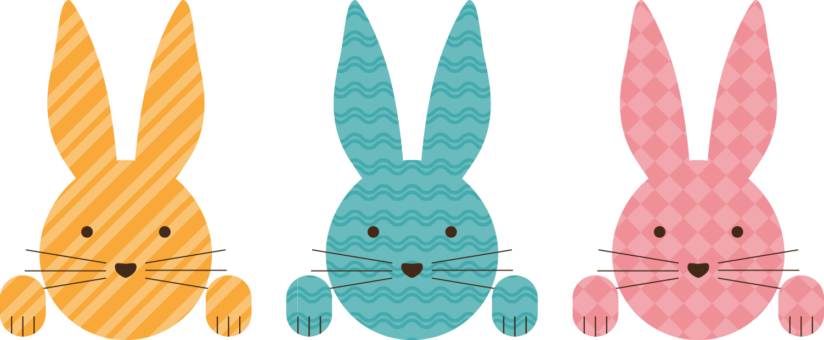
STEP 01
ART TEMPLATE
Just for today I will try to live through this day only and not tackle my whole life problem at once
STEP 02
Just for today I will try to live through this day only and not tackle my whole life problem at once
STEP 03
Just for today I will try to live through this day only and not tackle my whole life problem at once

Slide 17
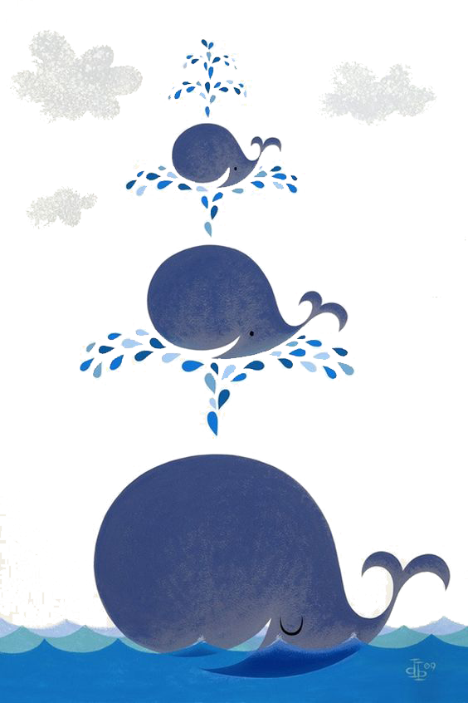
ADD YOUR TITTLE HERE
Just for today I will try to live through this day only and not tackle my whole life problem at once. I can do for twelve hours that Just for today I will try to live
ADD YOUR TITTLE HERE
Just for today I will try to live through this day only and not tackle my whole life problem at once. I can do for twelve hours that Just for today I will try to live

Slide 18
0 1
Just for today I will try to live through this day only and not tackle my whole life problem at once
0 2
Just for today I will try to live through this day only and not tackle my whole life problem at once
ADD YOUR TITTLE HERE
Just for today I will try to live through this day only and not tackle my whole life problem at once. I can do for twelve hours that Just for today I will try to live through this day. Just for today I will try to live through this day only and not tackle my whole life problem at once.

Slide 19
04
ADD YOUR TITTLE HERE
Just for today I will try to live through this day only and not tackle my whole life problem at once. I can do for twelve hours that Just for today I will try to live through this day. Just for today I will try to live through this day only and not tackle my whole life problem at once.

Slide 20
章 节 提 要：
Just for today I will try to live through this day only and not tackle my whole life problem at once. I can do for twelve hours that Just for today I will try to live through this day. Just for today I will try to live through this day only and not tackle my whole life problem at once.

Slide 21
ART TEMPLATE
0 1
Just for today I will try to live through this day only and not tackle my whole life problem at once
0 2
Just for today I will try to live through this day only and not tackle my whole life problem at once
03
Just for today I will try to live through this day only and not tackle my whole life problem at once
0 4
Just for today I will try to live through this day only and not tackle my whole life problem at once
05
Just for today I will try to live through this day only and not tackle my whole life problem at once
06
Just for today I will try to live through this day only and not tackle my whole life problem at once

Slide 22
感 谢 大 家 的 观 看
THIS IS A ART TEMPLATE ,THE TEMPLATE DESIGN. THANK YOU WATCHING THIS ONE.

