Slide 1
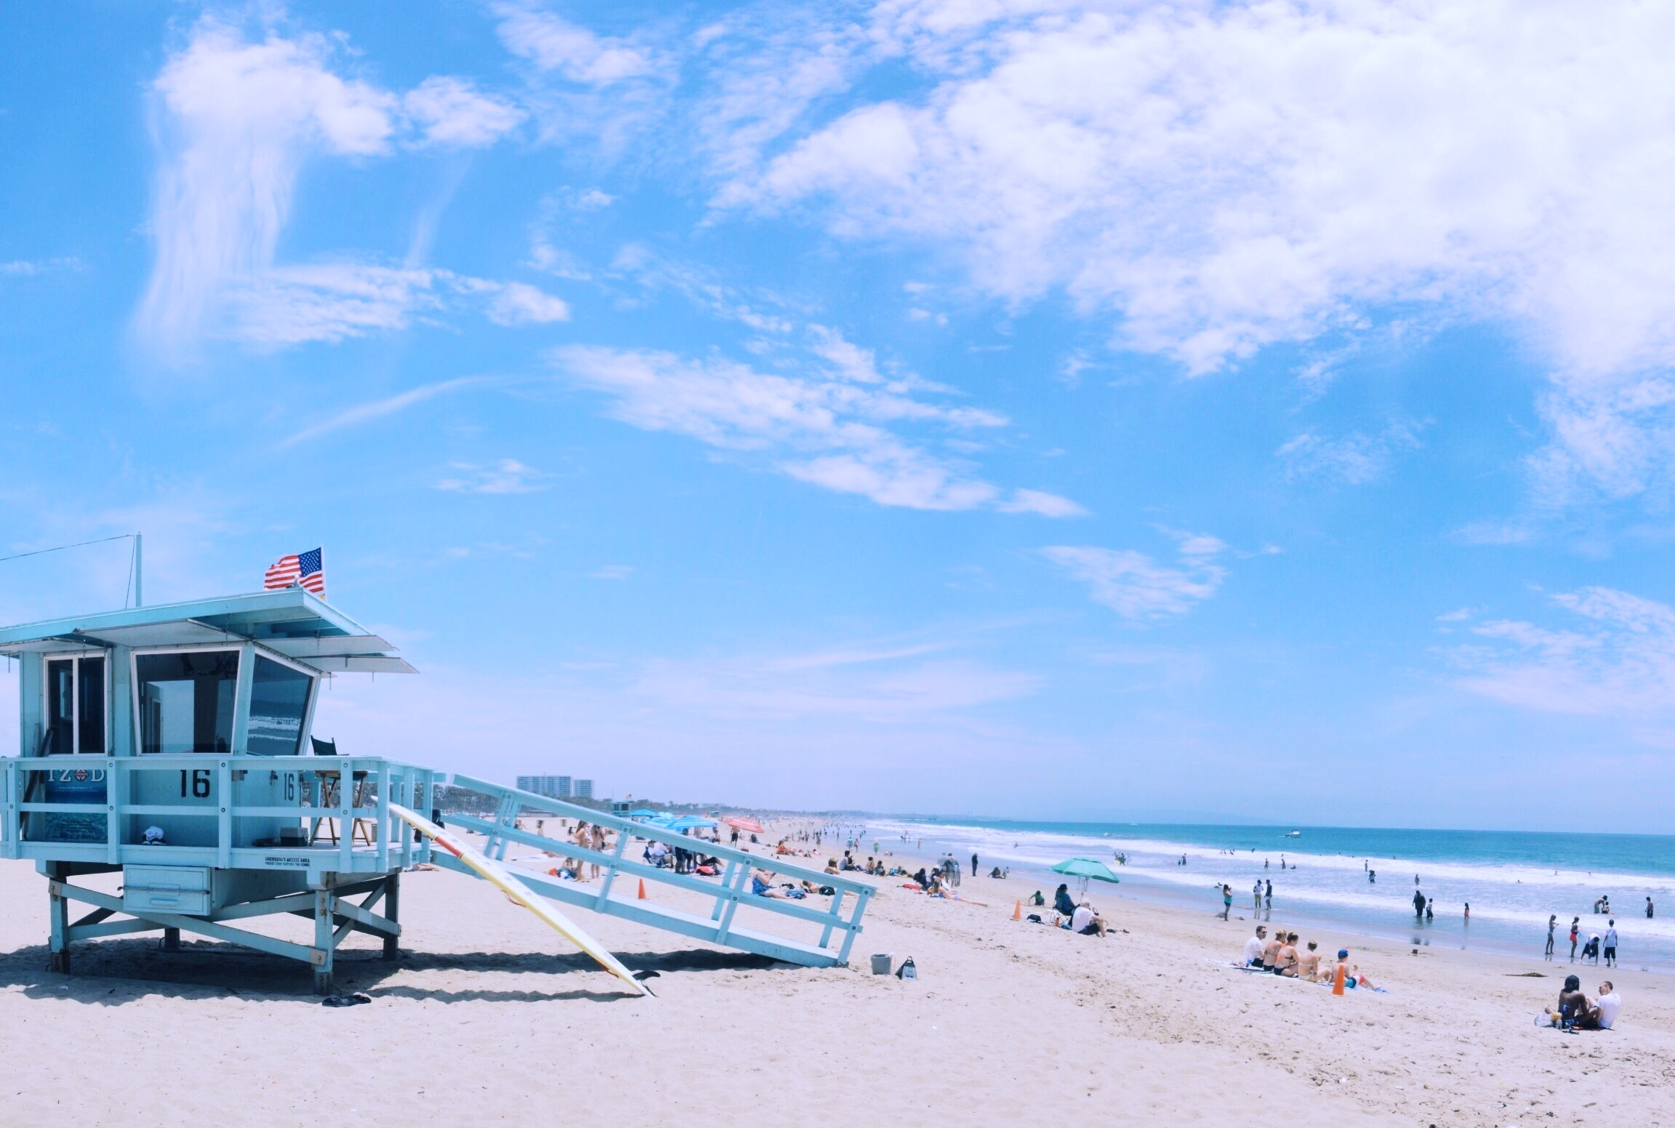
JUNE HELLO
There was no cloud in the air. There was no wind. There was only a hot sun overhead. All the trees stood idly and lazily.

Slide 2
CONTENT
01. SUNNY DAY
Entrepreneurial activities differ substantially depending on the type of organization
02. SANDY BEACH
Entrepreneurial activities differ substantially depending on the type of organization
03. LAKE WATER
Entrepreneurial activities differ substantially depending on the type of organization
04. PRETTY GIRL
Entrepreneurial activities differ substantially depending on the type of organization

Slide 3
PART.01
01. SUNNY DAY
Entrepreneurial activities differ substantially depending on the type of organization

Slide 4
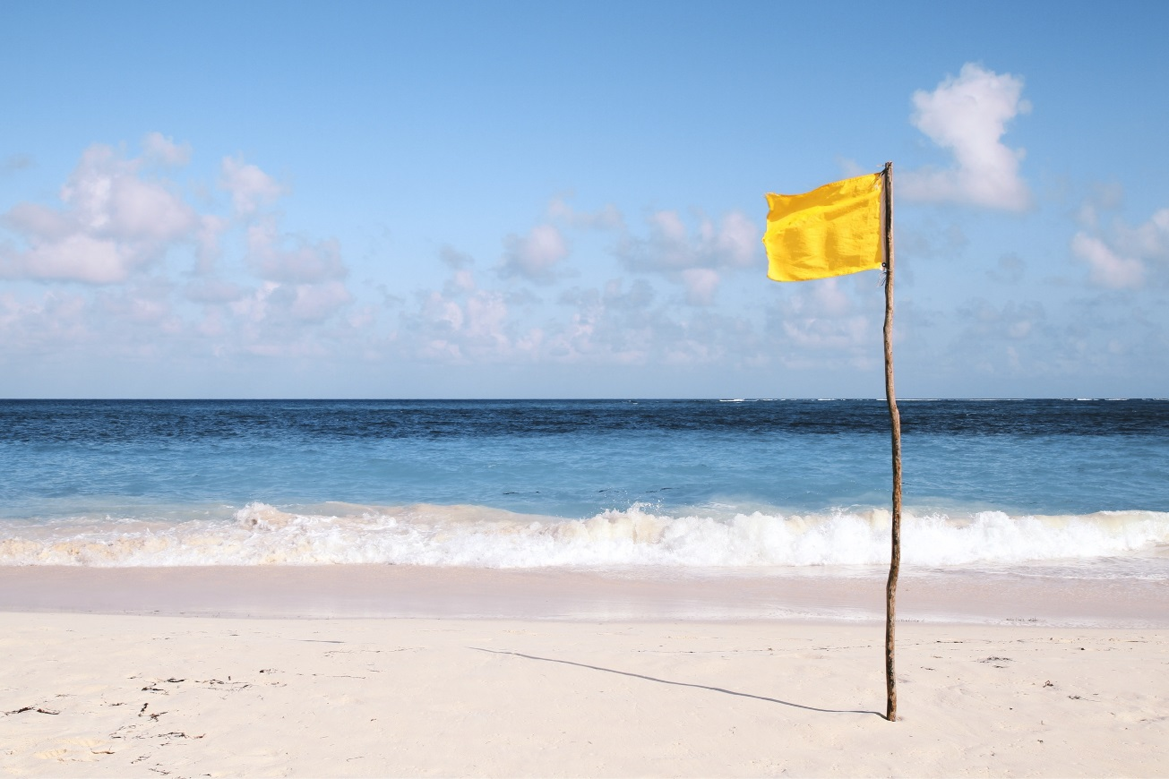
YOUR TITLE
A company is an association or collection of individuals, whether natural persons, legal persons, or a mixture of both. Company members share a common purpose and unite in order to focus their various talents and organize their collectively available skills or resources to achieve specific, declared goals

Slide 5
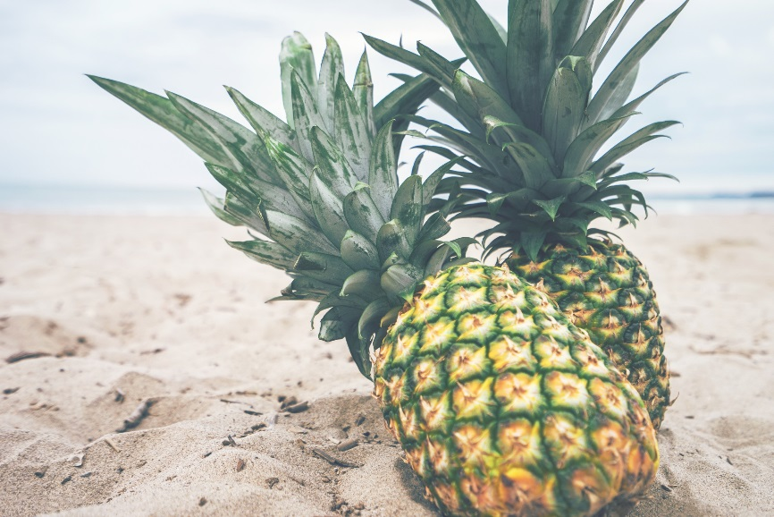
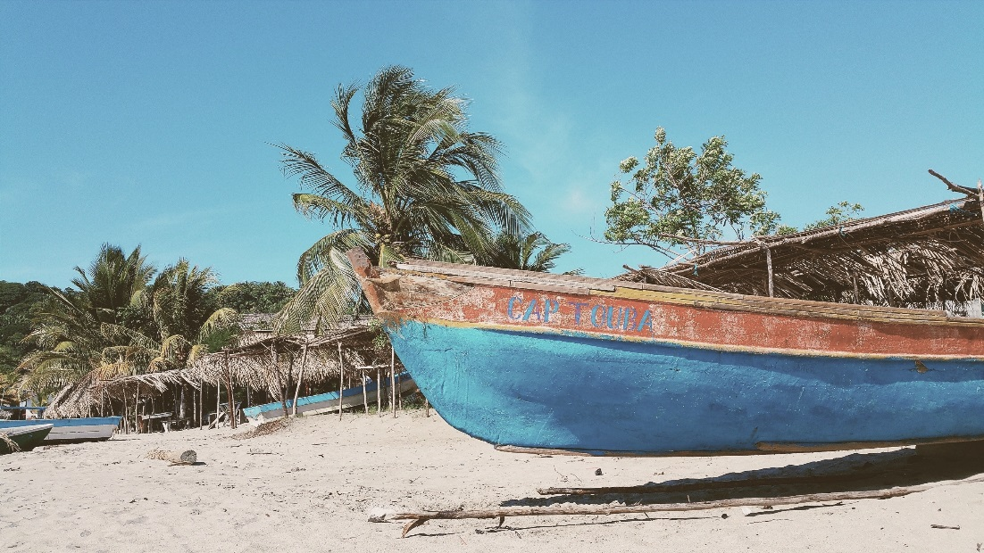
A company is an association or collection of individuals, whether natural persons, legal persons, or a mixture of both. Company members share a common purpose and unite in order to focus their various talents.
SUNNY DAY

Slide 6
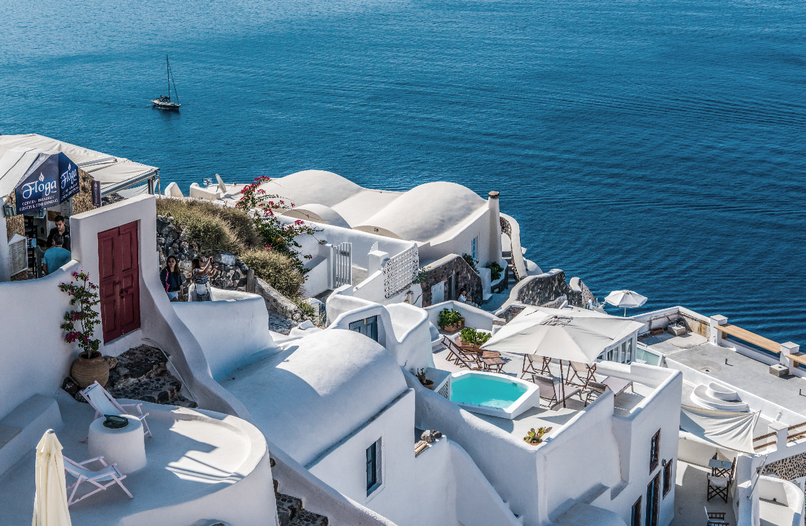
SUNNY DAY
A company is an association or collection of individuals, whether natural persons, legal persons, or a mixture of both. Company members share a common purpose and unite in order to focus their various talents and organize their collectively available skills or resources to achieve specific, declared goals

Slide 7
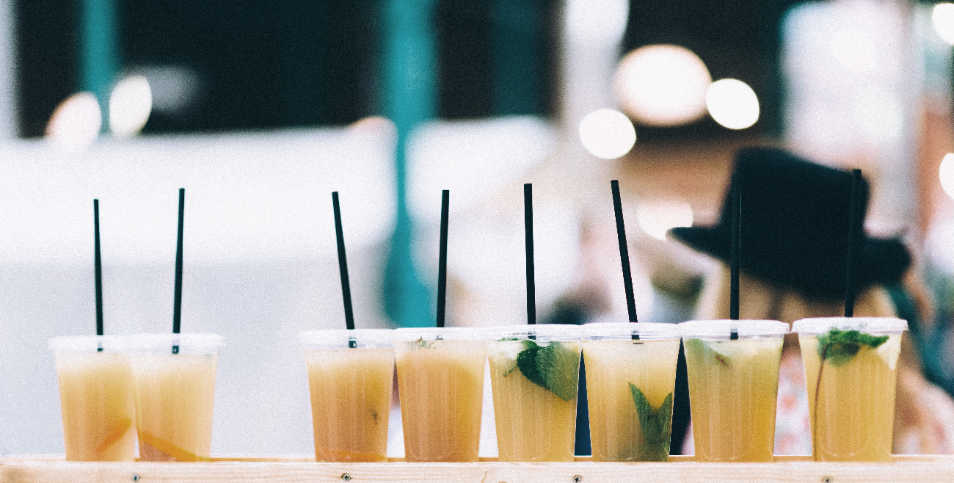
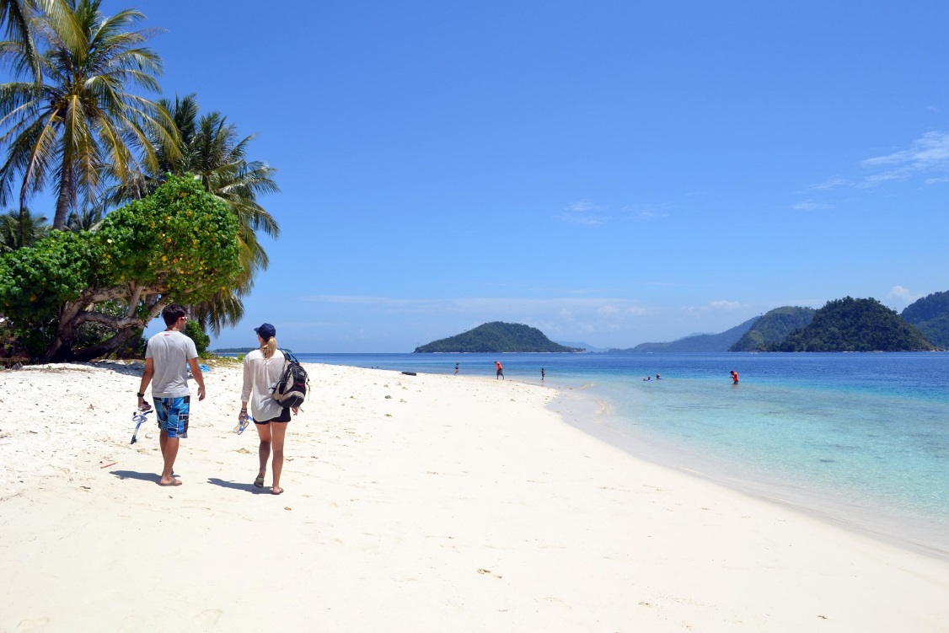
A company is an association or collection of individuals, whether natural persons, legal persons, or a mixture of both. Company members share a common purpose and unite in order to focus their various talents and
SUNNY
DAY

Slide 8
PART.02
02. SUNNY DAY
Entrepreneurial activities differ substantially depending on the type of organization

Slide 9
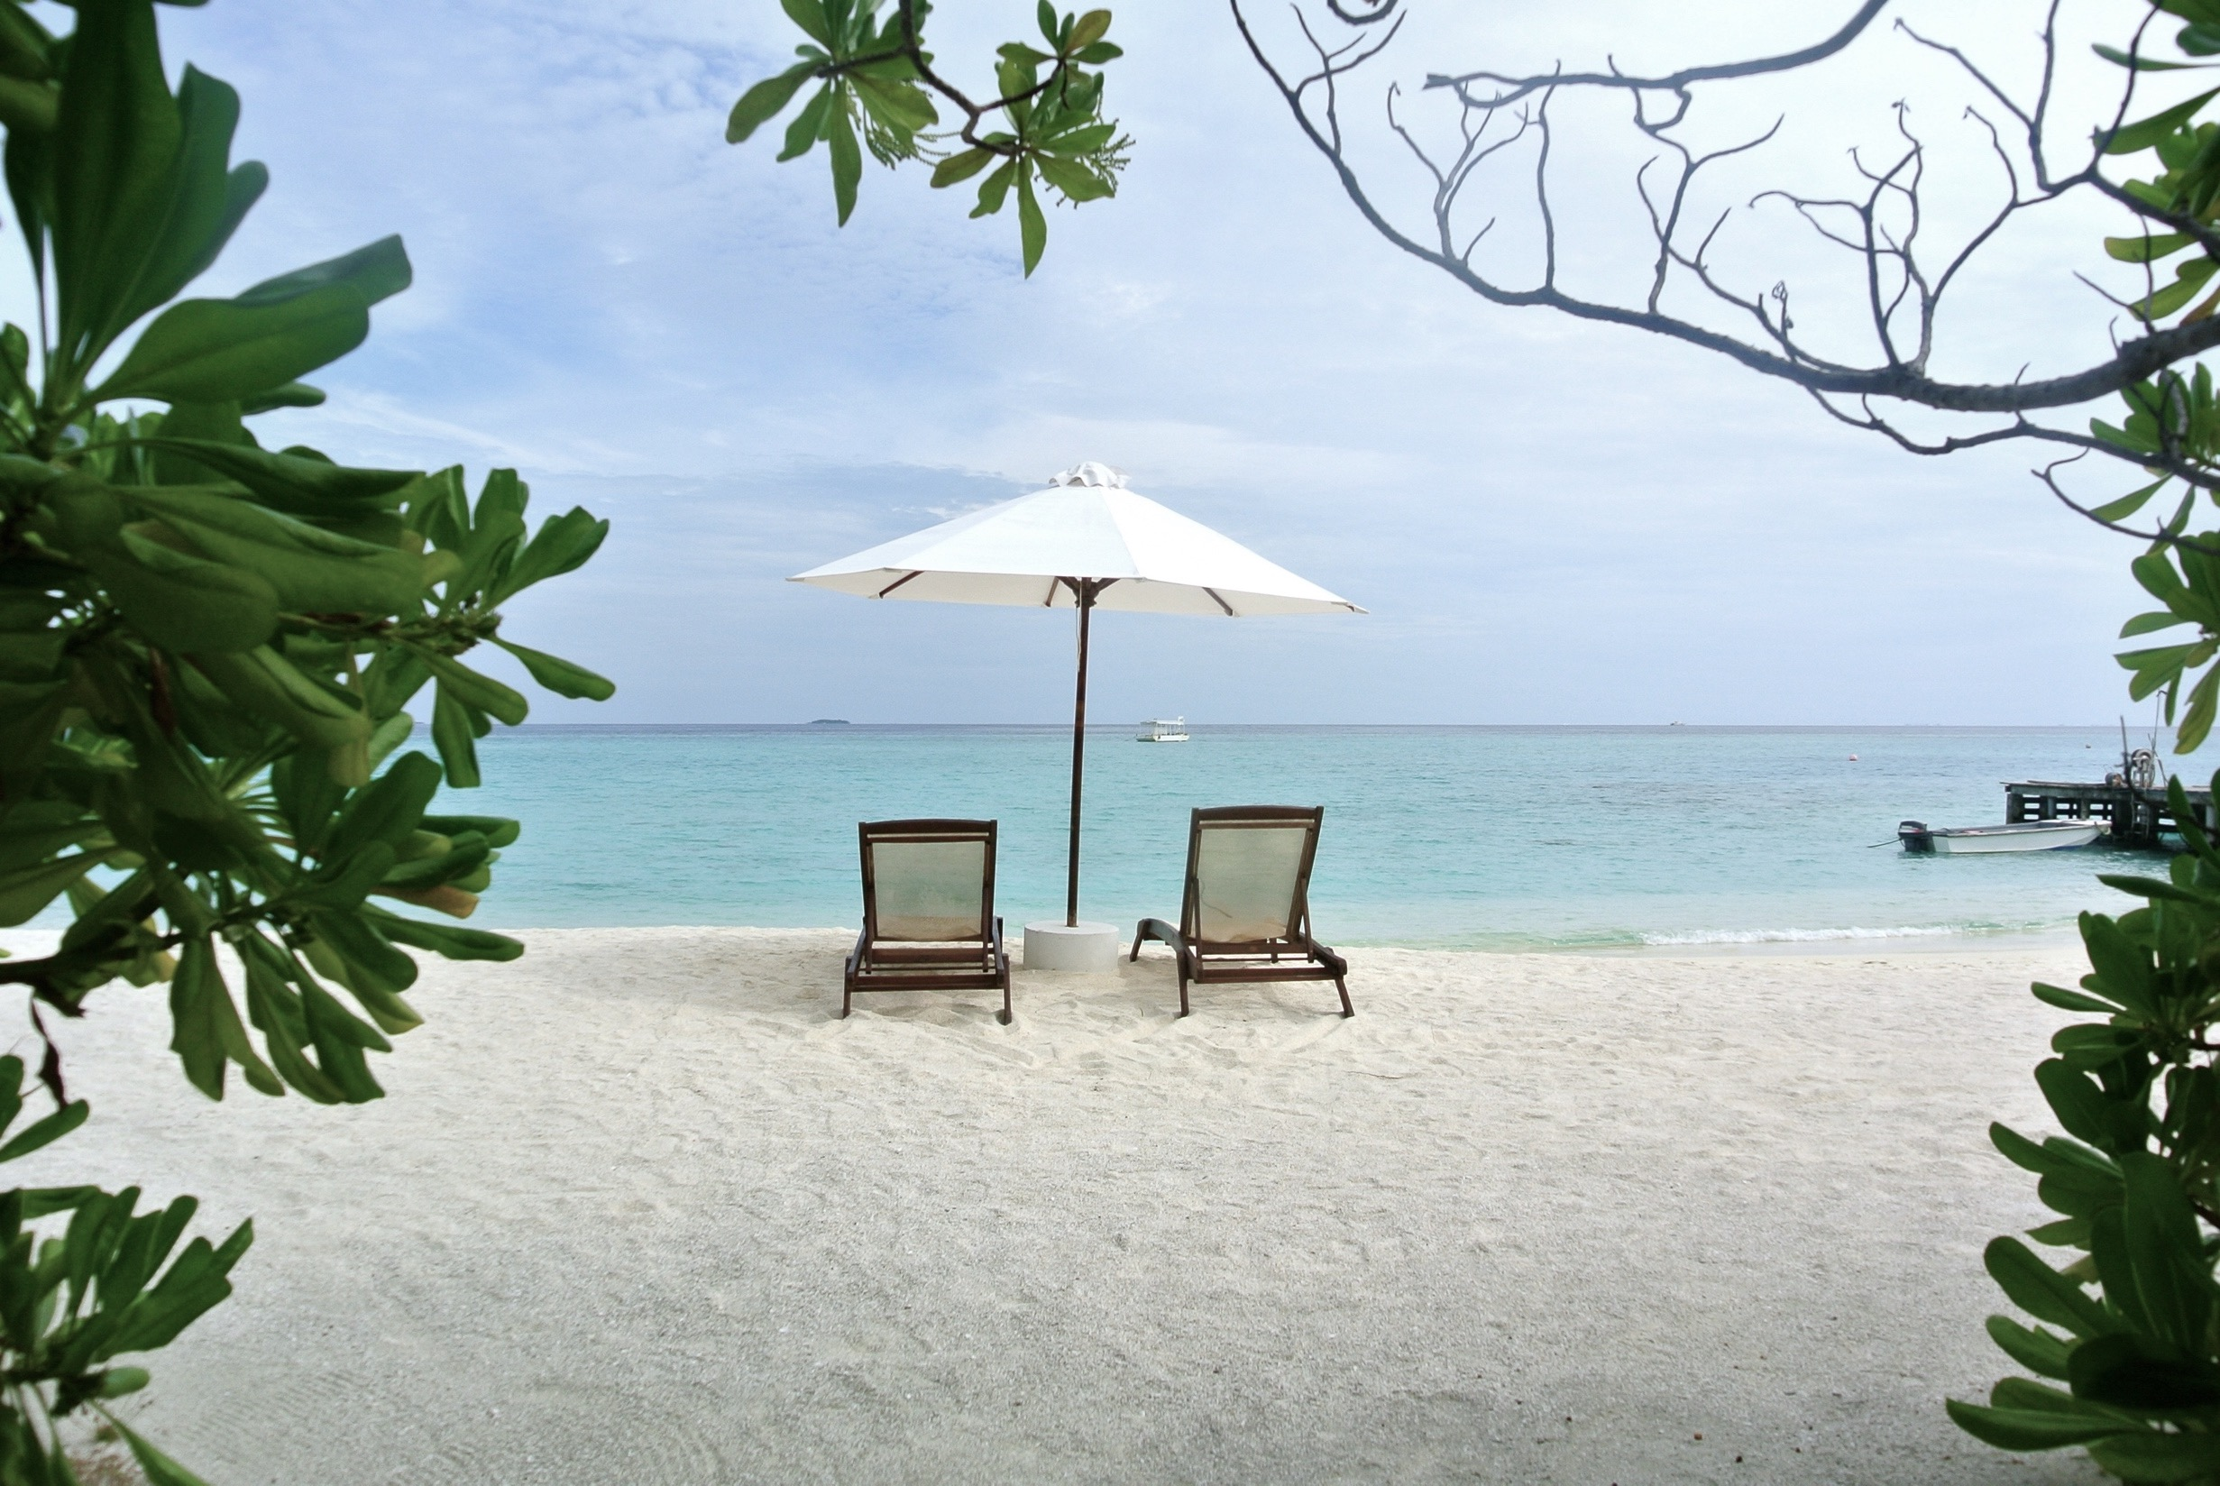
A company is an association or collection of individuals, whether natural persons, legal persons, or a mixture of both. Company members share a common purpose and unite in order to focus their various talents and
ABOUT US
Entrepreneurial activities differ type depending on the type of organization
Entrepreneurial activities differ substantially depending on the type of organization.

Slide 10
OUR LATEST WORKS
A company is an association or collection of individuals, whether natural persons, legal persons, or a mixture of both. Company members share a common purpose and unite in order to focus their various talents.

Slide 11
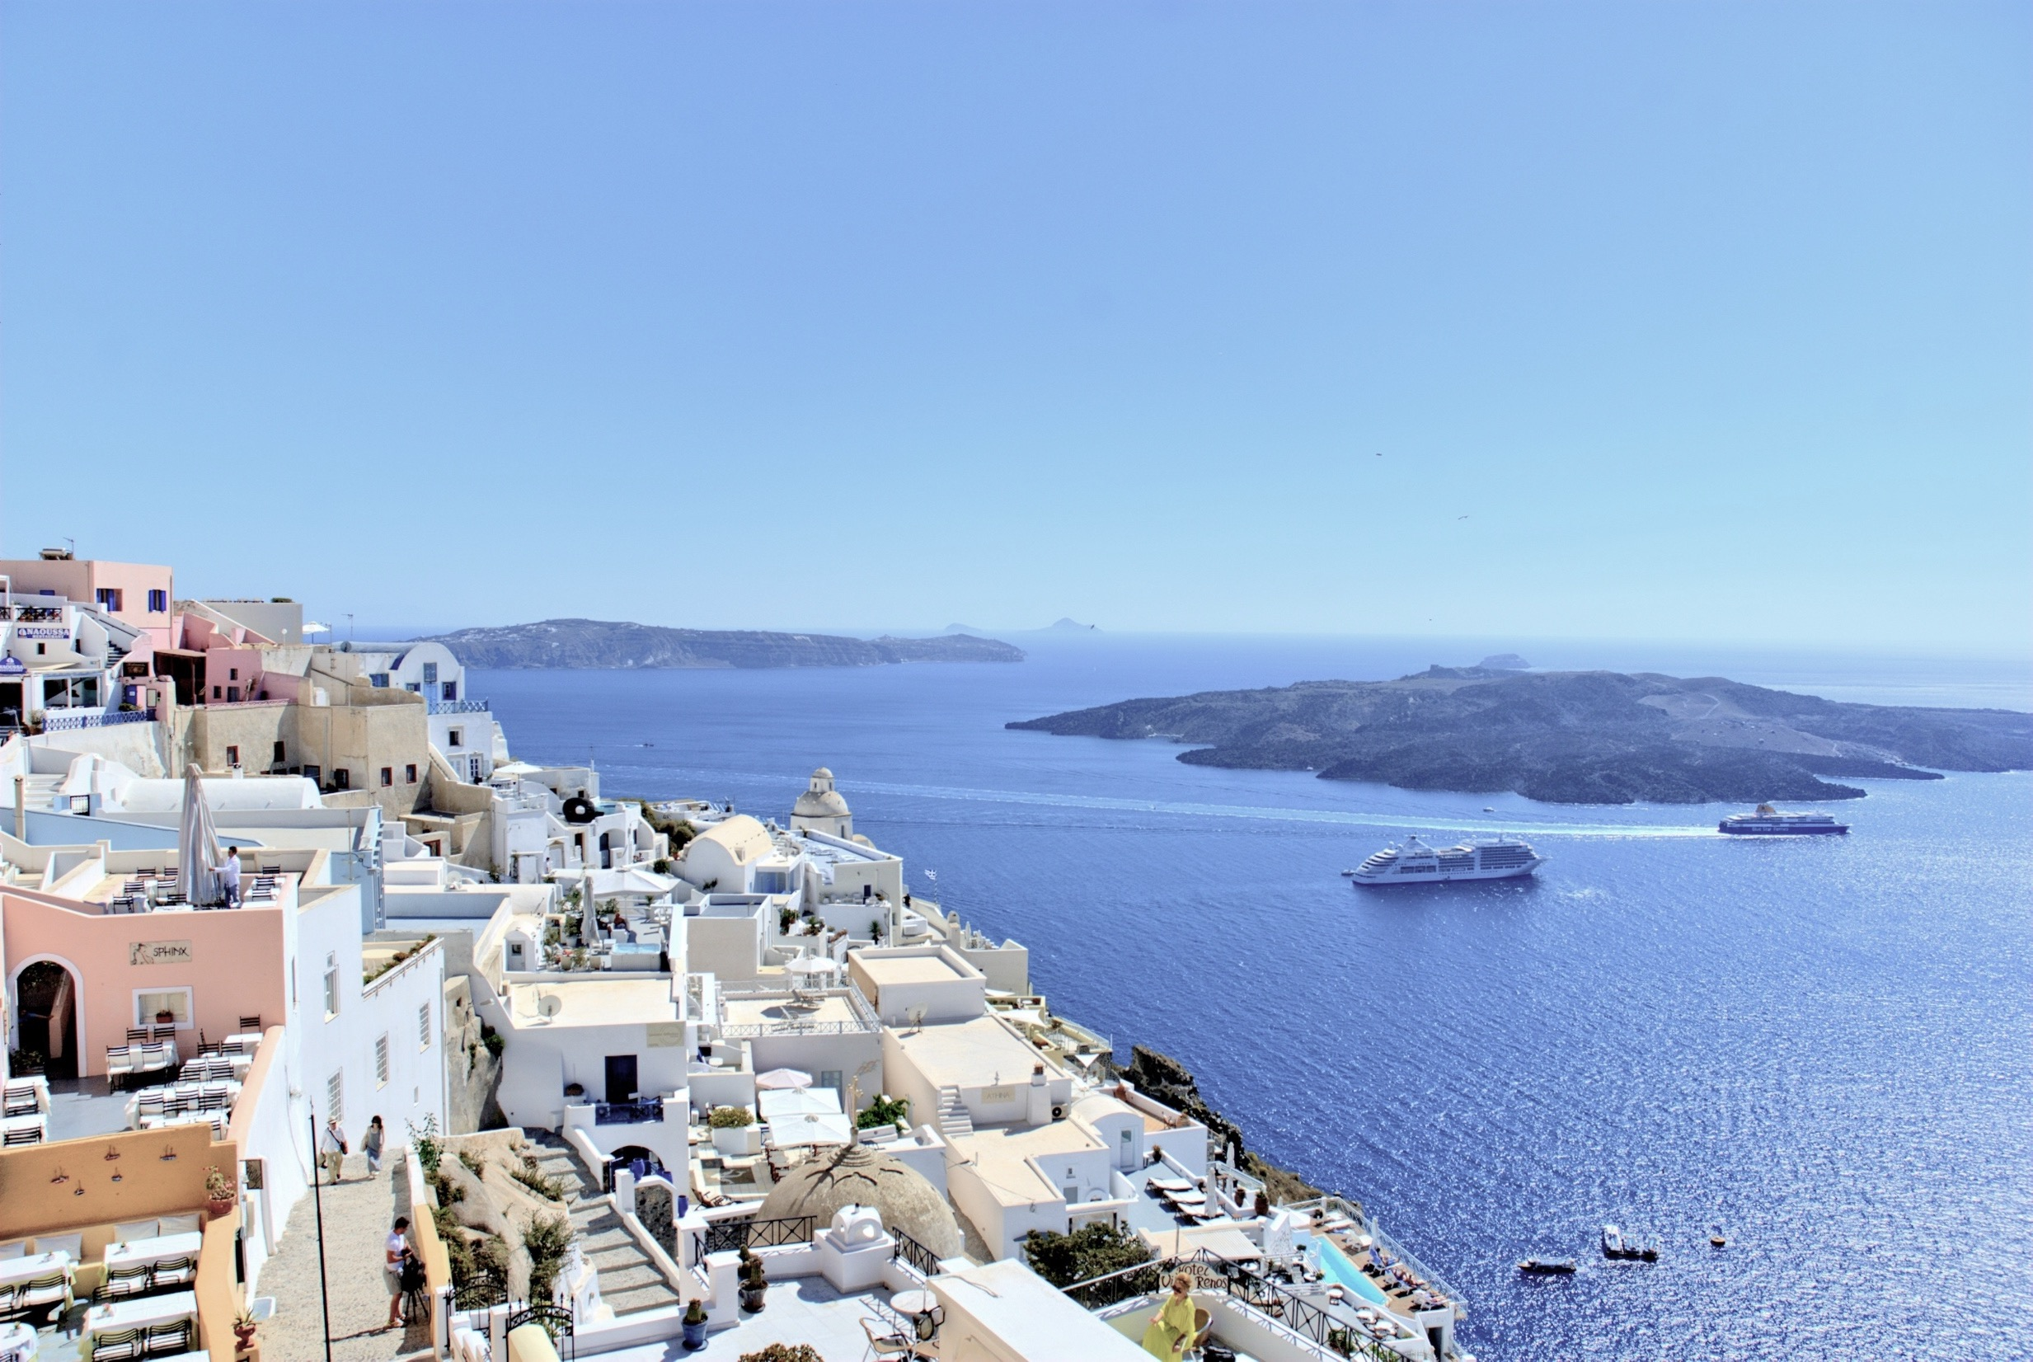
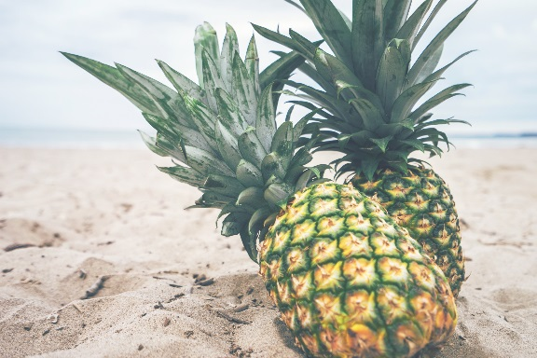
SHORT
Entrepreneurial activities differ substantially depending on the type of organization and creativity involved.
LONG TERM
Entrepreneurial activities differ substantially depending on the type of organization and creativity involved.
OUR LATEST WORKS
A company is an association or collection of individuals, whether natural persons, legal persons, or a mixture of both. Company members share a common purpose and unite in order to focus their various talents.

Slide 12
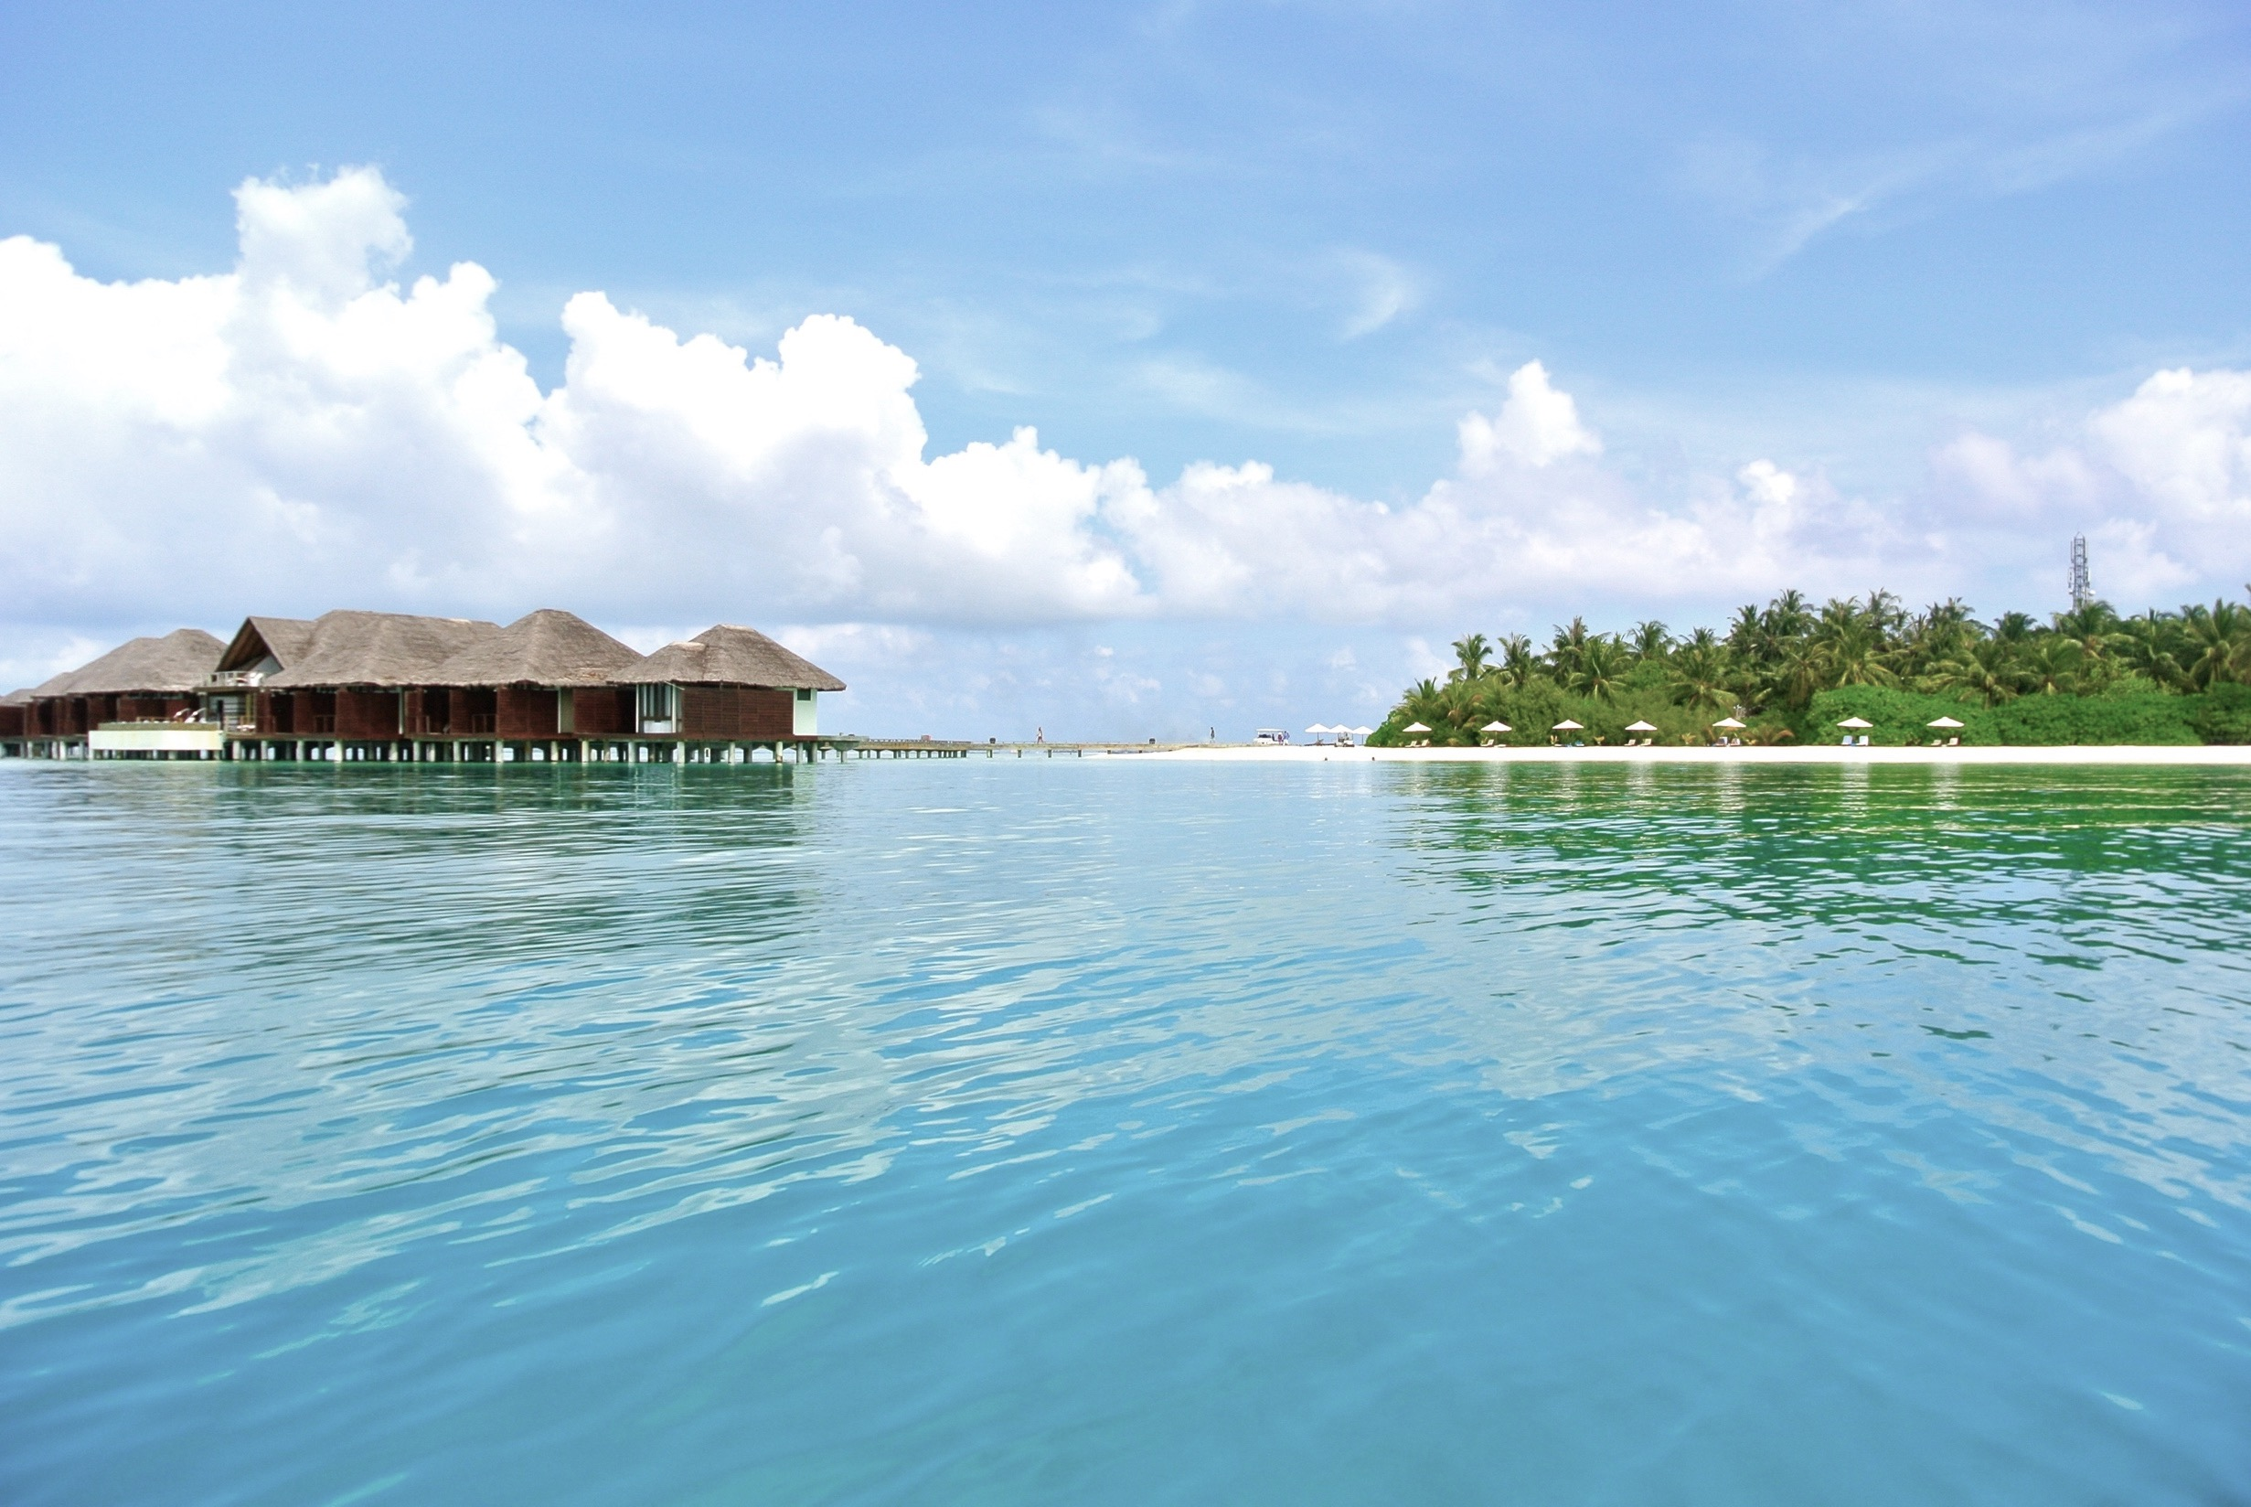
OUR LATEST WORKS
Entrepreneurial activities differ type depending on the type of organization
OUR VALUES
Entrepreneurial activities differ type depending on the type of organization

Slide 13
PART.03
03. LAKE WATER
Entrepreneurial activities differ substantially depending on the type of organization

Slide 14
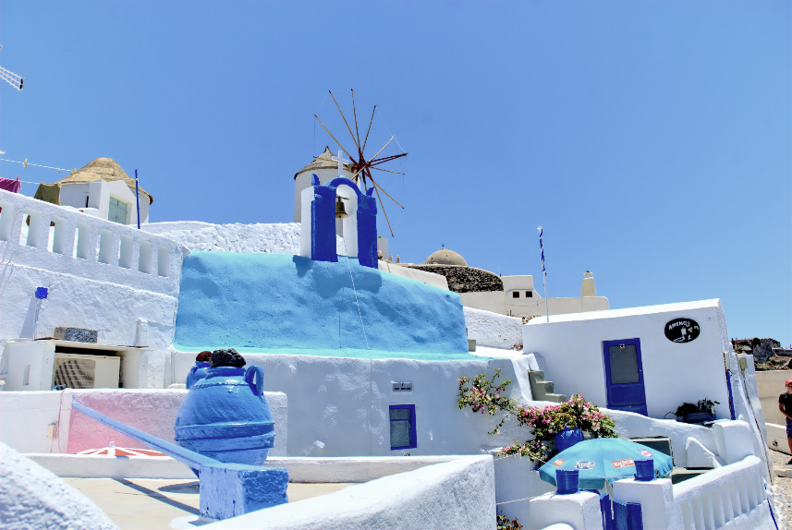
OUR LATEST WORKS
A company is an association or collection of individuals, whether natural persons, legal persons, or a mixture of both. Company members share a common purpose and unite in order to focus their various talents.

Slide 15
OUR LATEST
A company is an association or collection of individuals, whether natural persons, legal persons, or a mixture of both. Company members .
A company is an association or collection of individuals, whether natural persons, legal persons, or a mixture of both. Company members share a common purpose and unite in order to focus their various talents.

Slide 16
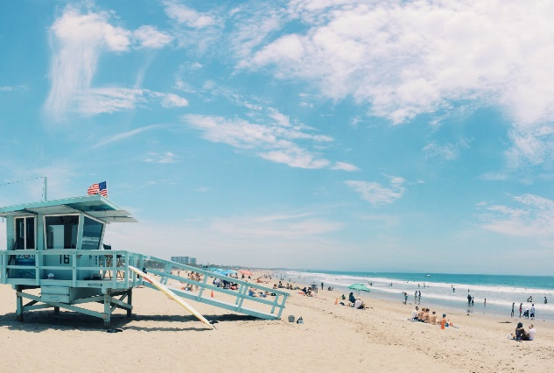
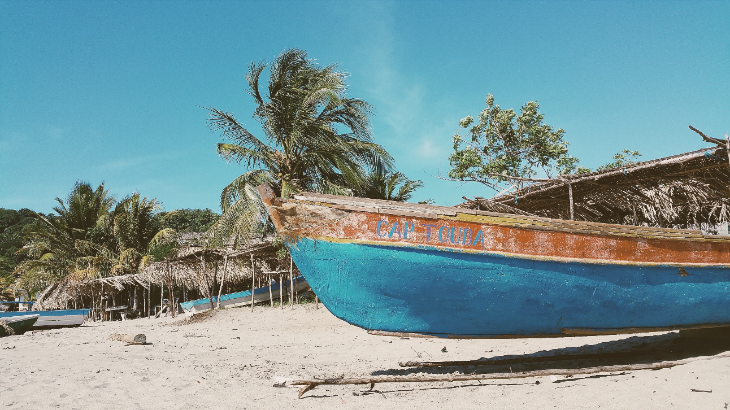
OUR LATEST WORKS
Entrepreneurial activities differ substantially depending on the type of organization and creativity involved. Entrepreneurship ranges in scale from solo, part-time projects to large-scale.
A company is an association or collection of individuals, whether natural persons, legal persons, or a mixture of both. Company members share a common purpose and unite in order to focus their various talents.

Slide 17
PART.04
04. PRETTY GIRL
Entrepreneurial activities differ substantially depending on the type of organization

Slide 18
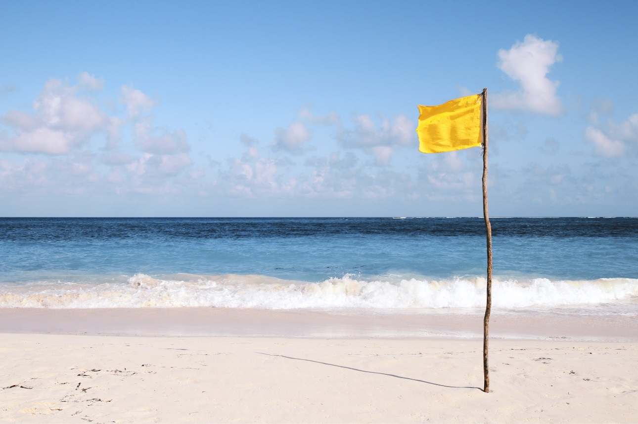
OUR LATEST WORKS
Entrepreneurial activities differ substantially depending on the type of organization and creativity involved. Entrepreneurship ranges in scale from solo, part-time projects to large-scale.

Slide 19
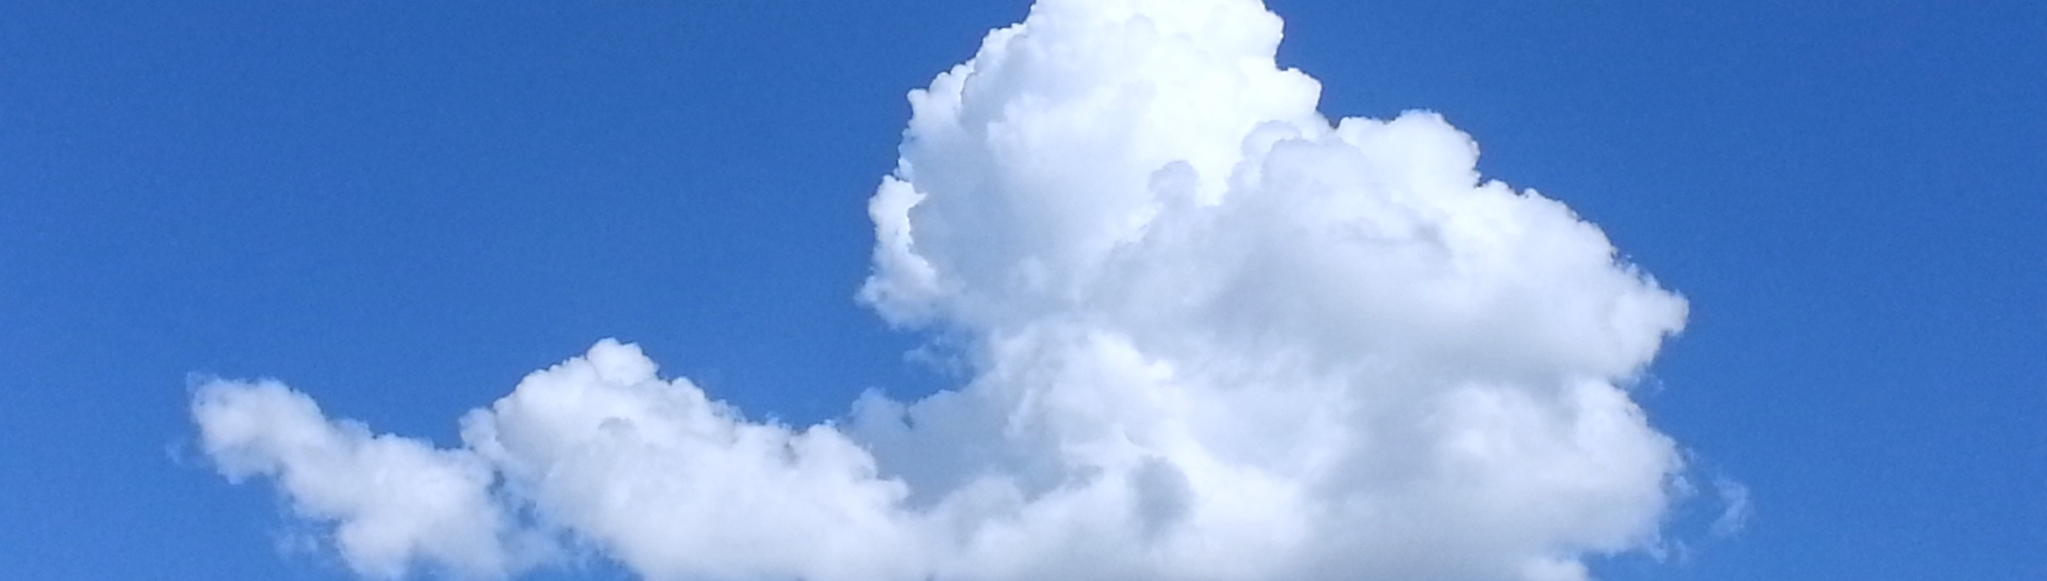
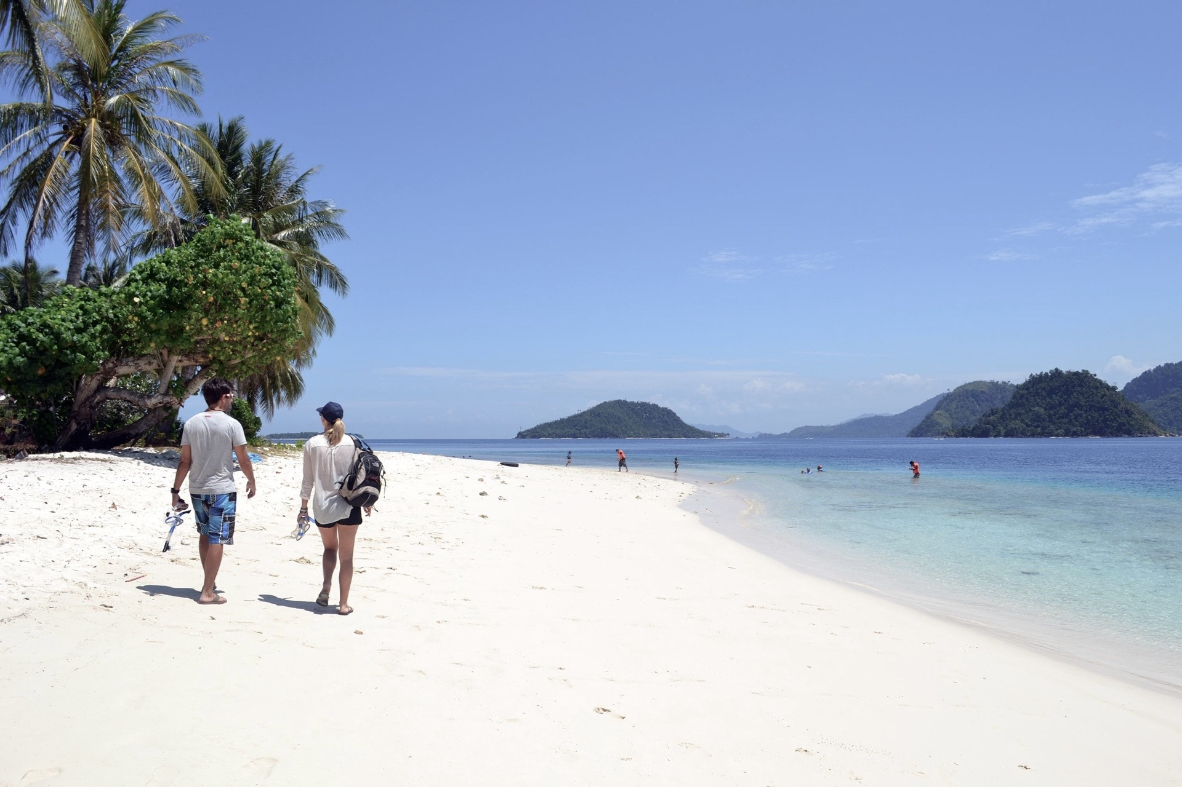
OUR LATEST WORKS
A company is an association or collection of individuals, whether natural persons, legal persons, or a mixture of both. Company members share a common purpose and unite in order to focus their various talents.
OUR LATEST WORKS
A company is an association or collection of individuals, whether natural persons, legal persons, or a mixture of both. Company members share a common purpose and unite in order to focus their various talents.

Slide 20
YOUR TITLE
A company is an association or collection of individuals, whether natural persons, legal persons, or a mixture of both. Company members share a common purpose and unite in order to focus their various talents and organize their collectively available skills or resources to achieve specific, declared goals

Slide 21
THANK YOU
There was no cloud in the air. There was no wind. There was only a hot sun overhead. All the trees stood idly and lazily.

