Slide 1
手 绘 总 结 通 用 模 板

Slide 2
C O N T E N T S
ADD TITLE HERE
1
Just for today I will try to live through
2
ADD TITLE HERE
Just for today I will try to live through
3
ADD TITLE HERE
Just for today I will try to live through
4
ADD TITLE HERE
Just for today I will try to live through

Slide 3
PART 01
THIS IS A REMO TEMPLATE ,THANK YOU WATCHING THIS ONE.THIS IS A REMO TEMPLATE ,THANK YOU WATCHING THIS ONE.

Slide 4
Just for today I will try to live through this day only and not tackle my whole life problem at once. I can do for twelve. Just for today I will try to live through this day only and not tackle my whole life problem at once. I can do for twelve.
ADD TITTLE HERE
THIS IS A REMO TEMPLATE ,THANK YOU WATCHING THIS ONE
Just for today I will try to live through this day only and not tackle my whole life problem at once. I can do for twelve. Just for today I will try to live through this day only and not tackle my whole life problem at once. I can do for twelve.

Slide 5
THIS IS A ART TEMPLATE ,THANK YOU WATCHING THIS ONE
Just for today I will try to live through this day only and not tackle my whole life problem at once. I can do for twelve hours that
Just for today I will try to live through this day only and not tackle my whole life problem at once. I can do for twelve hours that hours that Just for today I will try to live through this day only and not tackle my
Just for today I will exercise my soul in three ways. I will do somebody a good turnJust for today I will exercise my soul
hours that Just for today I will try to live through this day only and not tackle my whole life problem at once. I can do for twelve hours that Just for today I will try to live through this day only

Slide 6
leave night , Not a sound from the pavement Has the moon lost her memory She is smiling alone In the lamplight leave night , Not a sound
50%
60%
70%
Just for today I will exercise my soul in three ways. I will do somebody a good turn
Just for today I will exercise my soul in three ways. I will do somebody a good turn
Just for today I will exercise my soul in three ways. I will do somebody a good turn

Slide 7
ADD YOUR TITTLE HERE
THIS IS A REMO TEMPLATE ,THANK YOU WATCHING THIS ONE.THIS IS A REMO TEMPLATE ,THANK YOU WATCHING THIS ONE.
Just for today I will try to live through this day only and not tackle my whole life problem at once. I can do for twelve hours that Just for today I will try to live through this day. Just for today I will try to live through this day only

Slide 8
PART 02
THIS IS A REMO TEMPLATE ,THANK YOU WATCHING THIS ONE.THIS IS A REMO TEMPLATE ,THANK YOU WATCHING THIS ONE.

Slide 9
0 1
Just for today I will try to live through this day only and not tackle my whole life problem at once. I can do for twelve hours that
0 2
Just for today I will try to live through this day only and not tackle my whole life problem at once. I can do for twelve hours that
0 3
Just for today I will try to live through this day only and not tackle my whole life problem at once. I can do for twelve hours that
0 4
Just for today I will try to live through this day only and not tackle my whole life problem at once. I can do for twelve hours that

Slide 10
ADD TITTLE HERE
THIS IS A REMO TEMPLATE ,THANK YOU WATCHING THIS ONE
hours that Just for today I will try to live through this day only and not tackle my whole life problem at
hours that Just for today I will try to live through this day only and not tackle my whole life problem at
hours that Just for today I will try to live through this day only and not tackle my whole life problem at
hours that Just for today I will try to live through this day only and not tackle my whole life problem at

Slide 11
THIS IS A REMO TEMPLATE ,THANK YOU WATCHING THIS ONE.THIS IS A REMO TEMPLATE ,THANK YOU WATCHING THIS ONE.
Just for today I will try to live through this day only and not tackle my whole life problem at once. I can do for twelve hours that Just for today I will try to live through this day. Just for today I will try to live through this day only and not tackle my whole life problem at once.
ART TEMPLATE

Slide 12
01
02
03
ADD TITLE
ADD TITLE
ADD TITLE
Just for today I will try to live through this day only and not tackle my whole life problem at once. I can do for twelve hours that Just for
Just for today I will try to live through this day only and not tackle my whole life problem at once. I can do for twelve hours that Just for
Just for today I will try to live through this day only and not tackle my whole life problem at once. I can do for twelve hours that Just for

Slide 13
PART 03
THIS IS A REMO TEMPLATE ,THANK YOU WATCHING THIS ONE.THIS IS A REMO TEMPLATE ,THANK YOU WATCHING THIS ONE.

Slide 14
SUBTITLE
CLICK HERE TO ADD YOUR CONTENTS
SUBTITLE
CLICK HERE TO ADD YOUR CONTENTS
Just for today I will try to live through this day only and not tackle my whole life problem at once. I can do for twelve hours that Just for today I will try to live through this day

Slide 15
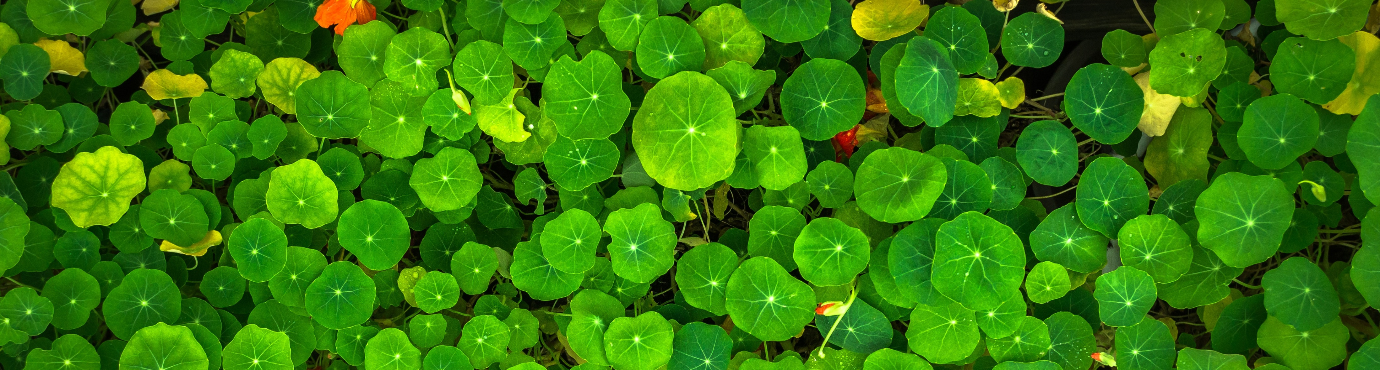
TITTLE HERE
TITTLE HERE
TITTLE HERE
Just for today I will try to live through this day only and not tackle my whole life once. I can do for twelve hours that Just for
Just for today I will try to live through this day only and not tackle my whole life once. I can do for twelve hours that Just for
Just for today I will try to live through this day only and not tackle my whole life once. I can do for twelve hours that Just for

Slide 16
ADD YOUR TITTLE
ADD YOUR TITTLE
Just for today I will exercise my soul in three ways. I will do somebody a good turn and not get found out: If anybody knows of it,
Just for today I will exercise my soul in three ways. I will do somebody a good turn and not get found out: If anybody knows of it,
1
3
2
4
ADD YOUR TITTLE
ADD YOUR TITTLE
Just for today I will exercise my soul in three ways. I will do somebody a good turn and not get found out: If anybody knows of it,
Just for today I will exercise my soul in three ways. I will do somebody a good turn and not get found out: If anybody knows of it,

Slide 17
PART 04
THIS IS A REMO TEMPLATE ,THANK YOU WATCHING THIS ONE.THIS IS A REMO TEMPLATE ,THANK YOU WATCHING THIS ONE.

Slide 18
6 7 %
3 2 %
Just for today I will try to live through this day only and not tackle my whole life problem at once.
Just for today I will try to live through this day only and not tackle my whole life problem at once.

Slide 19
STEP 01
STEP 02
Just for today I will try to live through this day only and not tackle my whole
Just for today I will try to live through this day only and not tackle my whole
STEP 03
STEP 04
Just for today I will try to live through this day only and not tackle my whole
Just for today I will try to live through this day only and not tackle my whole

Slide 20
感 谢 您 的 观 看

