Slide 1
SUMMER
Entrepreneurial activities differ substantially depending on the type of organization and creativity. Entrepreneurial activities differ
FANSION
20XX.09.25

Slide 2
CONTENTS
01.
Click here to add a title
02.
Click here to add a title
03.
Click here to add a title
04.
Click here to add a title

Slide 3
PART ONE
Click here to add a title

Slide 4
Entrepreneurial activities differ substantially depending on the type of organization and creativity. Entrepreneurial activities differ

Slide 5
YOUR TITLE HERE
YOUR TITLE HERE
YOUR TITLE HERE
Entrepreneurial activities differ substantially depending on the type of organization and creativity. Entrepreneurial

Slide 6
Entrepreneurial activities differ substantially depending on the type of organization and creativity. Entrepreneurial activities differ
SWOT

Slide 7
PART TWO
Click here to add a title

Slide 8
YOUR TITLE
YOUR TITLE
YOUR TITLE
YOUR TITLE
Entrepreneurial activities differ substantially depending on
Entrepreneurial activities differ substantially depending on
Entrepreneurial activities differ substantially depending on
Entrepreneurial activities differ substantially depending on

Slide 9
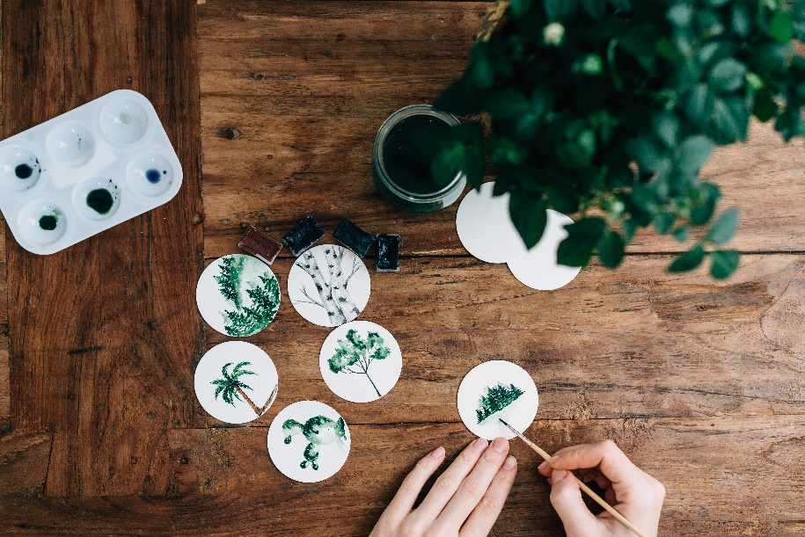
WRITE HERE SOMETHING
SUMMER
Entrepreneurial activities differ substantially depending on the type of organization and creativity. Entrepreneurial activities differ substantially depending on the type of organization and creativity

Slide 10
SUMMER

Slide 11
WRITE HERE SOMETHING
SUNMMER
Entrepreneurial activities differ substantially depending on the type of organization and creativity. Entrepreneurial activities differ substantially depending on the type of organization and creativity

Slide 12
PART THREE
Click here to add a title

Slide 13
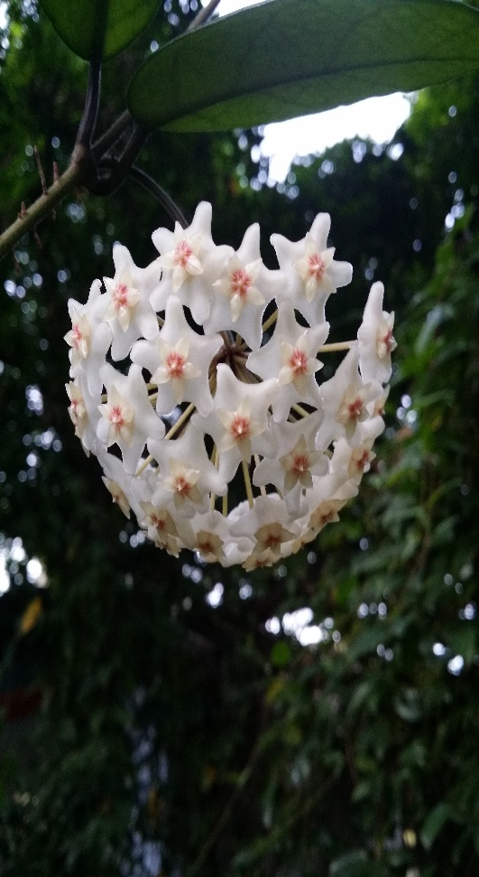
01
NICE DAY
Entrepreneurial activities differ substantially depending differ
02
NICE DAY
Entrepreneurial activities differ substantially depending differ

Slide 14
32%
Entrepreneurial activities differ substantially depending on the type of organization and creativity. Entrepreneurial activities differ

Slide 16
PART FOUR
Click here to add a title

Slide 17
W
Click here to add words
«
Click here to add words
Click here to add words
Click here to add words

Slide 18
S
SUMMER
Entrepreneurial activities differ substantially depending on the type of organization and creativity. Entrepreneurial activities differ

Slide 19
O
添加标题
添加标题
单击此处添加文本单击此处添加文本单击此处
单击此处添加文本单击此处添加文本单击此处
添加标题
添加标题
单击此处添加文本单击此处添加文本单击此处
单击此处添加文本单击此处添加文本单击此处
2017
2018
2019
2020

Slide 20
T
SUNMMER
Entrepreneurial activities differ substantially depending on the type of organization and creativity. Entrepreneurial activities differ substantially depending on the type of organization and creativity

Slide 21
GOODBYE
Entrepreneurial activities differ substantially depending on the type of organization and creativity. Entrepreneurial activities differ
FANSION
20XX.09.25

