Slide 1
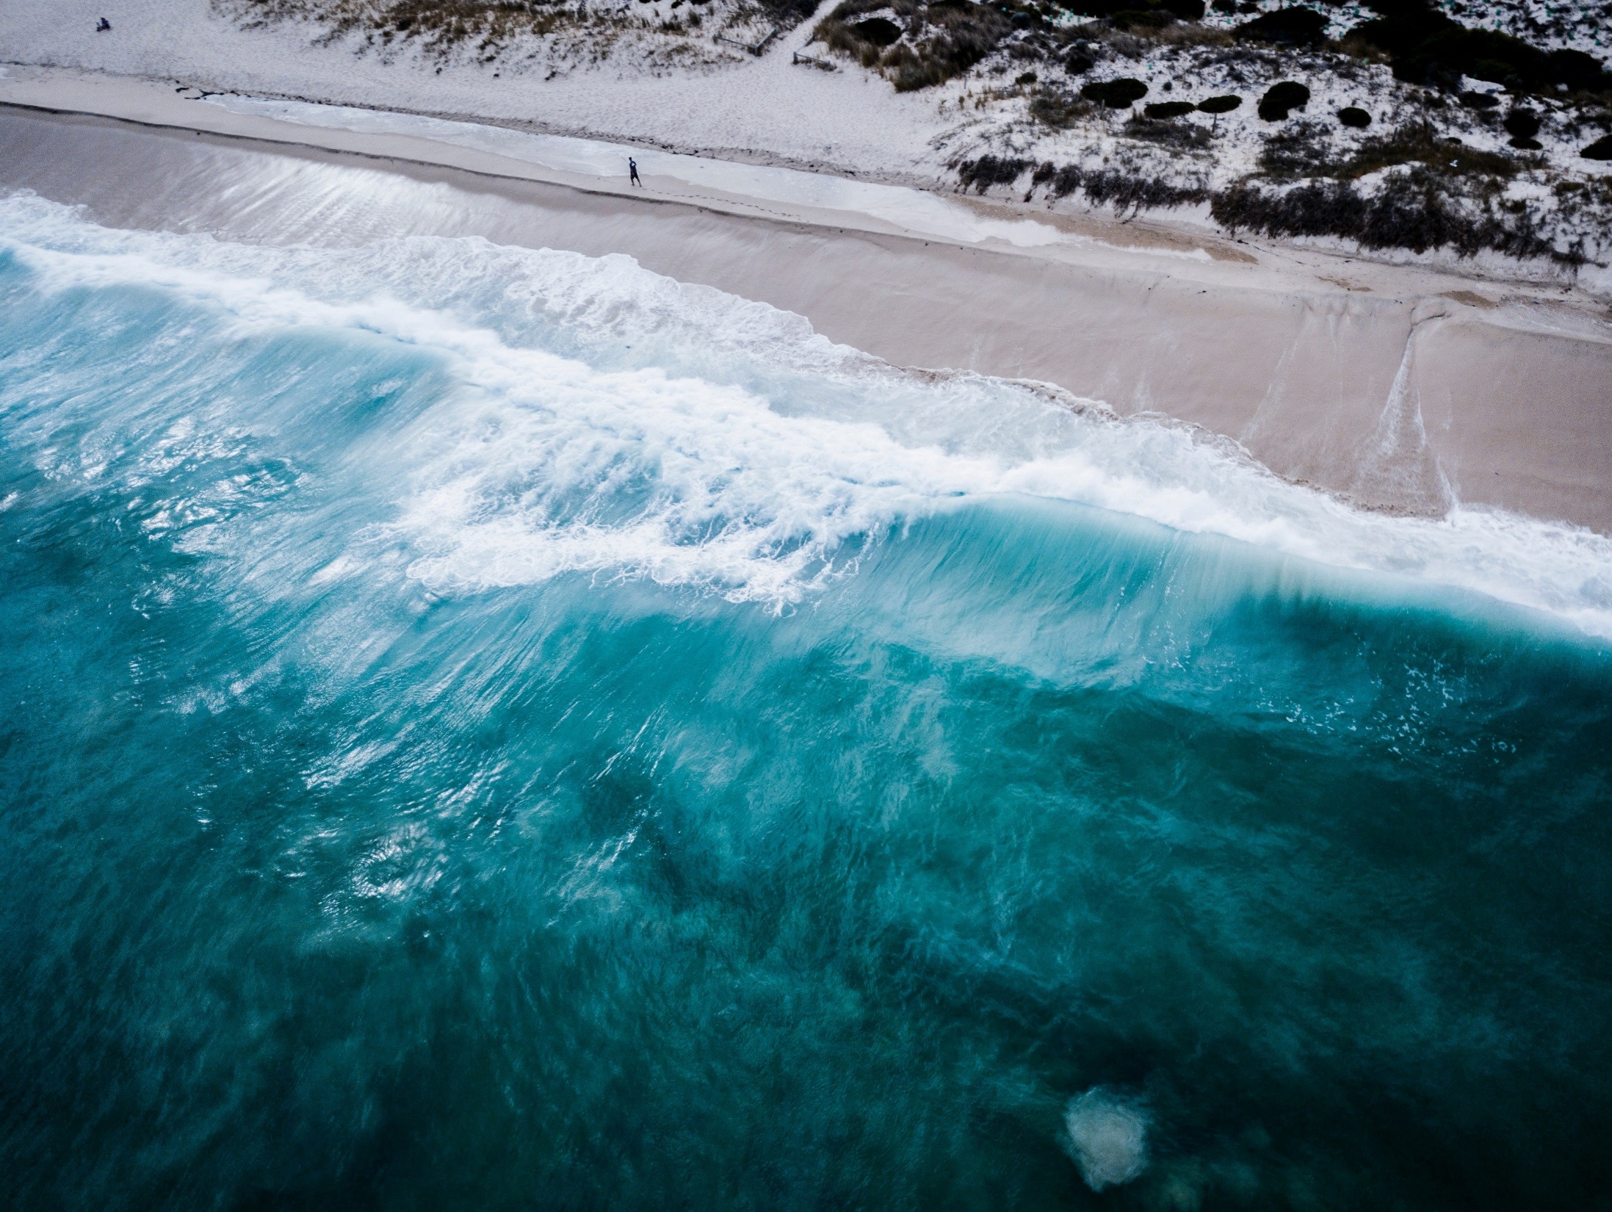
旷野的风
Put crepe bows round
the white necks of public doves, Let
the traffic policemen wear
black cotton gloves. He was my
North, my South, my East and West.

Slide 2
关于我们
About us
The stars are not wanted now:
put out every one;
Pack up the moon and dismantle the sun; Pour away the ocean and sweep up the wood; For nothing now can
ever come to any good.

Slide 3
目录
点 此 输 入 第 一 章 标 题
点 此 输 入 第 一 章 标 题
点 此 输 入 第 一 章 标 题
点 此 输 入 第 一 章 标 题
总 结

Slide 4
Headlines

Slide 5
旷野的风
Click here to enter the text of this section

Slide 6
Subtitle
Subtitle
Subtitle

Slide 7
Title
Subtitle
Title
Subtitle
Title
Subtitle

Slide 8
输入文本
输入文本
输入文本
Subtitle
Subtitle
Subtitle

Slide 9
文本内容
Text content
The stars
are not wanted now:
put out every
one; Pack up the moon and dismantle the sun

Slide 10
旷野的风
Click here to enter the text of this section

Slide 11
Click here to
input the replacement
text and suggest
replacing it with this
speech.
Click here to
input the replacement
text and suggest
replacing it with this
speech.
Click here to
input the replacement
text and suggest
replacing it with this
speech.

Slide 12
此处标题
Text content
The stars
are not wanted now:
put out every
one; Pack up the moon and dismantle the sun;

Slide 13
Headlines
The stars
are not wanted now:
put out every one;
Pack up the moon and
dismantle the sun;

Slide 14
My working week and my
Sunday rest,
My noon, my midnight,
my talk, my song;
I thought that
love would last forever;
I was wrong.

Slide 15
旷野的风
Click here to enter the text of this section

Slide 16
此处标题
The stars are not
wanted now: put out every one;
Pack up the moon and dismantle the sun;

Slide 17
Headlines
The stars
are not wanted now:
put out every one;
Pack up the moon and
dismantle the sun;

Slide 18
Subtitle
Subtitle
Subtitle

Slide 19
大海沙滩
Text content
The stars
are not wanted now:
put out every
one; Pack up the moon and dismantle the sun;

Slide 20
总 结
Click here to enter the text of this section

Slide 21
总结
Pack up the moon and dismantle the sun;
Pour away the ocean and sweep up the wood; For nothing now can ever come to any good.

Slide 22
感谢欣赏

