Slide 1

“Feel The Charm Of Existence
“Feel The Charm Of Existence
Creative Business
植物系文艺范
BUSINESS REPORT

Slide 2

01
A wonderful serenity has taken possession of my entire soul, like these sweet mornings of spring which I enjoy
YOUR CONTENTS
02
A wonderful serenity has taken possession of my entire soul, like these sweet mornings of spring which I enjoy
03
A wonderful serenity has taken possession of my entire soul, like these sweet mornings of spring which I enjoy
04
A wonderful serenity has taken possession of my entire soul, like these sweet mornings of spring which I enjoy

Slide 3

Part One
Presentation Template

Slide 4

Creative Business
Upcoming Work Shop This Week
August
18
Title
Check Out
2021
For 30 Minutes
A wonderful serenity has taken possession of my entire soul, like these sweet mornings of spring which I enjoy with my whole heart.
@HAOKE
@HAOKE
@HAOKE

Slide 5

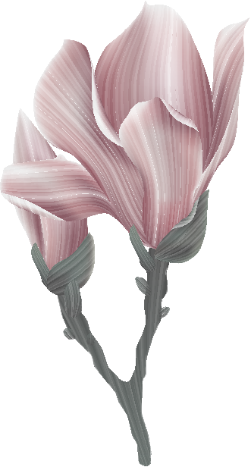
Creative Business
Better Think Better Smart
A wonderful serenity has taken possession of my entire soul, like these sweet mornings of spring which I enjoy with my whole heart. I am alone, and feel the charm of existence in this spot, which was created for the bliss of souls like mine.
1998 serenity has taken possession of my entire soul, like these sweet mornings

Slide 6

Breaking News
A wonderful serenity has taken possession of my entire soul, like these sweet mornings of spring which I enjoy
A wonderful serenity has taken possession of my entire soul, like these sweet mornings of spring which I enjoy
Better Think Better
A wonderful serenity has taken possession of my entire soul, like these sweet mornings of spring which I enjoy with my whole heart. I am alone, and feel the charm of existence in this spot, which was created for the bliss of souls like mine. I am so happy, my dear friend, so absorbed in the exquisite sense of mere tranquil existence, that I neglect my talents.

Slide 7

$56k
Our University
Your Text Goes Here
Better Think Smart
A wonderful serenity has taken possession of my entire soul, like these sweet mornings of spring which I enjoy
28%
Your Text Goes Here
A wonderful serenity has taken possession of my entire soul, like these sweet mornings
When, while the lovely valley teems with around me, and the meridian
A wonderful serenity has taken possession of my entire soul, like these sweet mornings of spring which I enjoy with my whole heart.

Slide 8
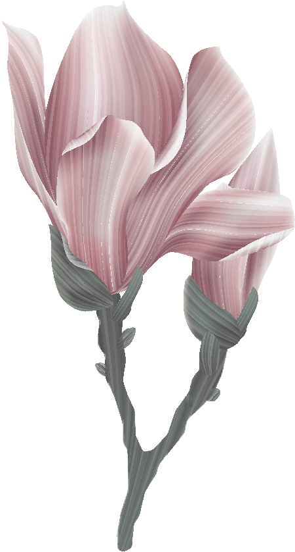
Designer
²⁰²¹
Creative Business
We Love Teamwork
Your Text Goes Here
A wonderful serenity has taken possession of my entire soul, like these sweet mornings
²⁰²¹
When, while the lovely valley teems with around me, and the meridian
Your Text Goes Here
A wonderful serenity has taken possession of my entire soul, like these sweet mornings of spring which I enjoy with my whole heart. I am alone, and feel the charm of existence in this spot, which was created for the bliss of souls like mine. I am so happy, my dear friend, so absorbed in the exquisite sense of mere tranquil existence, that I neglect my talents.
A wonderful serenity has taken possession of my entire soul, like these sweet mornings
GET STARTED NOW

Slide 9



Part Two
Presentation Template

Slide 10

Creative Business
When, while the lovely valley teems with around me, and the meridian
New Package Open last Moon!
A wonderful serenity has taken possession of my entire soul, like these sweet mornings of spring which I enjoy with my whole heart. I am alone, and feel the charm of existence in this spot, which was created for the bliss of souls like mine. I am so happy, my dear friend, so absorbed in the exquisite sense of mere tranquil existence, that I neglect my talents.
Which Was Created For The Bliss Of Souls Like Mine. I Am So Happy, My Dear Friend.
$99/Day
A wonderful serenity has taken possession of my entire soul, like these sweet mornings of spring which I enjoy
GET STARTED NOW

Slide 11




Our Partner
Graphic River
Themeforest
Photodune
Videohive
A wonderful serenity
A wonderful serenity
A wonderful serenity
A wonderful serenity
5678+
3908+
2009+
1267+
A wonderful serenity has taken possession of my entire soul
A wonderful serenity has taken possession of my entire soul
A wonderful serenity has taken possession of my entire soul
A wonderful serenity has taken possession of my entire soul

Slide 12


Creative Business
College Students
A wonderful serenity has taken possession of my entire soul, like these sweet mornings of spring which I enjoy with my whole heart. I am alone
Gender Classification
1500+
A wonderful serenity has taken possession of my entire soul, like these sweet mornings of spring which I enjoy
900+
A wonderful serenity has taken possession of my entire soul, like these sweet mornings of spring which I enjoy

Slide 13

Fresh Graduate
A wonderful serenity has taken possession of my entire soul, like these sweet mornings of spring which I enjoy with my whole heart. I am alone, and feel the charm of existence in this spot, which was created for the bliss of souls like mine.
90,1
Quis Nostrud exerci tation ullamcorper
A wonderful serenity has taken possession of my entire soul, like these sweet mornings of spring which I enjoy with my whole heart. I am alone, and feel the charm of existence in this spot, which was created for the bliss of souls like mine.

Slide 14

Education
A wonderful serenity has taken possession of my entire soul, like these sweet mornings of spring which I enjoy with my whole heart. I am alone, and feel the charm
Better Think Better Smart
OVERVIEW PICTURE
01
20 March 2018
02
20 March 2018
03
20 March 2018

Slide 15




A wonderful serenity has taken possession of my entire soul, like these sweet mornings of spring which I enjoy with my whole heart.
Evelin- Design Communication
Creative Business
“A wonderful serenity has taken possession of my entire soul, like these sweet mornings of spring which I enjoy with my whole heart.
Students College Comment
Jonathan – Technology Information
A wonderful serenity has taken possession of my entire soul, like these sweet mornings of spring which I enjoy with my whole heart.
Lionel Wiz – Web Design

Slide 16


Part Three
Presentation Template

Slide 17
WHATCH, LEARN, CREATE.
#LetsDoIt
Story Of Success
Campus Life
Inspiring Person
A wonderful serenity has taken possession of my entire soul
A wonderful serenity has taken possession of my entire soul
A wonderful serenity has taken possession of my entire soul

Slide 18

CAMPUS LIFE
When, while the lovely valley teems with around me, and the meridian
A wonderful serenity has taken possession of my entire soul, like these sweet mornings of spring which I enjoy with my whole heart. I am alone, and feel the charm of existence in this spot, which was created for the bliss of souls like mine. I am so happy, my dear friend, so absorbed in the exquisite sense of mere tranquil existence, that I neglect my talents.
#Campuslife
1500+
A wonderful serenity has taken possession of my entire soul, like these sweet mornings of spring which I enjoy
900+
A wonderful serenity has taken possession of my entire soul, like these sweet mornings of spring which I enjoy

Slide 19
First Step
Second Step
A wonderful serenity has taken possession of my entire soul
A wonderful serenity has taken possession of my entire soul
Two Ways To Be Smart
A wonderful serenity has taken possession of my entire soul, like these sweet mornings of spring which I enjoy with my whole heart. I am alone, and feel the charm of existence in this spot

Slide 20
About Member
Team Working
A wonderful serenity has taken possession of my entire soul, like these sweet mornings of spring which I enjoy with my whole heart. I am alone, and feel the charm of existence in this spot, which was created for the bliss of souls like mine. I am so happy, my dear friend, so absorbed in the exquisite sense of mere tranquil existence.
A wonderful serenity has taken possession of my entire soul, like these sweet mornings of spring which I enjoy with my whole heart. I am alone, and feel the charm of existence in this spot, which was created for the bliss of souls like mine. I am so happy, my dear friend, so absorbed in the exquisite sense of mere tranquil existence.

Slide 21

Part Four
Presentation Template

Slide 22

27 Sep 2021
Fresh Graduate
Networking
A wonderful serenity has taken possession of my entire soul, like these sweet mornings of spring which I enjoy with my whole heart.
A wonderful serenity has taken possession of my entire soul, like these sweet mornings of spring which I enjoy with my whole heart.
Important Point
Learn A Book
Creative Idea
A wonderful serenity has taken possession of my entire soul, like these sweet mornings of spring which I enjoy with my whole heart. I am alone, and feel the charm of existence in this spot, which was created for the bliss of souls like mine.
A wonderful serenity has taken possession of my entire soul, like these sweet mornings of spring which I enjoy with my whole heart.
A wonderful serenity has taken possession of my entire soul, like these sweet mornings of spring which I enjoy with my whole heart.

Slide 23

Creative Business
We Love Teamwork
When, while the lovely valley teems with around me, and the meridian
A wonderful serenity has taken possession of my entire soul, like these sweet mornings of spring which I enjoy with my whole heart. I am alone, and feel the charm of existence in this spot.
Your Title Here
Your Title Here
Your Title Here
Your Title Here
A wonderful serenity has taken possession of my entire soul
A wonderful serenity has taken possession of my entire soul
A wonderful serenity has taken possession of my entire soul
A wonderful serenity has taken possession of my entire soul

Slide 24
University
ANNOUNCEMENT
“A wonderful serenity has taken possession of my entire soul, like these sweet mornings of spring which I enjoy with my whole heart.
I am alone, and feel the charm of existence in this spot, which was created for the bliss of souls like mine. I am so happy, my dear friend, so absorbed in the exquisite sense of mere tranquil existence, that I neglect my talents.
User Name
@username
@username

Slide 25

Find Us On Social Media
A wonderful serenity has taken possession of my entire soul, like these sweet mornings of spring which I enjoy with my whole heart. I am alone, and feel the charm of existence in this spot, which was created for the bliss of souls like mine.
@HAOKE.COM
@HAOKE.COM
@HAOKE.COM

Slide 26
“Feel The Charm Of Existence
“Feel The Charm Of Existence
Creative Business
THANK YOU
BUSINESS REPORT

