Slide 1
蓝色手绘爱心猫咪模板
Blue hand-painted love cat template
Click here to add your subtitle click here to add your subtitle click here to add your subtitle

Slide 2
目 录
CONTENTS
添加标题文字
Click here to add your subtitle click here to add your subtitle
添加标题文字
Click here to add your subtitle click here to add your subtitle
添加标题文字
Click here to add your subtitle click here to add your subtitle
添加标题文字
Click here to add your subtitle click here to add your subtitle

Slide 3
第一章节
添加输入标题内容
Click here to add your subtitle click here to add your subtitle Click here to add your subtitle click here to add your subtitle

Slide 4
添加输入标题内容
Click here to add your subtitle click here
标题文字内容
Was never one to patiently pick up broken fragments and new is broken--and rather remember it as it was at its best than mend see the broken places pick up broken fragments and new
Was never one to patiently pick up broken fragments and new is broken--and rather remember it as it was at

Slide 5
添加输入标题内容
Click here to add your subtitle click here
添加标题
添加标题
Was never one to patiently pick up broken and
new What is broken and rather, Was never
patiently pick up broken
Was never one to patiently pick up broken and
new What is broken and rather, Was never
patiently pick up broken
添加标题
添加标题
Was never one to patiently pick up broken and
new What is broken and rather, Was never
patiently pick up broken
Was never one to patiently pick up broken and
new What is broken and rather, Was never
patiently pick up broken

Slide 6
添加输入标题内容
Click here to add your subtitle click here
文字内容
文字内容
Was never one to patiently pick up broken fragments and new is broken--and rather remember it as it was at its best than mend see the broken places pick up broken fragments and new
Was never one to patiently pick up broken fragments and new is broken--and rather remember it as it was at its best than mend see the broken places pick up broken fragments and new

Slide 7
第二章节
添加输入标题内容
Click here to add your subtitle click here to add your subtitle Click here to add your subtitle click here to add your subtitle

Slide 8
添加输入标题内容
Click here to add your subtitle click here
标题文字内容
Was never one to patiently pick up broken fragments and new is broken--and rather remember it as it was at its best than mend see the broken places pick up broken fragments and new
Was never one to patiently pick up broken fragments and new is broken--and rather remember it as it was at

Slide 9
添加输入标题内容
Click here to add your subtitle click here
添加标题
添加标题
Was never one to patiently pick up broken fragments and new What is broken and rather
Was never one to patiently pick up broken fragments and new What is broken and rather
添加标题
添加标题
Was never one to patiently pick up broken fragments and new What is broken and rather
Was never one to patiently pick up broken fragments and new What is broken and rather

Slide 10
添加输入标题内容
Click here to add your subtitle click here
文字内容
文字内容
文字内容
文字内容
Was never one to patiently pick up broken fragments and new is broken--and rather remember it as it was at its best than mend see the broken places pick up broken fragments
and new
Was never one to patiently pick up broken fragments and new is broken--and rather remember it as it was at its best than mend see the broken places pick up broken fragments
and new
Was never one to patiently pick up broken fragments and new is broken--and rather remember it as it was at its best than mend see the broken places pick up broken fragments
and new
Was never one to patiently pick up broken fragments and new is broken--and rather remember it as it was at its best than mend see the broken places pick up broken fragments
and new

Slide 11
第三章节
添加输入标题内容
Click here to add your subtitle click here to add your subtitle Click here to add your subtitle click here to add your subtitle

Slide 12
添加输入标题内容
Click here to add your subtitle click here
文字内容
文字内容
Was never one to patiently pick up broken fragments and new is broken--and rather remember it as it was at its best than mend see the broken places pick up broken fragments and new
Was never one to patiently pick up broken fragments and new is broken--and rather remember it as it was at its best than mend see the broken places pick up broken fragments and new

Slide 13
添加输入标题内容
Click here to add your subtitle click here
文字内容
文字内容
文字内容
Was never one to patiently pick up broken fragments and new What is broken and rather
Was never one to patiently pick up broken fragments and new What is broken and rather
Was never one to patiently pick up broken fragments and new What is broken and rather

Slide 14
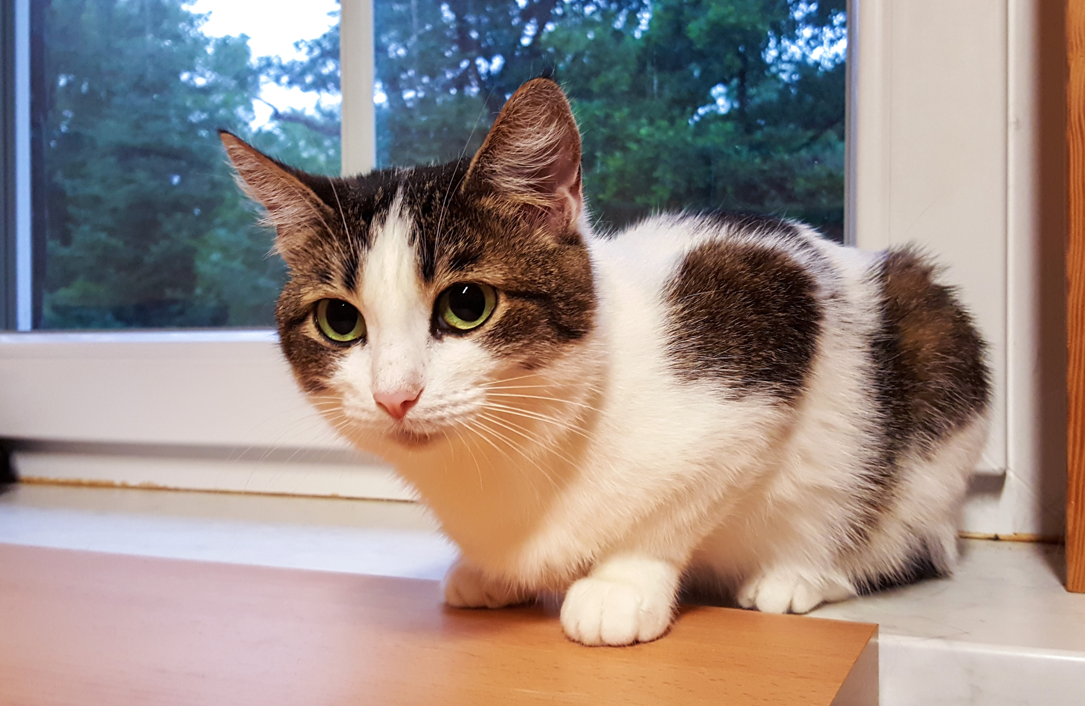


添加输入标题内容
Click here to add your subtitle click here
添加文字内容
Was never one to patiently pick up broken fragments and new What is broken and rather remember it as
添加文字内容
添加文字内容
Was never one to patiently pick up broken fragments and new
Was never one to patiently pick up broken fragments and new

Slide 15
第四章节
添加输入标题内容
Click here to add your subtitle click here to add your subtitle Click here to add your subtitle click here to add your subtitle

Slide 16


添加输入标题内容
Click here to add your subtitle click here
添加文字内容
Was never one to patiently pick up broken fragments and new is broken--and rather remember it as it was at its best than mend see the broken places pick up broken fragments and new
Was never one to patiently pick up broken fragments and new is broken--and rather remember it as it was

Slide 17
添加输入标题内容
Click here to add your subtitle click here
文字内容
文字内容
Was never one to patiently pick up broken fragments and new What is broken and rather
Was never one to patiently pick up broken fragments and new What is broken and rather
文字内容
文字内容
Was never one to patiently pick up broken fragments and new What is broken and rather
Was never one to patiently pick up broken fragments and new What is broken and rather

Slide 18
感谢大家的聆听
Thank you all for listening

