Slide 1
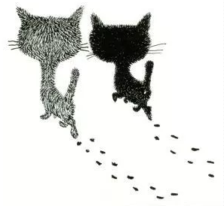
可爱小喵
Just for today I will try to live through this day only and not tackle my whole life problem at once. Just for today I will try to live through this day only and not tackle my whole life problem at once.

Slide 2
目 录
01
02
03
04
ADD TITTLE HERE
ADD TITTLE HERE
ADD TITTLE HERE
ADD TITTLE HERE
Just for today I will try to live through this day only and not tackle my
Just for today I will try to live through this day only and not tackle my
Just for today I will try to live through this day only and not tackle my
Just for today I will try to live through this day only and not tackle my

Slide 3
Just for today I will try to live through this day only and not tackle my whole life problem at once. Just for today I will try to live through this day only and not tackle my whole life problem at once.
01

Slide 4
Just for today I will try to live through this day only and not tackle my whole life at once. I can do Just for today I will try
TITTLE HERE
Just for today I will try to live through this day only and not tackle my whole life at once. I can do Just for today I will try
TITTLE HERE
Just for today I will try to live through this day only and not tackle my whole life at once. I can do Just for today I will try
TITTLE HERE

Slide 5
TITTLE HERE
Just for today I will try to live through this day only and not tackle my whole life at once. I can do Just for today I will try
TITTLE HERE
Just for today I will try to live through this day only and not tackle my whole life at once. I can do Just for today I will try

Slide 6
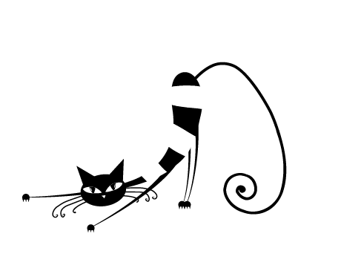
TITTLE HERE
TITTLE HERE
Just for today I will try to live through this day only and not tackle my whole life at once. I can do Just for today I will try
Just for today I will try to live through this day only and not tackle my whole life at once. I can do Just for today I will try
TITTLE HERE
TITTLE HERE
Just for today I will try to live through this day only and not tackle my whole life at once. I can do Just for today I will try
Just for today I will try to live through this day only and not tackle my whole life at once. I can do Just for today I will try

Slide 7
Just for today I will try to live through this day only and not tackle my whole life at once. I can do Just for today I will try
TITTLE HERE
Just for today I will try to live through this day only and not tackle my whole life at once. I can do Just for today I will try
TITTLE HERE

Slide 8
Just for today I will try to live through this day only and not tackle my whole life problem at once. Just for today I will try to live through this day only and not tackle my whole life problem at once.
02

Slide 9
Just for today I will try to live through this day only and not tackle my whole life at once. I can do Just for today I will try
TITTLE HERE
Just for today I will try to live through this day only and not tackle my whole life at once. I can do Just for today I will try
TITTLE HERE

Slide 10
TITTLE HERE
TITTLE HERE
TITTLE HERE
Just for today I will try to live through this day only and not tackle my whole life at once. I can do Just for today I will try
Just for today I will try to live through this day only and not tackle my whole life at once. I can do Just for today I will try
Just for today I will try to live through this day only and not tackle my whole life at once. I can do Just for today I will try

Slide 11
TITTLE HERE
Just for today I will try to live through this day only and not tackle my whole life at once. I can do Just for today I will try
TITTLE HERE
Just for today I will try to live through this day only and not tackle my whole life at once. I can do Just for today I will try

Slide 12
Just for today I will try to live through this day only and not tackle my whole life problem at once. Just for today I will try to live through this day only and not tackle my whole life problem at once.
03

Slide 13
Just for today I will try to live through this day only and not tackle my whole life at once. I can do Just for today I will try
TITTLE HERE
Just for today I will try to live through this day only and not tackle my whole life at once. I can do Just for today I will try
TITTLE HERE

Slide 14
Just for today I will try to live through this day only and not tackle my whole life problem at once. Just for today I will try to live through this day only and not tackle my whole life problem at once.
04

Slide 15
TITTLE HERE
Just for today I will try to live through this day only and not tackle my whole life at once. I can do Just for today I will try
TITTLE HERE
Just for today I will try to live through this day only and not tackle my whole life at once. I can do Just for today I will try

Slide 16
谢
谢
Just for today I will try to live through this day only and not tackle my whole life problem at once. Just for today I will try to live through this day only and not tackle my whole life problem at once.

