Slide 1
MORANDI
SIMPLE BUSINESS WORK SCHEDULE
Distant Time by Rabindranath. I know not from what distant time .thou art ever coming nearer to meet me thou art ever coming nearer to meet me
XXX

Slide 2
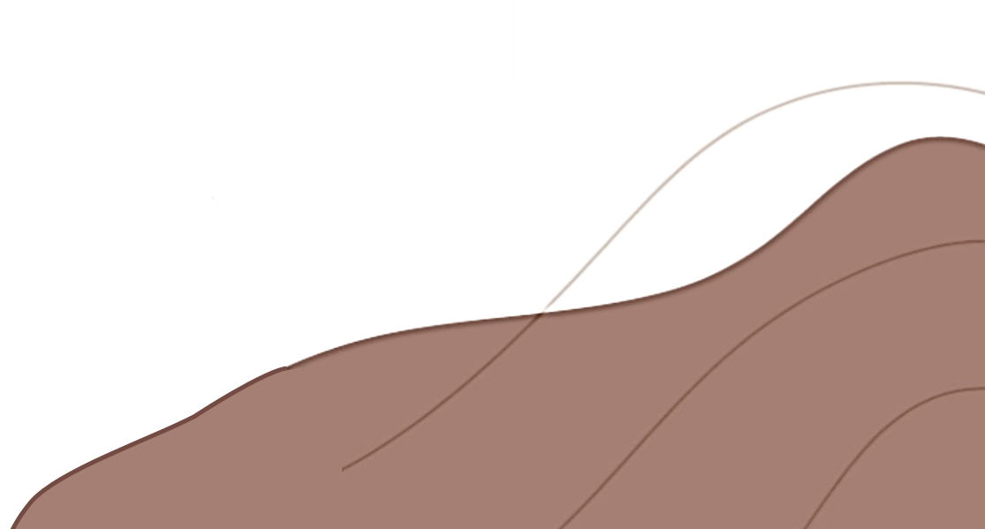
01
工作内容回顾
Review of work content
02
工作难点分析
目录
Analysis of work difficulties
CONTENTS
03
市场状况概述
Overview of market conditions
04
未来工作计划
Plans for future work

Slide 3
工作内容回顾
Review of work content
Distant Time by Rabindranath. I know not from what distant time .thou art ever coming nearer to meet me thou art ever coming nearer to meet me
Part 01

Slide 4
工作内容回顾
Review of work content
工作内容回顾
Distant Time by Rabindranath. I know not from what distant time thou art ever coming nearer to meet me. I know not from what distant time. Distant Time by Rabindranath. I know not from what distant time thou art ever coming nearer to meet me.
Distant Time by Rabindranath. I know not from what distant time thou art ever coming nearer to meet me. I know not from what distant time.
77%
65%
50%
95%

Slide 5
工作内容回顾
Review of work content
工作内容回顾
Distant Time by Rabindranath. I know not from what distant time thou art ever coming nearer to meet me. I know not from what distant time. Distant Time by Rabindranath. I know not from what distant time thou art ever coming nearer to meet me.
工作内容回顾
工作内容回顾
Distant Time by Rabindranath. I know not from what distant time thou art ever coming nearer to meet me
Distant Time by Rabindranath. I know not from what distant time thou art ever coming nearer to meet me

Slide 6
工作难点分析
Analysis of work difficulties
Distant Time by Rabindranath. I know not from what distant time .thou art ever coming nearer to meet me thou art ever coming nearer to meet me
Part 02

Slide 7
工作难点分析
Analysis of work difficulties
工作难点分析
工作难点分析
Distant Time by Rabindranath. I know not from what distant time thou art ever coming nearer to meet me.
Distant Time by Rabindranath. I know not from what distant time thou art ever coming nearer to meet me.
Distant Time by Rabindranath. I know not from what distant time thou art ever coming nearer to meet me.
Distant Time by Rabindranath. I know not from what distant time thou art ever coming nearer to meet me.
Distant Time by Rabindranath. I know not from what distant time thou art ever coming nearer to meet me.
Distant Time by Rabindranath. I know not from what distant time thou art ever coming nearer to meet me.
Distant Time by Rabindranath. I know not from what distant time thou art ever coming nearer to meet me. I know not from what distant time. Distant Time by Rabindranath. I know not from what distant time thou art ever coming nearer to meet me.
Distant Time by Rabindranath. I know not from what distant time thou art ever coming nearer to meet me. I know not from what distant time.

Slide 8
工作难点分析
Analysis of work difficulties
工作难点分析
Distant Time by Rabindranath. I know not from what distant time thou art ever coming nearer to meet me. I know not from what distant time.
工作难点分析
Distant Time by Rabindranath. I know not from what distant time thou art ever coming nearer to meet me. I know not from what distant time.
工作难点分析
Distant Time by Rabindranath. I know not from what distant time thou art ever coming nearer to meet me. I know not from what distant time.
工作难点分析
Distant Time by Rabindranath. I know not from what distant time thou art ever coming nearer to meet me. I know not from what distant time.

Slide 9
市场状况概况
Overview of market conditions
Distant Time by Rabindranath. I know not from what distant time .thou art ever coming nearer to meet me thou art ever coming nearer to meet me
Part 03

Slide 10
市场状况概况
Overview of market conditions
市场状况概况
市场状况概况
市场状况概况
市场状况概况
Distant Time by Rabindranath. I know not from what distant time thou art ever coming nearer to meet me. I know not from what distant time.
Distant Time by Rabindranath. I know not from what distant time thou art ever coming nearer to meet me. I know not from what distant time.
Distant Time by Rabindranath. I know not from what distant time thou art ever coming nearer to meet me. I know not from what distant time.
Distant Time by Rabindranath. I know not from what distant time thou art ever coming nearer to meet me. I know not from what distant time.

Slide 11
市场状况概况
Overview of market conditions
01
市场状况概况
Distant Time by Rabindranath. I know not from what distant time thou art ever coming nearer to meet me. I know not from what distant time.
02
市场状况概况
Distant Time by Rabindranath. I know not from what distant time thou art ever coming nearer to meet me. I know not from what distant time.
03
市场状况概况
Distant Time by Rabindranath. I know not from what distant time thou art ever coming nearer to meet me. I know not from what distant time.
04
市场状况概况
Distant Time by Rabindranath. I know not from what distant time thou art ever coming nearer to meet me. I know not from what distant time.

Slide 12
未来工作计划
Plans for future work
Distant Time by Rabindranath. I know not from what distant time .thou art ever coming nearer to meet me thou art ever coming nearer to meet me
Part 04

Slide 13
未来工作计划
Plans for future work
未来工作计划
单机输入标题
Distant Time by Rabindranath. I know not from what distant time thou art ever coming nearer to meet me. I know not from what distant time.
Distant Time by Rabindranath. I know not from what distant time thou art ever coming nearer to meet me. I know not from what distant time. Distant Time by Rabindranath. I know not from what distant time thou art ever coming nearer to meet me.
Distant Time by Rabindranath. I know not from what distant time thou art ever coming nearer to meet me. I know not from what distant time.
单机输入标题
Distant Time by Rabindranath. I know not from what distant time thou art ever coming nearer to meet me. I know not from what distant time.
单机输入标题
Distant Time by Rabindranath. I know not from what distant time thou art ever coming nearer to meet me. I know not from what distant time.

Slide 14
未来工作计划
Plans for future work
未来工作计划
未来工作计划
未来工作计划
未来工作计划
Distant Time by Rabindranath. I know not from what distant time thou art ever coming nearer to meet me. I know not from what distant time.
Distant Time by Rabindranath. I know not from what distant time thou art ever coming nearer to meet me. I know not from what distant time.
Distant Time by Rabindranath. I know not from what distant time thou art ever coming nearer to meet me. I know not from what distant time.
Distant Time by Rabindranath. I know not from what distant time thou art ever coming nearer to meet me. I know not from what distant time.

Slide 15
THANK YOU
Thank you for watching my work and correct me
Distant Time by Rabindranath. I know not from what distant time .thou art ever coming nearer to meet me thou art ever coming nearer to meet me
XXX

Slide 16
感谢您の支持，送您一套常用可替换图标：

