Slide 1
今夜海风
Click here to input the replacement
text and suggest replacing it with this speech

Slide 2
今夜
B R E E Z E
晚风
The stars are not wanted now:
put out every one; Pack up the moon and dismantle the sun; Pour away
the ocean and sweep up the wood;

Slide 3
今夜海风
The stars are not
wanted now:
put out every one; Pack
up the moon
and dismantle the sun;
The stars are not wanted now

Slide 4
海风
The stars are not wanted now:
put out every one; Pack up the moon
and dismantle the sun;
The stars are not wanted now
put out every one; Pack up
the moon and dismantle the sun; Pour away
the ocean and sweep up the wood
今 夜 的 海

Slide 5
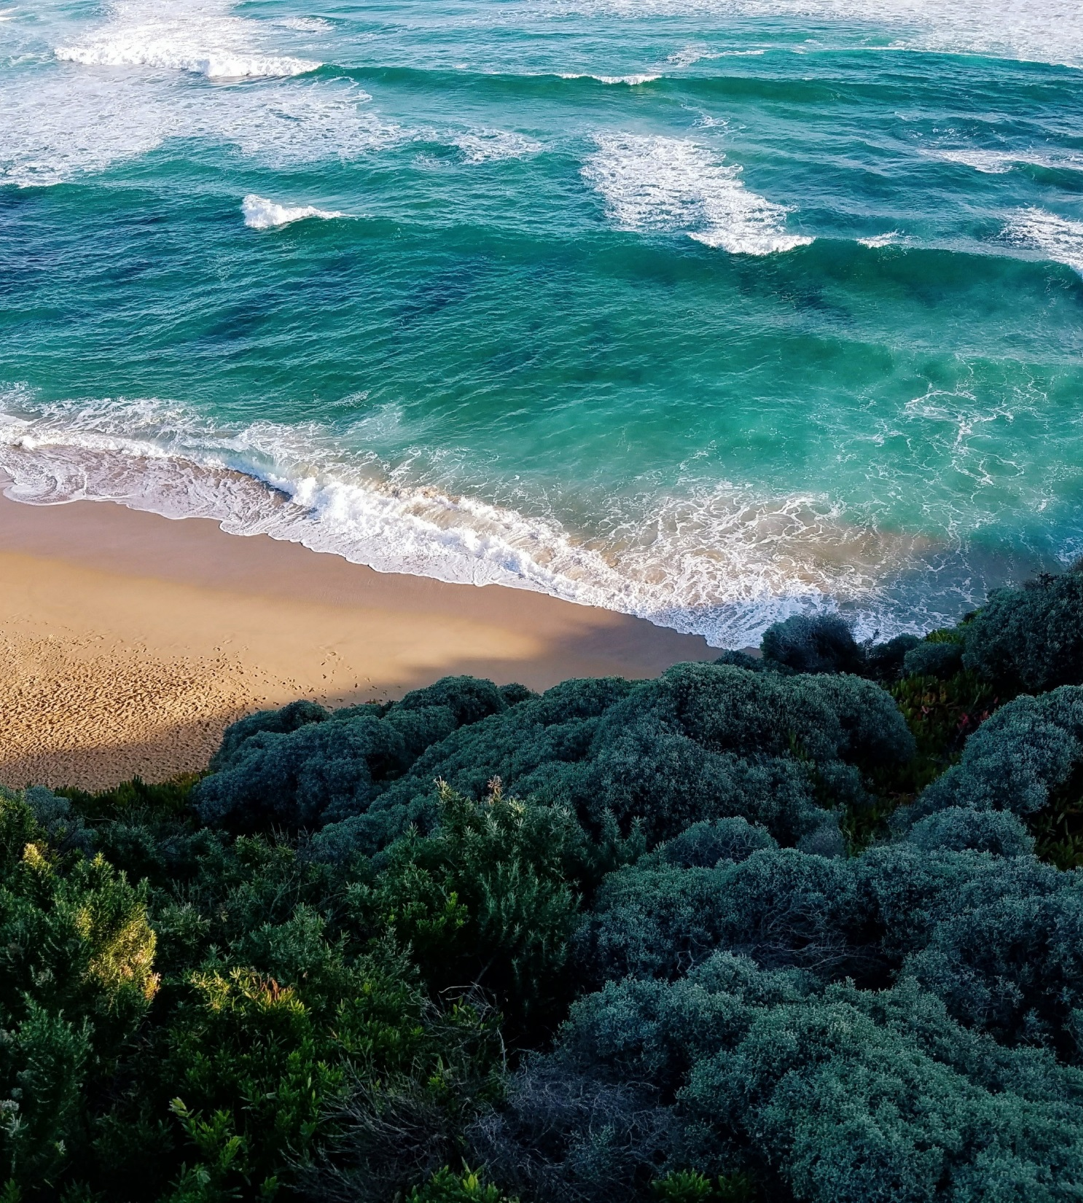
今夜
B R E E Z E
晚风
The stars are not want:
put out every one; Pack up the mdismantle the sun; Pour the ocean and sweep up;

Slide 6
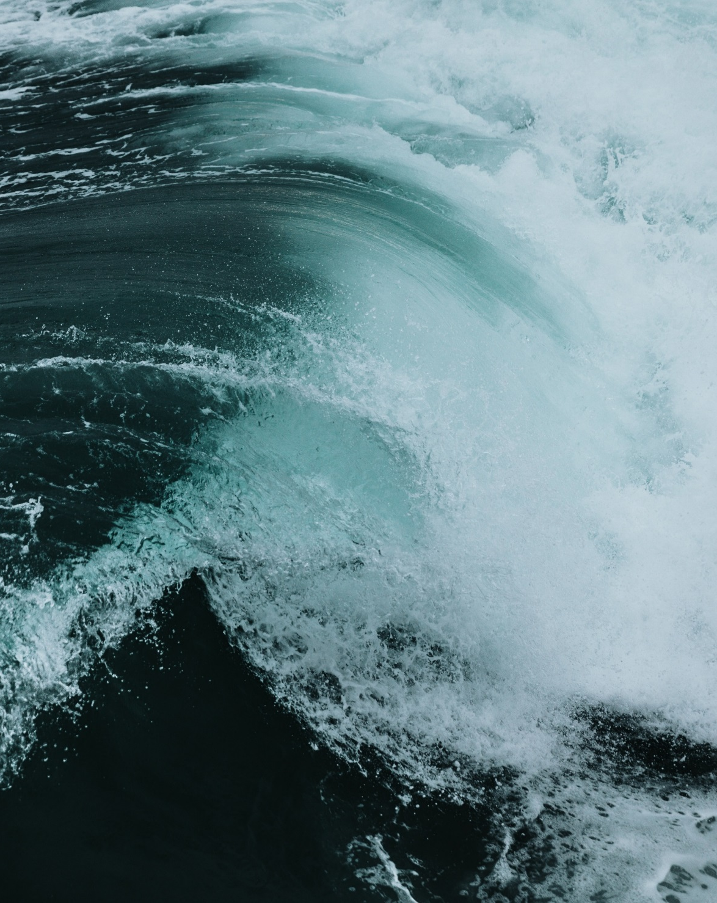
Sea breeze
今夜海风
The stars are not wanted now:
put out every one; Pack up the moon
and dismantle the sun; Pour away
the ocean and sweep up the wood;

Slide 7
今夜海风
The stars are not wanted now
put out every one; Pack up the mon
and dismantle the sun
Pour away the ocean and sweep up
the wood; For nothing
now can ever come to any good
The stars are not wanted now

Slide 8
B R E E Z
Pack up the moon
The stars are not wanted
now put out every one; Pack
up the moon

Slide 9
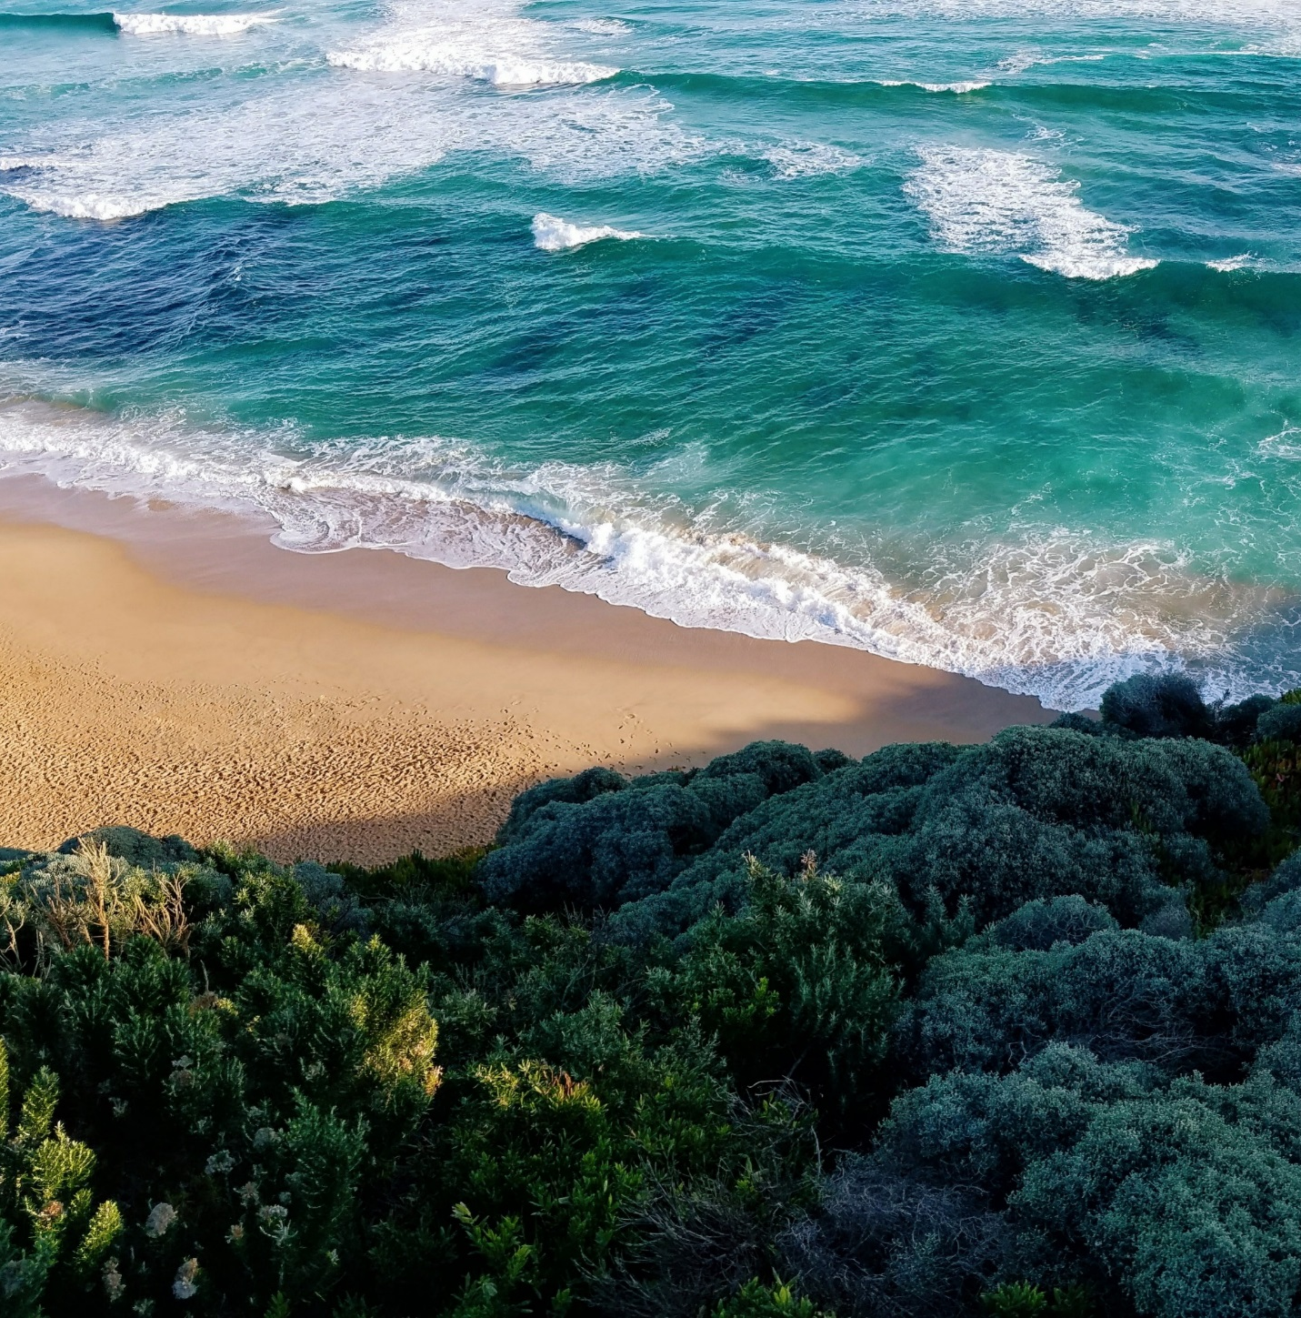
B R E E Z
Pack up the moon
The stars are not wanted now
put out every one;

Slide 10
B R E E Z
The stars are not wanted now
put out every one; Pack up the mon
and dismantle the sun
Pour away the ocean and sweep up
the wood; For nothing
now can ever come to any good
The stars are not wanted now put out every one

Slide 11
Sea breeze
今夜海风
The stars are not wanted now
put out every one;

Slide 12
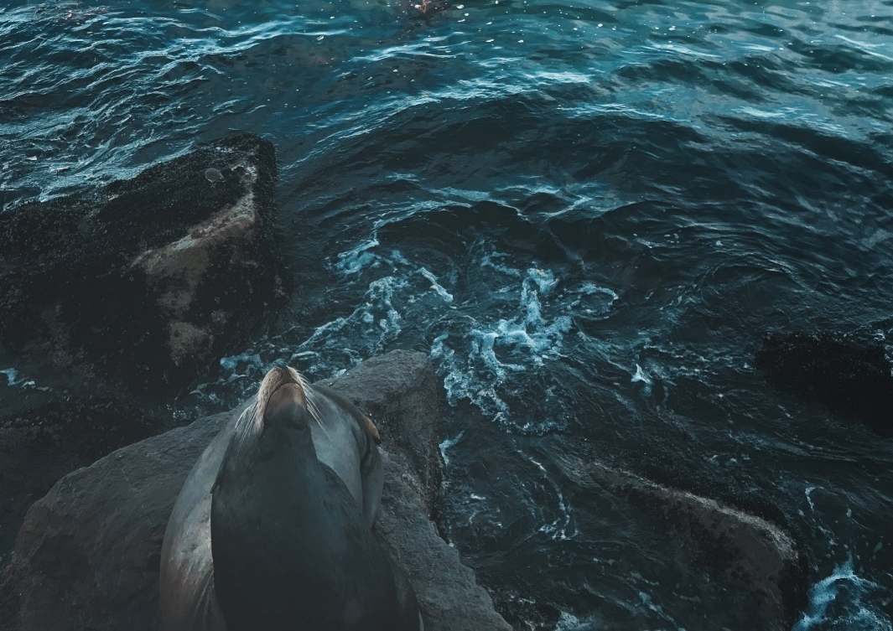
海风
The stars are not wanted now:
put out every one; Pack up the moon
and dismantle the sun;
B R E E Z
The stars are not wanted now
put out every one; Pack up the
mon and dismantle the sun

Slide 13
今夜的海风
Click here to input the replacement
text and suggest replacing it with this speech

Slide 14
B R E E Z E
海风
The stars are not wanted now:
put out every one; Pack up the
moon and dismantle the sun;

Slide 15
BREEZ
The stars are not
wanted now
put out every one;
Pack up the
mon and dismantle

Slide 16
海风
B R E E Z
The stars are not wanted now:
put out every one; Pack up the
moon and dismantle the sun;

Slide 17
海风
B R E E Z E
The stars are not wanted now:
put out every one; Pack up the
moon and dismantle the sun;
The stars are not wanted now put out every one;

Slide 18
Please add content here
今夜的海风

Slide 19
总 结
The stars are not wanted now put out every one;
Pack up the moon and dismantle the sun
Pour away the ocean and sweep up
the wood;
For nothing now can ever come to any good

Slide 20
感谢欣赏
Click here to input the replacement
text and suggest replacing it with this speech

