Slide 1
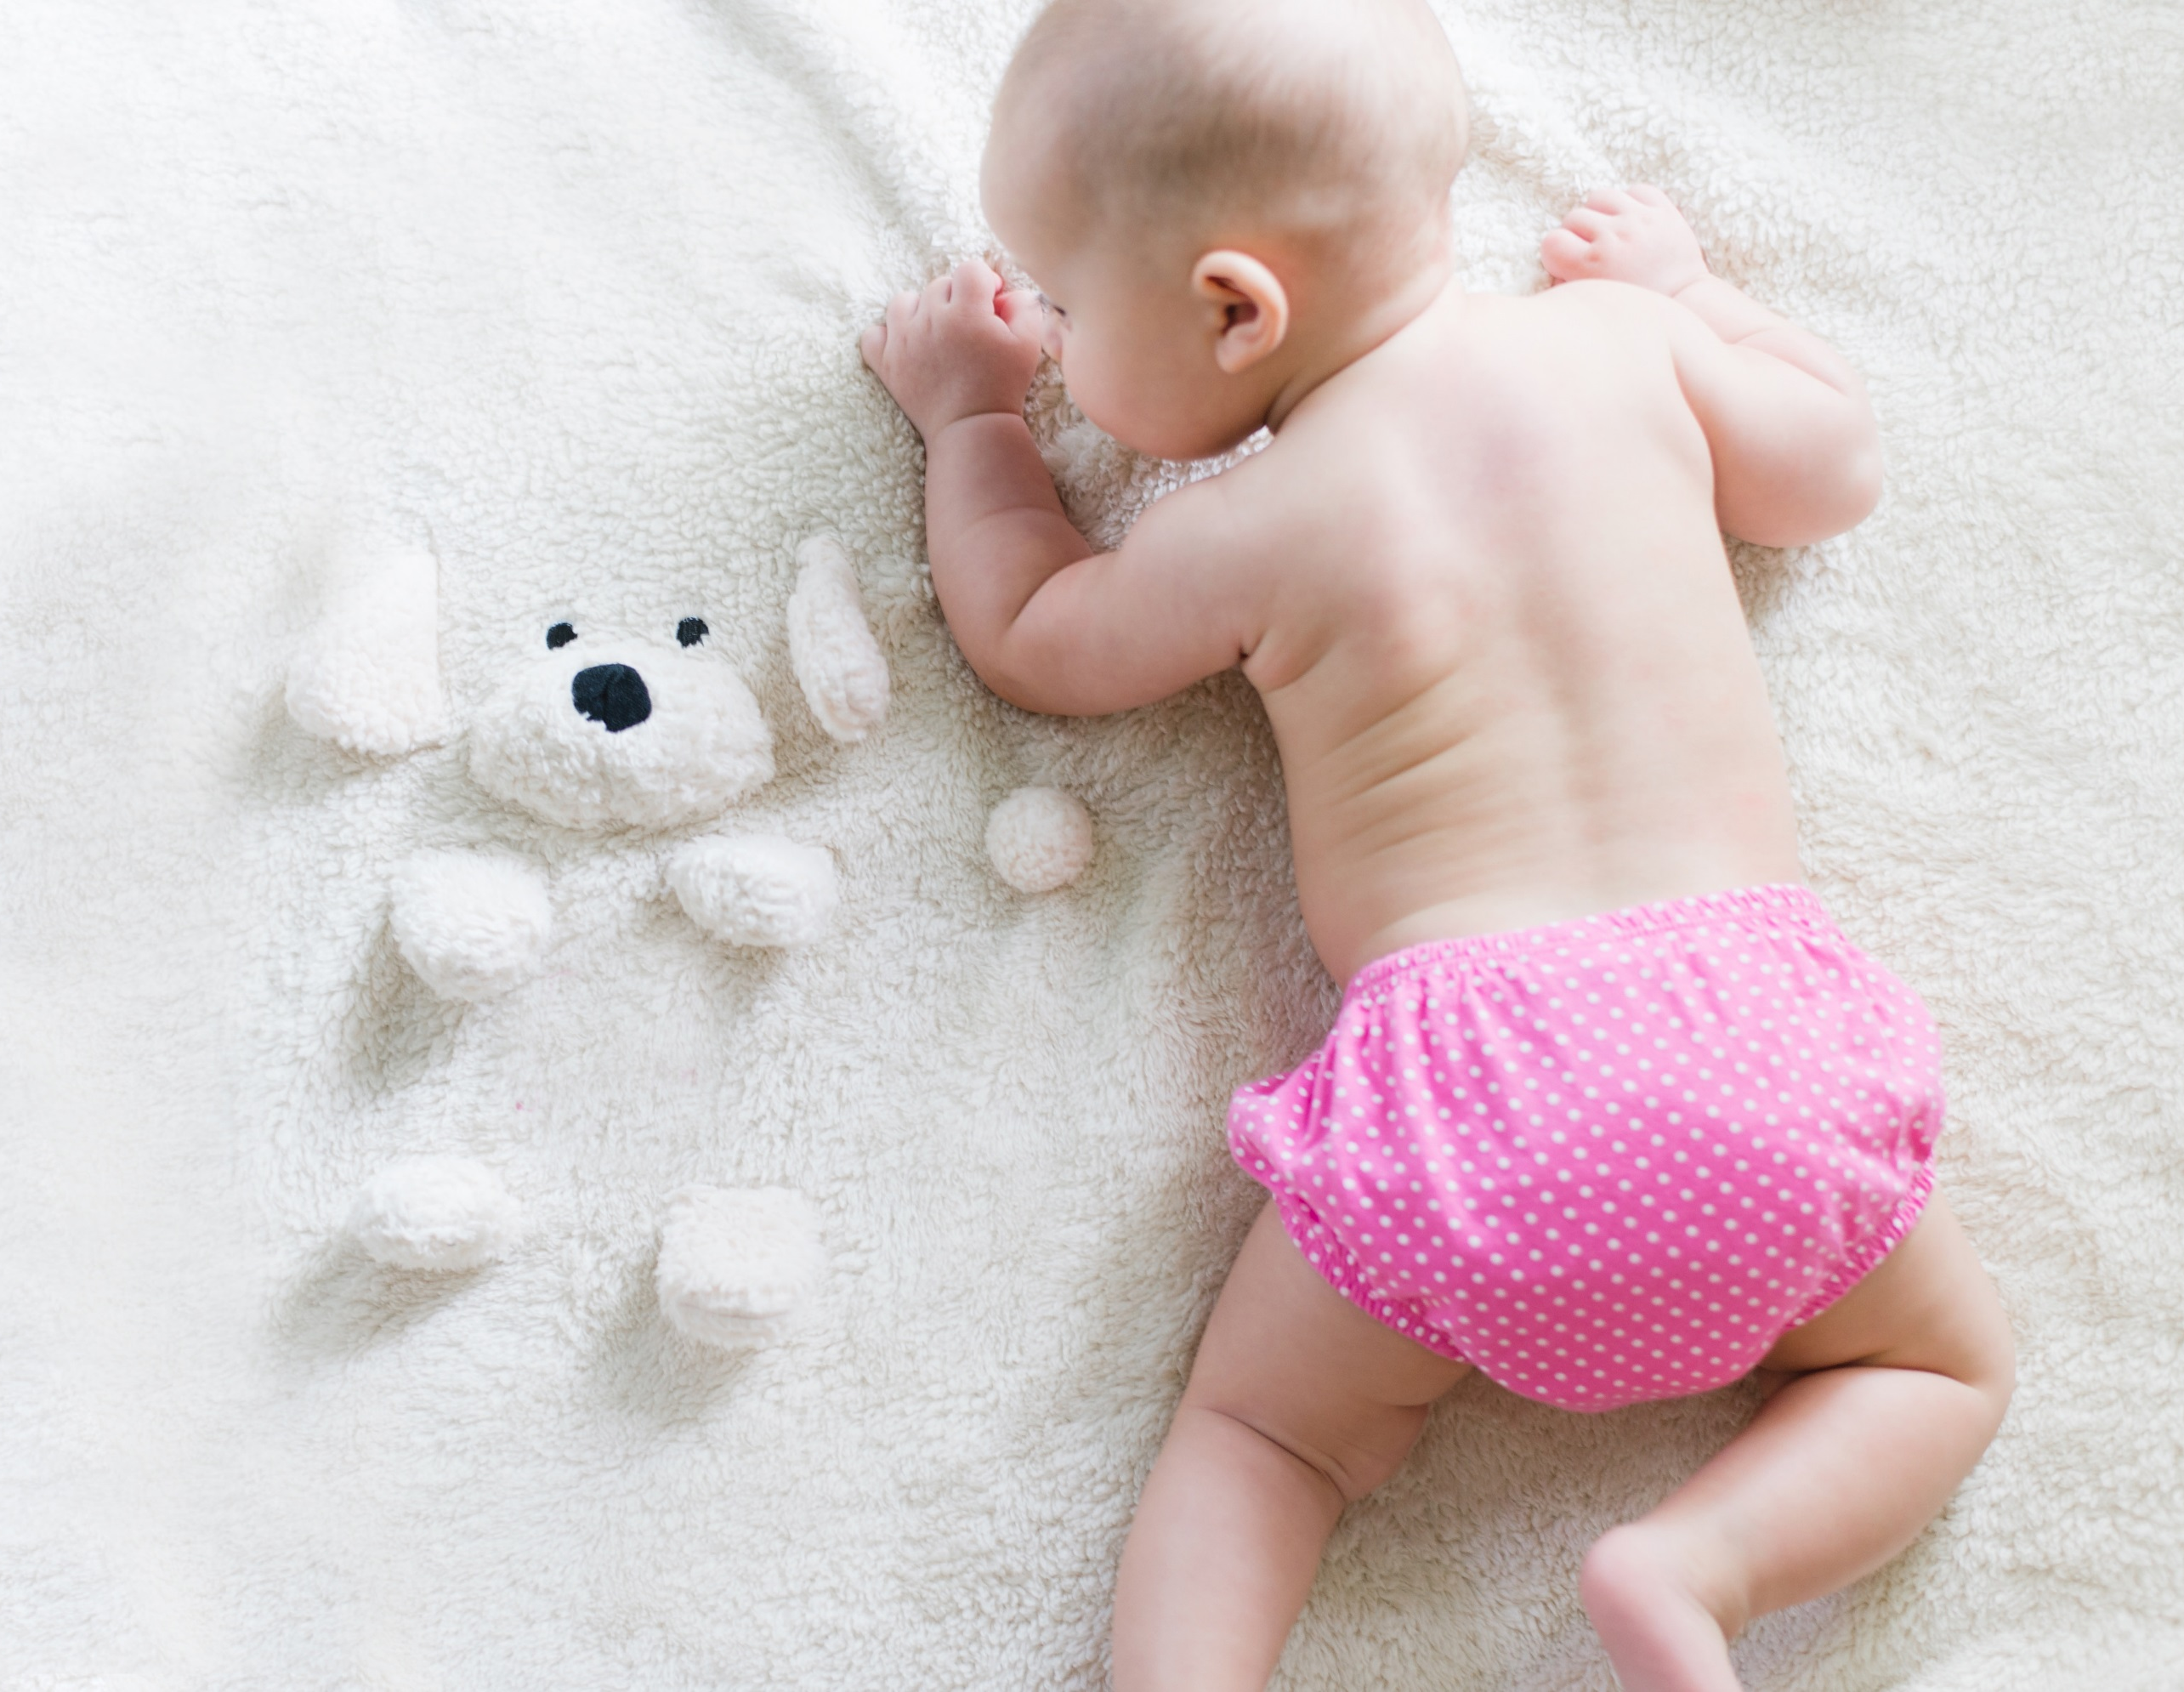
BABY
― 23 December 2021 ―
成长画册
San Francisco • CA

Slide 2
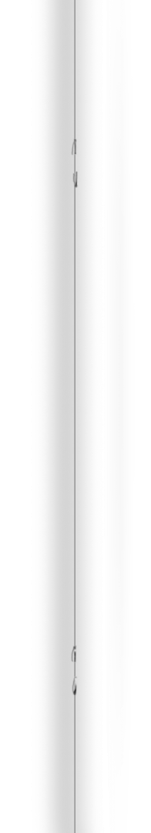
― BABY’S BOOK ―
― BABY’S BOOK ―
MOMENTS
MOMENTS
Happy day
Smiles
Our moments
First words
Ultrasound
Milestones
36 weeks
First Christmas
About you
Your arrival
Your parents
First family photo
Grandparents
Doctor visit
December
December

Slide 3
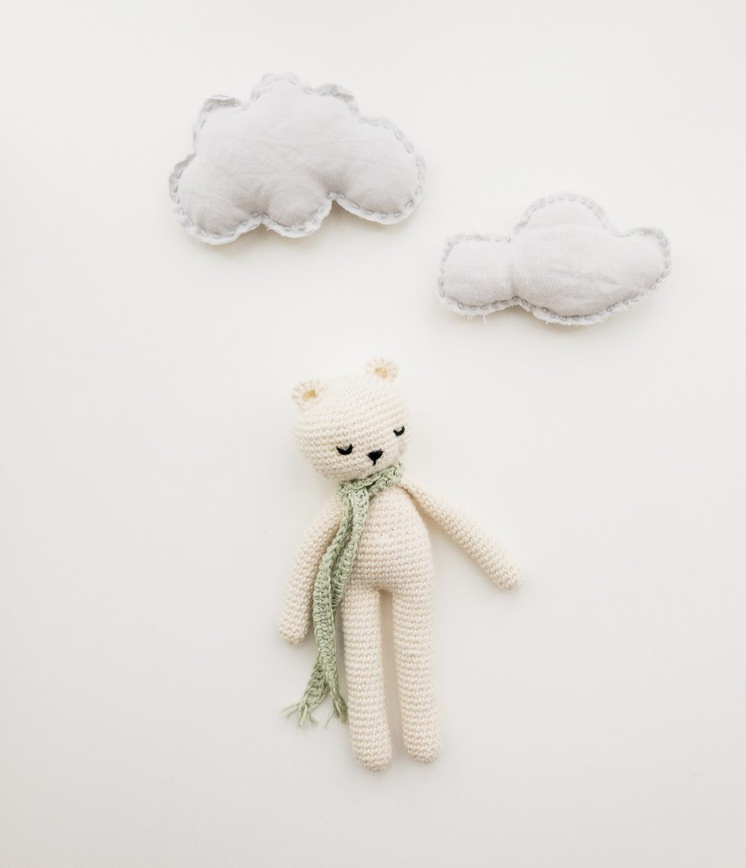
― BABY’S BOOK ―
2018
♡ VICTORIA SECRET ♡
WAS BORN TO
DAY OF THE WEEK
Monday at 12:43 AM
DATE
23 December 2018
WEIGHT & LENGTH
7 Lbs & 21 inch
COLORS
Gray Eyes & Brown Hair
HEAD MEASUREMENT
Jon Snow
San Francisco, CA
December
December

Slide 4
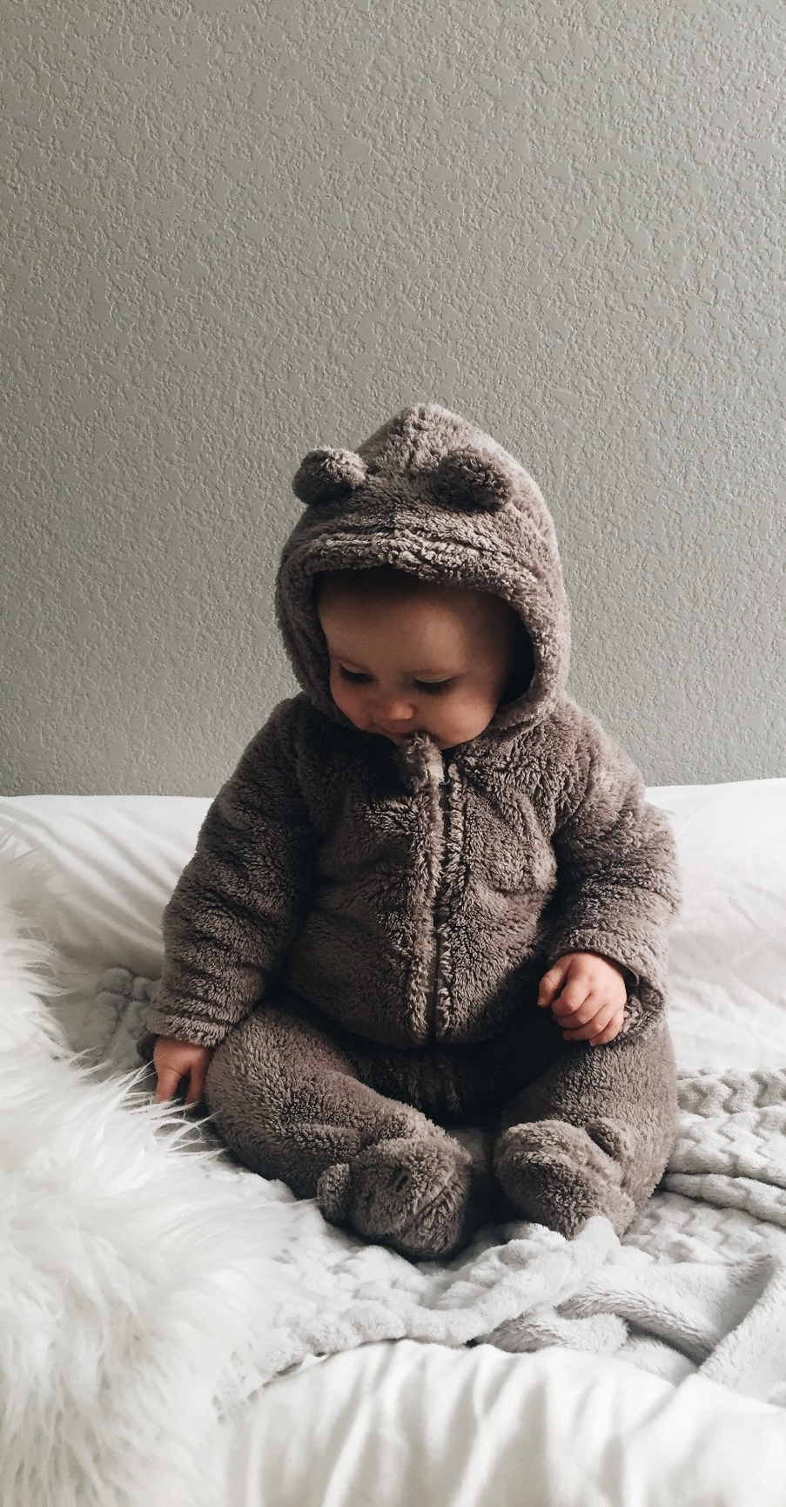
― BABY’S BOOK ―
2018
37 weeks
― Looking forward ―
San Francisco, CA
December
December

Slide 5
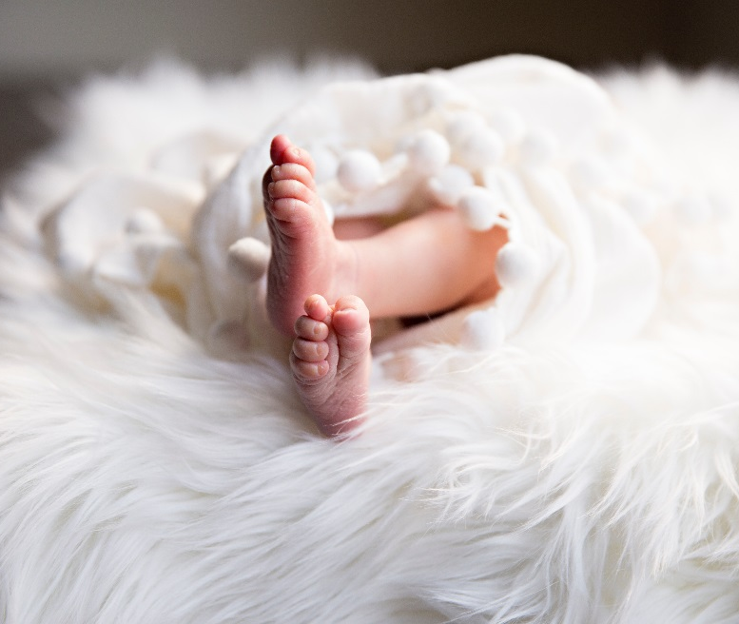
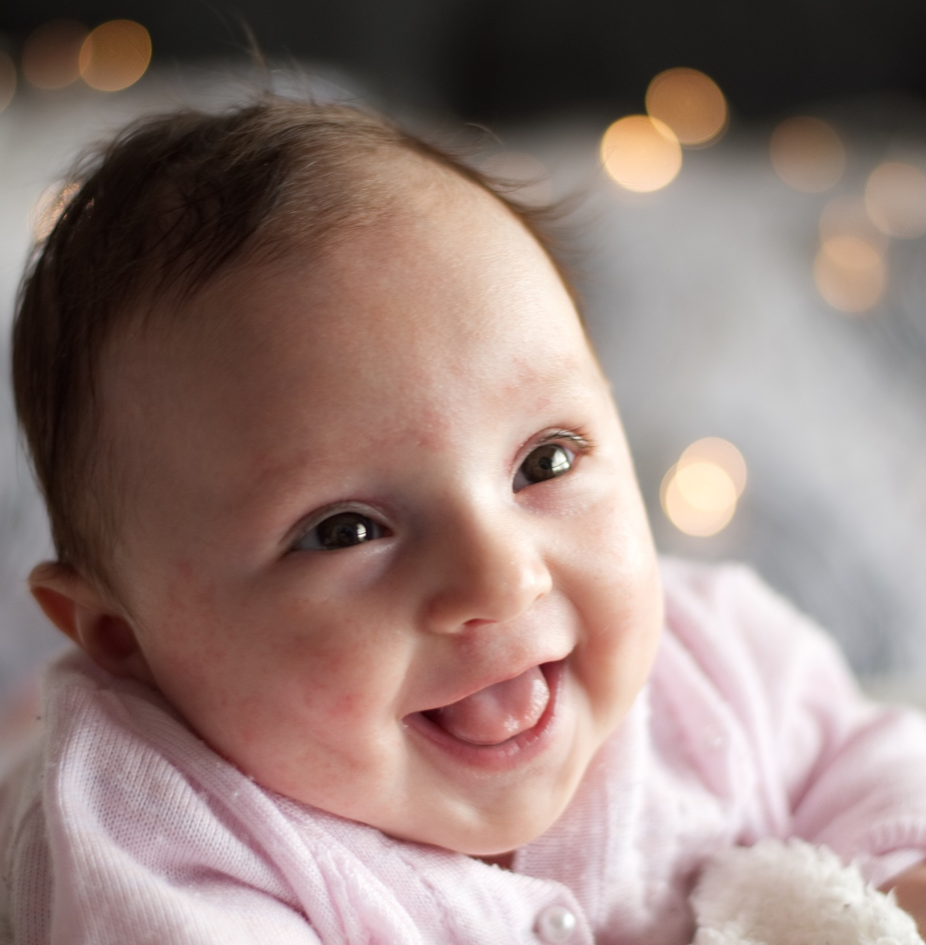
― BABY’S BOOK ―
2018
Our history
This is the story of Little Red Riding Hood. She’s got a red coat with a hood. She loves the coat. She wears it every day. She’s very happy today. It’s her birthday.
Little Red Riding Hood’s father is a woodcutter. He works in the forest every day. A lot of animals live in the forest, and a wolf lives there too!
San Francisco, CA
December
December

Slide 6
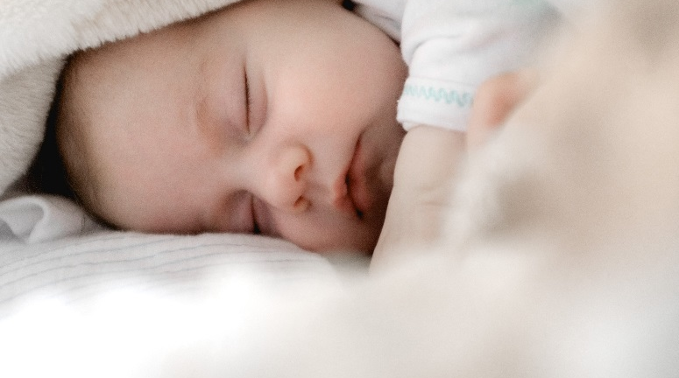
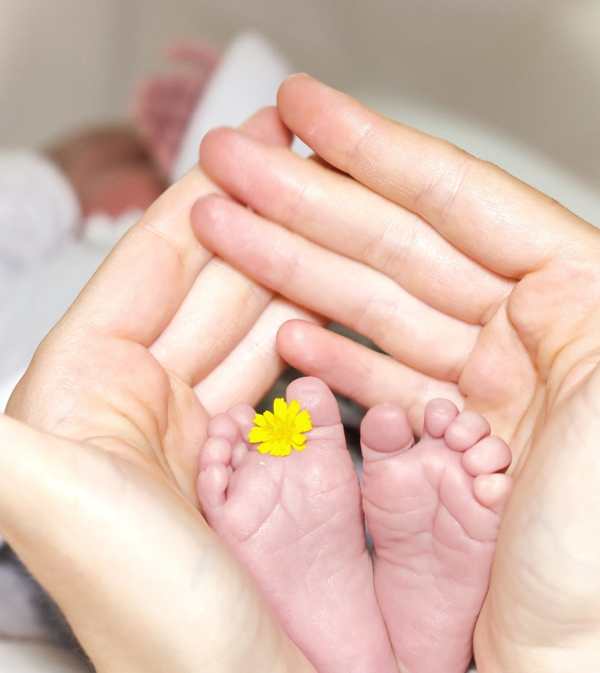
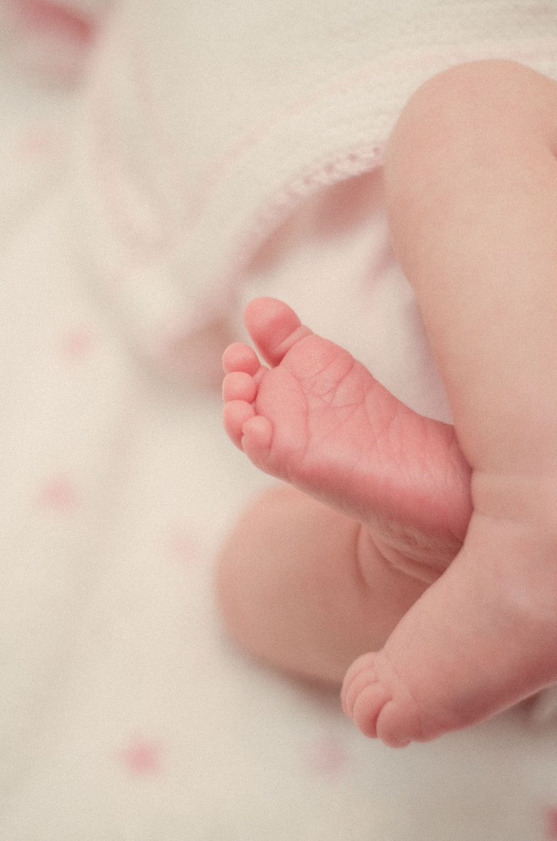

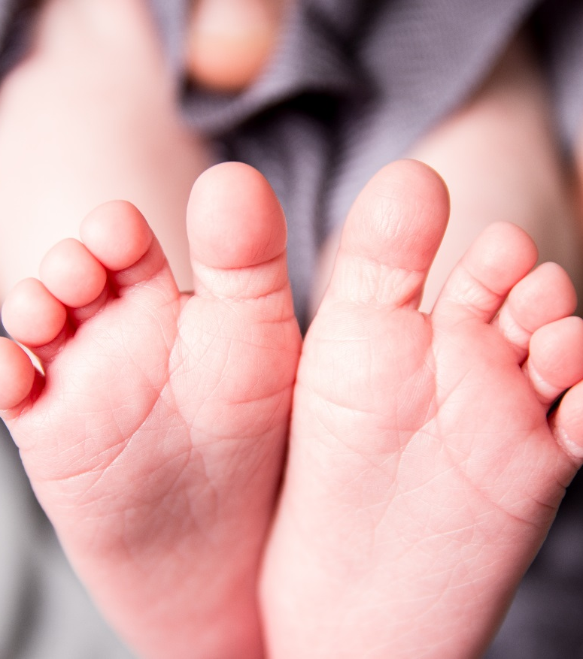
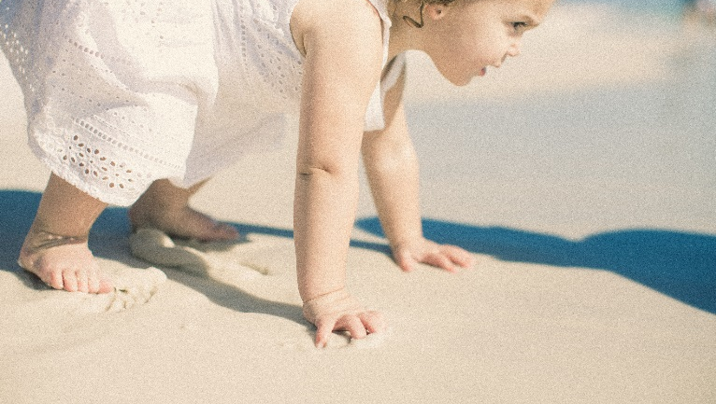
― BABY’S BOOK ―
2018
Happy moments
San Francisco, CA
December
December

Slide 7

― BABY’S BOOK ―
2018
HAPPY MOMENTS
One day, in a small country, the Queen has a baby. Everyone is very happy. The baby has got pink cheeks and black hair.
Mam and Dad
San Francisco, CA
December
December

Slide 8

― BABY’S BOOK ―
2018
HAPPY MOMENTS
One day, in a small country, the Queen has a baby. Everyone is very happy. The baby has got pink cheeks and black hair.
Mam and Dad
December
December

Slide 9

― BABY’S BOOK ―
2018
2018
This is the story of Little Red Riding Hood. She’s got a red coat with a hood. She loves the coat. She wears it every day. She’s very happy today.
Mam & Dad.
San Francisco, CA
San Francisco, CA
December
December

Slide 10
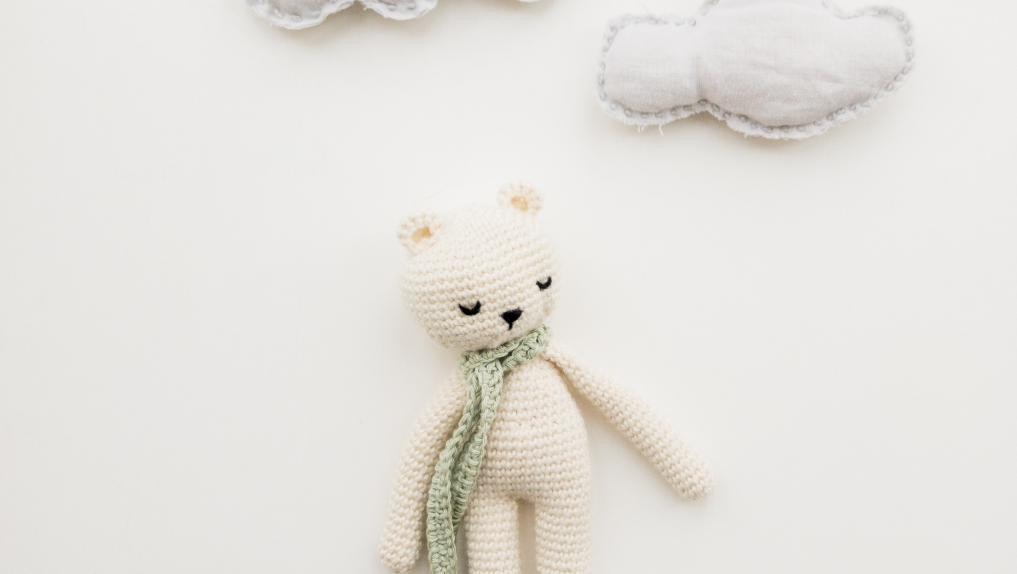
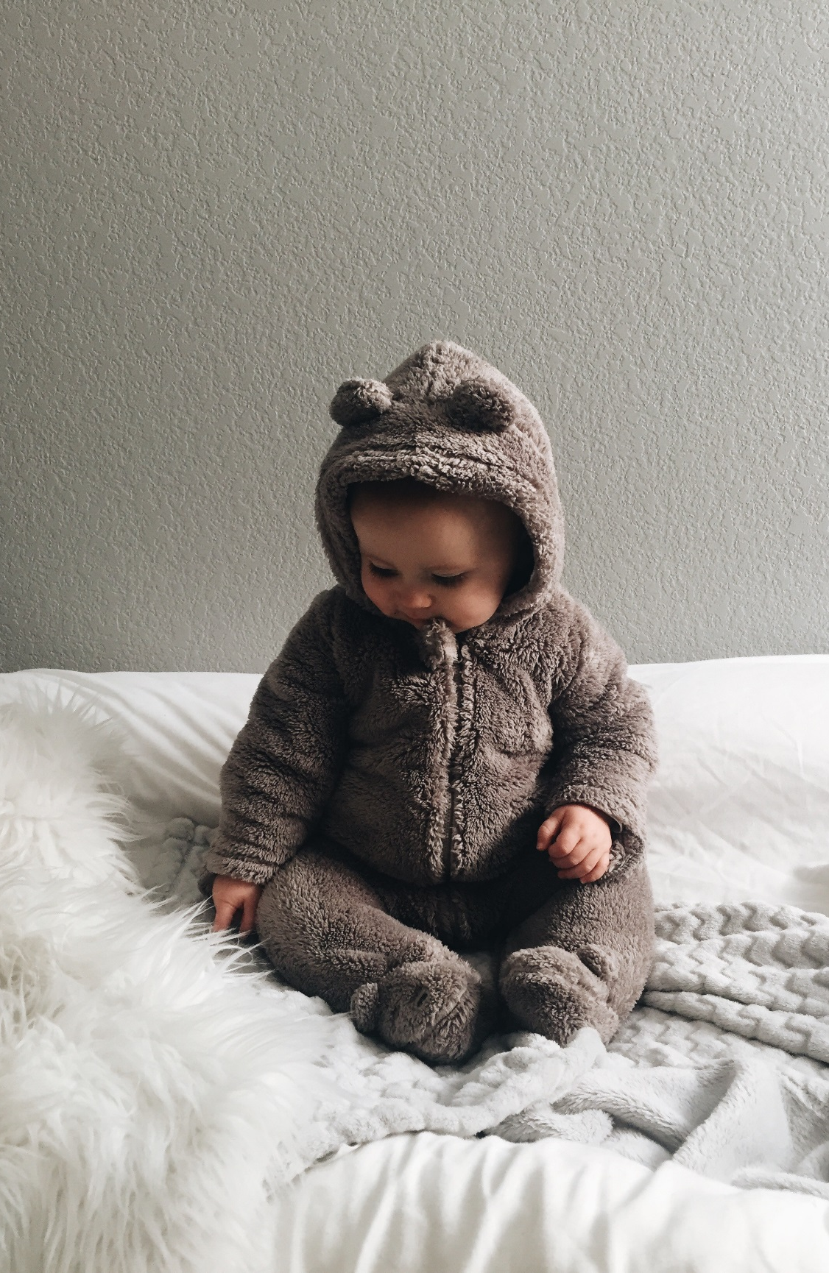
― BABY’S BOOK ―
2018
2018
Everyone is very happy.
San Francisco, CA
San Francisco, CA
December
December

Slide 11
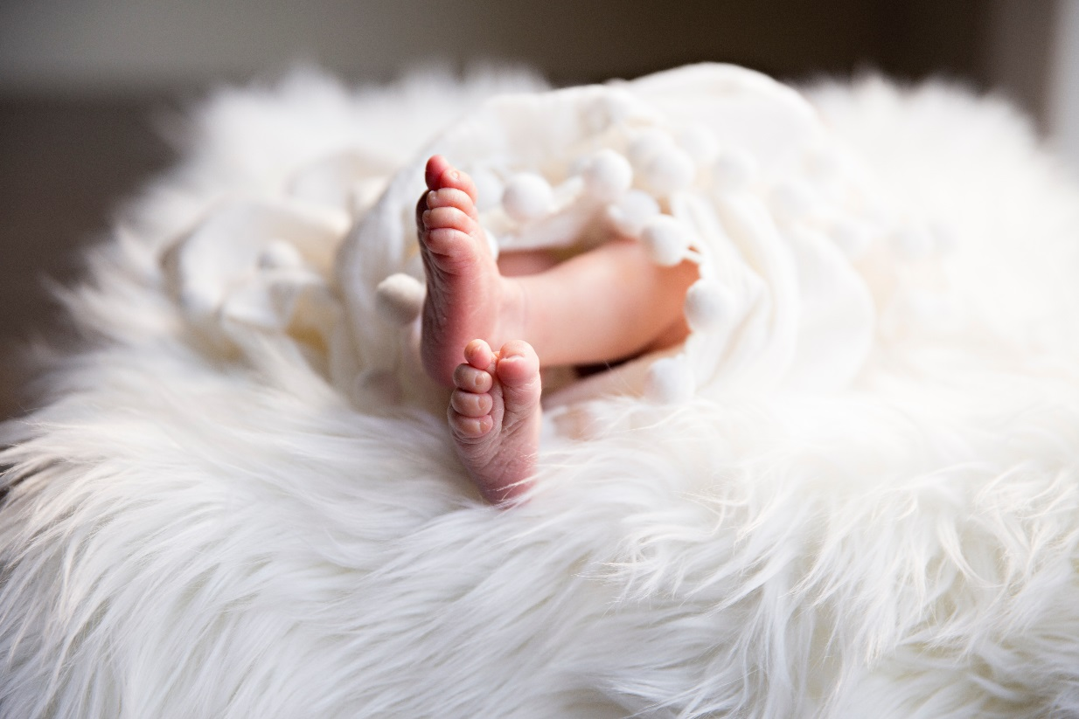

― BABY’S BOOK ―
14 February 2018
One day, in a small country, the Queen has a baby. Everyone is very happy. The baby has got pink cheeks and black hair.
Mam and Dad
Your
7 May 2018
One day, in a small country, the Queen has a baby. Everyone is very happy. The baby has got pink cheeks and black hair.
Mam and Dad
― ULTRASOUND ―
December
December

Slide 12
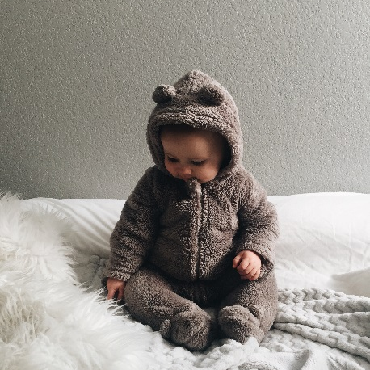

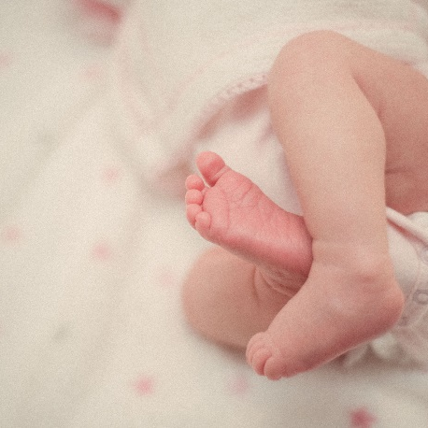


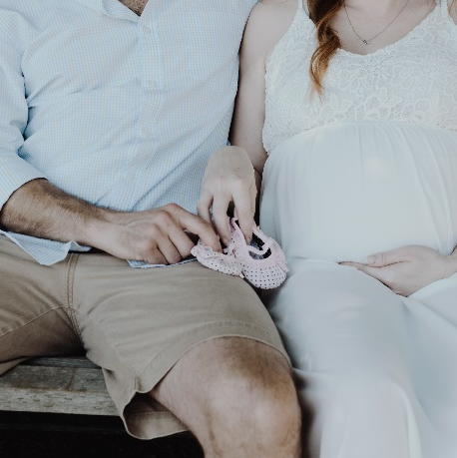

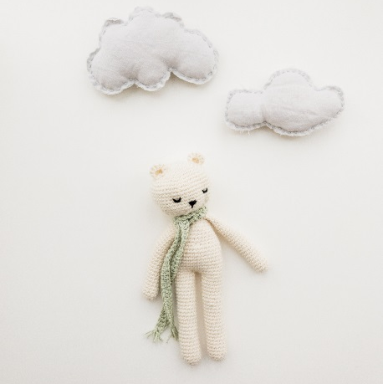
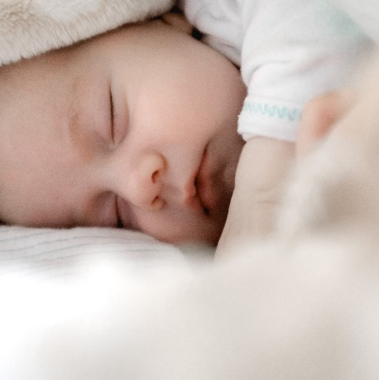
― BABY’S BOOK ―
2018
5 weeks
10 weeks
12 weeks
HAPPY MOMENTS
16 weeks
20 weeks
23 weeks
This is the story of Little Red Riding Hood. She’s got a red coat with a hood. She loves the coat. She wears it every day. She’s very happy today. It’s her birthday.
Little Red Riding Hood’s father is a woodcutter. He works in the forest every day. A lot of animals live in the forest, and a wolf lives there too!
29 weeks
32 weeks
37 weeks
San Francisco, CA
December
December
Notes:
Note: After insert your images click right button and choose the tab ‘Reset Slide’ for updatin

Slide 13


― BABY’S BOOK ―
2018
HAPPY MOMENTS
This is the story of Little Red Riding Hood. She’s got a red coat with a hood. She loves the coat. She wears it every day. She’s very happy today. It’s her birthday.
Little Red Riding Hood’s father is a woodcutter. He works in the forest every day. A lot of animals live in the forest, and a wolf lives there too!
23 December
San Francisco, CA
December
December

Slide 14
― BABY’S BOOK ―
2018
2018
♡ VICTORIA SECRET ♡
I was born
WAS BORN TO
DAY
Monday at 12:43 AM
DATE
23 December 2018
WEIGHT & LENGTH
7 Lbs & 21 inch
― Hello world! ―
COLORS
Gray Eyes & Brown Hair
HEAD MEASUREMENT
Jon Snow
San Francisco, CA
San Francisco, CA
December
December

Slide 15

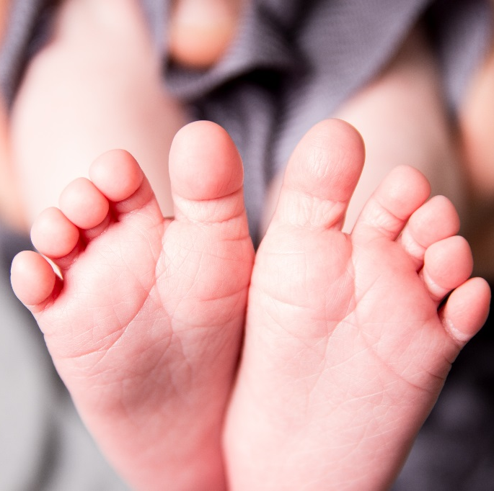


― BABY’S BOOK ―
2018
2018
Smiles
First step
This is the story of Little Red Riding Hood. She’s got a red coat with a hood. She loves the coat. She wears it every day. She’s very happy today. It’s her birthday.
Little Red Riding Hood’s father is a woodcutter. He works in the forest every day. A lot of animals live in the forest, and a wolf lives there too!
San Francisco, CA
San Francisco, CA
December
December

Slide 16



― BABY’S BOOK ―
2018
HAPPY MOMENTS
One day, in a small country, the Queen has a baby. Everyone is very happy. The baby has got pink cheeks and black hair. Her skin is very white.
From Ned & Helen
Moments
This is the story of Little Red Riding Hood. She’s got a red coat with a hood. She loves the coat. She wears it every day. She’s very happy today. It’s her birthday.
Little Red Riding Hood’s father is a woodcutter. He works in the forest every day. A lot of animals live in the forest, and a wolf lives there too!
San Francisco, CA
December
December

Slide 17

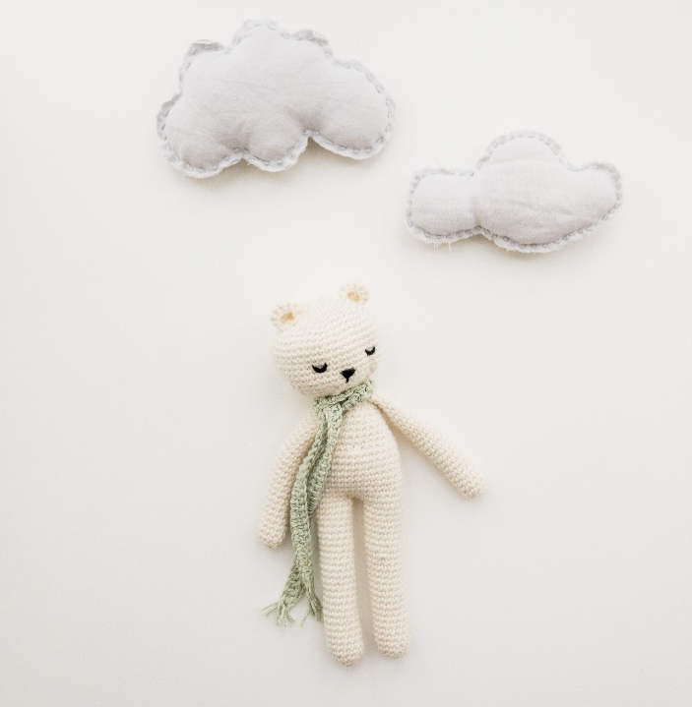
― BABY’S BOOK ―
2018
2018
AGE
11 months
DATE
21 November 2018
WEIGHT
7 Lbs
LENGTH
21 inch
SUCCESS
First step
San Francisco, CA
San Francisco, CA
December
December

Slide 18
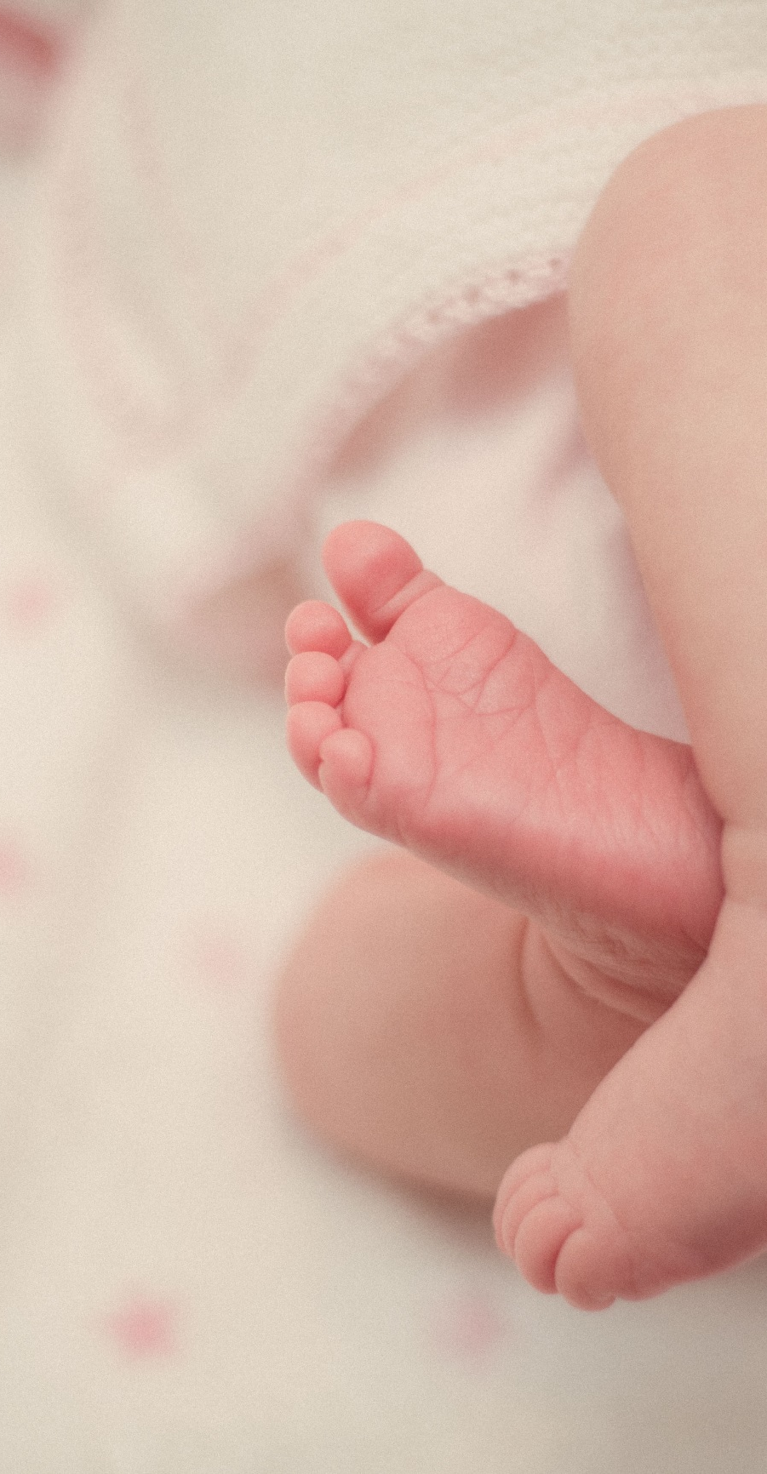
― BABY’S BOOK ―
2018
7 months
― 22 July 2018 ―
San Francisco, CA
December
December

Slide 19


― BABY’S BOOK ―
2018
2018
One day, in a small country, the Queen has a baby. Everyone is very happy. The baby has got pink cheeks and black hair. Her skin is very white.
From Ned & Helen
Smiles
First step
This is the story of Little Red Riding Hood. She’s got a red coat with a hood. She loves the coat. She wears it every day. She’s very happy today. It’s her birthday.
Little Red Riding Hood’s father is a woodcutter. He works in the forest every day. A lot of animals live in the forest, and a wolf lives there too!
San Francisco, CA
San Francisco, CA
December
December

Slide 20
― BABY’S BOOK ―
2018
HAPPY MOMENTS
∙ MILESTONE ∙
∙ MILESTONE ∙
One day, in a small country, the Queen has a baby.
Everyone is very happy.
She loves the coat. She wears it every day. She’s very happy today. It’s her birthday.
∙ MILESTONE ∙
∙ MILESTONE ∙
Everyone is very happy.
One day, in a small country, the Queen has a baby.
∙ MILESTONE ∙
∙ MILESTONE ∙
Everyone is very happy.
One day, in a small country, the Queen has a baby.
San Francisco, CA
December
December

Slide 21


― BABY’S BOOK ―
2018
2018
23 August 2018
The baby has got pink cheeks and black hair. Her skin is very white.
23 August 2018
Everyone is very happy. The baby has got pink cheeks and black hair. Her skin is very white.
San Francisco, CA
San Francisco, CA
December
December

Slide 22


― BABY’S BOOK ―
2018
2018
23 August 2018
The baby has got pink cheeks and black hair. Her skin is very white.
23 August 2018
The baby has got pink cheeks and black hair. Her skin is very white.
Everyone is very happy. The baby has got pink cheeks and black hair. Her skin is very white.
San Francisco, CA
San Francisco, CA
December
December

Slide 23

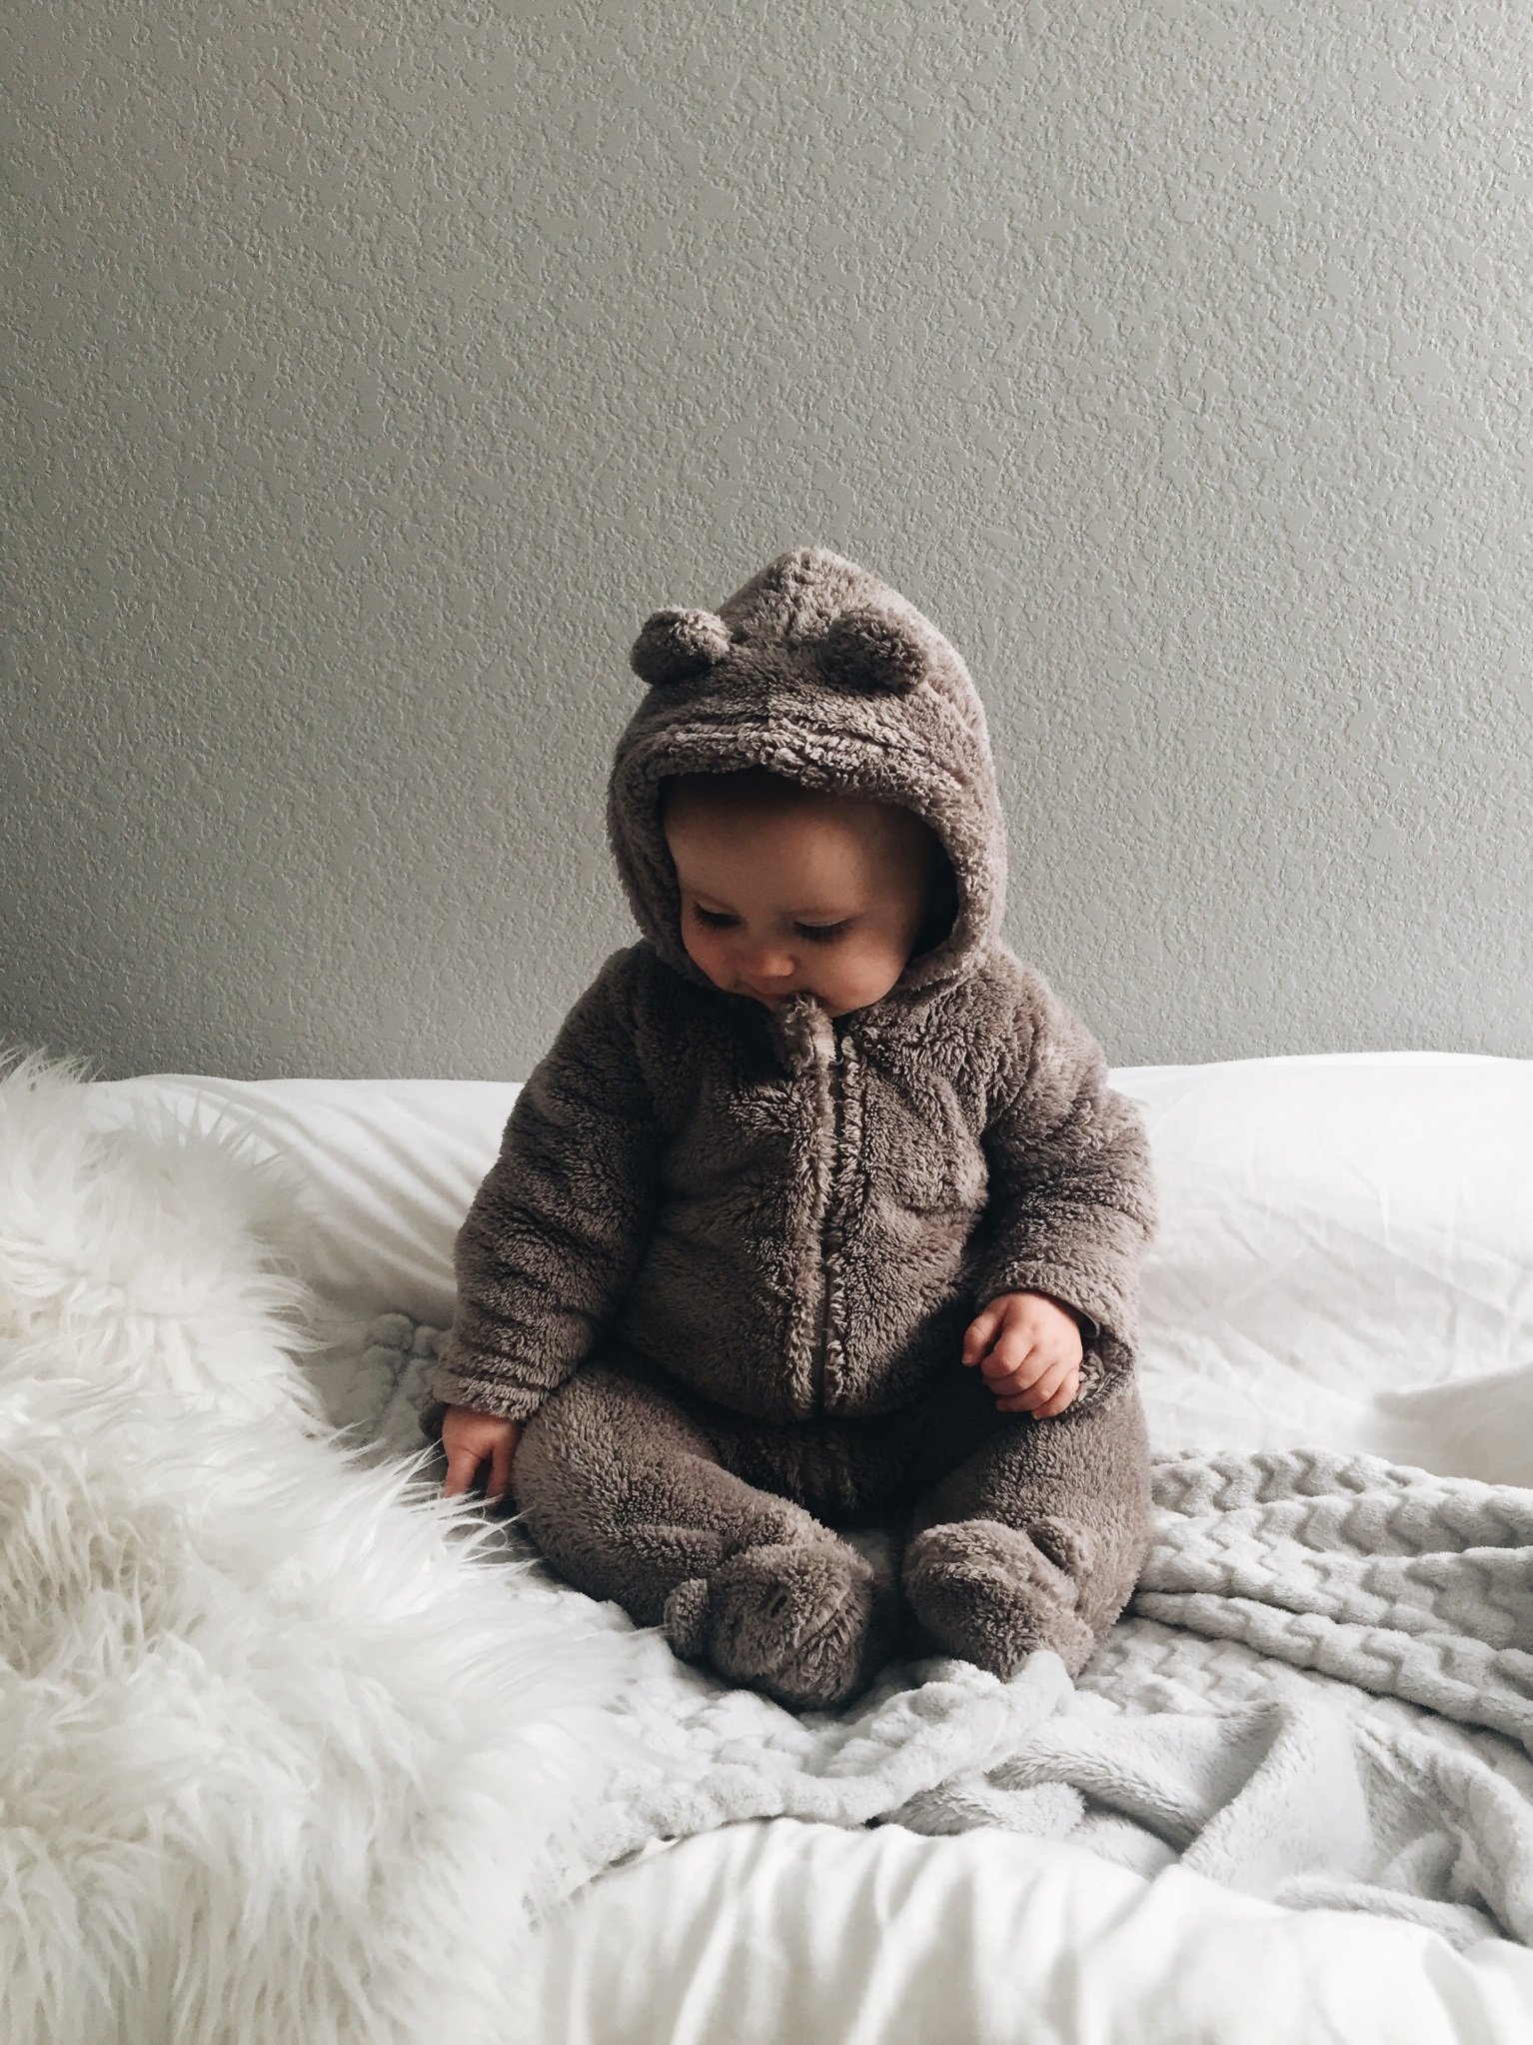

― BABY’S BOOK ―
2018
2018
HAPPY MOMENTS
22 December
AGE
11 Months
First visitors
DATE
23 November 2018
WEIGHT
7 Lbs.
LENGTH
21 inch.
SUCCESS
First step
23 December
San Francisco, CA
San Francisco, CA
December
December

Slide 24


― BABY’S BOOK ―
2018
23 August 2018
One day, in a small country, the Queen has a baby. Everyone is very happy. The baby has got pink cheeks and black hair. Her skin is very white.
This is the story of Little Red Riding Hood. She’s got a red coat with a hood. She loves the coat. She wears it every day. She’s very happy today. It’s her birthday.
23 August 2018
The baby has got pink cheeks and black hair. Her skin is very white.
San Francisco, CA
December
December

Slide 25


― BABY’S BOOK ―
2018
2018
AGE
AGE
22 December 2018
22 December 2018
San Francisco, CA
San Francisco, CA
December
December

Slide 26


― BABY’S BOOK ―
2018
2018
HAPPY MOMENTS
AGE
10 months
DATE
22 October 2018
WEIGHT
7 Lbs
LENGTH
21 inch
SUCCESS
First step
San Francisco, CA
San Francisco, CA
December
― BABY’S BOOK ―

Slide 27
― BABY’S BOOK ―
2018
UPPER TEETH
HAPPY MOMENTS
20 September 2018
5 September 2018
Teeth
9 MONTHS
9 MONTHS
12 October 2018
15 October 2018
10 MONTHS
10 MONTHS
5 June 2019
27 June 2019
18 MONTHS
18 MONTHS
10 May 2019
1 May 2019
15 MONTHS
15 MONTHS
19 December 2019
30 December 2019
29 MONTHS
29 MONTHS
Record
30 December 2019
19 December 2019
28 MONTHS
28 MONTHS
1 May 2019
10 May 2019
This is the story of Little Red Riding Hood. She’s got a red coat with a hood. She loves the coat. She wears it every day. She’s very happy today. It’s her birthday.
Little Red Riding Hood’s father is a woodcutter. He works in the forest every day. A lot of animals live in the forest, and a wolf lives there too!
16 MONTHS
16 MONTHS
27 June 2019
5 June 2019
20 MONTHS
20 MONTHS
15 October 2018
12 October 2018
13 MONTHS
13 MONTHS
5 September 2018
20 September 2018
8 MONTHS
8 MONTHS
LOWER TEETH
San Francisco, CA
December
December

Slide 28


― BABY’S BOOK ―
2018
2018
HAPPY MOMENTS
San Francisco, CA
San Francisco, CA
December
December

Slide 29



MOMENTS
2018
2018
HAPPY MOMENTS
This is the story of Little Red Riding Hood. She’s got a red coat with a hood. She loves the coat. She wears it every day. She’s very happy today. It’s her birthday.
Little Red Riding Hood’s father is a woodcutter. He works in the forest every day. A lot of animals live in the forest, and a wolf lives there too!
San Francisco, CA
San Francisco, CA
December
December

Slide 30
BABY
― 23 December 2021 ―
我的婴儿时代
San Francisco • CA

