Slide 1
旅行日记

Slide 2
PART ONE
Click here to add your title
CONTENTS
PART TWO
Click here to add your title
PART THREE
Click here to add your title
PART FOUR
Click here to add your title

Slide 3
01
Click here to add your title
Click here to add your title

Slide 4
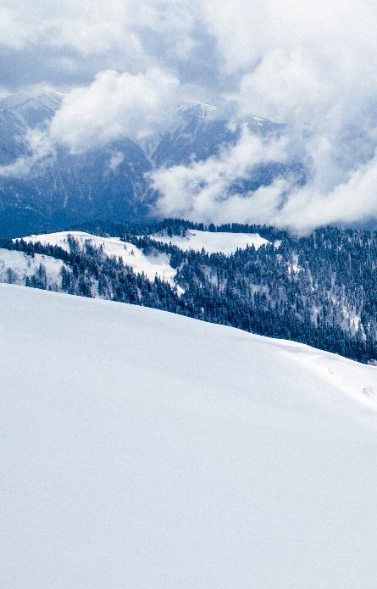
GO
I love you more than I've ever loved any woman. And I've waited longer for you than I've waited for any woman.
I love you more than I've ever loved any woman. And I've waited longer for you than I've waited for any woman.I love you more than I've ever loved any woman. And I've waited longer for you than I've waited for any woman.

Slide 5
I love you more than I've ever loved any woman. And I've waited longer for you than I've waited for any woman.I love you more than I've ever loved any woman. And I've waited longer for you than I've waited for any woman.
I love you more than I've ever loved any woman. And I've waited longer for you than I've waited for any woman.

Slide 6
I love you more than I've ever loved any woman. And I've waited longer for you than I've waited for any woman
.I love you more than I've ever loved any woman. And I've waited longer for you than I've waited for any woman.
Xiamen
20XX年XX月XX日

Slide 7
02
Click here to add your title
Click here to add your title

Slide 8
ALL OR NOTHING
NOW OR NEVER
DESTINY
FREEDOM
DESTINY FREEDOM
I love you more than I've ever loved any woman. And I've waited longer for you than I've waited for any woman.
I love you more than I've ever loved any woman. And I've waited longer for you than I've waited for any woman.I love you more than I've ever loved any woman. And I've waited longer for you than I've waited for any woman.
I love you more than I've ever loved any woman. And I've waited longer for you than I've waited for any woman.
ALL OR
NOTHING
NOW OR
NEVER

Slide 9
I love you more than I've ever loved any woman. And I've waited longer for you than I've waited for any woman.
OUR
MEMO
I love you more than I've ever loved any woman. And I've waited longer for you than I've waited for any woman.I love you more than I've ever loved any woman. And I've waited longer for you than I've waited for any woman.

Slide 10
20XX年XX月XX日
I love you more than I've ever loved any woman. And I've waited longer for you than I've waited for any woman.
I love you more than I've ever loved any woman. And I've waited longer for you than I've waited for any woman.

Slide 11
03
Click here to add your title
Click here to add your title

Slide 12
来日可期
I love you more than I've ever loved any woman. And I've waited longer for you than I've waited for any woman.
I love you more than I've ever loved any woman. And I've waited longer for you than I've waited for any woman.I love you more than I've ever loved any woman. And I've waited longer for you than I've waited for any woman.

Slide 13
BLUE
CLEAR
I love you more than I've ever loved any woman.
And I've waited longer for you than I've waited for any woman.
I love you more than I've ever loved any woman.
And I've waited longer for you than I've waited for any woman.

Slide 14
Xiamen
I love you more than I've ever loved any woman. And I've waited longer for you than I've waited for any woman.
I love you more than I've ever loved any woman. And I've waited longer for you than I've waited for any woman.I love you more than I've ever loved any woman. And I've waited longer for you than I've waited for any woman.

Slide 15
OUR
MEMORY
I love you more than I've ever loved any woman.
And I've waited longer for you than I've waited for any woman.
I love you more than I've ever loved any woman.
And I've waited longer for you than I've waited for any woman.

Slide 16
04
Click here to add your title
Click here to add your title

Slide 17
I love you more than I've ever loved any woman. And I've waited longer for you than I've waited for any woman.
I love you more than I've ever loved any woman. And I've waited longer for you than I've waited for any woman.I love you more than I've ever loved any woman. And I've waited longer for you than I've waited for any woman.
I love you more than I've ever loved any woman. And I've waited longer for you than I've waited for any woman.

Slide 18
MY
DREAM
I love you more than I've ever loved any woman. And I've waited longer for you than I've waited for any woman.I love you more than I've ever loved any woman. And I've waited longer for you than I've waited for any woman.

Slide 19
I love you more than I've ever loved any woman. And I've waited longer for you than I've waited for any woman.I love you more than I've ever loved any woman. And I've waited longer for you than I've waited for any woman.
BLUE
CLEAR
I love you more than I've ever loved any woman. And I've waited longer for you than I've waited for any woman.I love you more than I've ever loved any woman. And I've waited longer for you than I've waited for any woman.

Slide 20
I love you more than I've ever loved any woman. And I've waited longer for you than I've waited for any woman.I love you more than I've ever loved any woman. And I've waited longer for you than I've waited for any woman.
Xiamen
20XX年XX月XX日

Slide 21
记忆 再见

