Slide 1

LOGO
FASHION
高端时尚品牌宣传PPT模板
FASHION
汇报人：好客模板 时间：202X年XX月

Slide 2

01 添加标题内容
02 添加标题内容
Far far away, behind the word mountains, far from the
Far far away, behind the word mountains, far from the
03 添加标题内容
04 添加标题内容
Far far away, behind the word mountains, far from the
Far far away, behind the word mountains, far from the
目录/CONTENTS
slide :

Slide 3
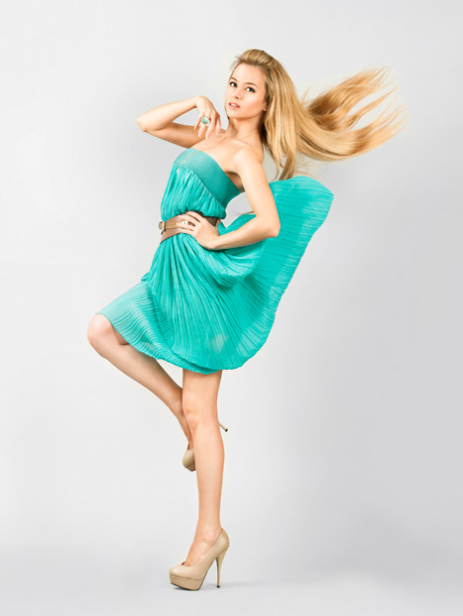
点此替换文本
01.
This is awesome title
S E C T I O N
Far far away, behind the word mountains, far from the countries Vokalia and Consonantia, there live the blind texts.
fashion
slide :

Slide 4

添加标题内容
Far far away, behind the word mountains, far from the countries Vokalia and Consonantia, there live the blind texts. Separated they live in Bookmarksgrove right at the coast of the Semantics, a large language ocean.
A small river named Duden flows by their place and supplies it with the necessary regelialia. It is a paradisematic country, in which roasted parts of sentences fly into your mouth.
slide :

Slide 5

添加标题内容
Far far away, behind the word mountains, far from the countries Vokalia and Consonantia, there live the blind texts. Separated they live in Bookmarksgrove right at the coast of the Semantics, a large language ocean.
slide :

Slide 6


添加标题内容
Far far away, behind the word mountains, far from the countries Vokalia and Consonantia, there live the blind texts.
slide :

Slide 7

添加标题内容
Far far away, behind the word mountains, far from the countries Vokalia and Consonantia, there live the blind texts.
Far far away, behind the word mountains, far from the countries Vokalia and Consonantia, there live the blind texts.
slide :

Slide 8
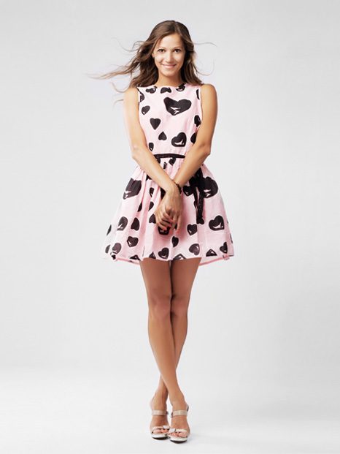
点此替换文本
02.
This is awesome title
S E C T I O N
Far far away, behind the word mountains, far from the countries Vokalia and Consonantia, there live the blind texts.
fashion
slide :

Slide 9


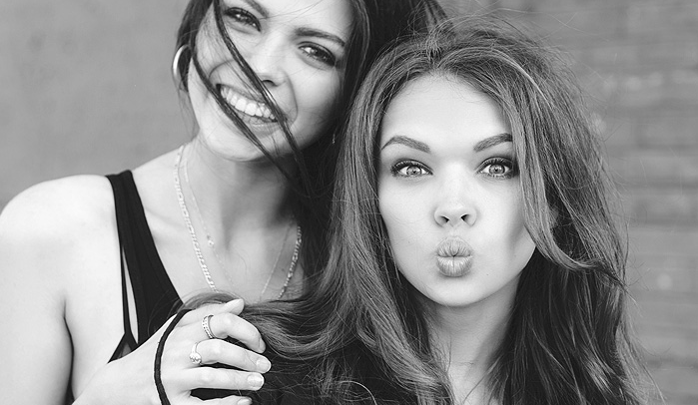
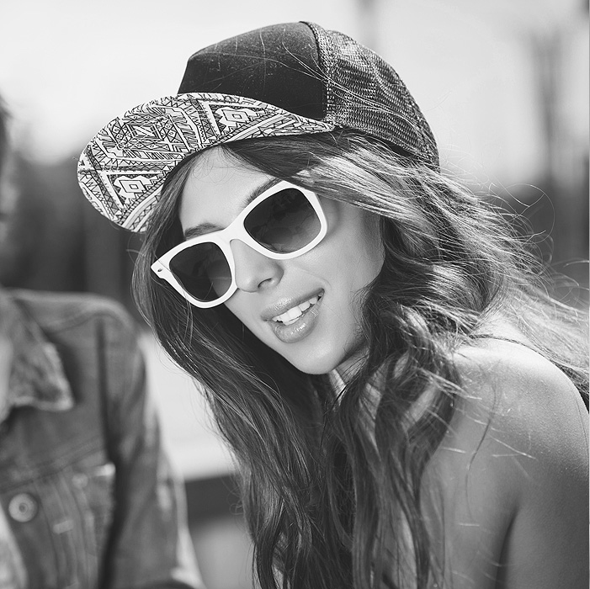
点此替换文本
Far far away, behind the word mountains, far from the countries Vokalia and Consonantia, there live the blind texts. Separated they live in Bookmarksgrove right at the coast of the Semantics, a large language ocean.
slide :

Slide 10

点此替换文本
Far far away, behind the word mountains, far from the countries Vokalia and Consonantia, there live the blind texts. Separated they live in Bookmarksgrove right at the coast of the Semantics, a large language ocean.
slide :

Slide 11

添加标题内容
AWESOME TITLE
Far far away, behind the word mountains, far from the countries Vokalia and Consonantia, there live the blind texts.
BEST LEADER
awesome title
slide :

Slide 12

点击标题内容
fashion
Far far away, behind the word mountains, far from the countries Vokalia and Consonantia, there live the blind texts. Separated they live in Bookmarksgrove right at the coast of the Semantics, a large language ocean.
slide :

Slide 13

OMAH | PRESENTATION
添加标题内容
This is awesome title
Far far away, behind the word mountains, far from the countries Vokalia and Consonantia, there live the blind texts. Separated they live in Bookmarksgrove right at the coast of the Semantics, a large language ocean.
slide :

Slide 14

点此替换文本
03.
This is awesome title
S E C T I O N
Far far away, behind the word mountains, far from the countries Vokalia and Consonantia, there live the blind texts.
fashion
slide :

Slide 15
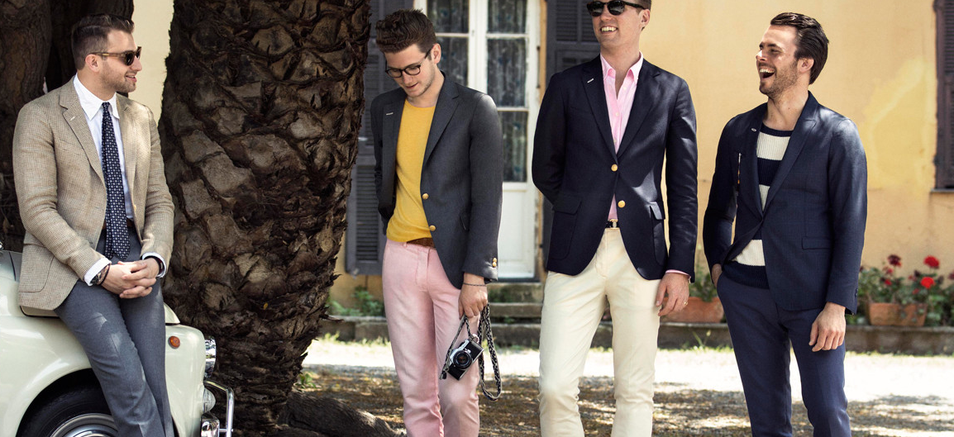
添加标题内容
This is awesome title
Far far away, behind the word mountains, far from the countries Vokalia and Consonantia, there live the blind texts. Separated they live in Bookmarksgrove right at the coast of the Semantics, a large language ocean.
slide :

Slide 16

AWESOME TITLE
添加标题内容
Far far away, behind the word mountains, far from the countries Vokalia and Consonantia, there live the blind texts. Separated they live in Bookmarksgrove right at the coast of the Semantics, a large language ocean.
BEST LEADER
awesome title
slide :

Slide 17

点此替换文本
fashion
Far far away, behind the word mountains, far from the countries Vokalia and Consonantia, there live the blind texts.
slide :

Slide 18
添加标题内容
AWESOME TITLE HERE
Far far away, behind the word mountains, far from the countries Vokalia and Consonantia, there live the blind texts.
slide :

Slide 19


点此替换文本
Far far away, behind the word mountains, far from the countries Vokalia and Consonantia, there live the blind texts. Separated they live in Bookmarksgrove right at the coast of the Semantics, a large language ocean.
slide :

Slide 20
点此替换文本
04.
This is awesome title
S E C T I O N
Far far away, behind the word mountains, far from the countries Vokalia and Consonantia, there live the blind texts.
fashion
slide :

Slide 21

Omah
添加标题内容
This is awesome title
Far far away, behind the word mountains, far from the countries Vokalia and Consonantia, there live the blind texts. Separated they live in Bookmarksgrove right at the coast of the Semantics, a large language ocean.
slide :

Slide 22


Far far away, behind the word mountains, far from the countries Vokalia and Consonantia, there live the blind texts.
点此替换文本
BEST LEADER
awesome title
slide :

Slide 23
Simplicity
is the nature
of great
souls
FASHION
点此替换文本
Far far away, behind the word mountains, far from the countries Vokalia and Consonantia, there live the blind texts.
slide :

Slide 24

添加标题内容
This is awesome title
Far far away, behind the word mountains, far from the countries Vokalia and Consonantia, there live the blind texts.
signature
slide :

Slide 25
添加标题内容
Far far away, behind the word mountains, far from the countries Vokalia and Consonantia, there live the blind texts. Separated they live in Bookmarksgrove right at the coast of the Semantics, a large language ocean.
slide :

Slide 26
点此替换文本
点此替换文本
点此替换文本
Far far away, behind the word mountains, far from the countries Vokalia and Consonantia.
Far far away, behind the word mountains, far from the countries Vokalia and Consonantia.
Far far away, behind the word mountains, far from the countries Vokalia and Consonantia.
AWESOME TITLE
点此替换文本
点此替换文本
点此替换文本
Far far away, behind the word mountains, far from the countries Vokalia and Consonantia.
Far far away, behind the word mountains, far from the countries Vokalia and Consonantia.
Far far away, behind the word mountains, far from the countries Vokalia and Consonantia.
添加标题内容
awesome title
slide :

Slide 27

数据分析
Far far away, behind the word mountains, far from the countries Vokalia and Consonantia, there live the blind texts.
slide :

Slide 28
LOGO
THANK YOU
高端时尚品牌宣传PPT模板
FASHION

